Slide 1

4

Slide 2







Slide 3


Slide 4


Slide 5
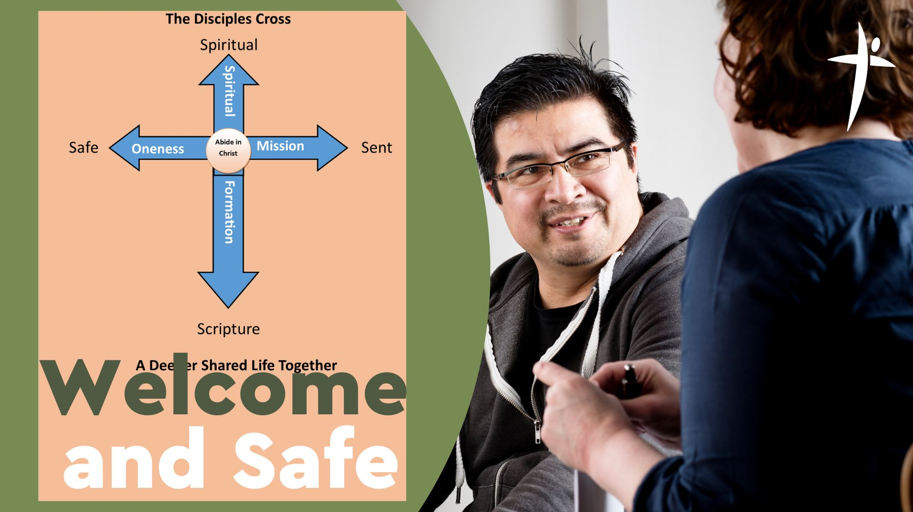

Slide 6
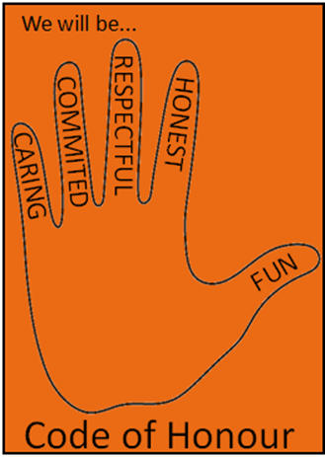
Safe

Slide 7
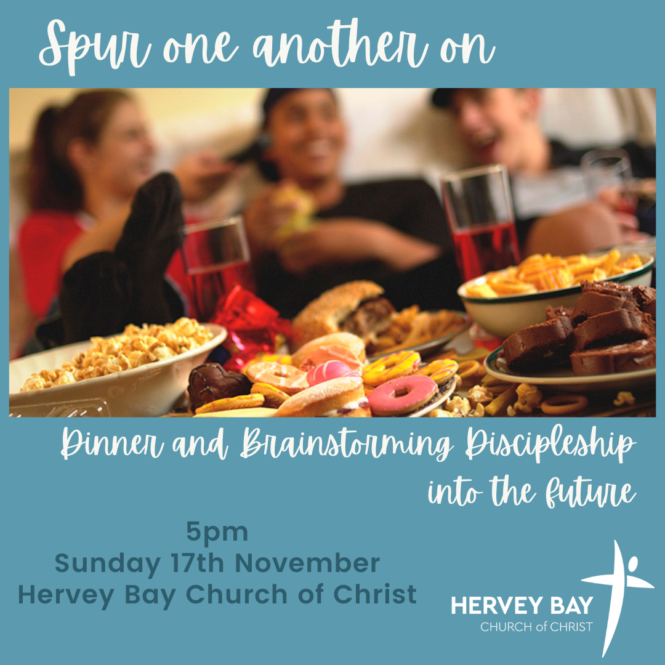

Slide 8


Slide 9


Slide 10

What is your day to day context?
Where have you seen God at work there?
How can we pray with you?

