Slide 1
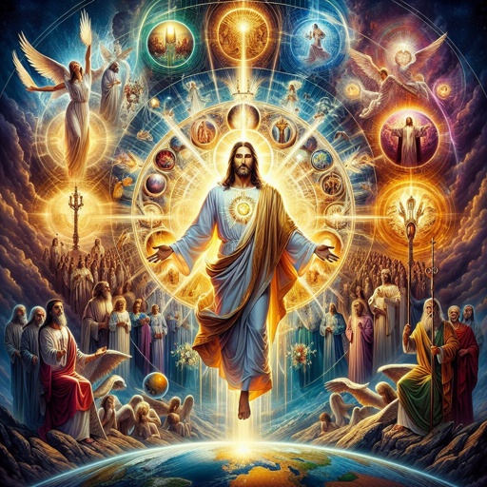
Revelation
Chapters 1-3

Slide 3
The book of Revelation is a 1st Century revelation of Jesus; against the Roman Empire; to the church(es); for the purpose of worship, encouragement and hope.

Slide 4
1. Apocalyptic literature 2. Prophesy 3. Letter

Slide 6
For each church:

Slide 7
Reflect
What is the hope I found in the text?

