Slide 1
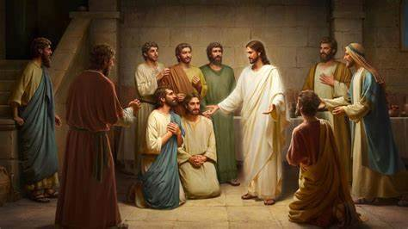
Jesus Appears
John 20:19-31

Slide 2
John 20:19-23
On the evening of that first day of the week, when the disciples were together, with the doors locked for fear of the Jewish leaders, Jesus came and stood among them and said, “Peace be with you!” After he said this, he showed them his hands and side. The disciples were overjoyed when they saw the Lord.
Again Jesus said, “Peace be with you! As the Father has sent me, I am sending you.” And with that he breathed on them and said, “Receive the Holy Spirit. If you forgive anyone’s sins, their sins are forgiven; if you do not forgive them, they are not forgiven.”

Slide 3
John 20:24-27
Now Thomas (also known as Didymus), one of the Twelve, was not with the disciples when Jesus came. So the other disciples told him, “We have seen the Lord!”
But he said to them, “Unless I see the nail marks in his hands and put my finger where the nails were, and put my hand into his side, I will not believe.”
A week later his disciples were in the house again, and Thomas was with them. Though the doors were locked, Jesus came and stood among them and said, “Peace be with you!” Then he said to Thomas, “Put your finger here; see my hands. Reach out your hand and put it into my side. Stop doubting and believe.”

Slide 4
John 20:28-31
Thomas said to him, “My Lord and my God!”
Then Jesus told him, “Because you have seen me, you have believed; blessed are those who have not seen and yet have believed.”
Jesus performed many other signs in the presence of his disciples, which are not recorded in this book. But these are written that you may believe that Jesus is the Messiah, the Son of God, and that by believing you may have life in his name.

Slide 5
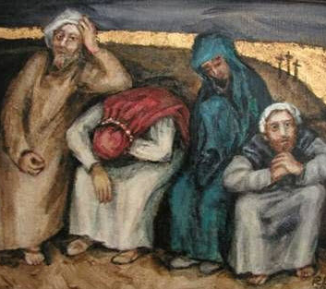
Fear and doubt

Slide 6
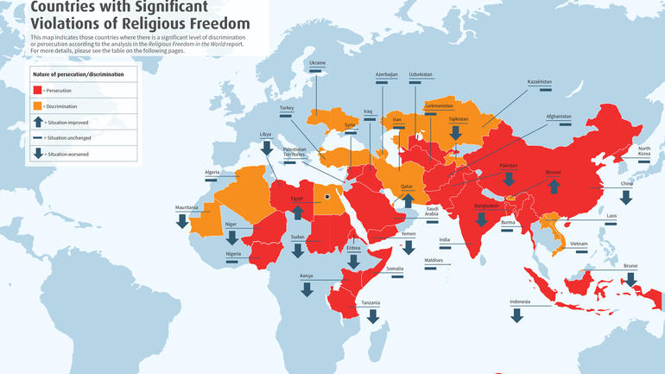

Slide 7
Fear and doubt

Slide 9
Resurrected community – The Church
The Presence of Jesus
The Peace of Jesus
Healed wounds
Joy and gladness at the recognition of His presence
The mission of Jesus (sent)
Receive and give forgiveness

Slide 10
Fear and doubt

Slide 11
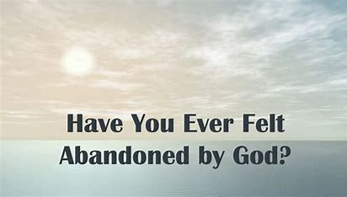

Slide 13
Sin doesn’t change how God relates to us, but it does change how we think God will relate to us.

Slide 15
Fear and doubt

Slide 17
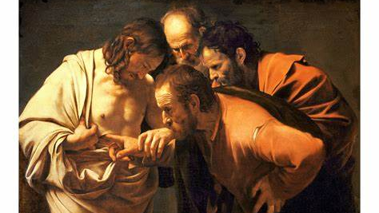

Slide 18
Peace

Slide 19
Blessing

Slide 21
Reflect

