Slide 1
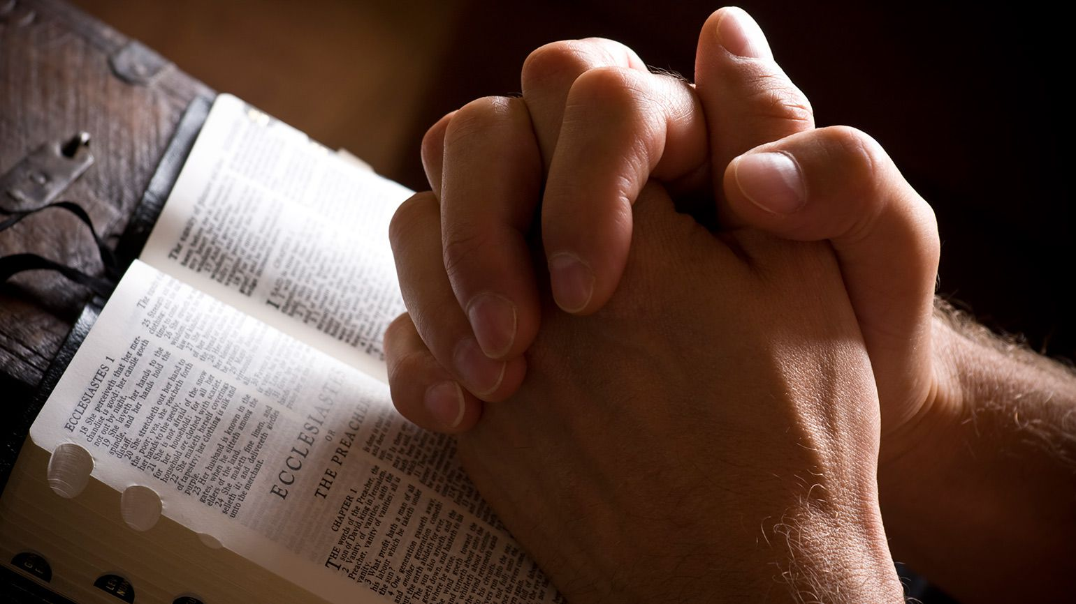
Prayer – Lectio Divina
Luke 11:1-13

Slide 2


Slide 3
Read
(Lectio)

Slide 4
Luke 11:1-4
One day Jesus was praying in a certain place. When he finished, one of his disciples said to him, “Lord, teach us to pray, just as John taught his disciples.”
He said to them, “When you pray, say:
“‘Father,
hallowed be your name,
your kingdom come.
Give us each day our daily bread.Forgive us our sins,
for we also forgive everyone who sins against us.
And lead us not into temptation.’”

Slide 5
Luke 11:5-10
Then Jesus said to them, “Suppose you have a friend, and you go to him at midnight and say, ‘Friend, lend me three loaves of bread; a friend of mine on a journey has come to me, and I have no food to offer him.’ And suppose the one inside answers, ‘Don’t bother me. The door is already locked, and my children and I are in bed. I can’t get up and give you anything.’ I tell you, even though he will not get up and give you the bread because of friendship, yet because of your shameless audacity he will surely get up and give you as much as you need.
“So I say to you: Ask and it will be given to you; seek and you will find; knock and the door will be opened to you. For everyone who asks receives; the one who seeks finds; and to the one who knocks, the door will be opened.

Slide 6
Luke 11:11-13
“Which of you fathers, if your son asks for a fish, will give him a snake instead? Or if he asks for an egg, will give him a scorpion? If you then, though you are evil, know how to give good gifts to your children, how much more will your Father in heaven give the Holy Spirit to those who ask him!”

Slide 7
Share with your table what words or phrases stick out for you.

Slide 8
Meditate(Reflect)

Slide 9
Luke 11:1-4
One day Jesus was praying in a certain place. When he finished, one of his disciples said to him, “Lord, teach us to pray, just as John taught his disciples.”
He said to them, “When you pray, say:
“‘Father,
hallowed be your name,
your kingdom come.
Give us each day our daily bread.Forgive us our sins,
for we also forgive everyone who sins against us.
And lead us not into temptation.’”

Slide 10
Luke 11:5-10
Then Jesus said to them, “Suppose you have a friend, and you go to him at midnight and say, ‘Friend, lend me three loaves of bread; a friend of mine on a journey has come to me, and I have no food to offer him.’ And suppose the one inside answers, ‘Don’t bother me. The door is already locked, and my children and I are in bed. I can’t get up and give you anything.’ I tell you, even though he will not get up and give you the bread because of friendship, yet because of your shameless audacity he will surely get up and give you as much as you need.
“So I say to you: Ask and it will be given to you; seek and you will find; knock and the door will be opened to you. For everyone who asks receives; the one who seeks finds; and to the one who knocks, the door will be opened.

Slide 11
Luke 11:11-13
“Which of you fathers, if your son asks for a fish, will give him a snake instead? Or if he asks for an egg, will give him a scorpion? If you then, though you are evil, know how to give good gifts to your children, how much more will your Father in heaven give the Holy Spirit to those who ask him!”

Slide 12
What do you feel?
What specific situation in your life does this relate to?
Share

Slide 13
Respond
(Prayer)

Slide 14
Luke 11:1-4
One day Jesus was praying in a certain place. When he finished, one of his disciples said to him, “Lord, teach us to pray, just as John taught his disciples.”
He said to them, “When you pray, say:
“‘Father,
hallowed be your name,
your kingdom come.
Give us each day our daily bread.Forgive us our sins,
for we also forgive everyone who sins against us.
And lead us not into temptation.’”

Slide 15
Luke 11:5-10
Then Jesus said to them, “Suppose you have a friend, and you go to him at midnight and say, ‘Friend, lend me three loaves of bread; a friend of mine on a journey has come to me, and I have no food to offer him.’ And suppose the one inside answers, ‘Don’t bother me. The door is already locked, and my children and I are in bed. I can’t get up and give you anything.’ I tell you, even though he will not get up and give you the bread because of friendship, yet because of your shameless audacity he will surely get up and give you as much as you need.
“So I say to you: Ask and it will be given to you; seek and you will find; knock and the door will be opened to you. For everyone who asks receives; the one who seeks finds; and to the one who knocks, the door will be opened.

Slide 16
Luke 11:11-13
“Which of you fathers, if your son asks for a fish, will give him a snake instead? Or if he asks for an egg, will give him a scorpion? If you then, though you are evil, know how to give good gifts to your children, how much more will your Father in heaven give the Holy Spirit to those who ask him!”

Slide 17
What is God’s personal invitation to you from the Scriptures?
Pray

Slide 18
Rest
(Contemplate)

Slide 19
Luke 11:1-4
One day Jesus was praying in a certain place. When he finished, one of his disciples said to him, “Lord, teach us to pray, just as John taught his disciples.”
He said to them, “When you pray, say:
“‘Father,
hallowed be your name,
your kingdom come.
Give us each day our daily bread.Forgive us our sins,
for we also forgive everyone who sins against us.
And lead us not into temptation.’”

Slide 20
Luke 11:5-10
Then Jesus said to them, “Suppose you have a friend, and you go to him at midnight and say, ‘Friend, lend me three loaves of bread; a friend of mine on a journey has come to me, and I have no food to offer him.’ And suppose the one inside answers, ‘Don’t bother me. The door is already locked, and my children and I are in bed. I can’t get up and give you anything.’ I tell you, even though he will not get up and give you the bread because of friendship, yet because of your shameless audacity he will surely get up and give you as much as you need.
“So I say to you: Ask and it will be given to you; seek and you will find; knock and the door will be opened to you. For everyone who asks receives; the one who seeks finds; and to the one who knocks, the door will be opened.

Slide 21
Luke 11:11-13
“Which of you fathers, if your son asks for a fish, will give him a snake instead? Or if he asks for an egg, will give him a scorpion? If you then, though you are evil, know how to give good gifts to your children, how much more will your Father in heaven give the Holy Spirit to those who ask him!”

Slide 22
Rest
(Contemplate)

Slide 23
Share with each other what you need to do in response to this reading?
Obey

