Slide 1
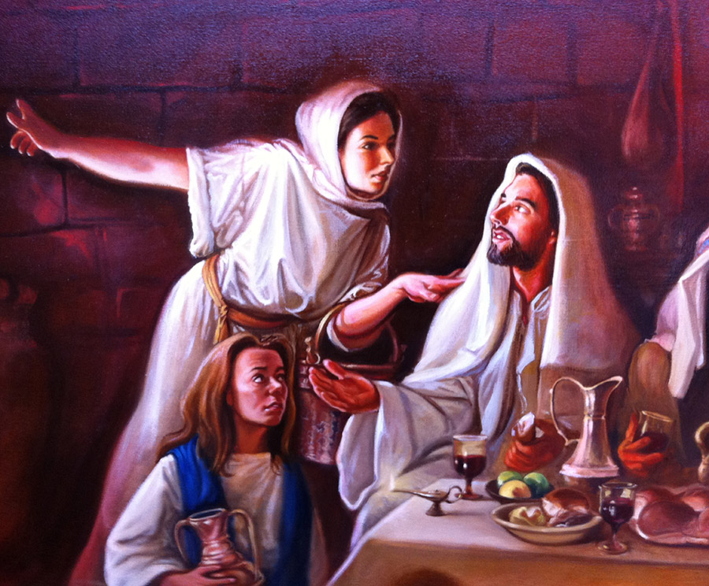
Luke 10:25-42
Loving God Loving People

Slide 2
Luke 10: 25-31
On one occasion an expert in the law stood up to test Jesus. ‘Teacher,’ he asked, ‘what must I do to inherit eternal life?’
‘What is written in the Law?’ he replied. ‘How do you read it?’
He answered, ‘“Love the Lord your God with all your heart and with all your soul and with all your strength and with all your mind”; and, “Love your neighbour as yourself.”’
‘You have answered correctly,’ Jesus replied. ‘Do this and you will live.’
But he wanted to justify himself, so he asked Jesus, ‘And who is my neighbour? In reply Jesus said: ‘A man was going down from Jerusalem to Jericho, when he was attacked by robbers. They stripped him of his clothes, beat him and went away, leaving him half-dead. A priest happened to be going down the same road, and when he saw the man, he passed by on the other side.

Slide 3
Luke 10:32-37
So too, a Levite, when he came to the place and saw him, passed by on the other side. But a Samaritan, as he travelled, came where the man was; and when he saw him, he took pity on him. He went to him and bandaged his wounds, pouring on oil and wine. Then he put the man on his own donkey, brought him to an inn and took care of him. The next day he took out two denarii and gave them to the innkeeper. “Look after him,” he said, “and when I return, I will reimburse you for any extra expense you may have.”
‘Which of these three do you think was a neighbour to the man who fell into the hands of robbers?’
The expert in the law replied, ‘The one who had mercy on him.’
Jesus told him, ‘Go and do likewise.’

Slide 4
Luke 10:38-42
As Jesus and his disciples were on their way, he came to a village where a woman named Martha opened her home to him. She had a sister called Mary, who sat at the Lord’s feet listening to what he said. But Martha was distracted by all the preparations that had to be made. She came to him and asked, ‘Lord, don’t you care that my sister has left me to do the work by myself? Tell her to help me!’
‘Martha, Martha,’ the Lord answered, ‘you are worried and upset about many things, but few things are needed – or indeed only one. Mary has chosen what is better, and it will not be taken away from her.’

Slide 5
Key Point
‘“Love the Lord your God with all your heart and with all your soul and with all your strength and with all your mind”; and, “Love your neighbour as yourself.”’

Slide 6
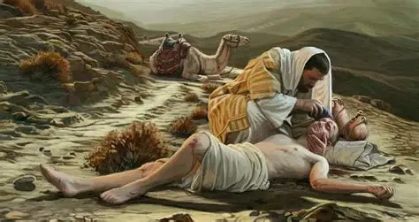
Loving God and Loving People

Slide 7
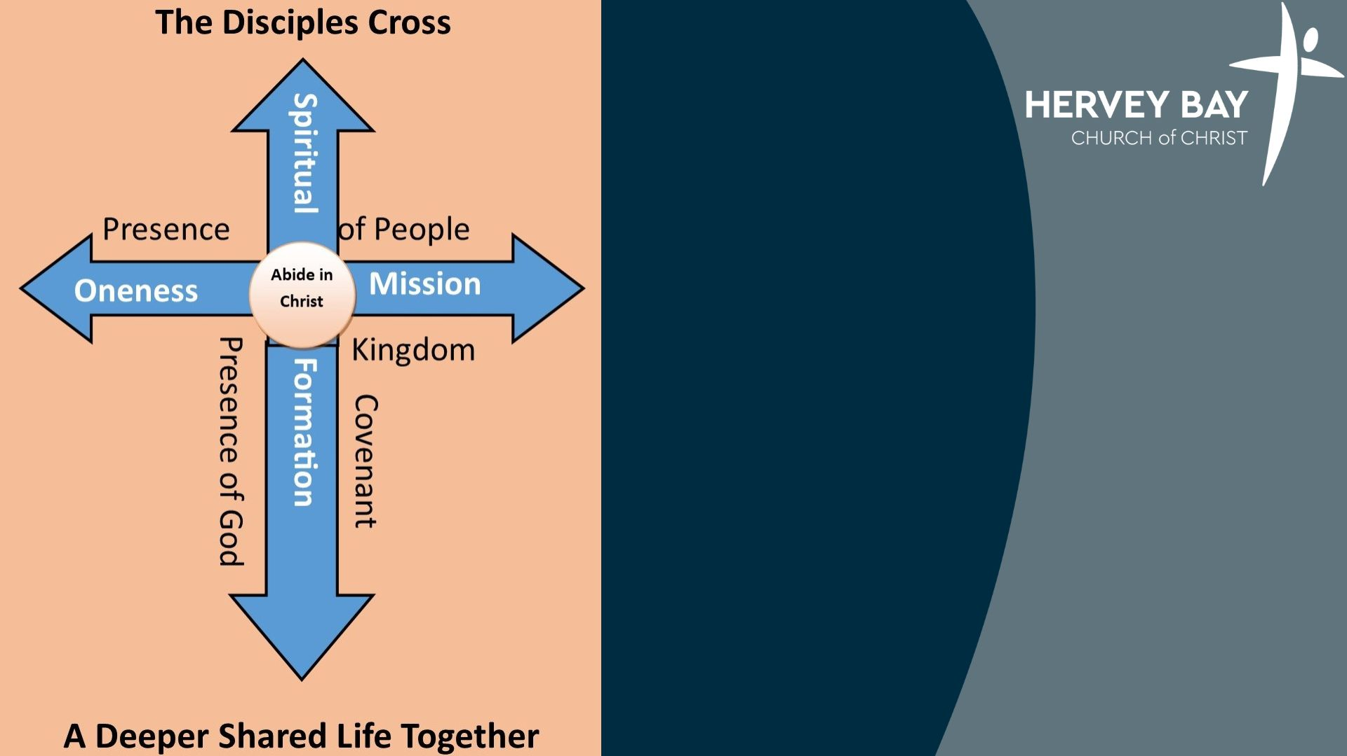

Slide 8
Abide
Fruitful

Slide 9
Daily Divert
Weekly Withdraw
Annually Abandon
Abide
Fruitful

Slide 10
Sitting at the feet of Jesus

Slide 11

The way we love people is the way we love God

Slide 12
The best action comes out of contemplation

Slide 13

Sitting at the feet of Jesus
(Love God-Abide)
Sabbath – Stop, Rest, Delight, Worship
Silence
Contemplation
Solitude
Scripture
Listening
Journaling

Slide 14

Living out our Faith
(Fruitful – Loving People)
Bless others
Be curious and actively interested
Serve one another
Be hospitable and generous
Share hope in Jesus

Slide 15
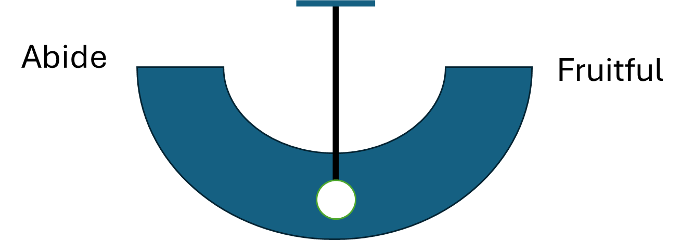
BELLSS
Bless
Eat
Listen
Learn
Sabbath
Sent

Slide 16
Reflect

