Slide 1
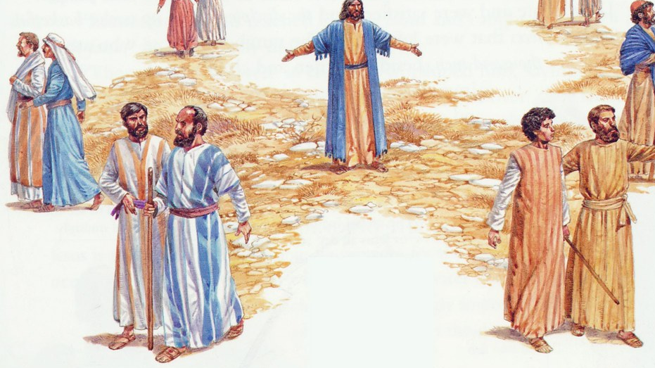
Mission
Luke 10:1-11; 16-20

Slide 2
Luke 10:1-7
After this the Lord appointed seventy-two others and sent them two by two ahead of him to every town and place where he was about to go. He told them, ‘The harvest is plentiful, but the workers are few. Ask the Lord of the harvest, therefore, to send out workers into his harvest field. Go! I am sending you out like lambs among wolves. Do not take a purse or bag or sandals; and do not greet anyone on the road.
‘When you enter a house, first say, “Peace to this house.” If someone who promotes peace is there, your peace will rest on them; if not, it will return to you. Stay there, eating and drinking whatever they give you, for the worker deserves his wages. Do not move around from house to house.

Slide 3
Luke 10:8-11
‘When you enter a town and are welcomed, eat what is offered to you. Heal those there who are ill and tell them, “The kingdom of God has come near to you.” But when you enter a town and are not welcomed, go into its streets and say, “Even the dust of your town we wipe from our feet as a warning to you. Yet be sure of this: the kingdom of God has come near.”

Slide 4
Luke 10:16-20
‘Whoever listens to you listens to me; whoever rejects you rejects me; but whoever rejects me rejects him who sent me.’
The seventy-two returned with joy and said, ‘Lord, even the demons submit to us in your name.’
He replied, ‘I saw Satan fall like lightning from heaven. I have given you authority to trample on snakes and scorpions and to overcome all the power of the enemy; nothing will harm you. However, do not rejoice that the spirits submit to you, but rejoice that your names are written in heaven.’

Slide 5
Trust and Obey

Slide 6
Person of Peace
1. Likes you
2. Listens to you
3. Serves you

Slide 7
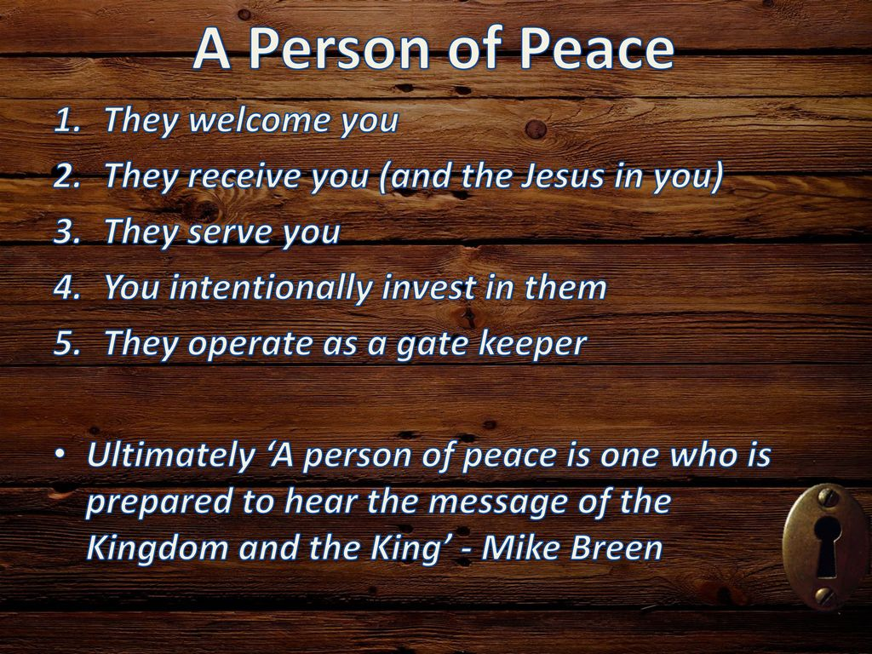

Slide 8
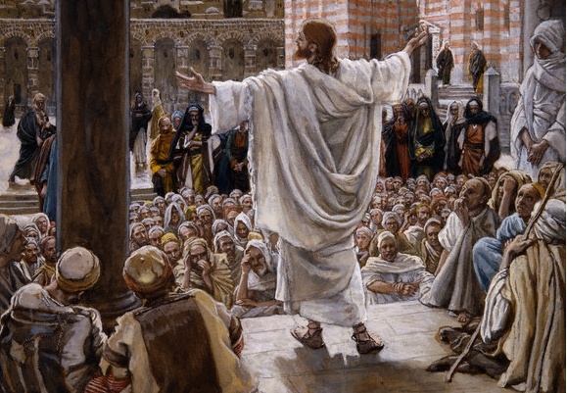
Proclaim the Universal Reign of God through Christ

Slide 9
Proclaim the Universal Reign of God through Christ 1. Call back the church to true vocation

Slide 10
Proclaim the Universal Reign of God through Christ 1. Call back the church to true vocation 2. Call other institutions back

Slide 11


Slide 12
Trust and Obey

Slide 13
Trust and Obey Reflect

