Slide 1
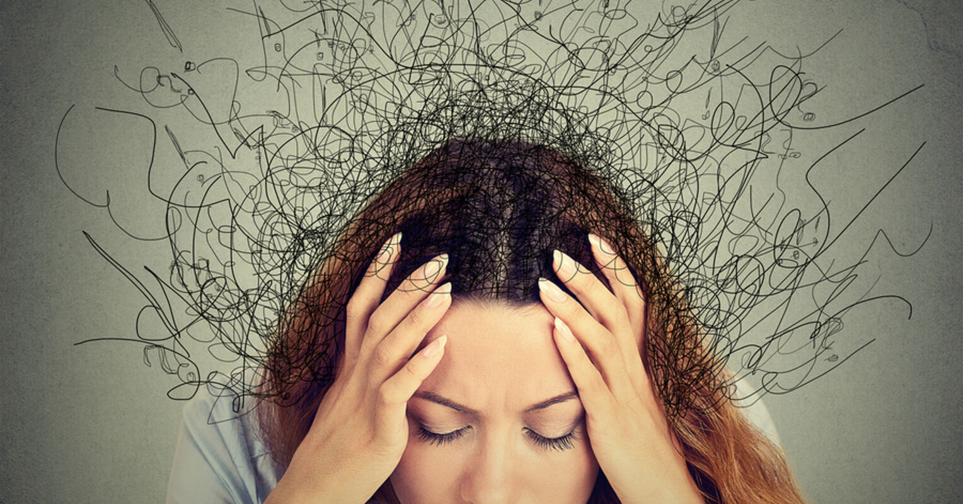
Anxiety!!!!!!?????
Luke 12:22-34

Slide 2
Luke 12:22-26
Then Jesus said to his disciples: ‘Therefore I tell you, do not worry about your life, what you will eat; or about your body, what you will wear. For life is more than food, and the body more than clothes. Consider the ravens: they do not sow or reap, they have no storeroom or barn; yet God feeds them. And how much more valuable you are than birds! Who of you by worrying can add a single hour to your life? Since you cannot do this very little thing, why do you worry about the rest?

Slide 3
Luke 12:27-31
‘Consider how the wild flowers grow. They do not labour or spin. Yet I tell you, not even Solomon in all his splendour was dressed like one of these. If that is how God clothes the grass of the field, which is here today, and tomorrow is thrown into the fire, how much more will he clothe you – you of little faith! And do not set your heart on what you will eat or drink; do not worry about it. For the pagan world runs after all such things, and your Father knows that you need them. But seek his kingdom, and these things will be given to you as well.

Slide 4
Luke 12:32-34
‘Do not be afraid, little flock, for your Father has been pleased to give you the kingdom. Sell your possessions and give to the poor. Provide purses for yourselves that will not wear out, a treasure in heaven that will never fail, where no thief comes near and no moth destroys. For where your treasure is, there your heart will be also.

Slide 5
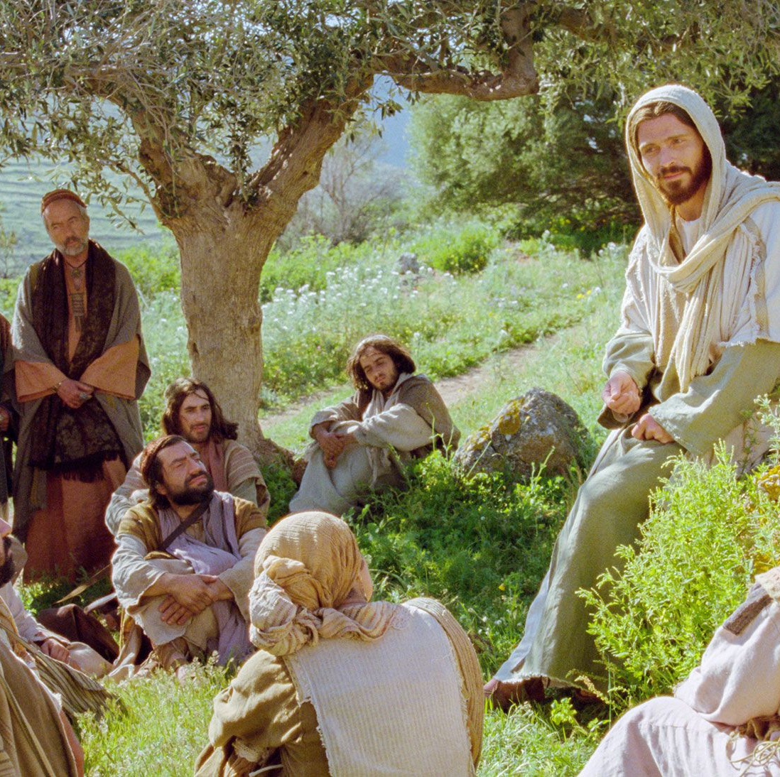
Discuss
What sticks out for you from the scriptures?
In what way does it relate to you and your life?

Slide 6
Anxiety!!!!!!?????

Slide 7
Discuss
What makes you anxious?

Slide 8
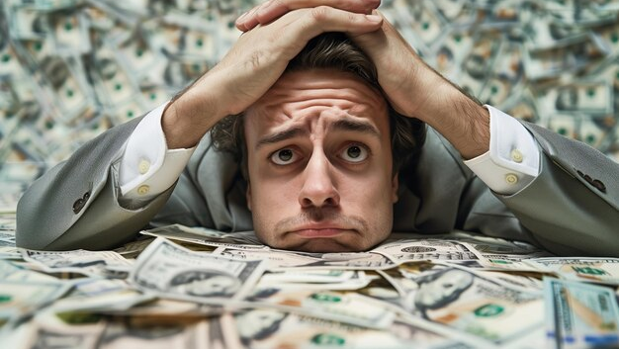
The Pagans run after these things!

Slide 9
The Pagans run after these things
Do I have enough?

Slide 10
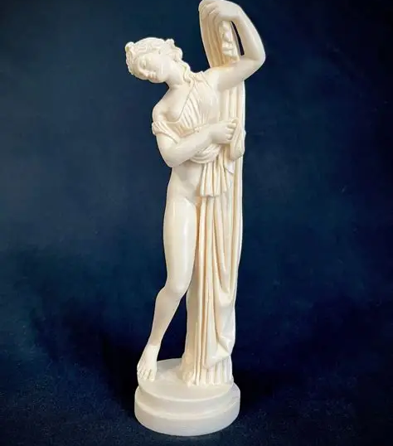
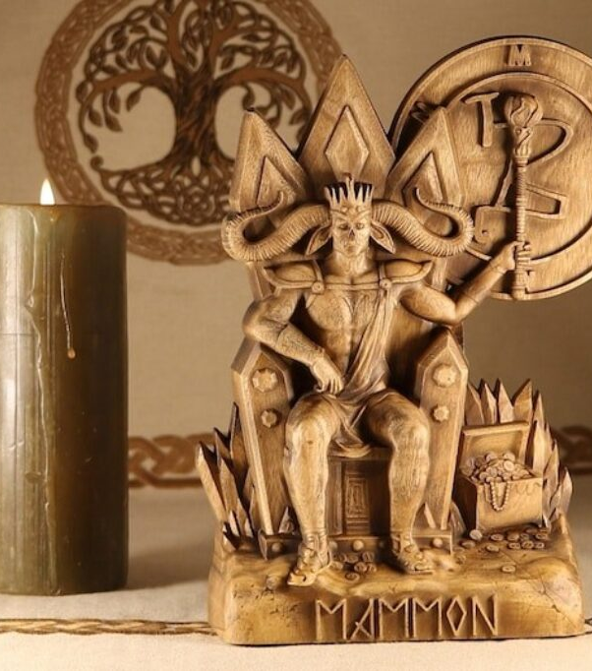
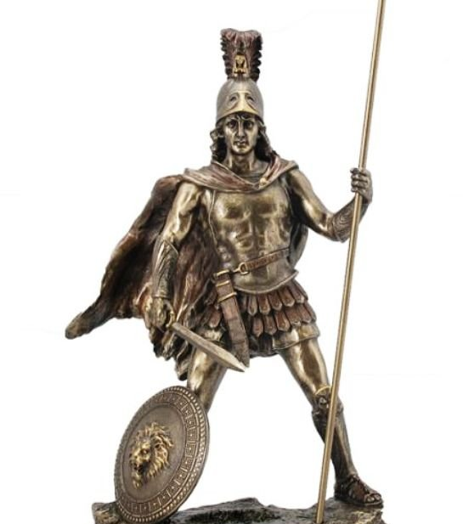
Mars -
War, Violence and Power
Aphrodite –
Sex
Mammon -
Money

Slide 11
Jesus Statements:
An example of how God looks after this world
Seek God’s kingdom and you will get these things also
God wants to give you his kingdom
Where your treasure is that’s where your heart is also

Slide 12


Slide 13
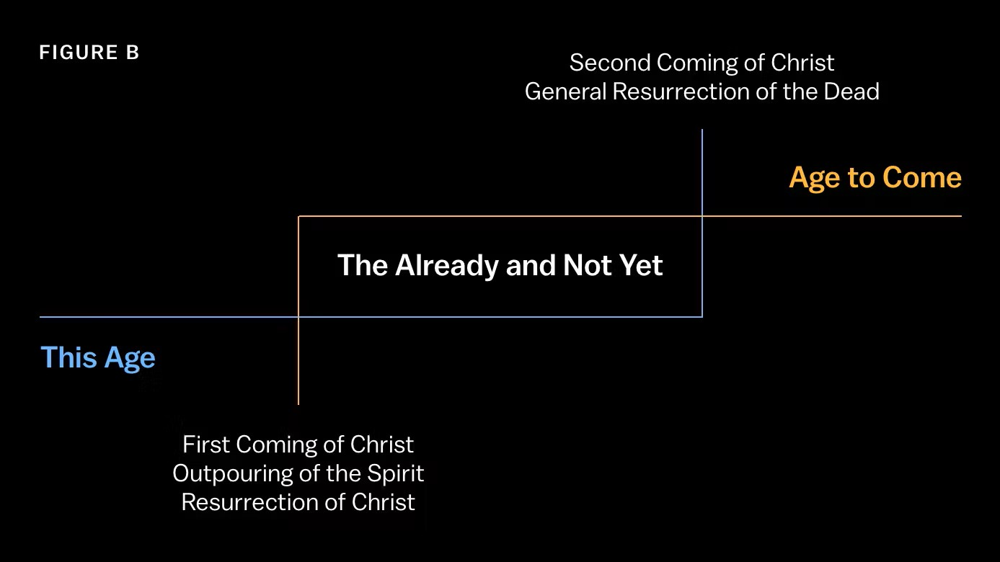

Slide 14
False
Evidence
Appearing
Real

Slide 15

How do I deal with Anxiety?

Slide 16
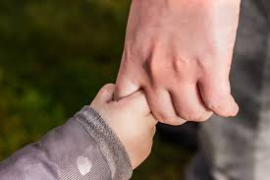
Can I trust God?

Slide 17
Can I trust God?
What makes me think I can?

Slide 18


Slide 19

Do you have a story of

Slide 20


