Slide 1


Slide 2
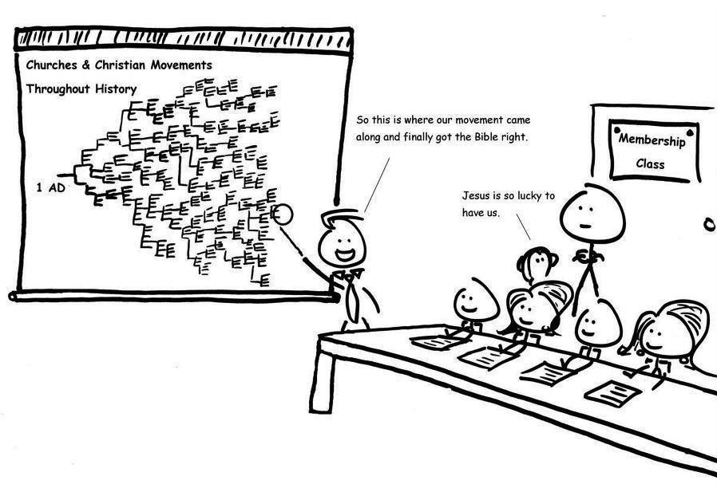

Slide 3
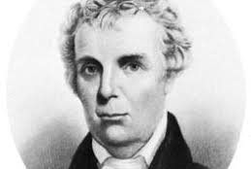
Barton Stone and the Cane Ridge Revival

Slide 4
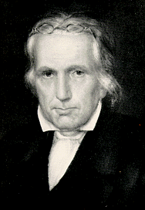
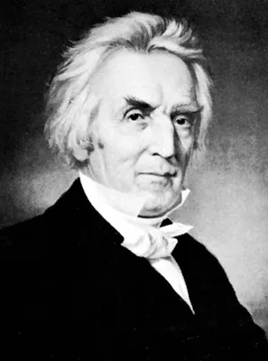
Thomas and Alexander Campbell

Slide 5
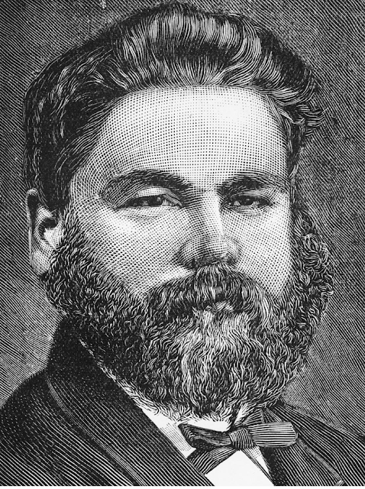
Stephen Cheek

Slide 6
Body
- Unifying for the sake of mission

Slide 7
John 17:20-23
“My prayer is not for them alone. I pray also for those who will believe in me through their message, that all of them may be one, Father, just as you are in me and I am in you. May they also be in us so that the world may believe that you have sent me. I have given them the glory that you gave me, that they may be one as we are one— I in them and you in me—so that they may be brought to complete unity. Then the world will know that you sent me and have loved them even as you have loved me.”

Slide 8
Body
-United based on Common Ground

Slide 9
Body
- Christians only but not the only Christians

Slide 10
Body
- Jesus Centred
- Everyone Matters
- Safe
- Authentic

Slide 11
Our Mission Needs Everyone

Slide 12
Our Mission Needs Everyone
- The Priesthood of all Believers

Slide 13
1 Corinthians 12:12-27
For just as the body is one and has many members, and all the members of the body, though many, are one body, so it is with Christ. For in one Spirit we were all baptized into one body—Jews or Greeks, slaves or free—and all were made to drink of one Spirit. For the body does not consist of one member but of many. If the foot should say, “Because I am not a hand, I do not belong to the body,” that would not make it any less a part of the body. And if the ear should say, “Because I am not an eye, I do not belong to the body,” that would not make it any less a part of the body.

Slide 14
1 Corinthians 12:12-27
If the whole body were an eye, where would the sense of hearing be? If the whole body were an ear, where would be the sense of smell? But as it is, God arranged the members in the body, each one of them, as he chose. If all were a single member, where would the body be? As it is, there are many parts, yet one body. The eye cannot say to the hand, “I have no need of you,” nor again the head to the feet, “I have no need of you.” On the contrary, the parts of the body that seem to be weaker are indispensable,

Slide 15
1 Corinthians 12:12-27
and on those parts of the body that we think less honourable we bestow the greater honour, and our unpresentable parts are treated with greater modesty, which our more presentable parts do not require. But God has so composed the body, giving greater honour to the part that lacked it, that there may be no division in the body, but that the members may have the same care for one another. If one member suffers, all suffer together; if one member is honoured, all rejoice together. Now you are the body of Christ and individually members of it.

Slide 16
Our Mission Needs Everyone
- The Priesthood of all Believers
- We are the church

Slide 17
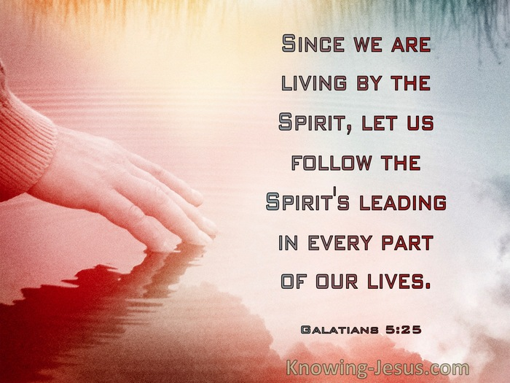
Deep but Simple Spirituality

Slide 18
Body – Unity
Mission – Inclusive
Spirituality – Deep, Simple, Transformative

Slide 19
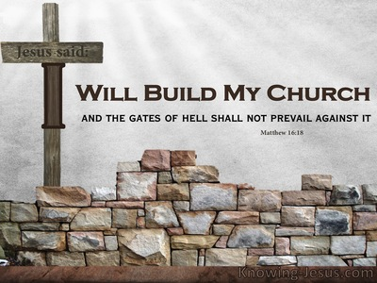

Slide 20
Reflect

