Slide 1

Uganda, Kenya, Australia and the challenge of Luke 16:1-13

Slide 2
Luke 16:1-5
Jesus told his disciples: ‘There was a rich man whose manager was accused of wasting his possessions. So he called him in and asked him, “What is this I hear about you? Give an account of your management, because you cannot be manager any longer.”
‘The manager said to himself, “What shall I do now? My master is taking away my job. I’m not strong enough to dig, and I’m ashamed to beg – I know what I’ll do so that, when I lose my job here, people will welcome me into their houses.”
‘So he called in each one of his master’s debtors. He asked the first, “How much do you owe my master?”
“Three thousand litres of olive oil,” he replied.

Slide 3
Luke 16:6-10
‘The manager told him, “Take your bill, sit down quickly, and make it fifteen hundred.”
‘Then he asked the second, “And how much do you owe?”
‘“Thirty tons of wheat,” he replied.
‘He told him, “Take your bill and make it twenty-four.”
‘The master commended the dishonest manager because he had acted shrewdly. For the people of this world are more shrewd in dealing with their own kind than are the people of the light. 9 I tell you, use worldly wealth to gain friends for yourselves, so that when it is gone, you will be welcomed into eternal dwellings.
‘Whoever can be trusted with very little can also be trusted with much, and whoever is dishonest with very little will also be dishonest with much.

Slide 4
Luke 16:11-15
So if you have not been trustworthy in handling worldly wealth, who will trust you with true riches?
And if you have not been trustworthy with someone else’s property, who will give you property of your own?
‘No one can serve two masters. Either you will hate the one and love the other, or you will be devoted to the one and despise the other. You cannot serve both God and Money.’
The Pharisees, who loved money, heard all this and were sneering at Jesus. He said to them, ‘You are the ones who justify yourselves in the eyes of others, but God knows your hearts. What people value highly is detestable in God’s sight.

Slide 5
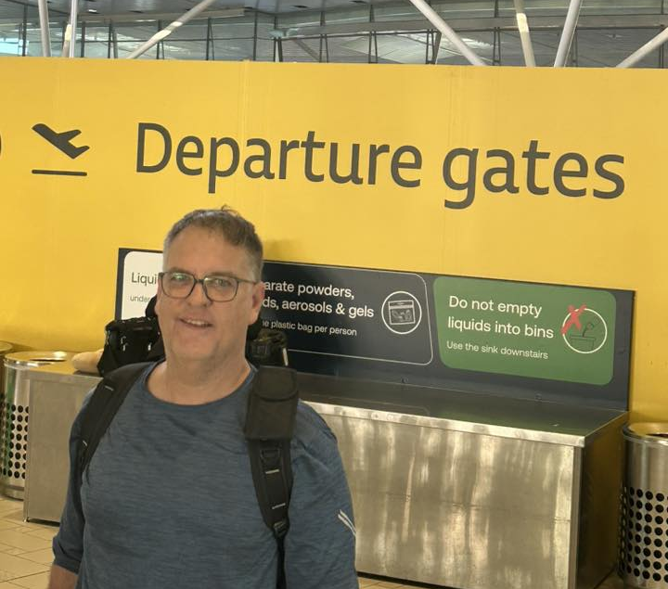
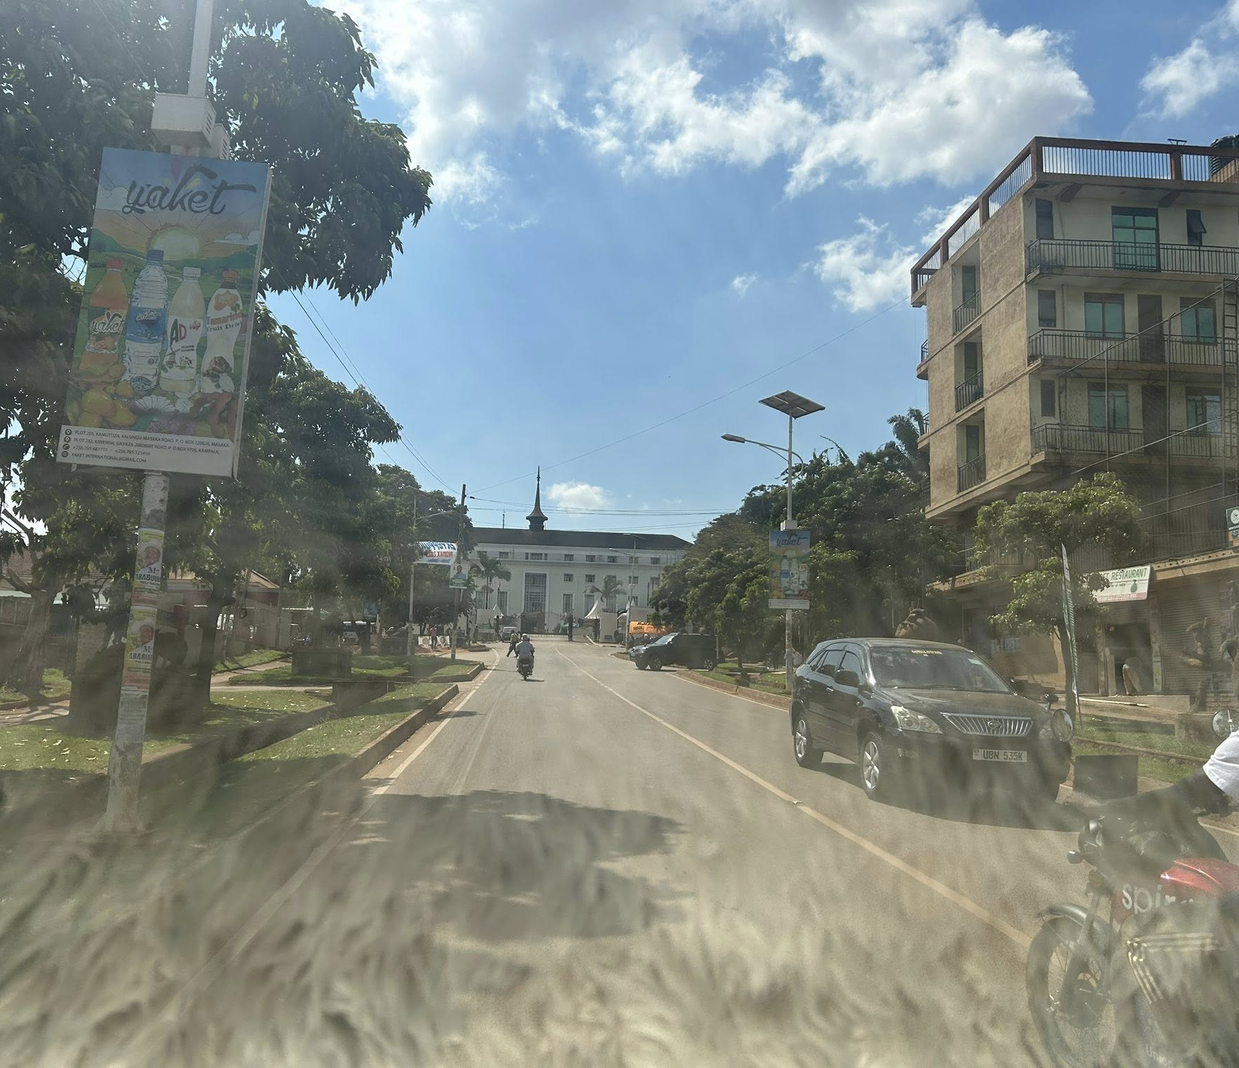
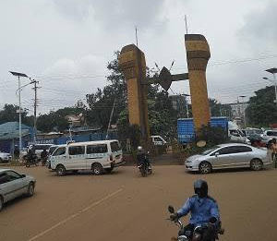
Travel

Slide 6
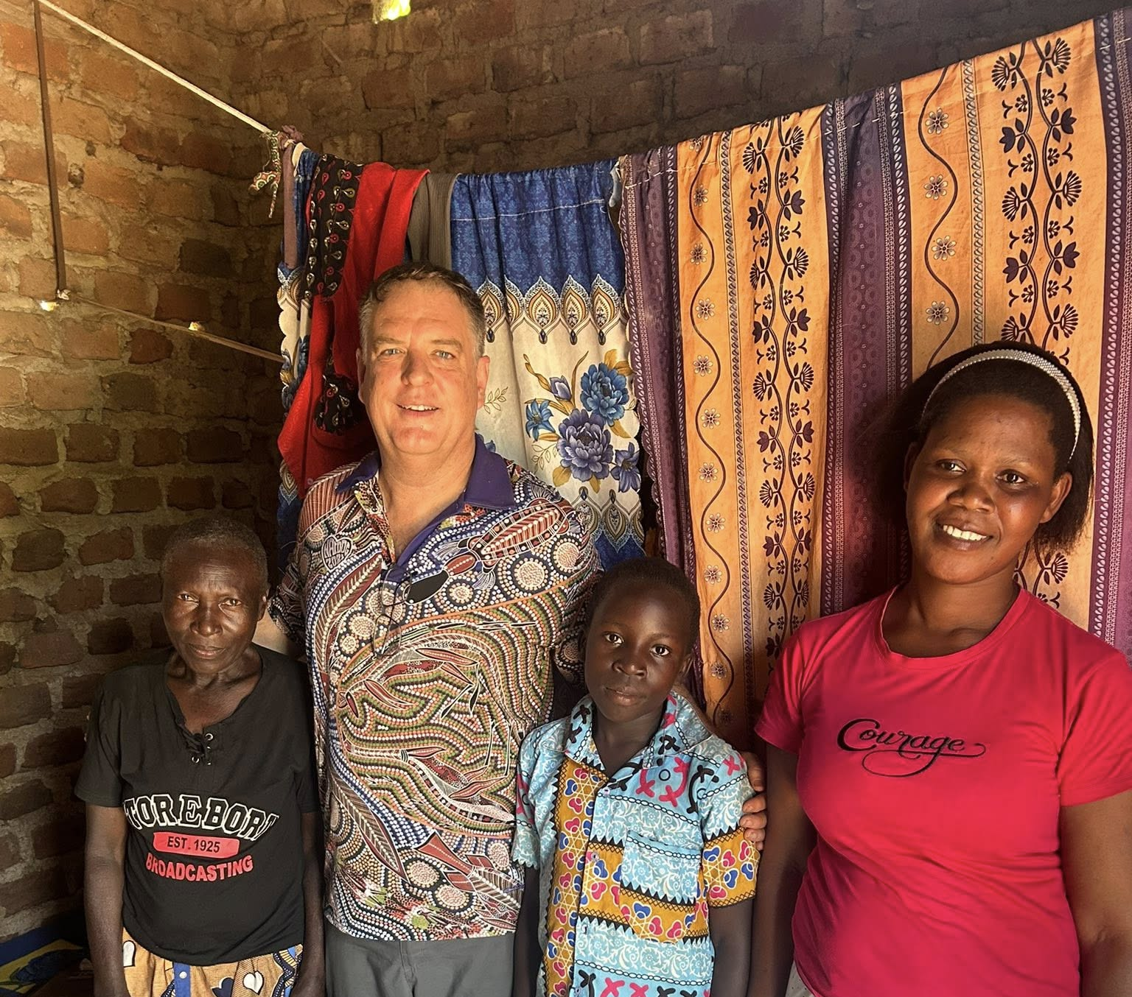
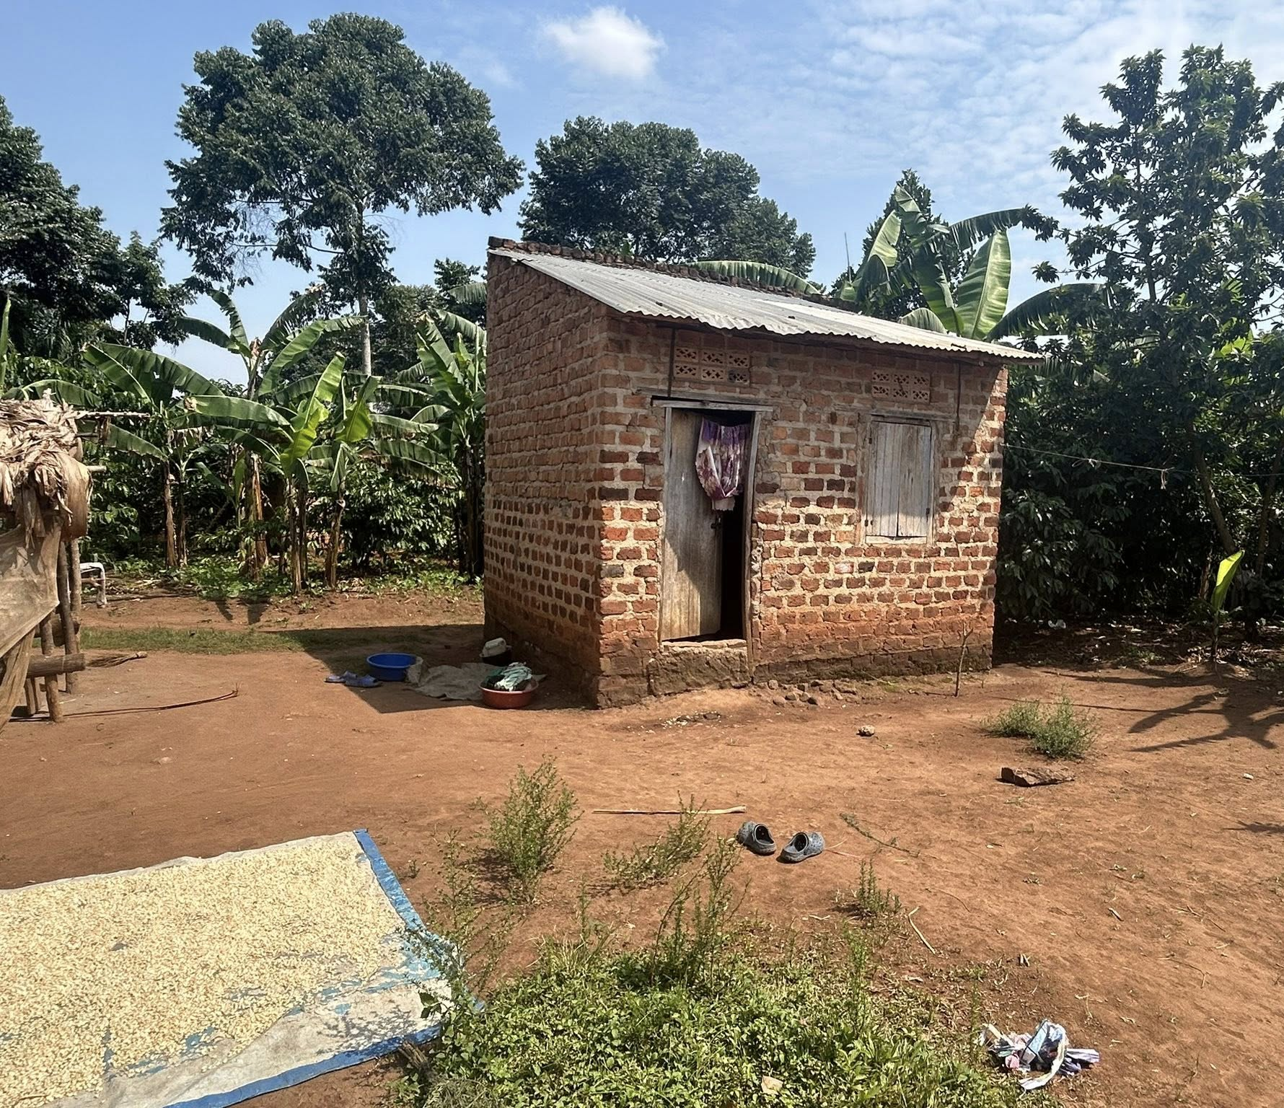
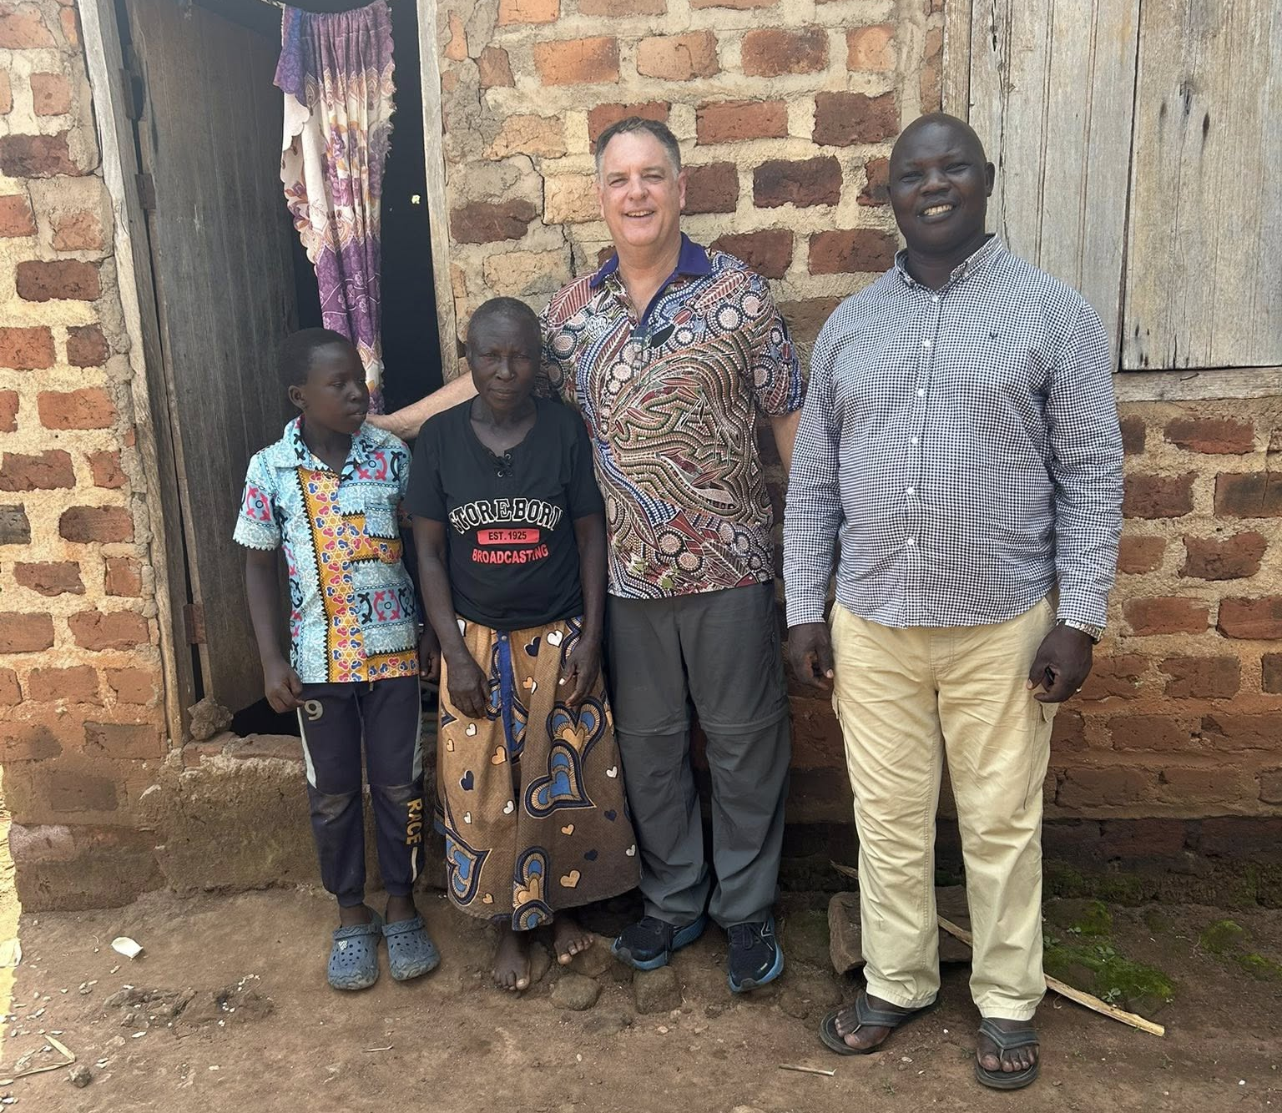
Visited Jesse

Slide 7
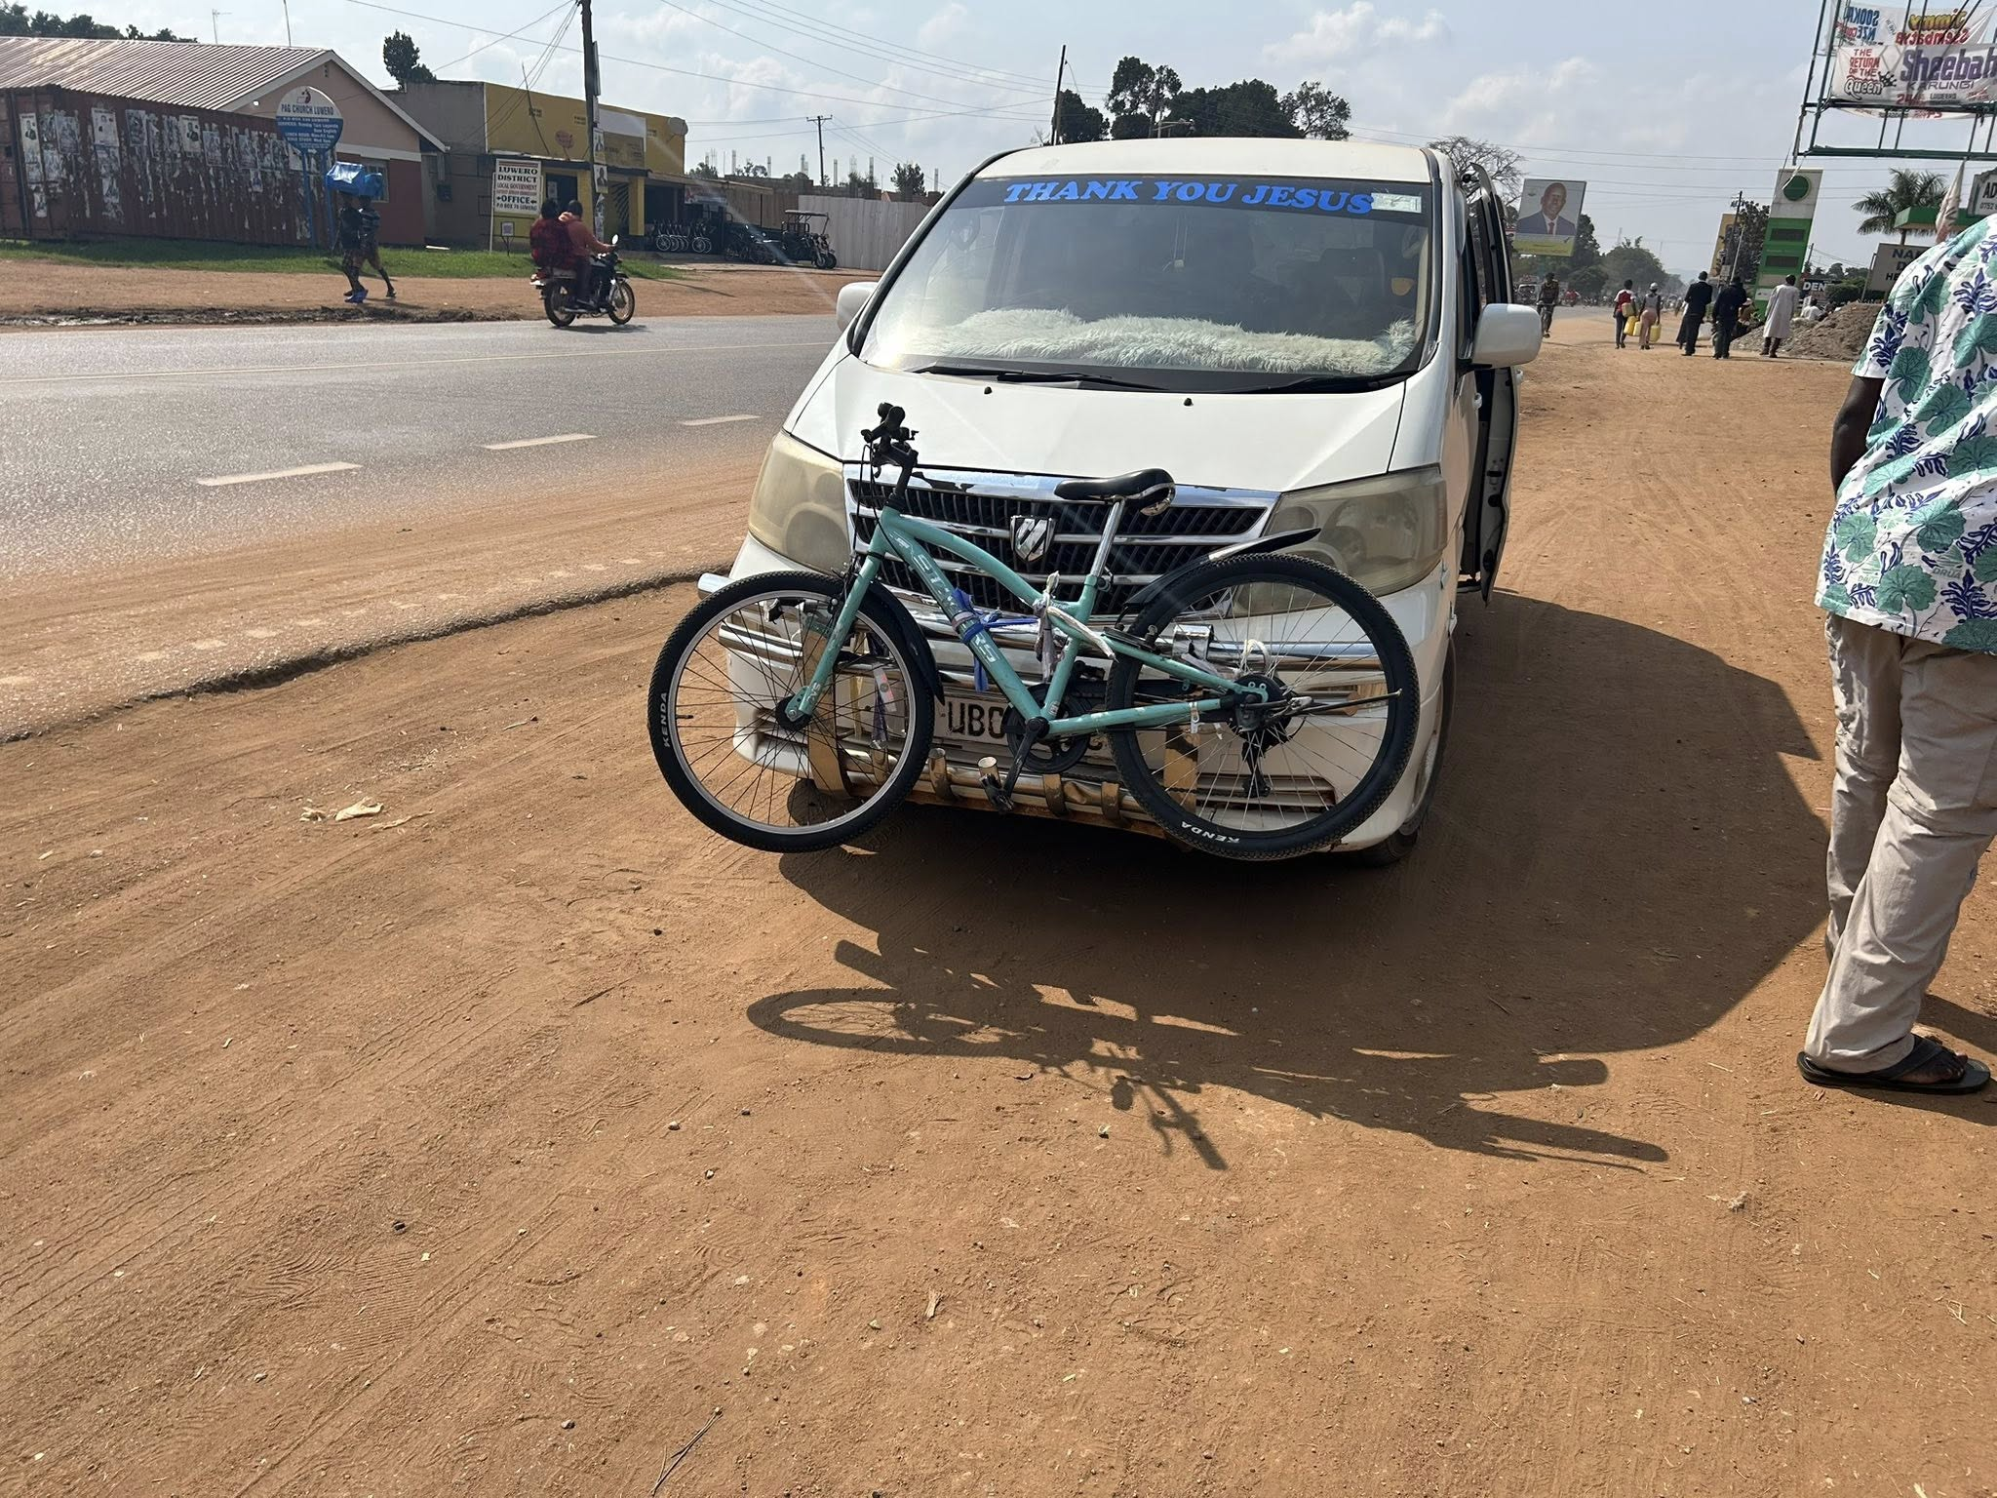
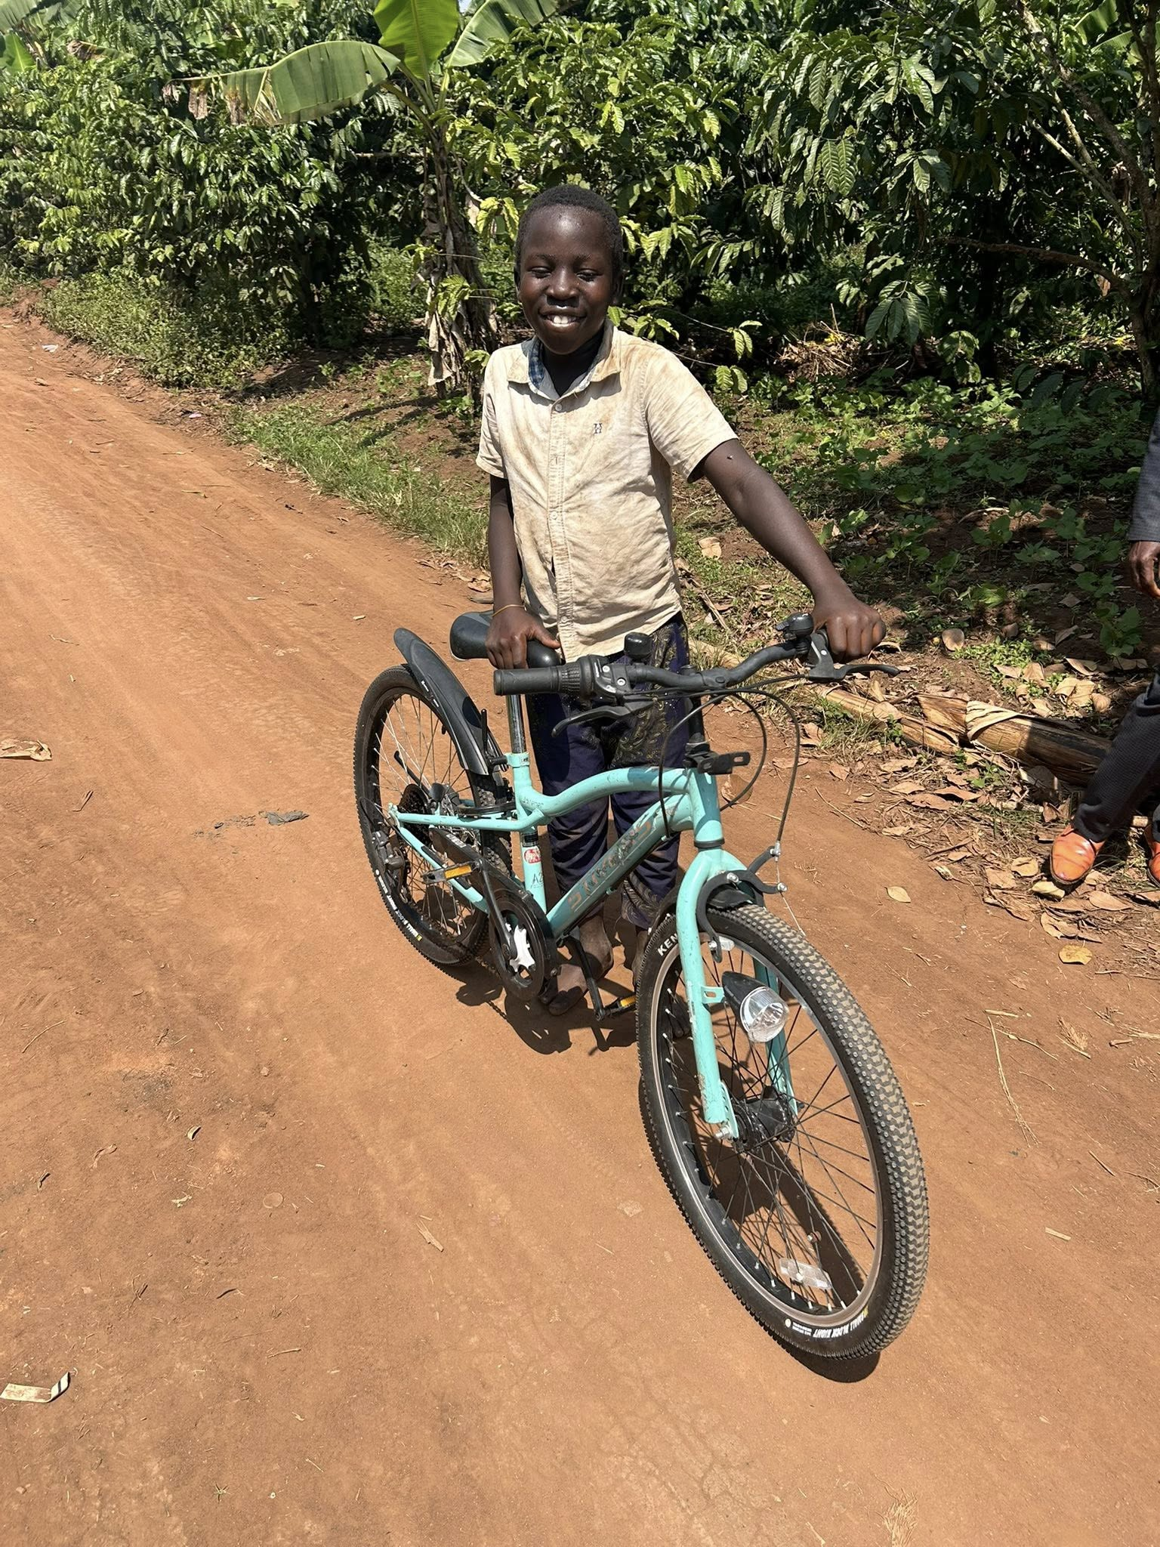
Bicycle

Slide 8
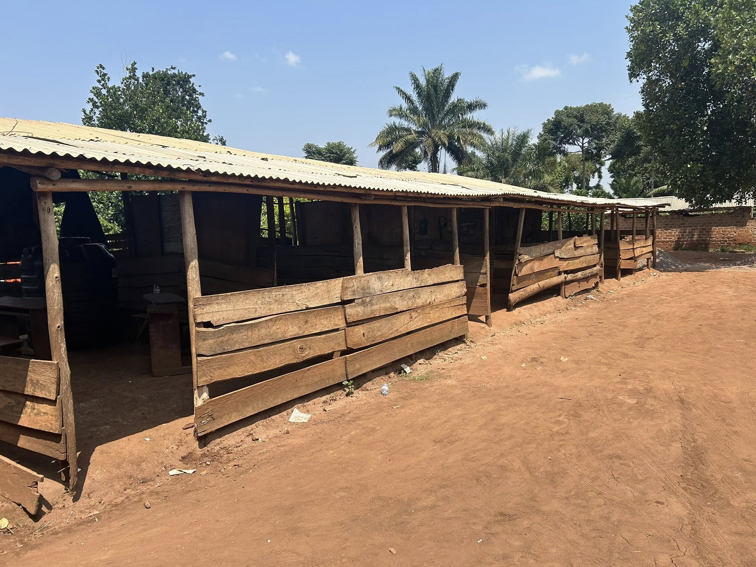
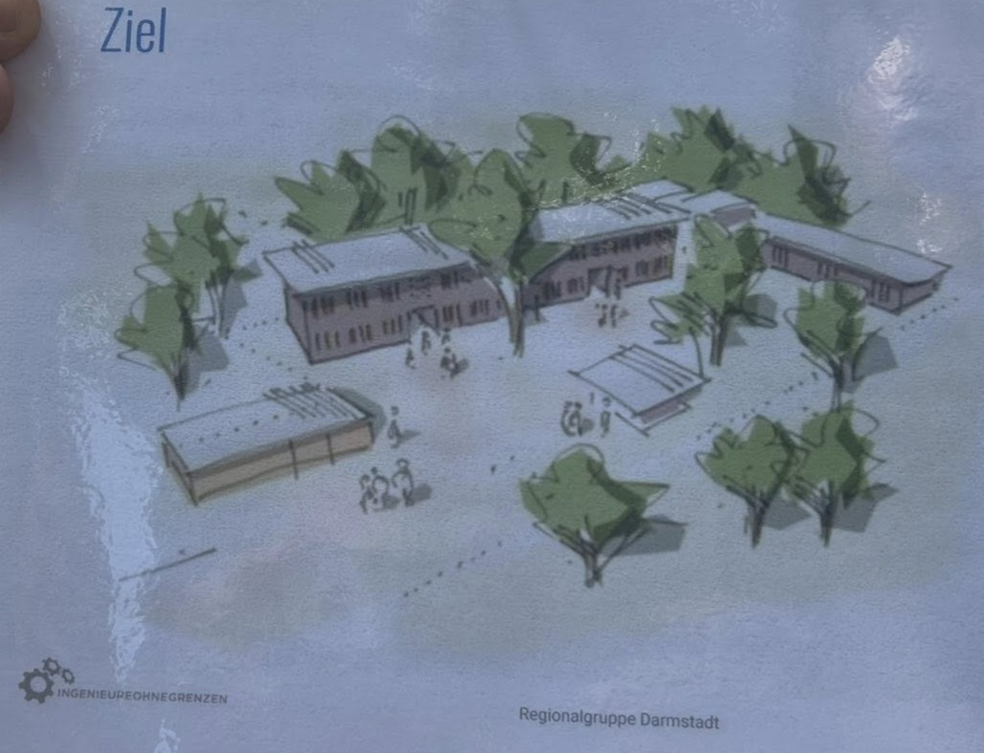
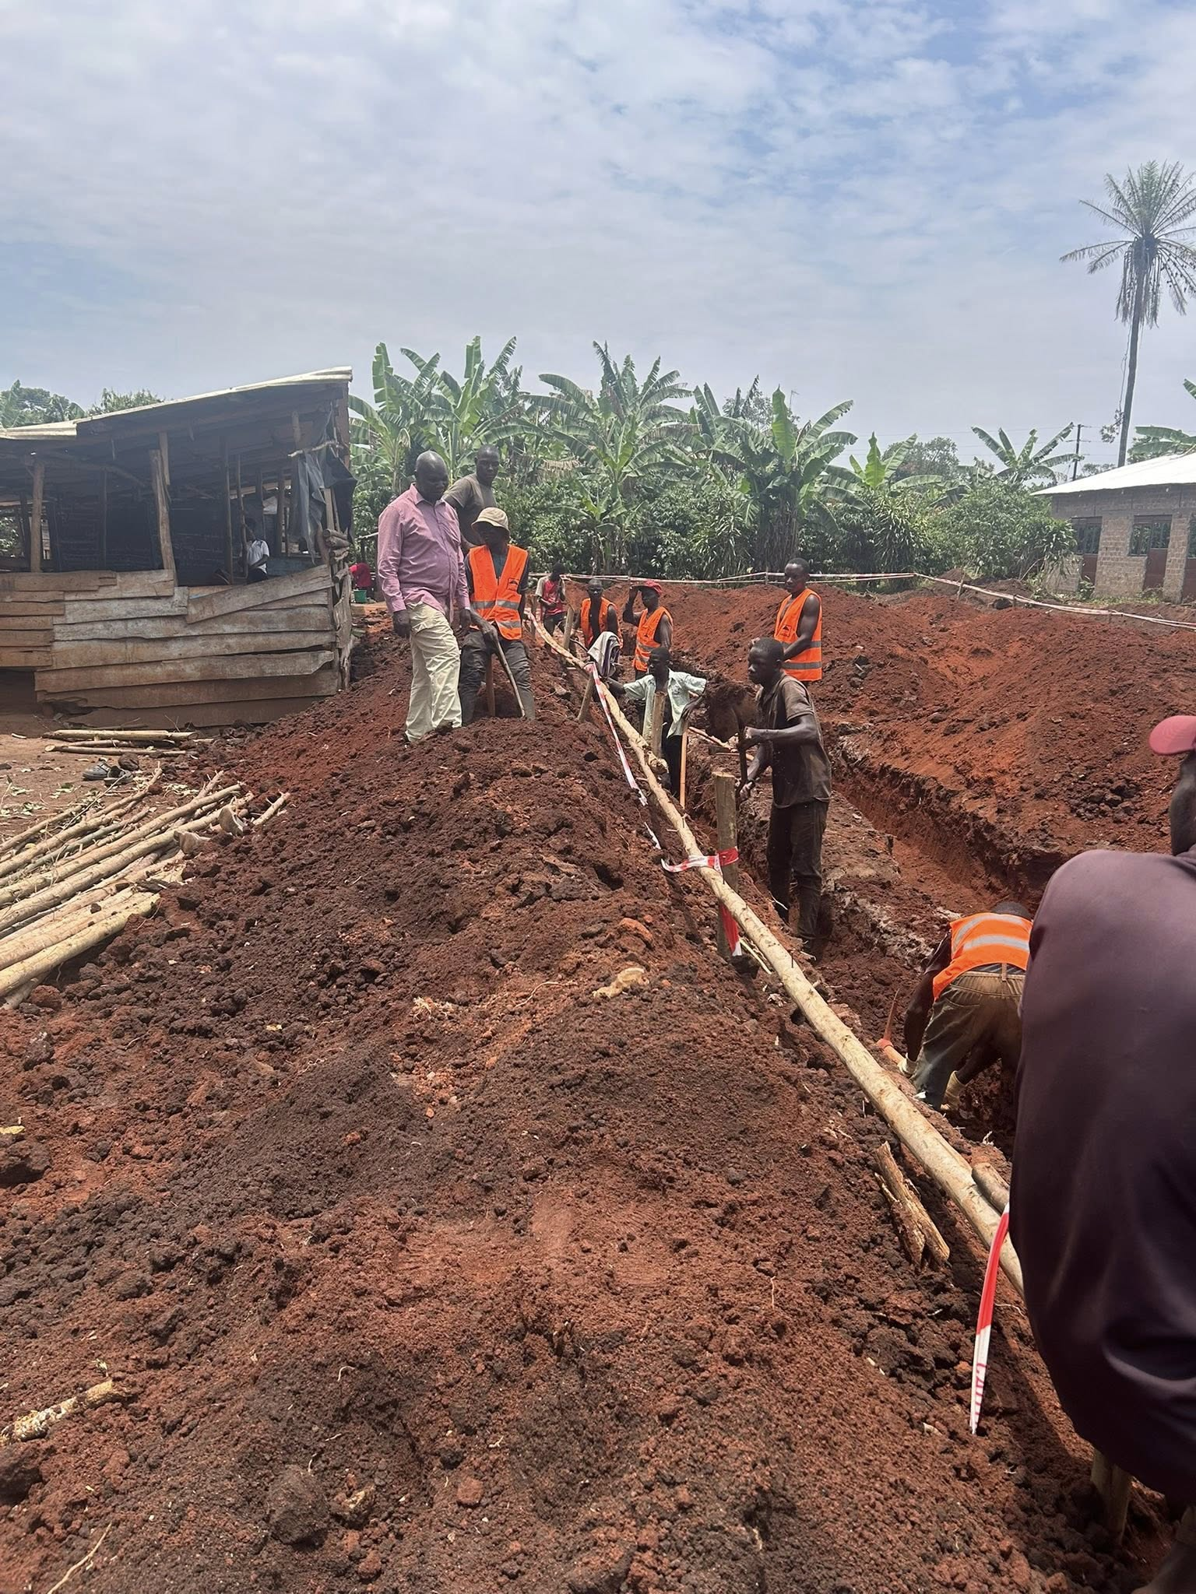
Wokinoni School

Slide 9
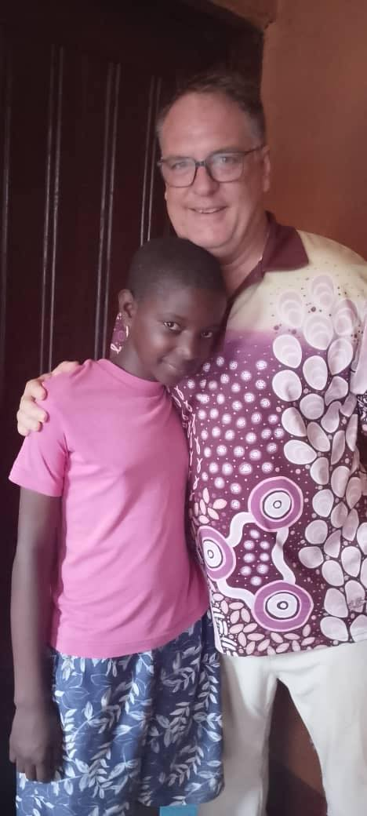
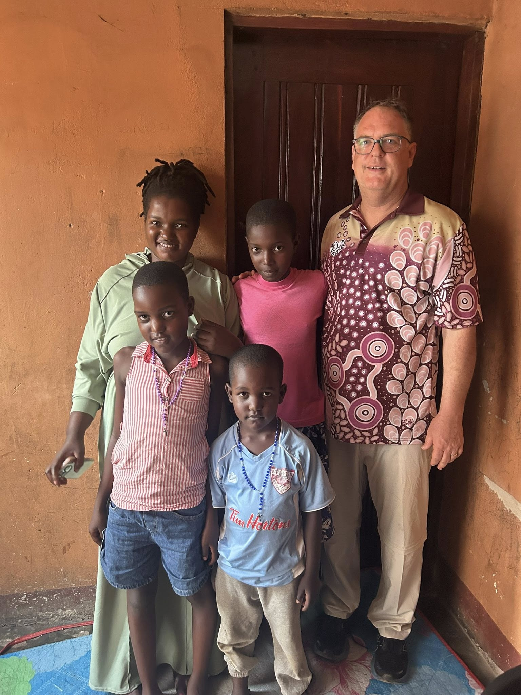
Pretty

Slide 10
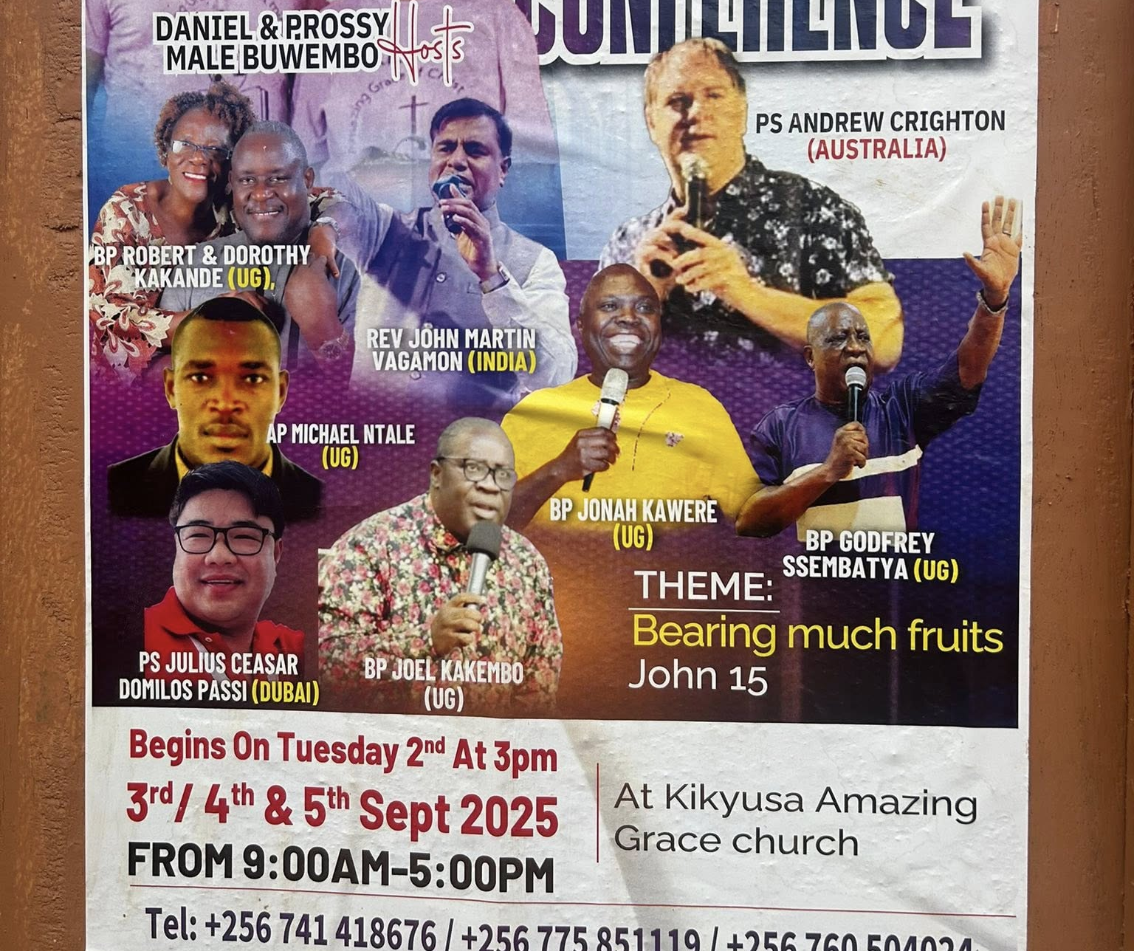
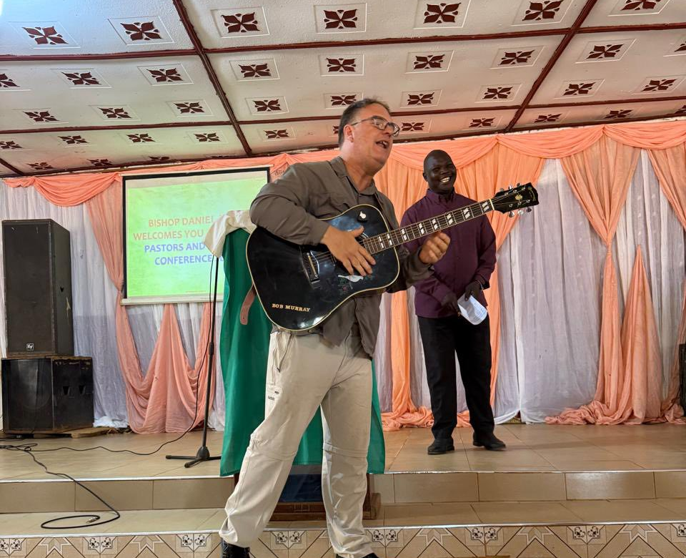
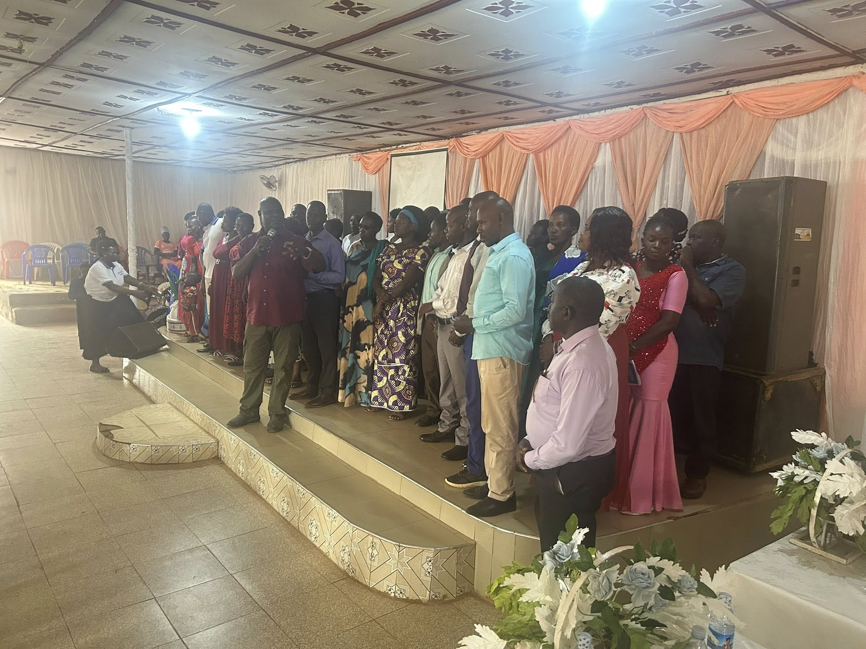
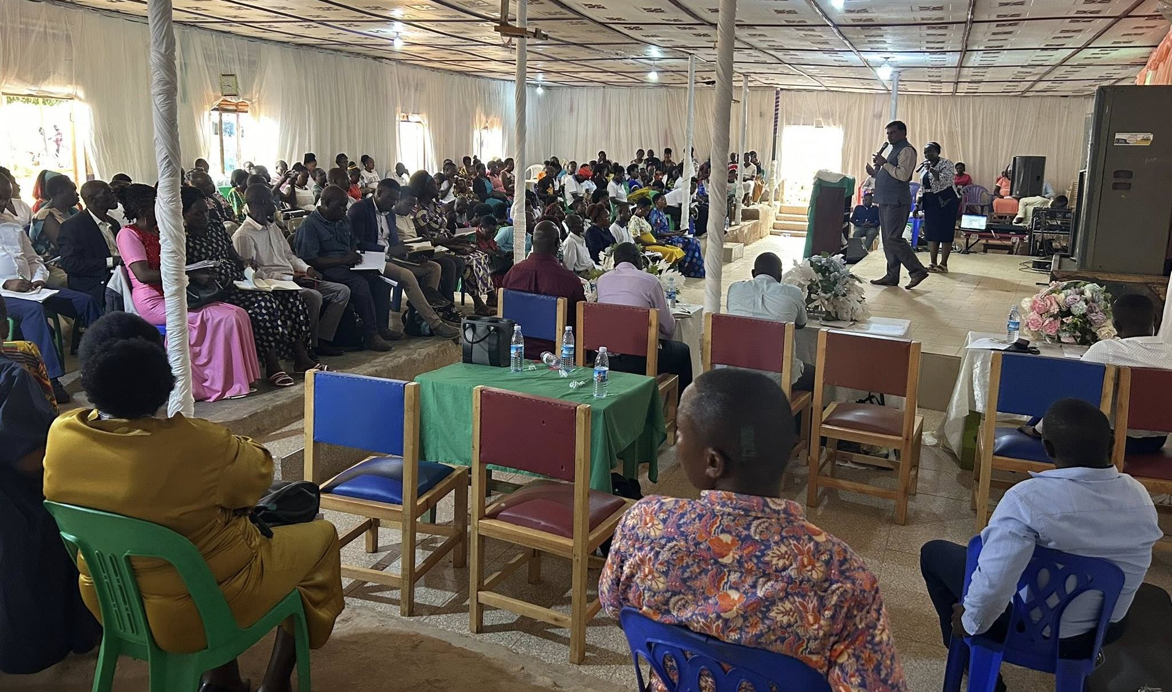
Pastors and Leaders Conference

Slide 11
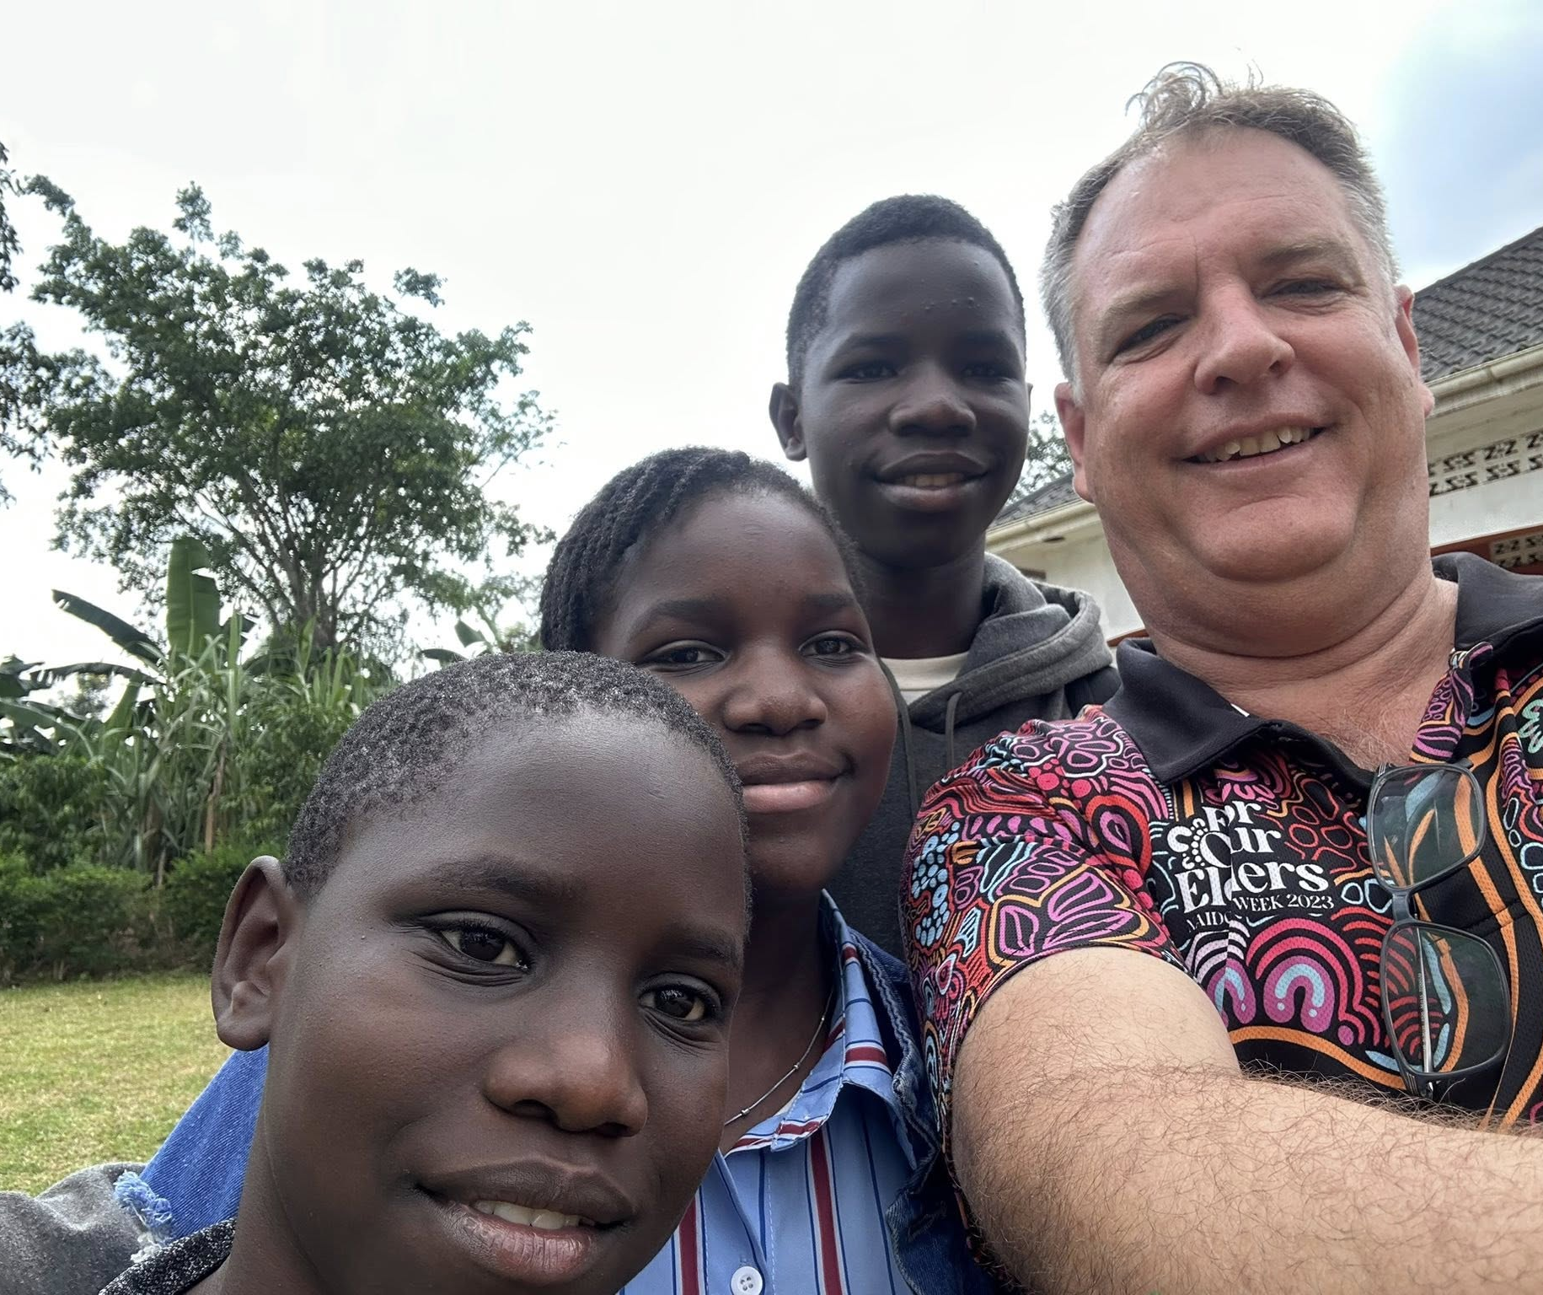
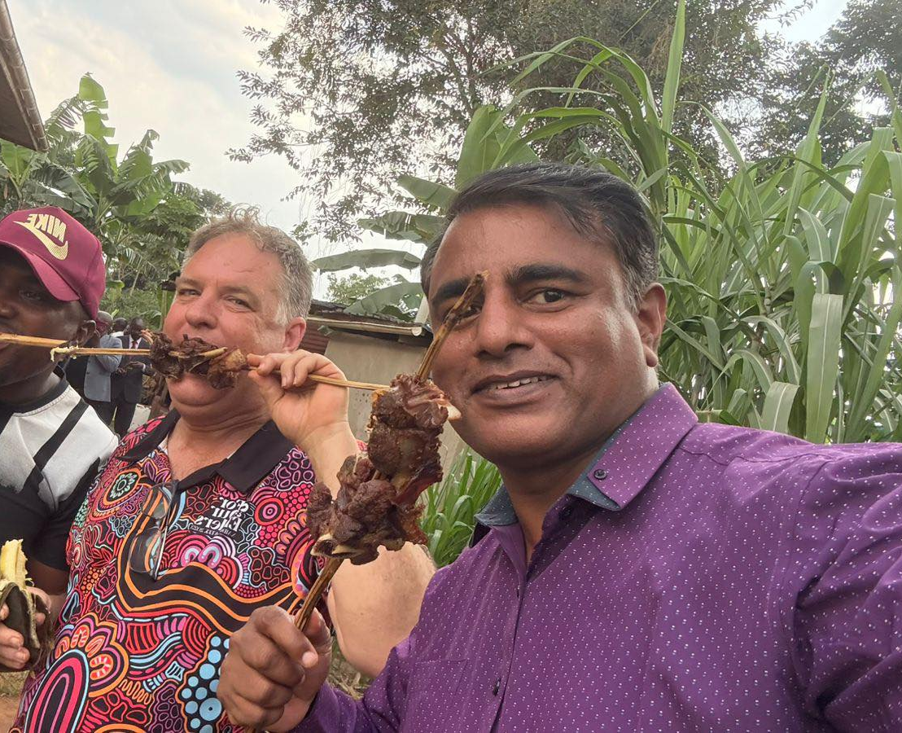
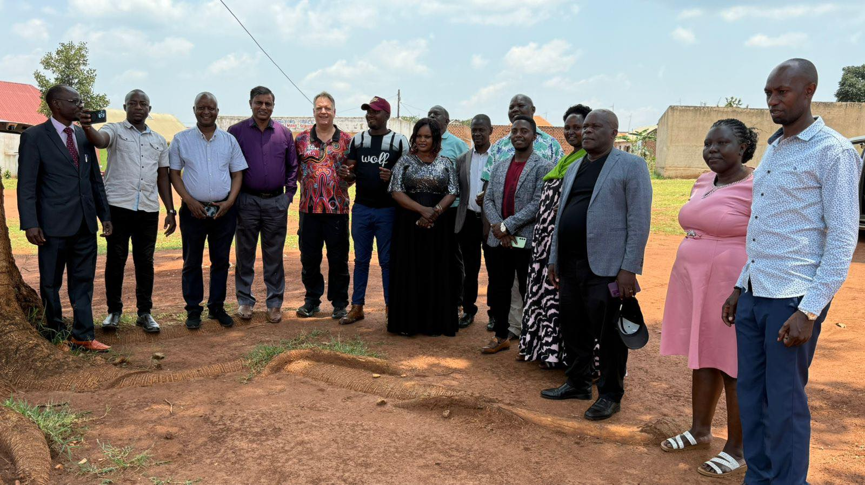
Kikyusa Oneness
Unity in action

Slide 12
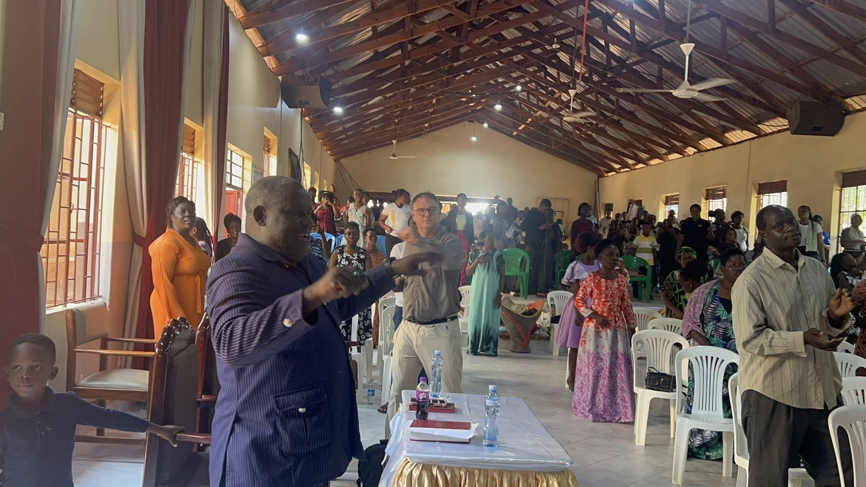
Worshiping with Gyaza Church and Bishop Robert

Slide 13
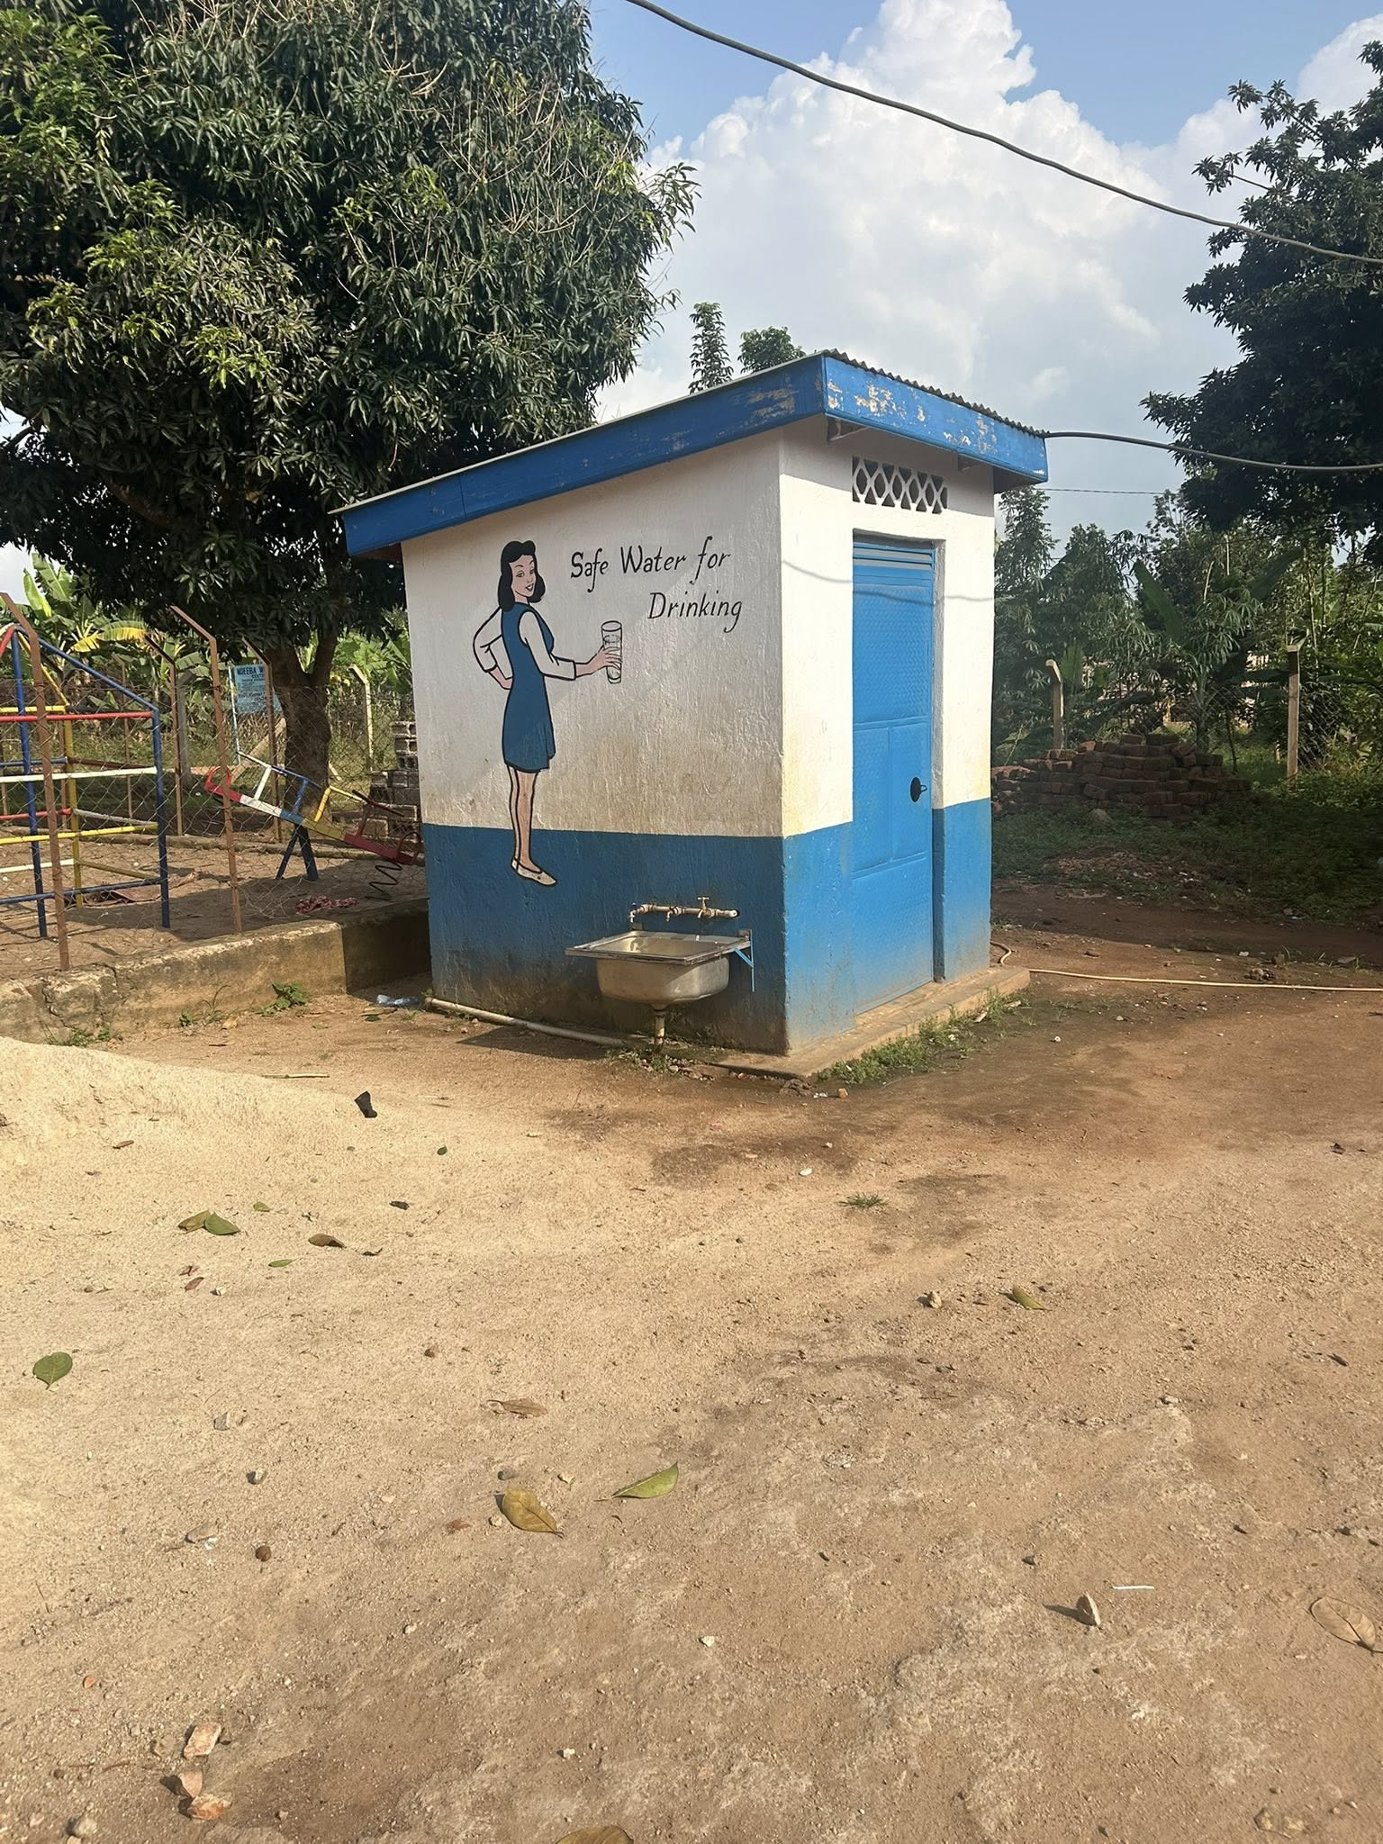
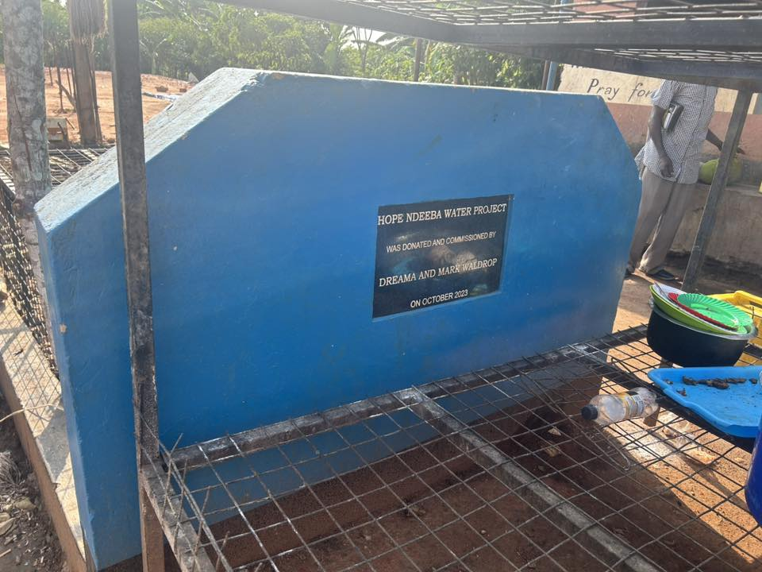
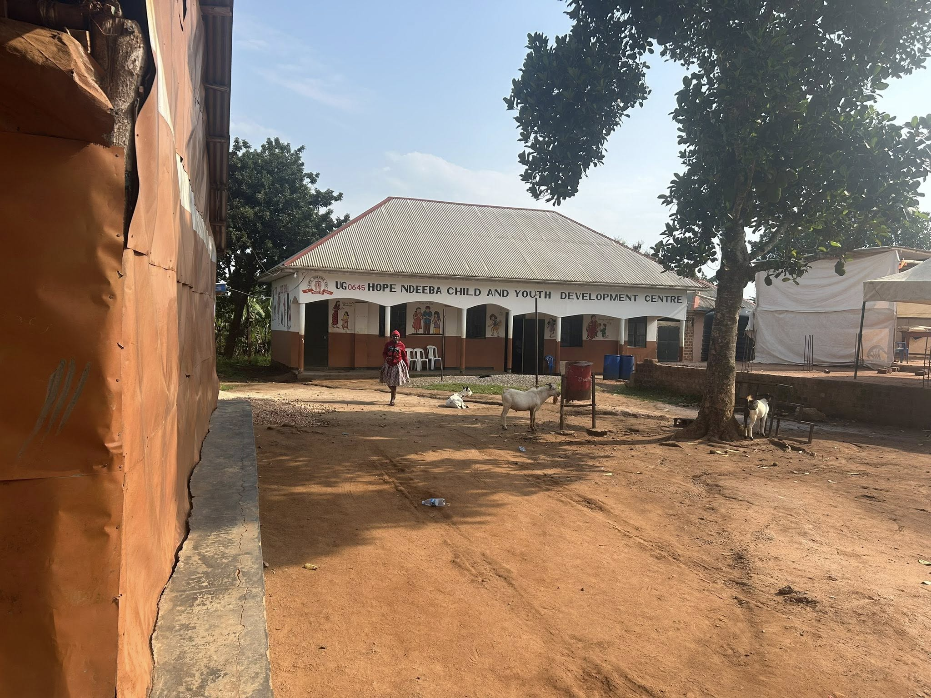
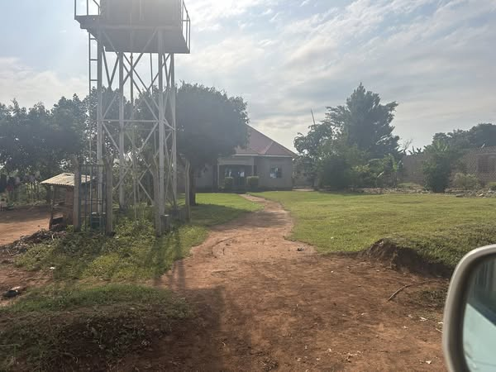
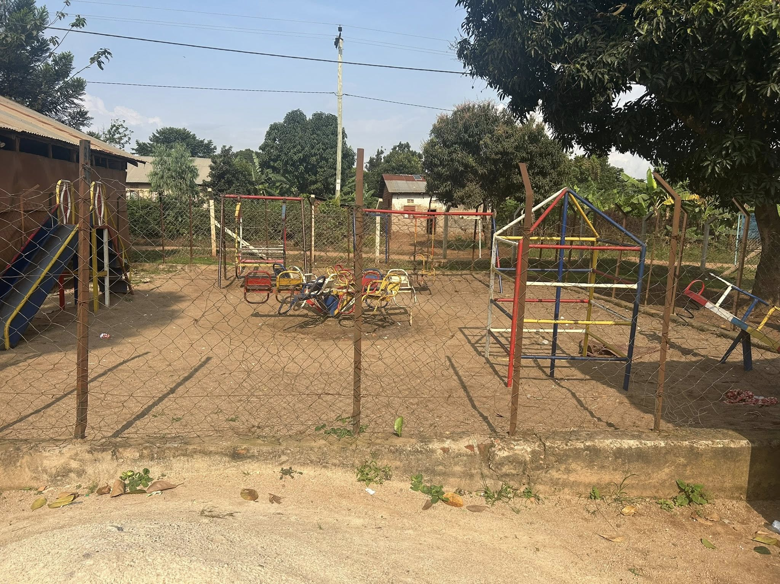
The kingdom of God at work

Slide 14
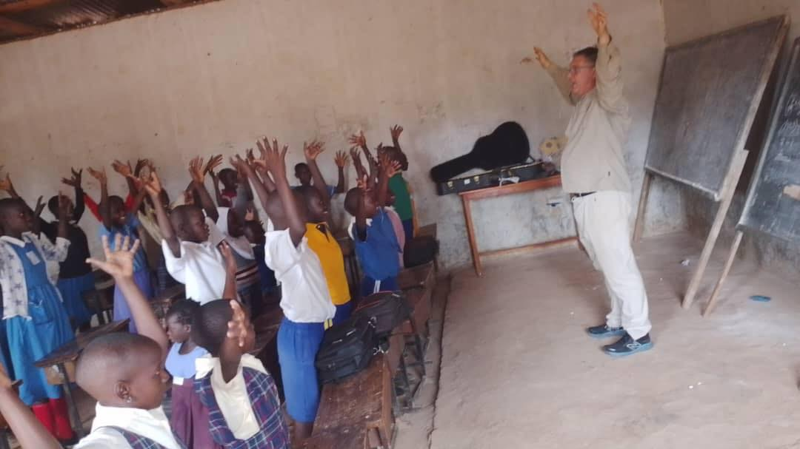
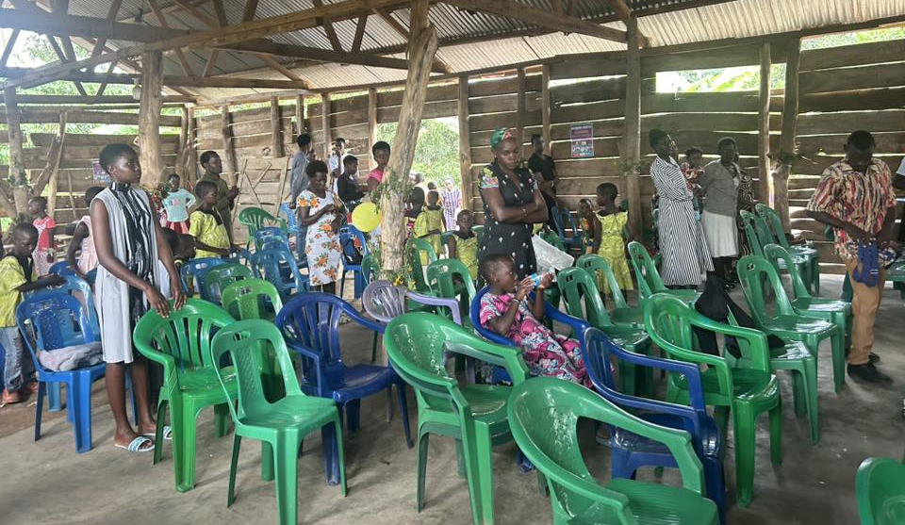
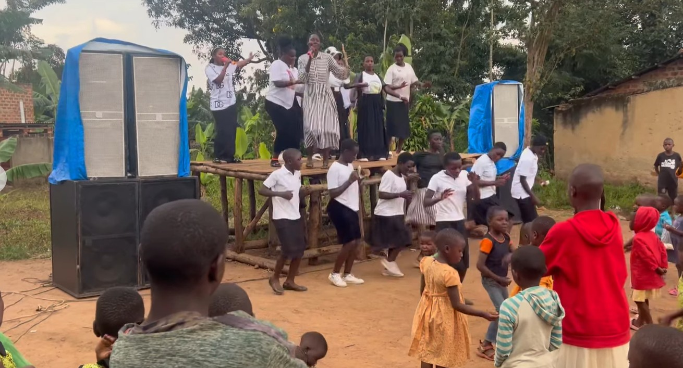
School visits and Conference and rally

Slide 15
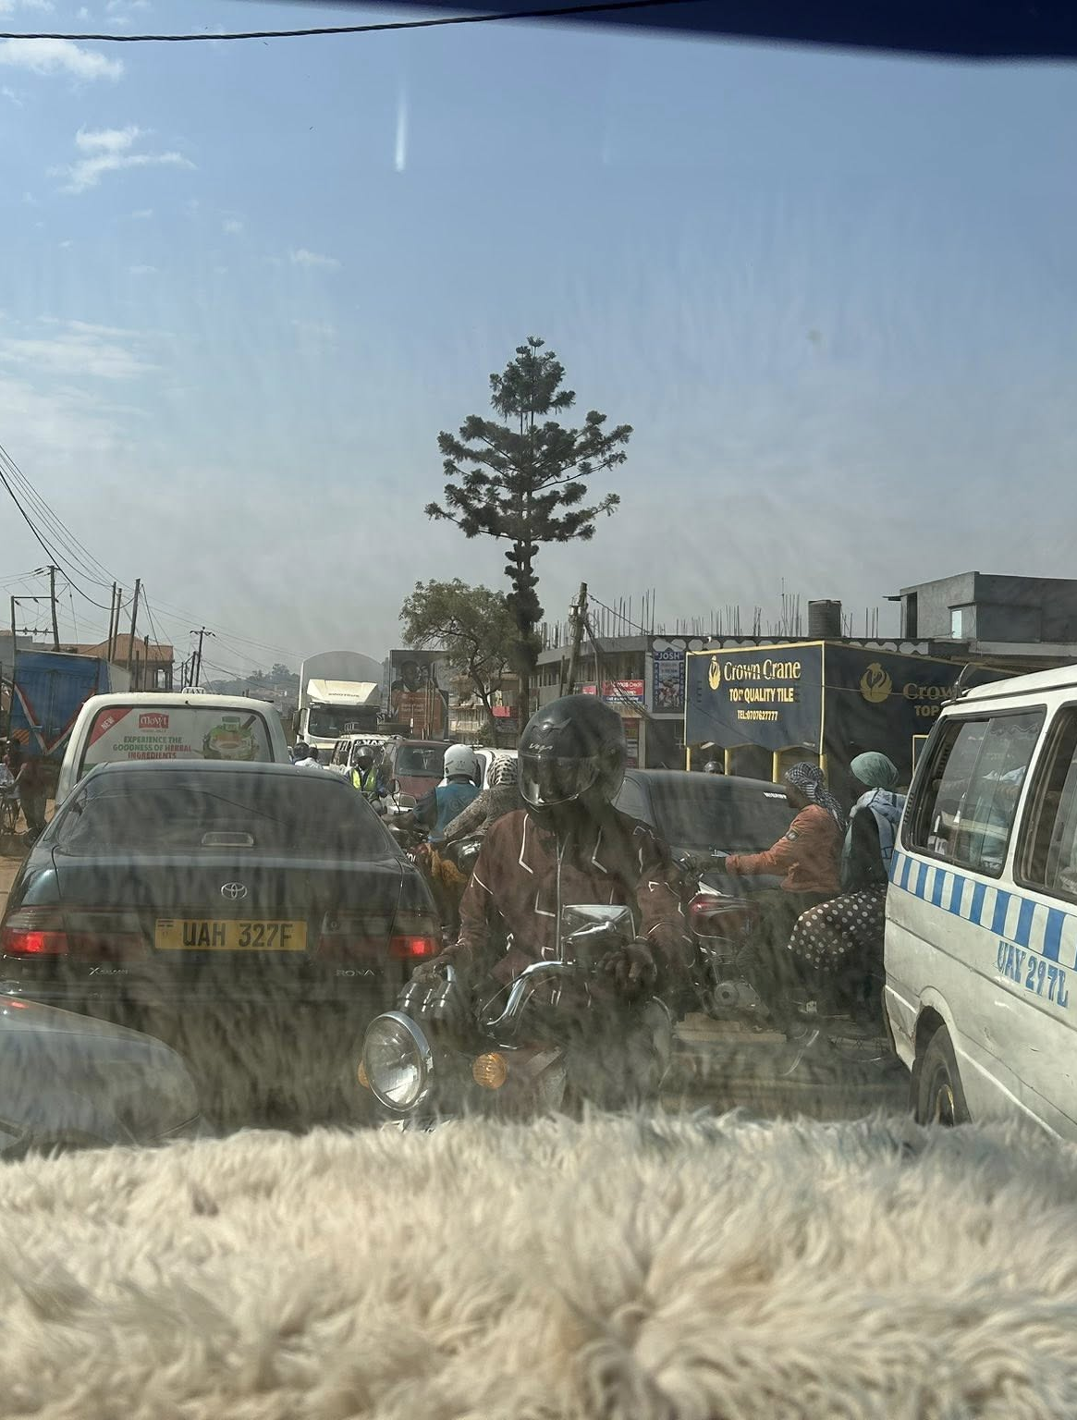
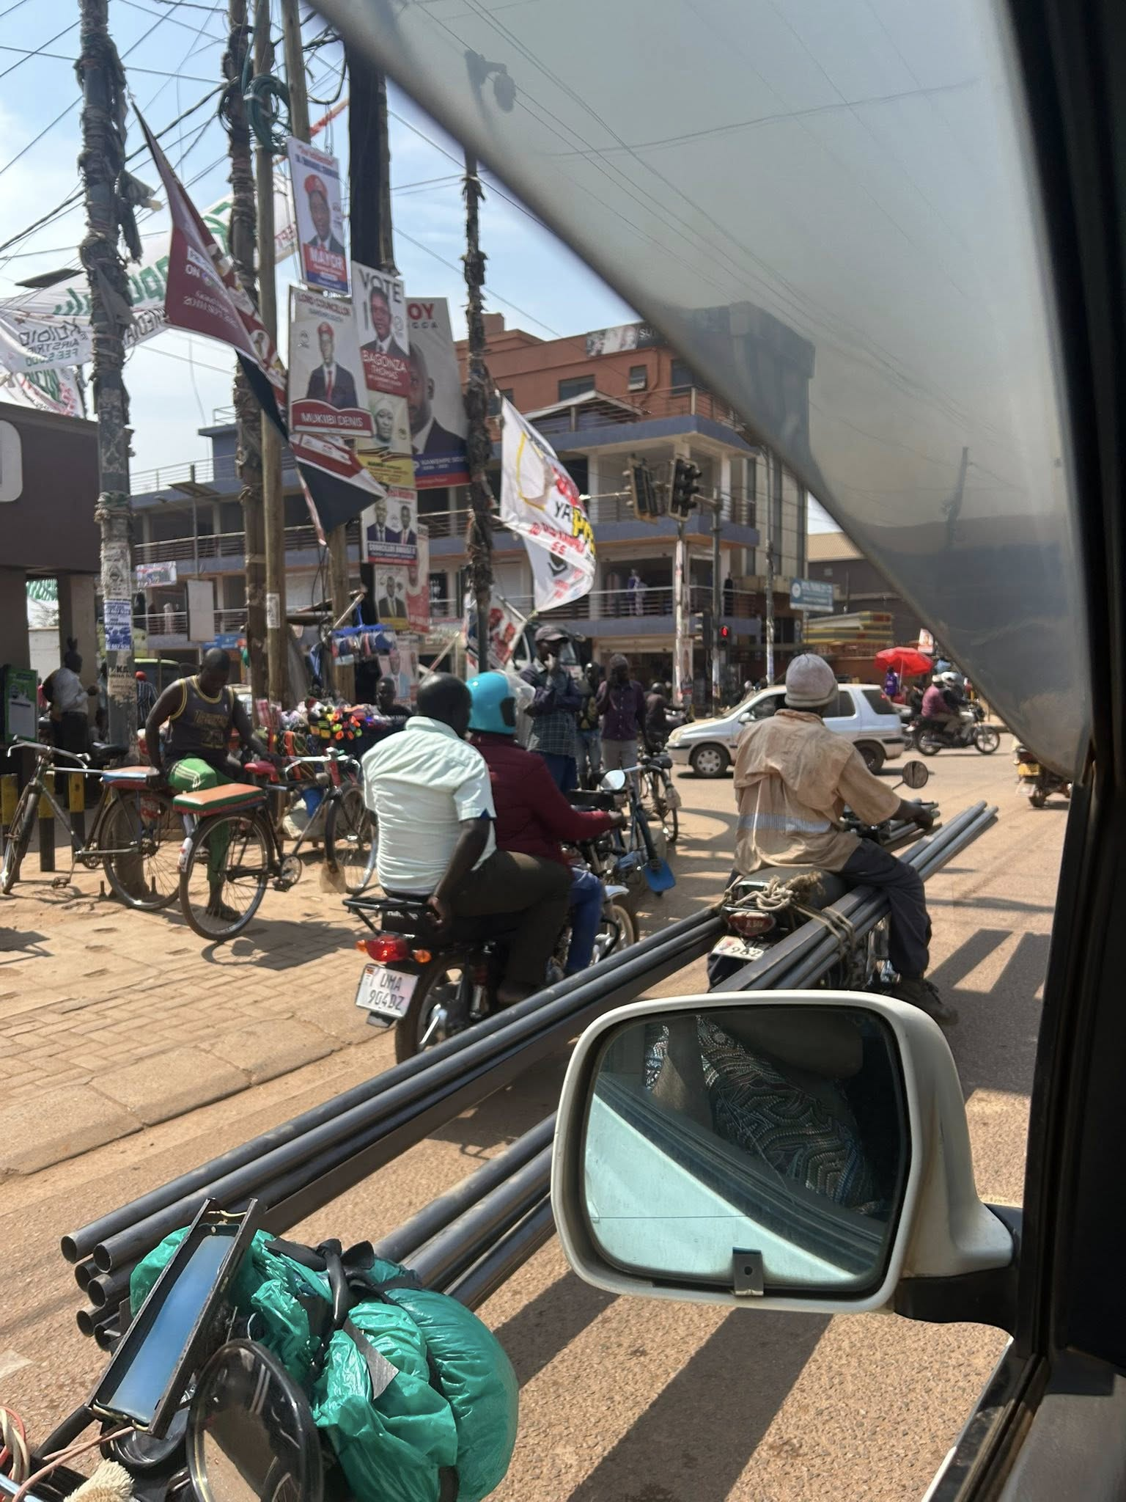
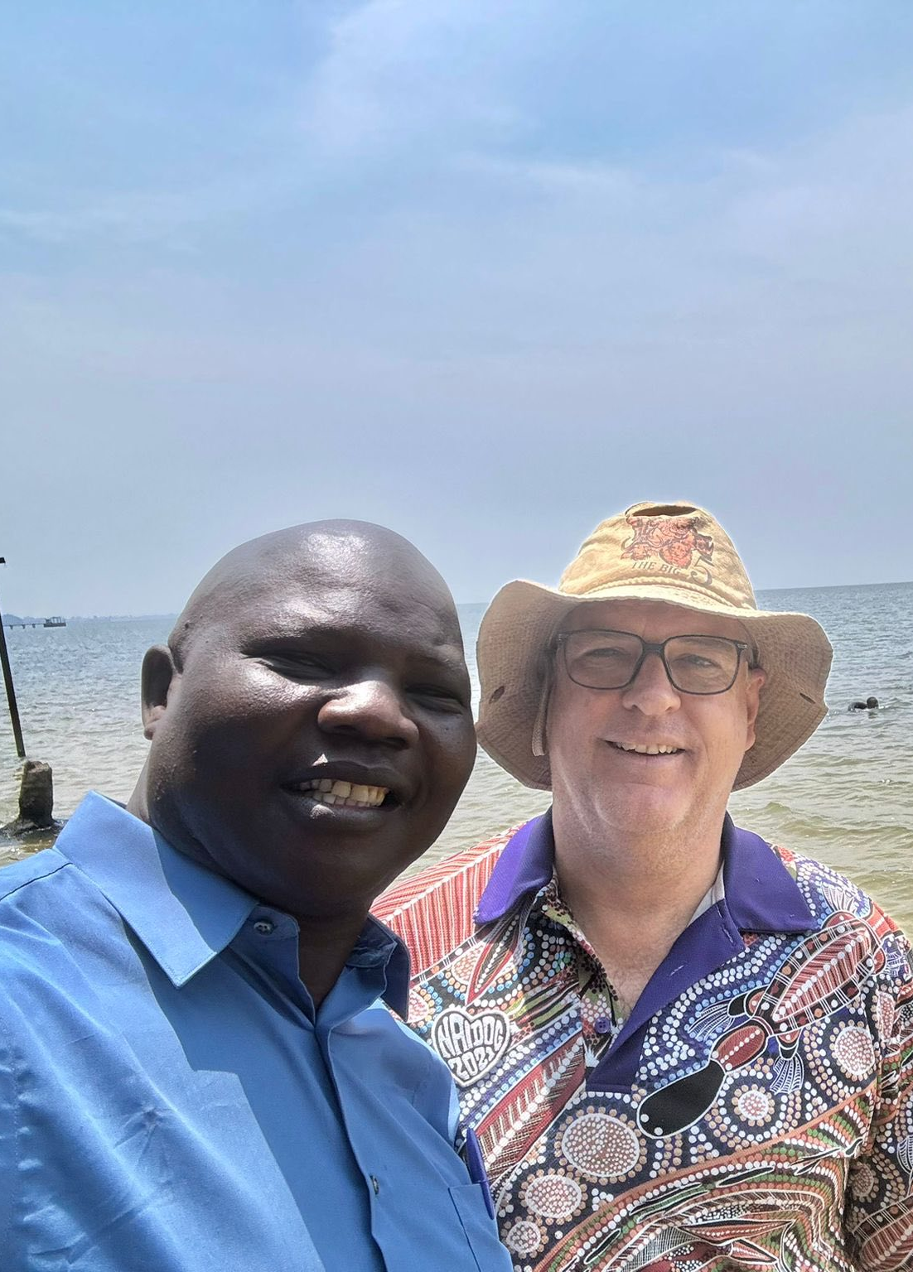
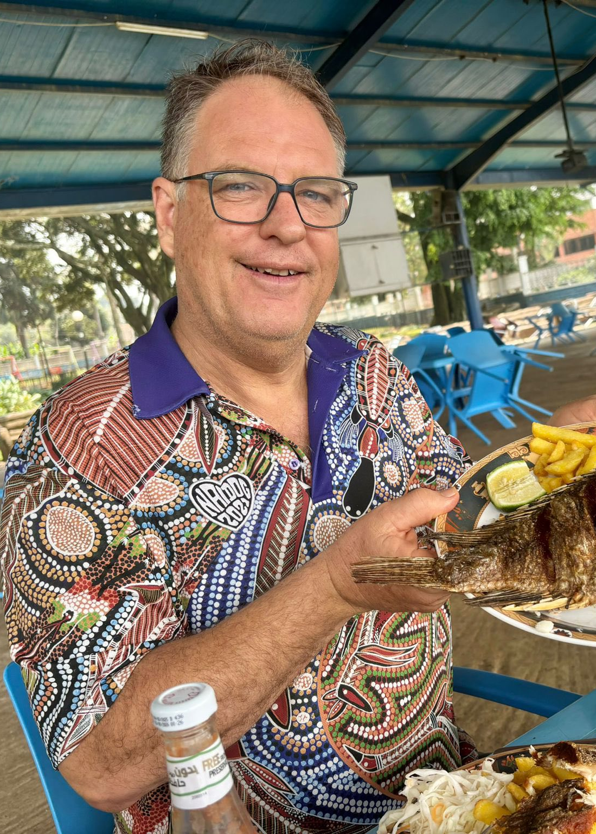
Kampala traffic, Lake Victoria and Fly to Kenya

Slide 16
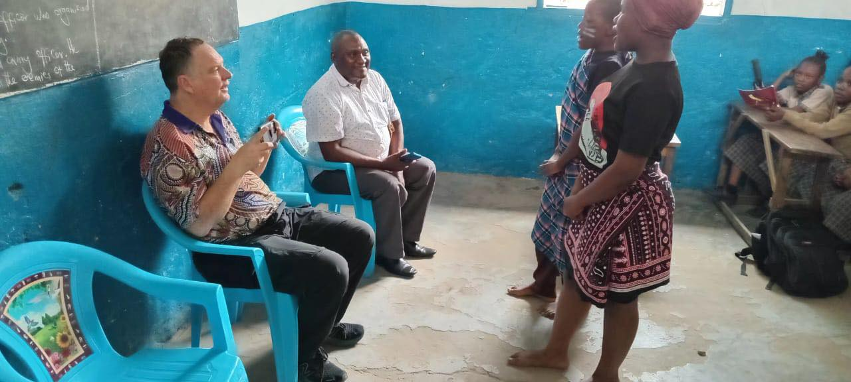


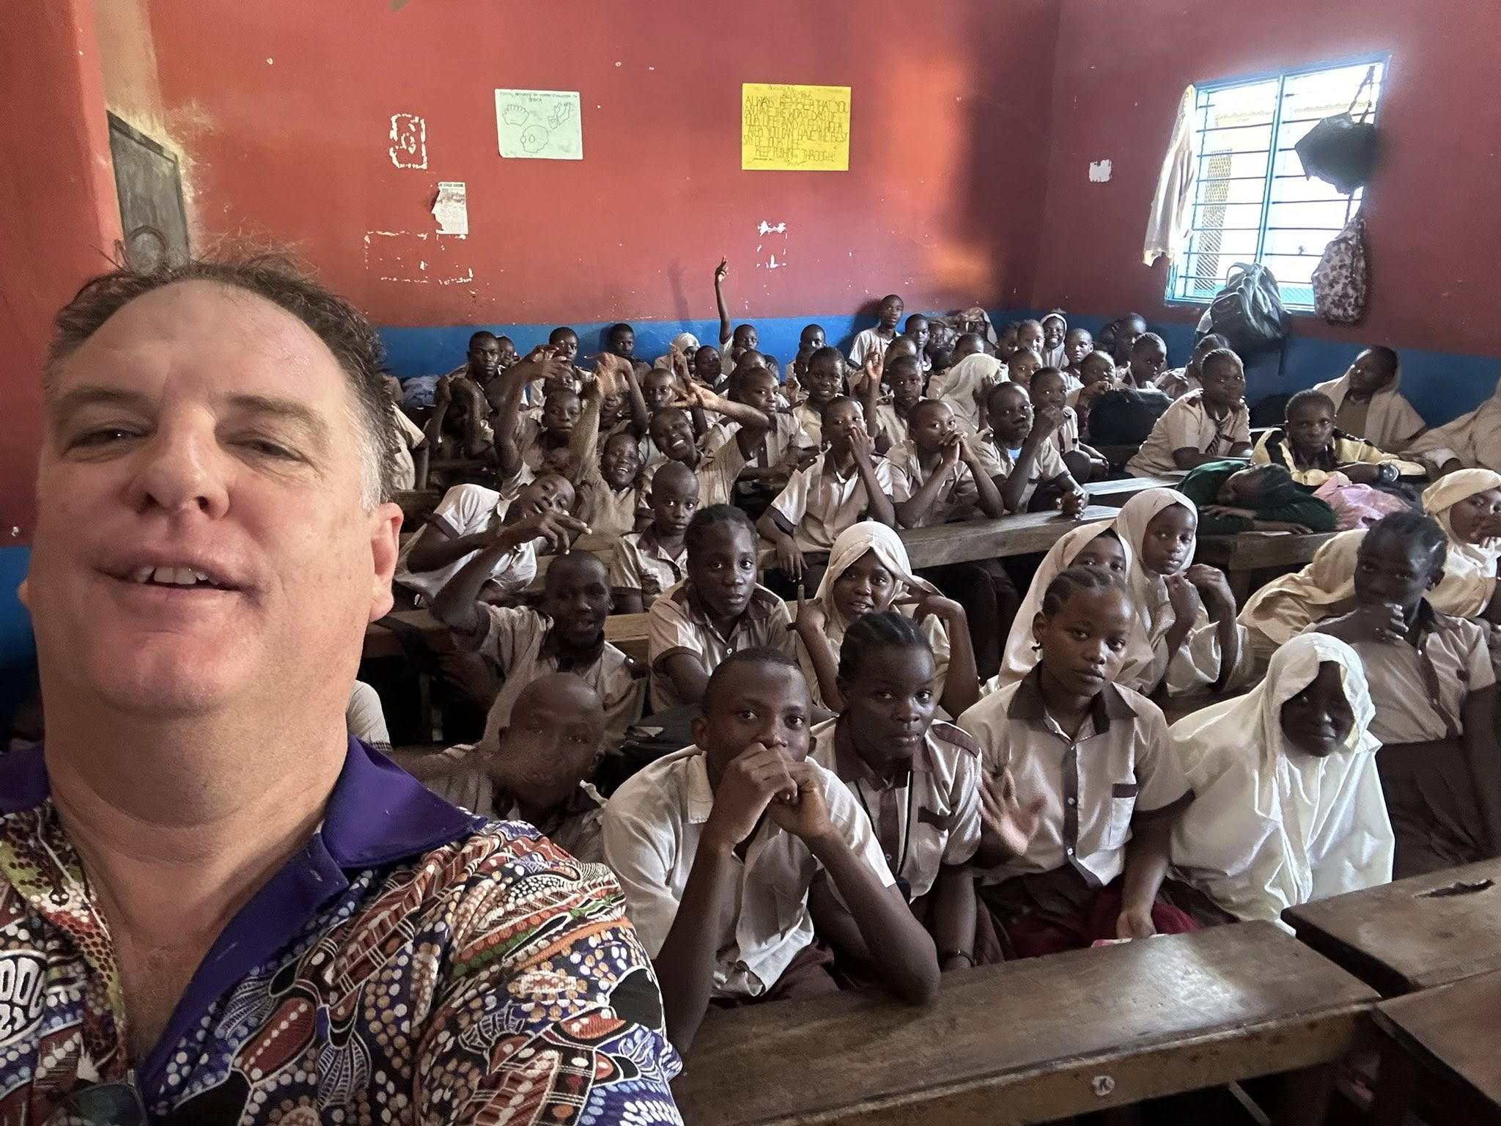

Slide 17
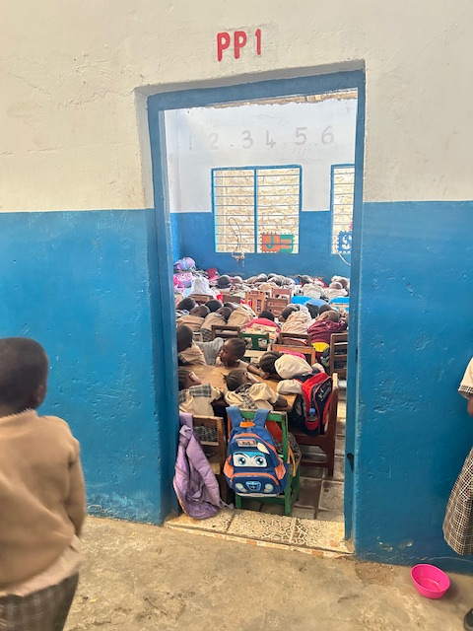

Sponsored Children

Slide 18
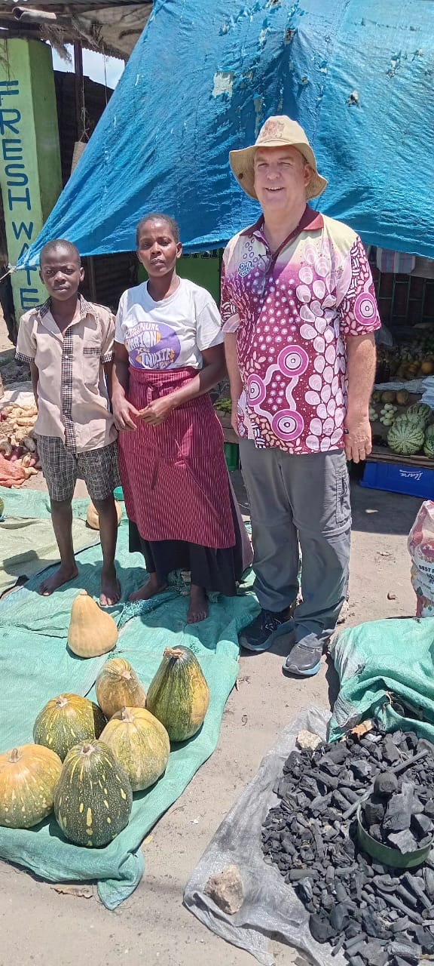
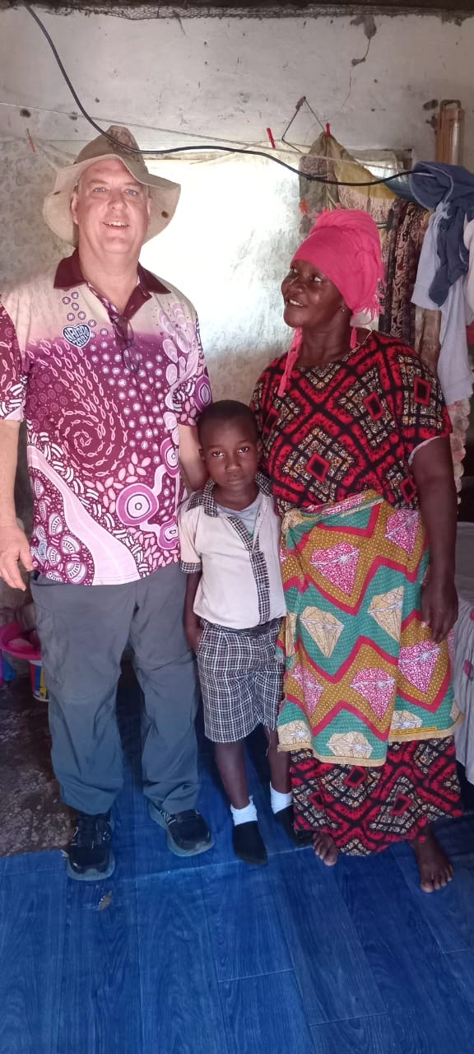
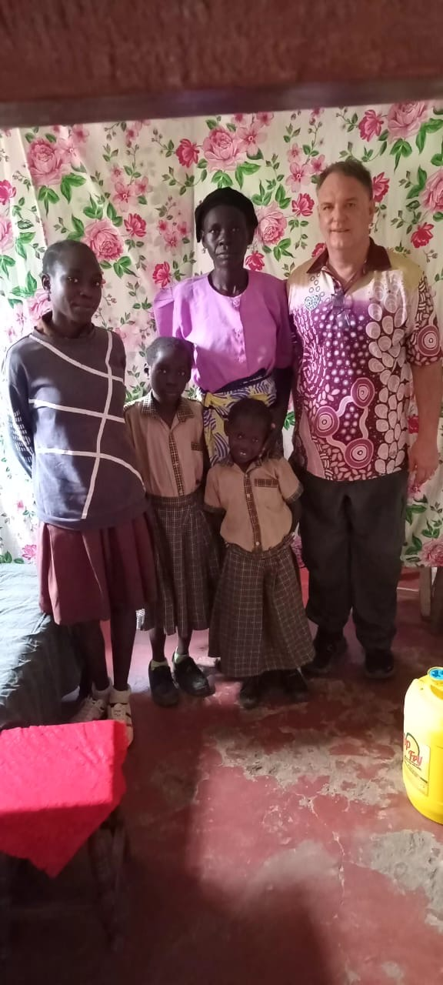
Visits

Slide 19
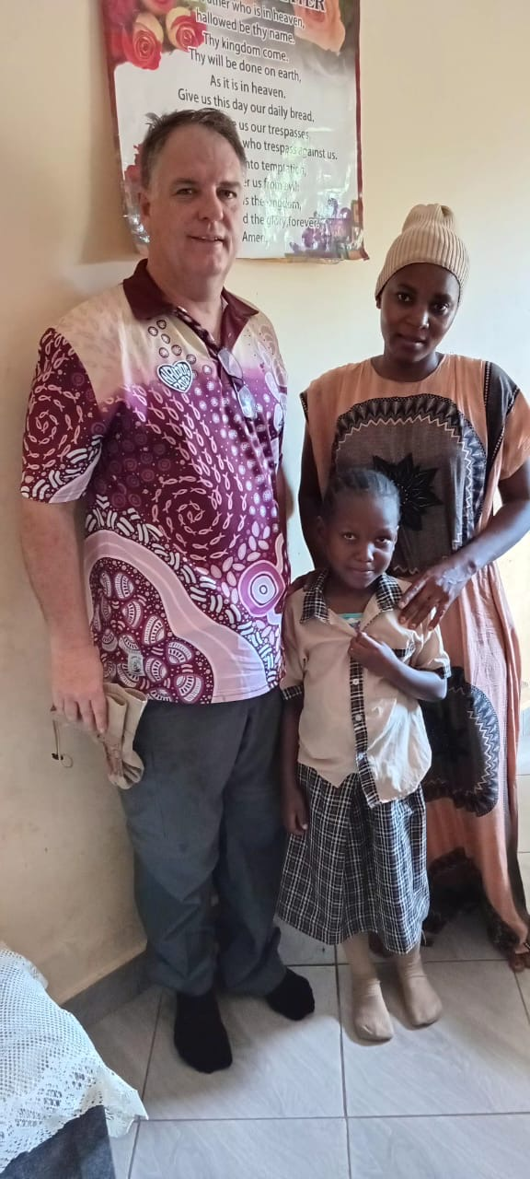
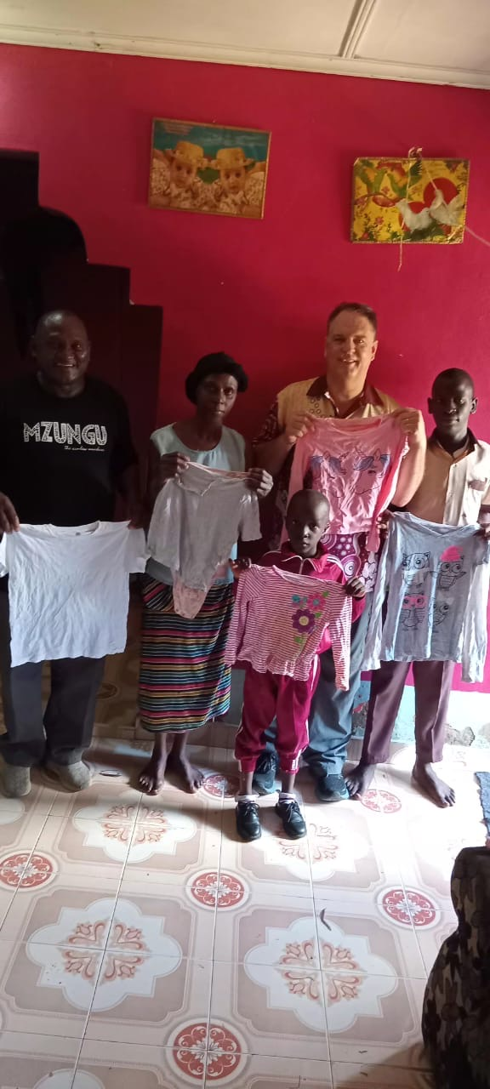
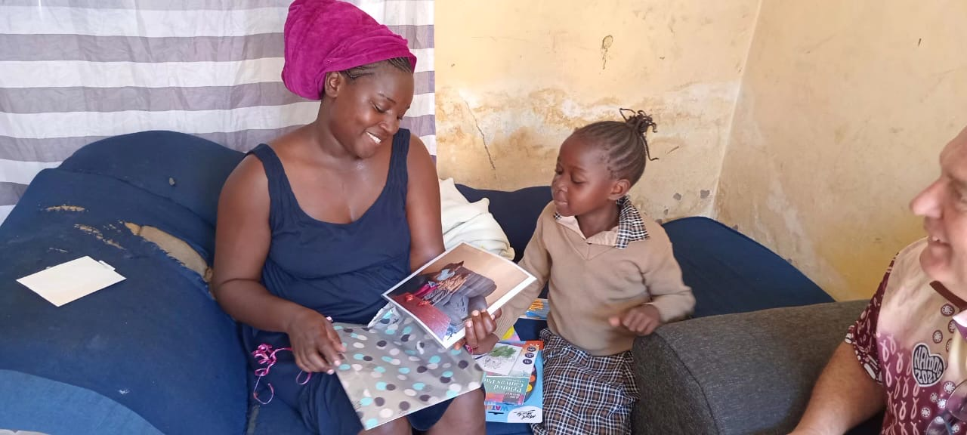
Visits

Slide 20
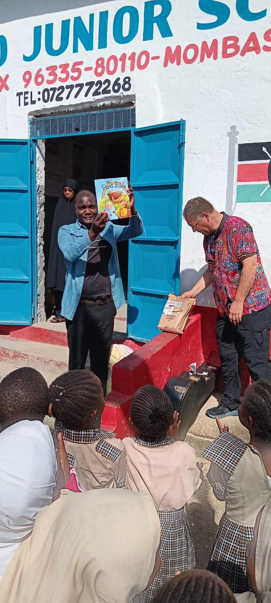
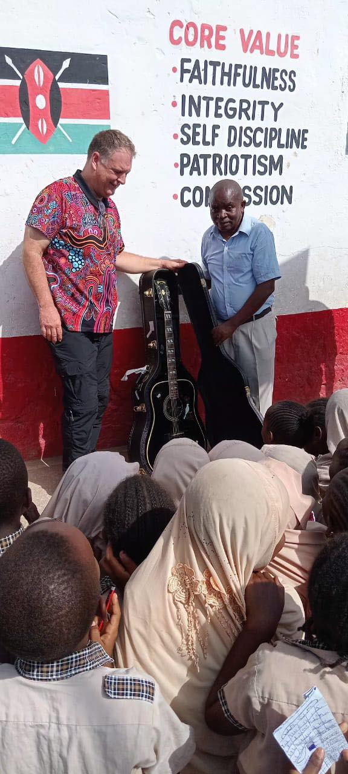
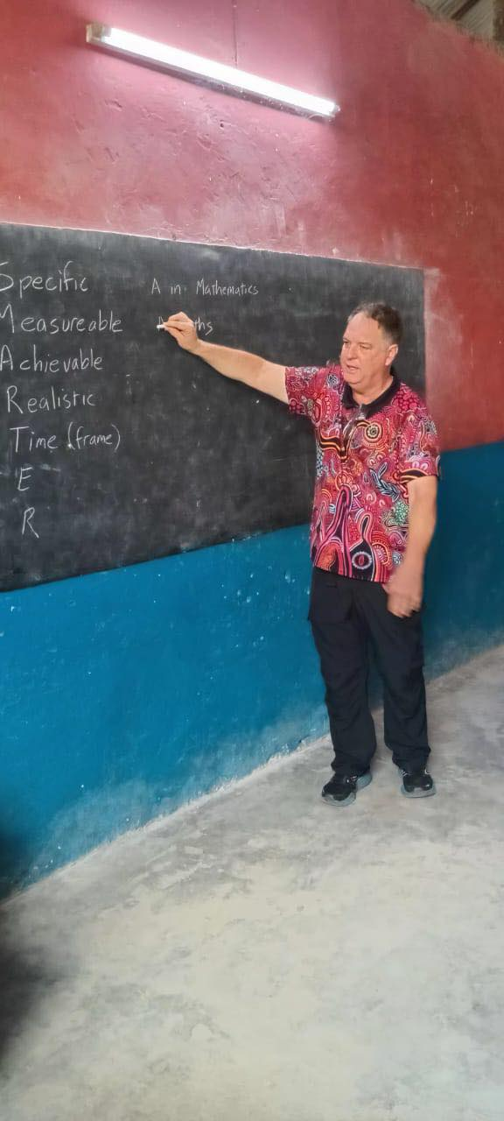
Friday at
Sunbird

Slide 21

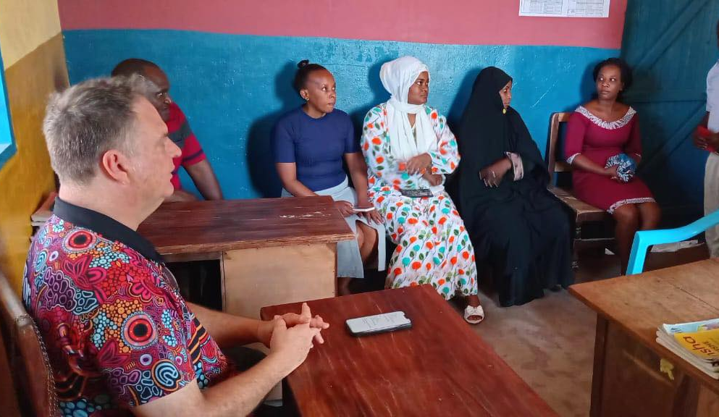
Friday at Sunbird

Slide 22
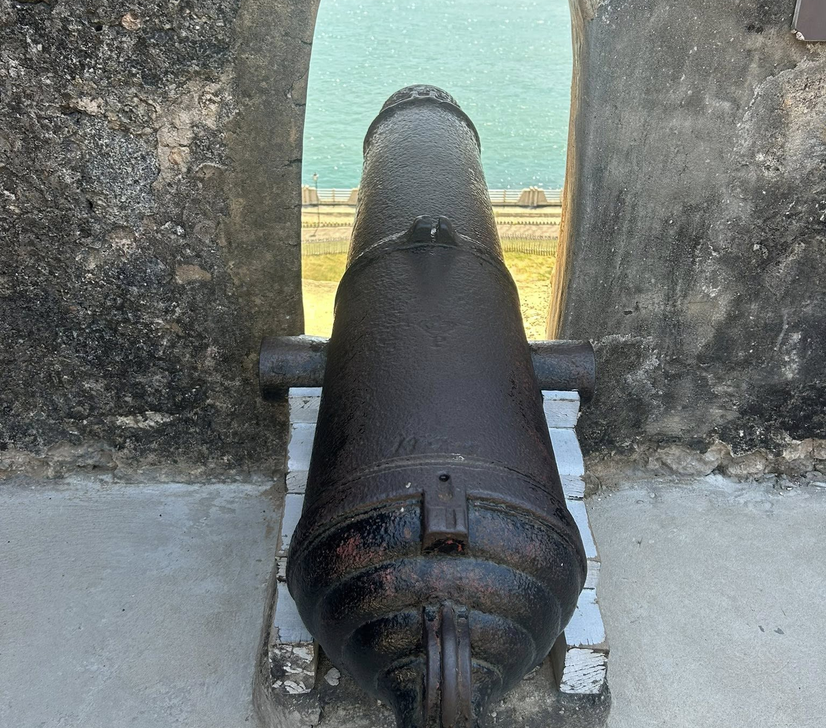
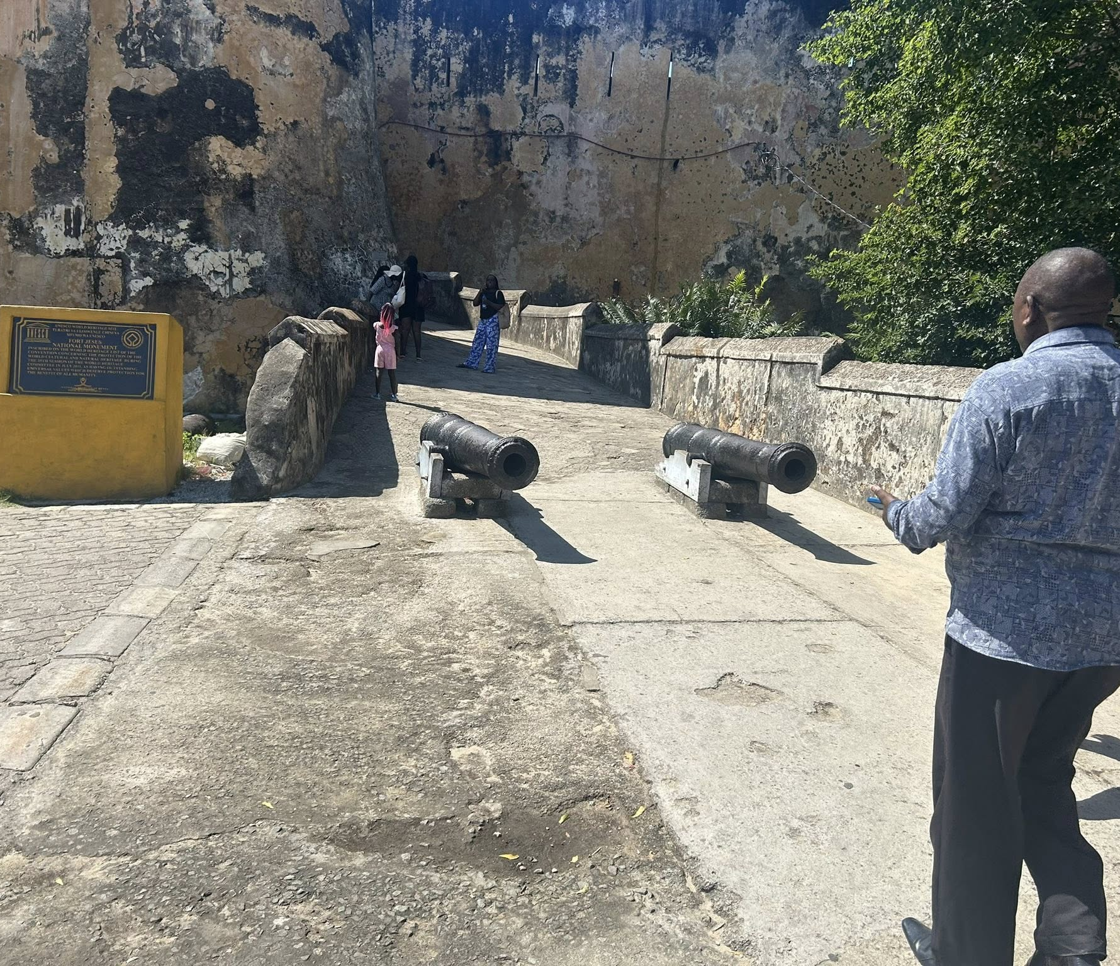
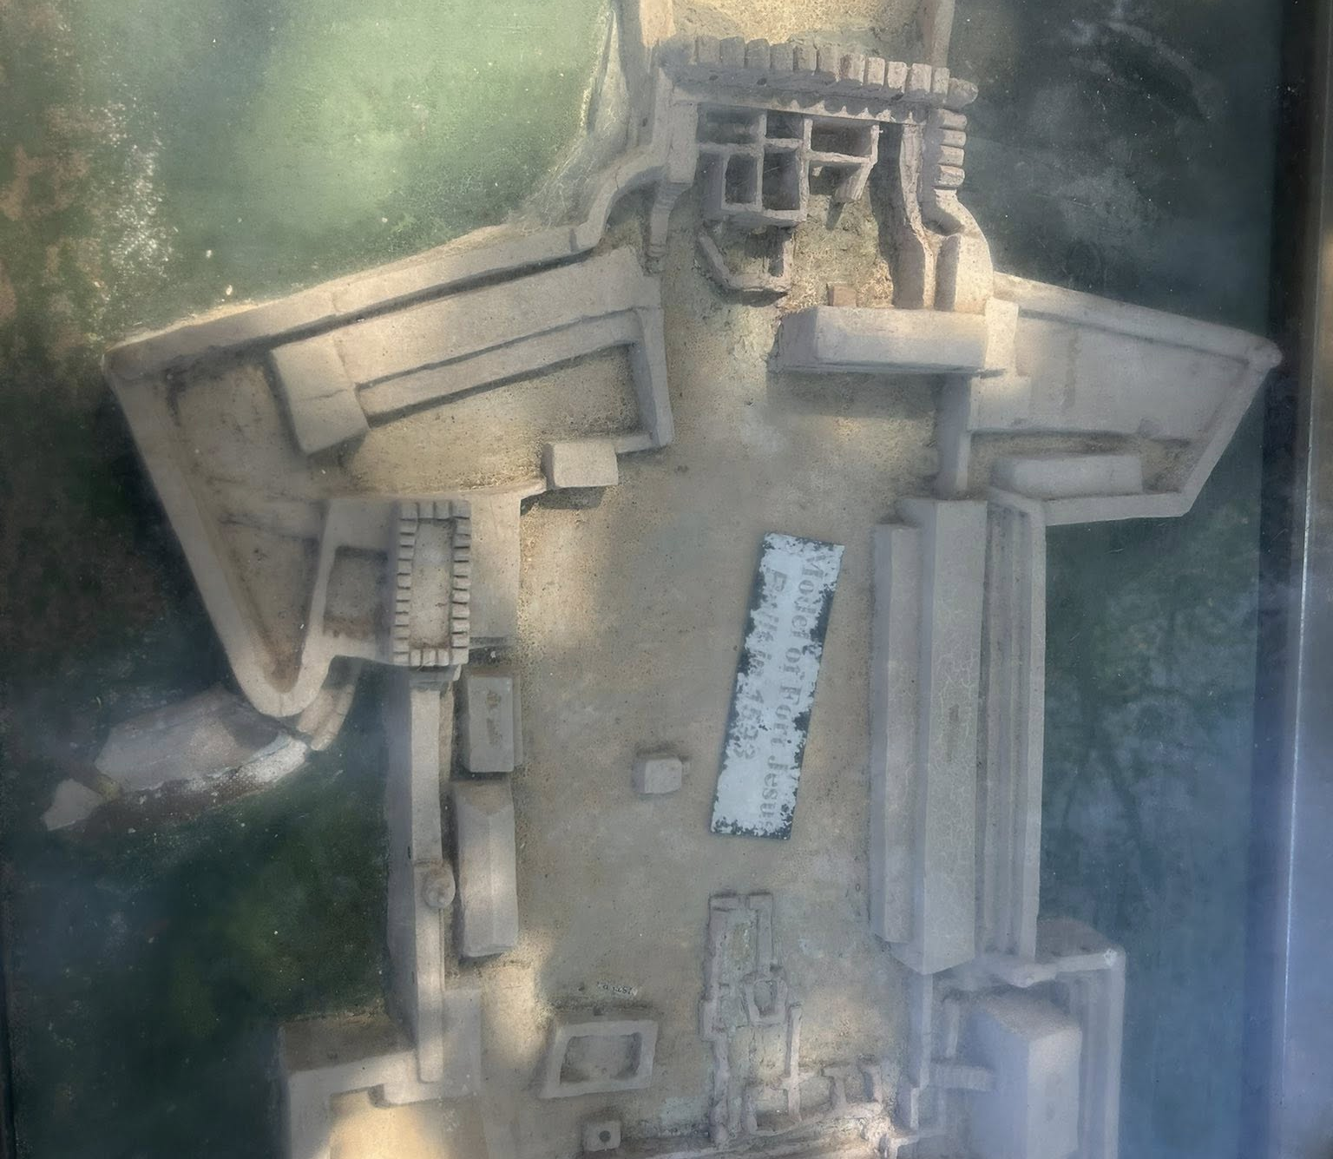
Fort Jesus

Slide 23
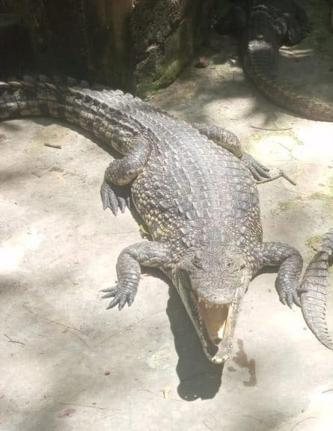

Wildlife

Slide 24



Mombasa Beach

Slide 25
Reflections
Stephen Said:
1. Materialism – love things use people
2. Xenophobia – racial, cultural, positional superiority over others
Luke 16:1-15 – You cannot serve two masters

Slide 26
Reflect
You cannot serve two masters:
What is the process I need to engage, to ensure I have my priorities straight?

