Slide 1


Slide 2
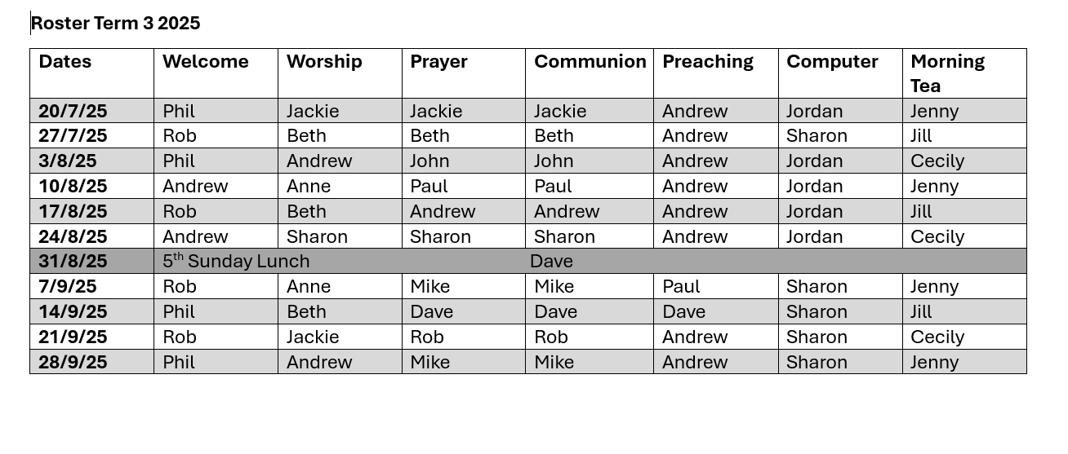
Rosters

Slide 3


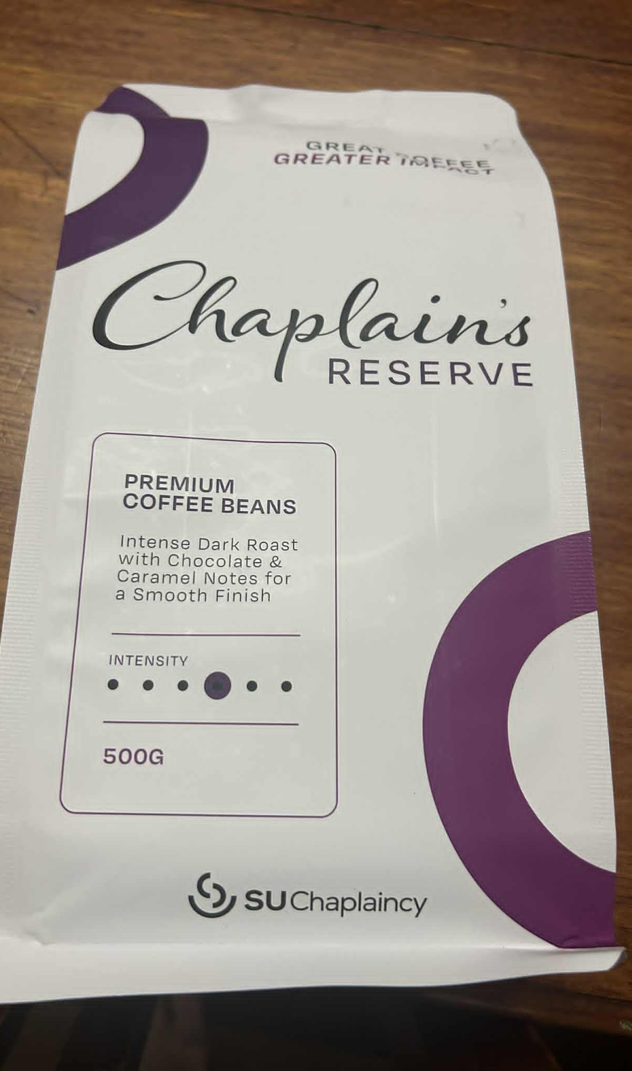



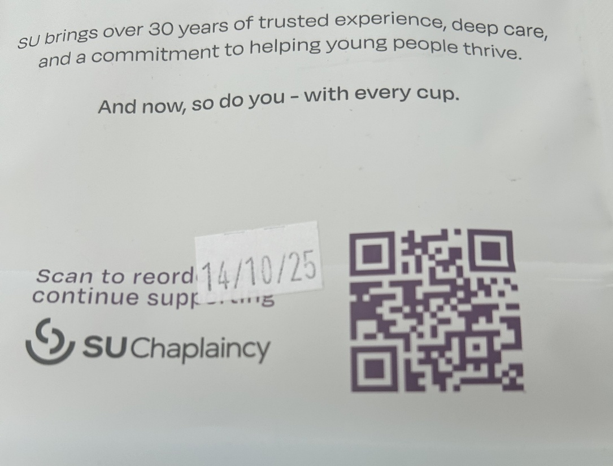

Coffee for SU Chaplaincy

Slide 4
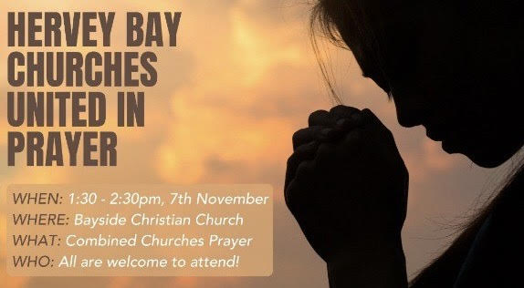

Slide 5
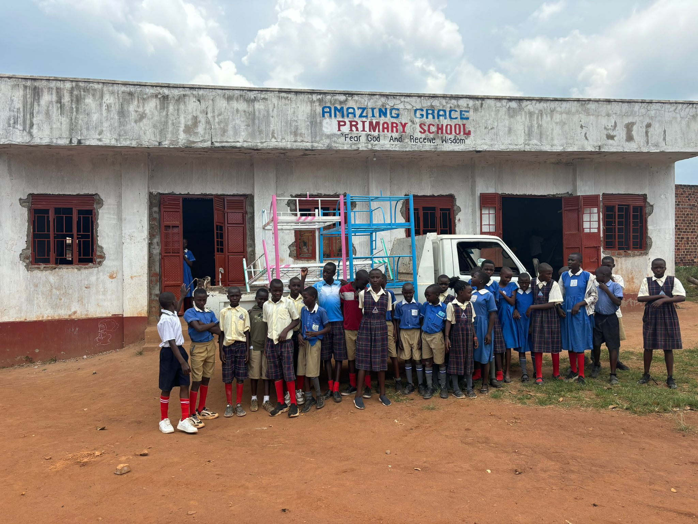
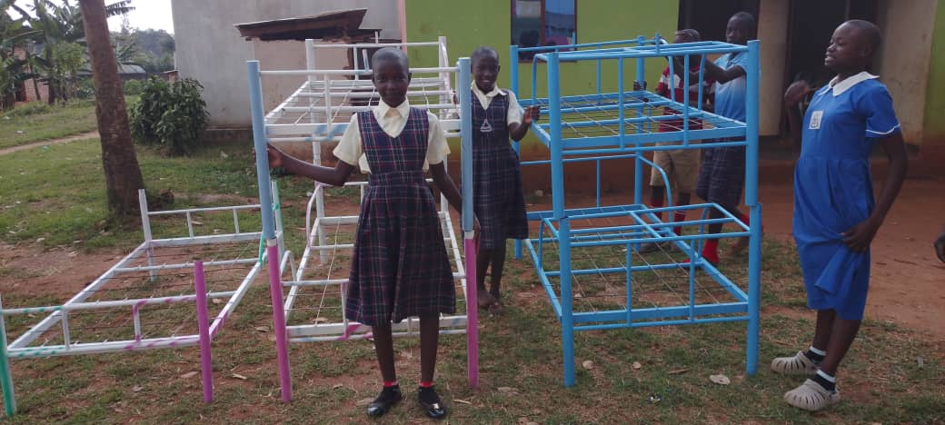
Beds for orphans
Need $500 more

Slide 6
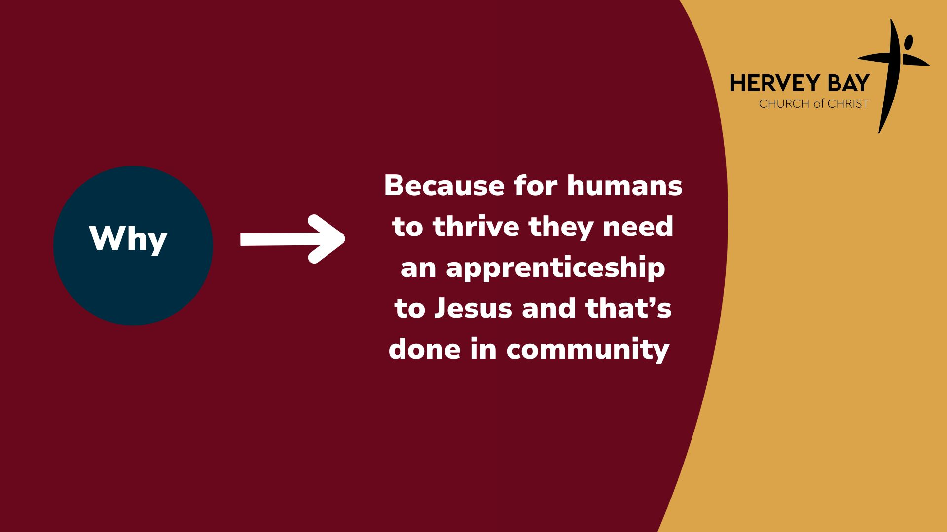

Slide 7
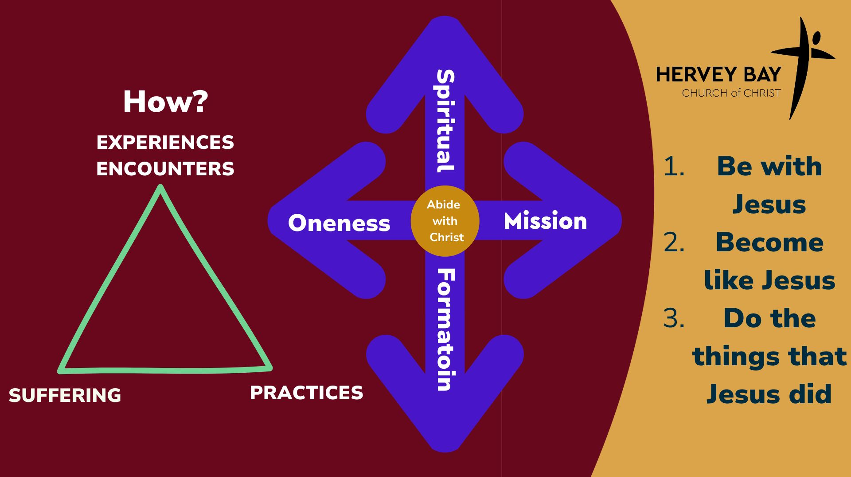

Slide 8


Slide 9


Slide 10

What is your day to day context?
Where have you seen God at work there?
How can we pray with you?

