Slide 1


Slide 2
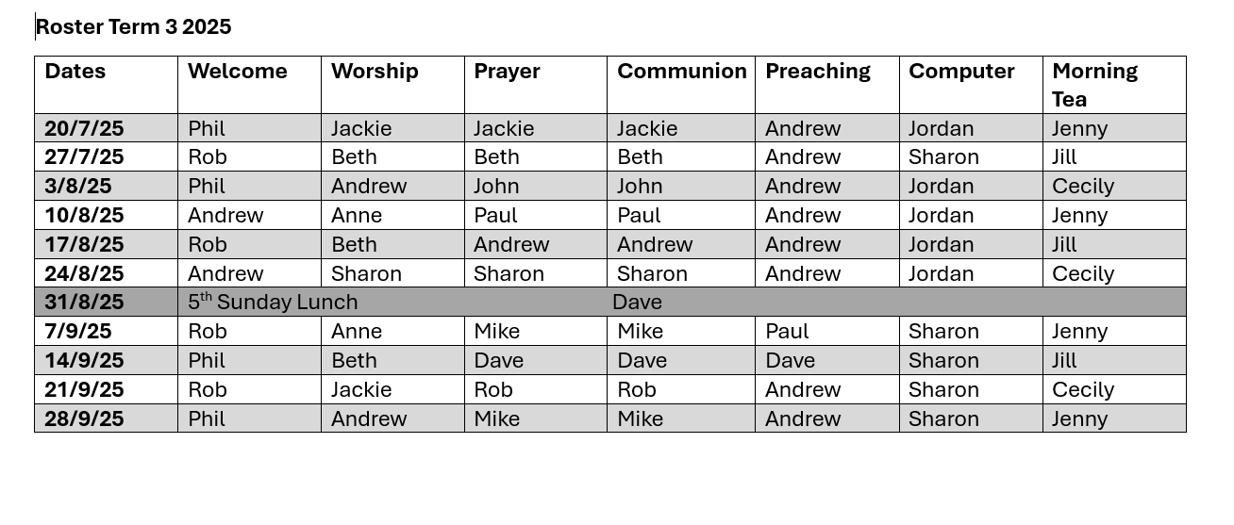
Rosters

Slide 3


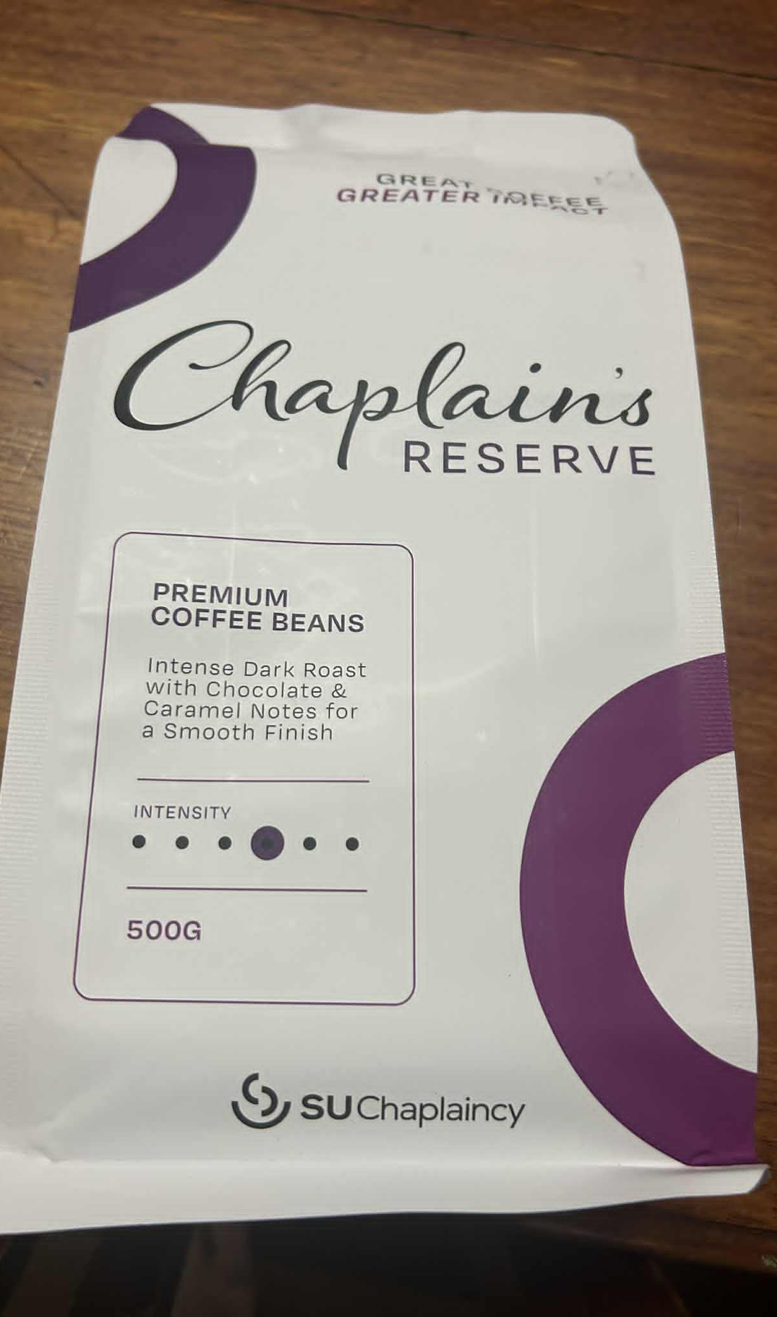



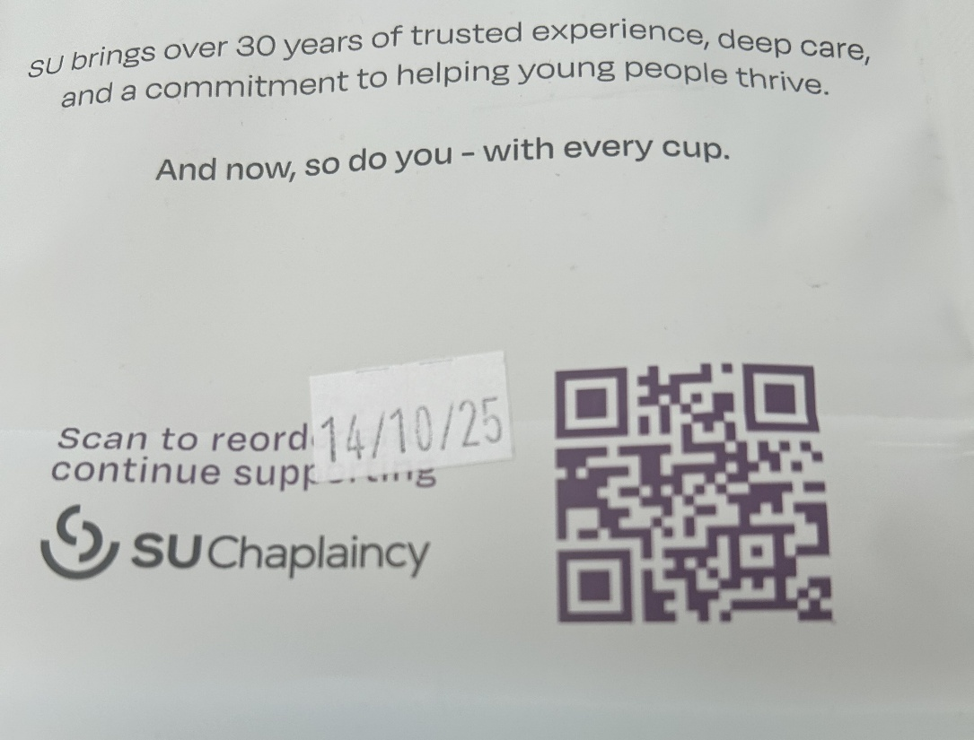

Coffee for SU Chaplaincy

Slide 4
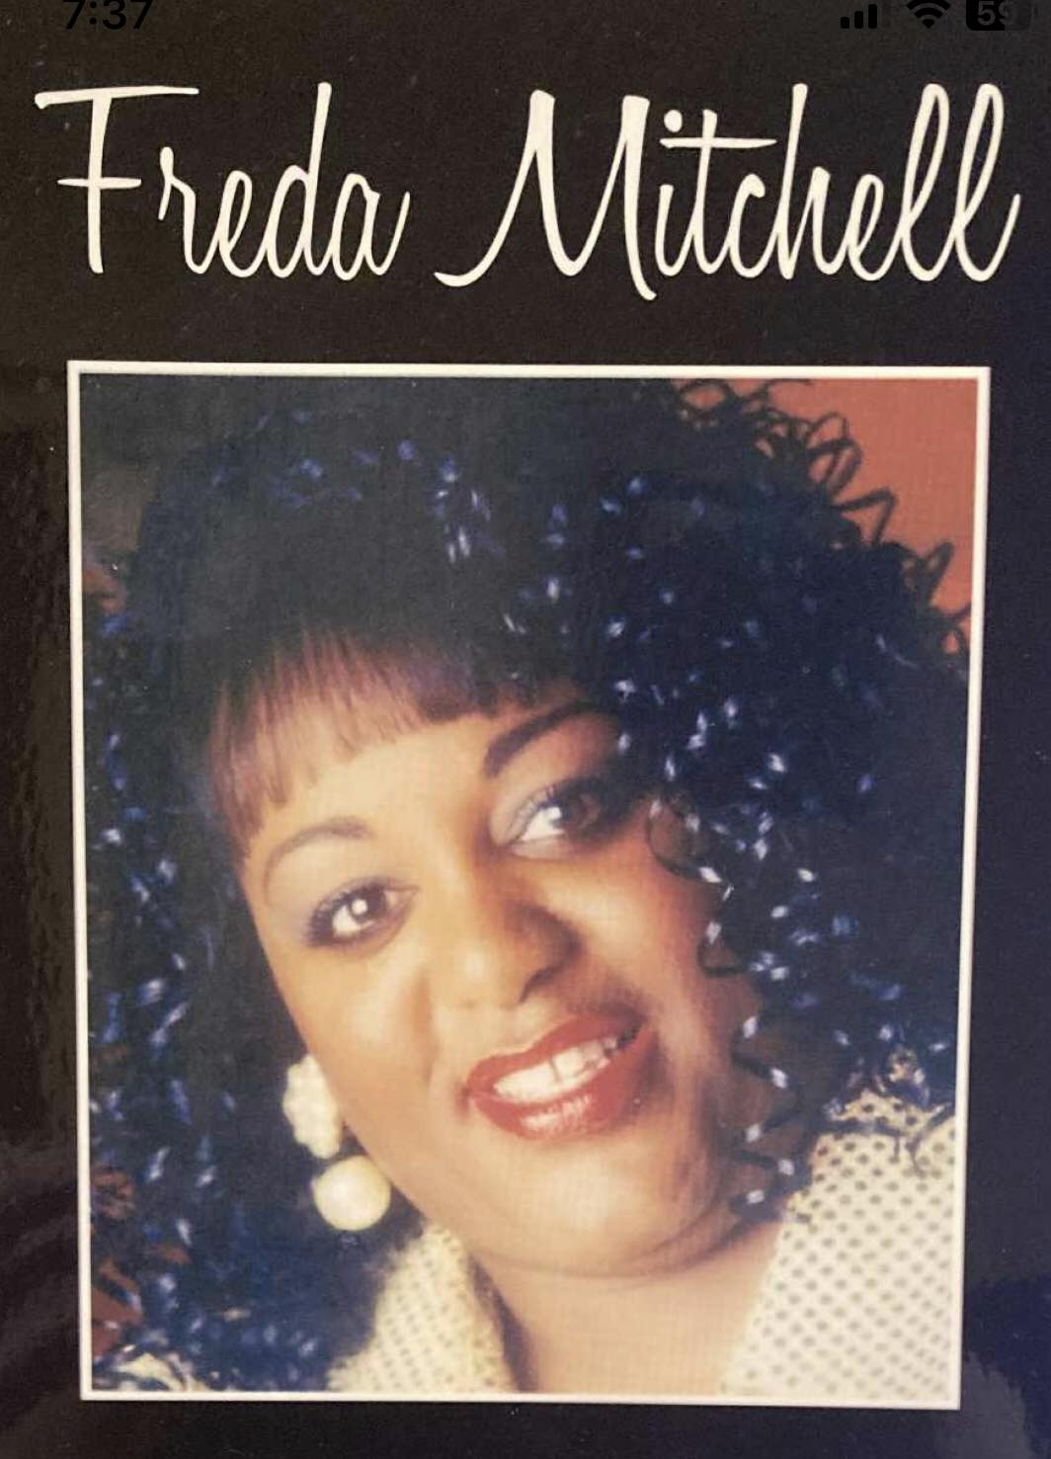
Tuesday 28th – Learn the Choir Parts
Wednesday 29th - Concert

Slide 5
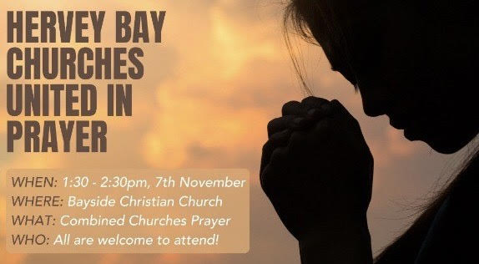

Slide 6
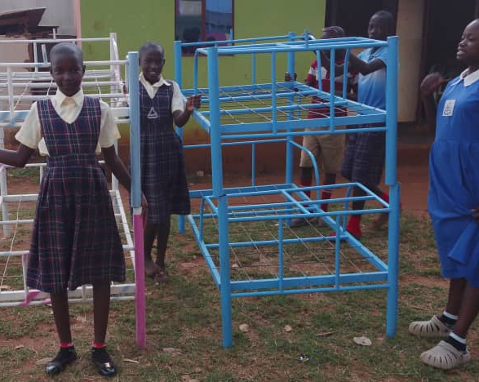
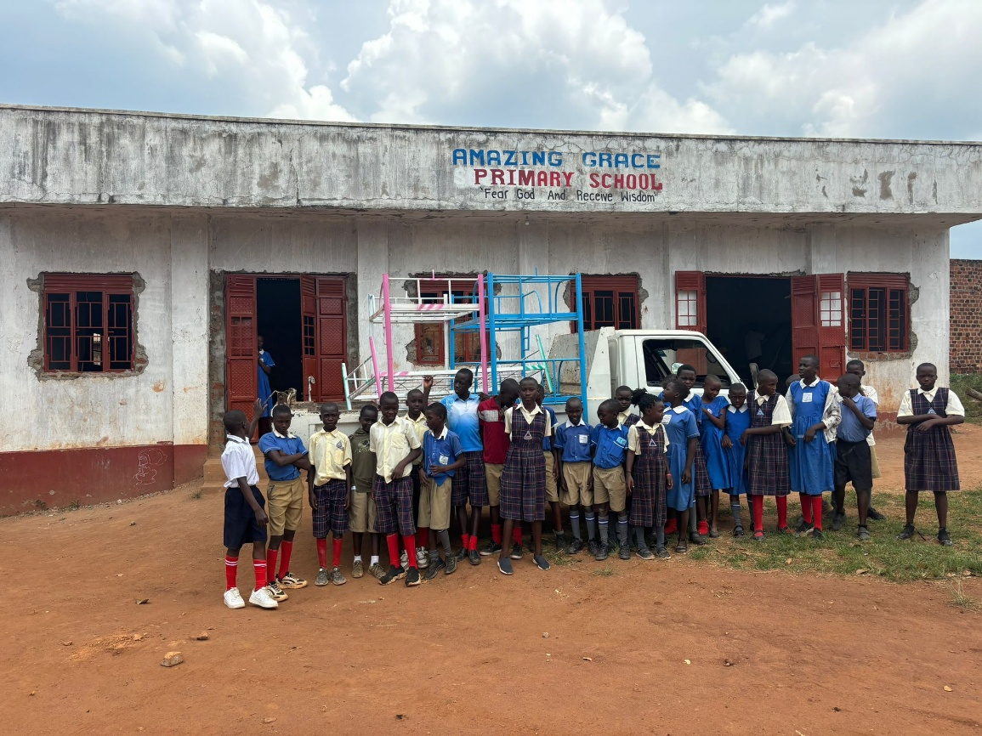
Beds for Orphans
Need $1800 more

Slide 7


Slide 8
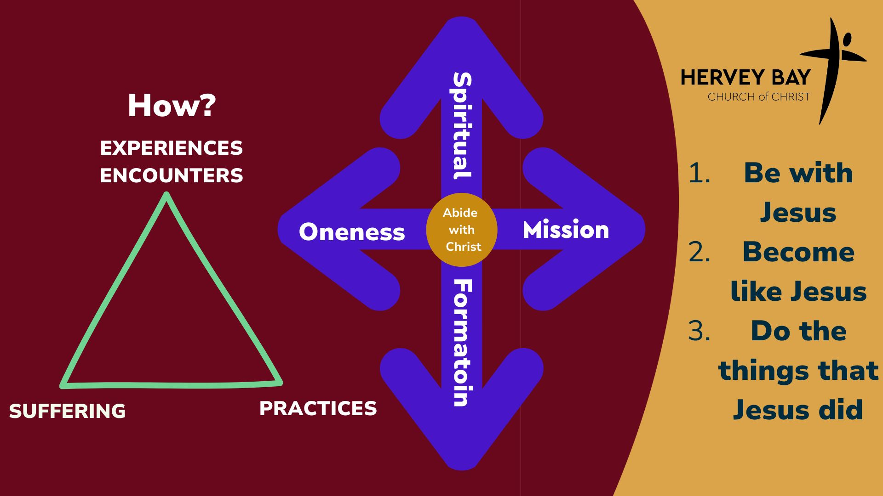

Slide 9


Slide 10


Slide 11

What is your day to day context?
Where have you seen God at work there?
How can we pray with you?

