Slide 1
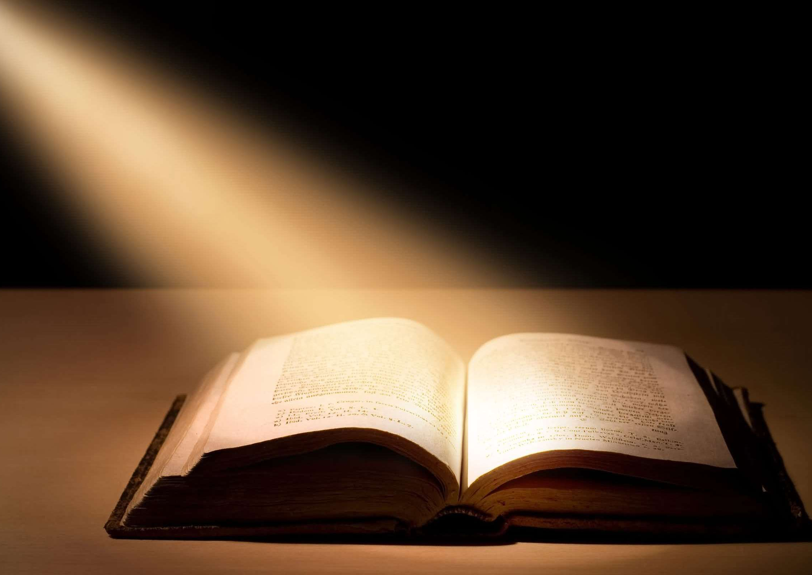
Luke 18:9-14

Slide 2
Luke 18:9-14
To some who were confident of their own righteousness and looked down on everyone else, Jesus told this parable: “Two men went up to the temple to pray, one a Pharisee and the other a tax collector. The Pharisee stood by himself and prayed: ‘God, I thank you that I am not like other people—robbers, evildoers, adulterers—or even like this tax collector. I fast twice a week and give a tenth of all I get.’
“But the tax collector stood at a distance. He would not even look up to heaven, but beat his breast and said, ‘God, have mercy on me, a sinner.’
“I tell you that this man, rather than the other, went home justified before God. For all those who exalt themselves will be humbled, and those who humble themselves wil l be exalted.”

Slide 3
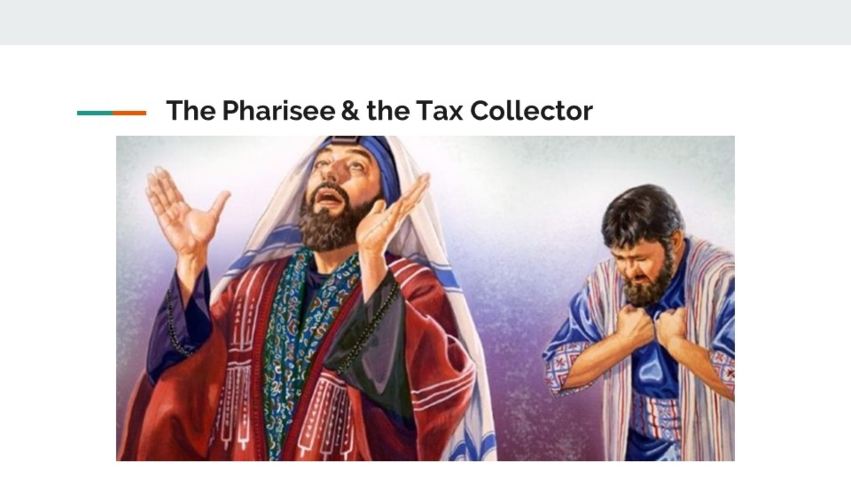

Slide 4
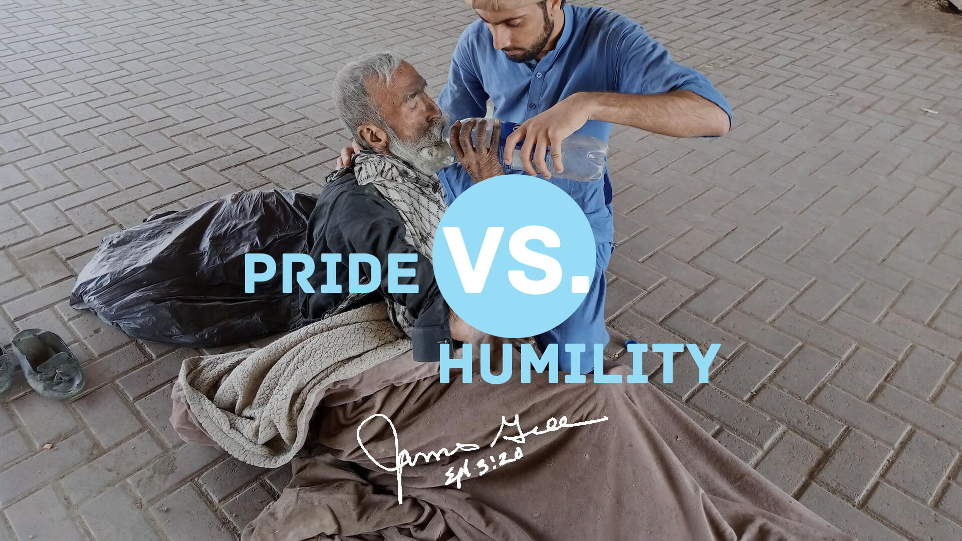

Slide 6
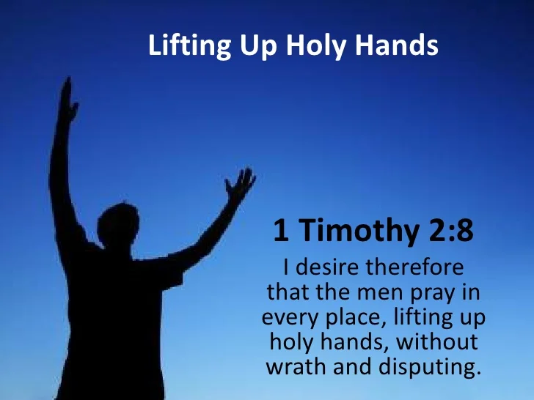
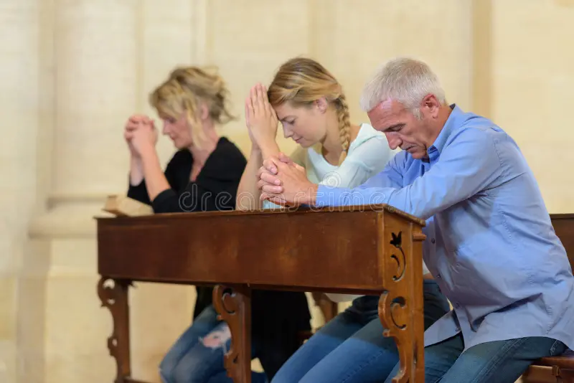
Prayer as an act of Humility

Slide 8
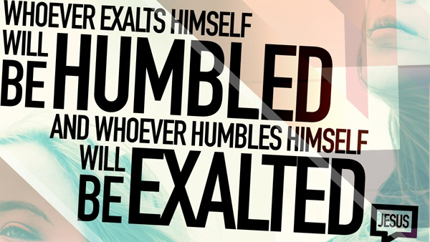

Slide 9
10 signs of a self-righteous person
1. Makes others feel inferior
2. Display their good works
3. Uncompassionate
4. Hates and condemns sinners
5. Approval addict
6. Keeps score
7. Confuses correction with rejection
8. Knows better than God
9. Think of themselves as important – God needs me
10. Wallows in self-pity

Slide 10
Signs of a humble person
• Admits mistakes
• Puts others first
Is respectful
• Shows gratitude
• Is a good listener
• Shows empathy
• Non-judgmental
• A team player

Slide 11


Slide 12
Parable

Slide 13
Reflect

