Slide 1

Luke 18:1-8
Pray and keep Praying

Slide 2
Luke 18:1-8
Jesus told them a parable, about how they should always pray and not give up.
2 “There was once a judge in a certain town,” he said, “who didn’t fear God, and didn’t have any respect for people. 3 There was a widow in that town, and she came to him and said, ‘Judge my case! Vindicate me against my enemy!’
4 “For a long time he refused. But, in the end, he said to himself, ‘It’s true that I don’t fear God, and don’t have any respect for people.

Slide 3
Luke 18:1-8
5 But because this widow is causing me a lot of trouble, I will put her case right and vindicate her, so that she doesn’t end up coming and giving me a black eye.’
6 “Well,” said the master, “did you hear what this unjust judge says? 7 And don’t you think that God will see justice done for his chosen ones, who shout out to him day and night? Do you suppose he is deliberately delaying? 8 Let me tell you, he will vindicate them very quickly. But—when the son of man comes, will he find faith on the earth?”

Slide 4
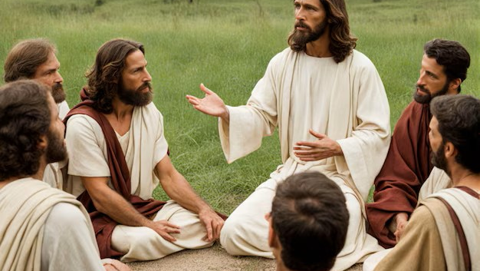
What do you think Jesus is asking?

Slide 5

Have you ever wrestled with God?

Slide 6
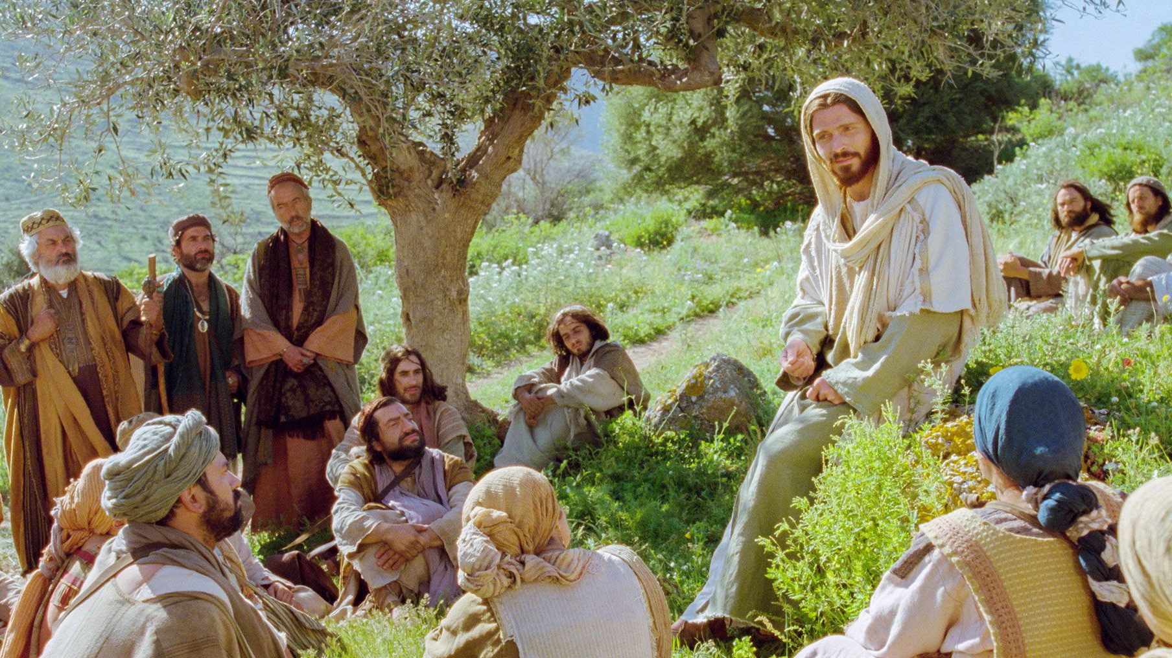

Slide 7
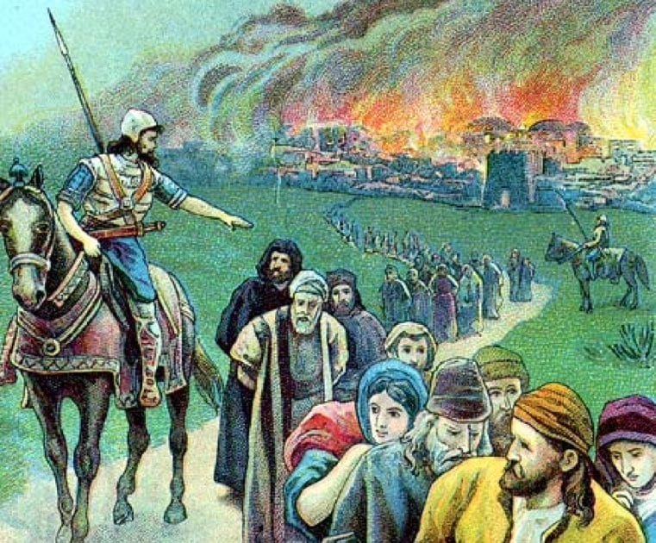
Centuries of Oppression

Slide 8


Slide 9
Martin Luther
“We don’t pray persistently to overcome God’s reluctance but to lay a hold of his willingness.”

Slide 10
How long, Oh Lord??!!

Slide 11
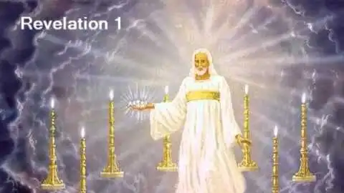

Slide 12
Will the Son of Man find faith on the Earth when he comes?

Slide 13
What’s the faith the son of man is looking for?

Slide 14


Slide 15
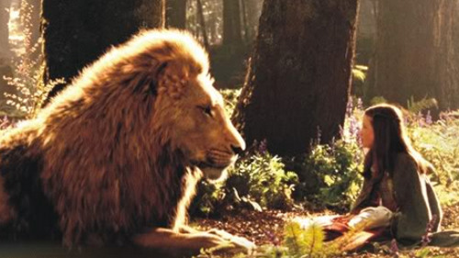

Slide 16

What is God’s invitation to you in this?

Slide 17


Slide 18


Slide 19
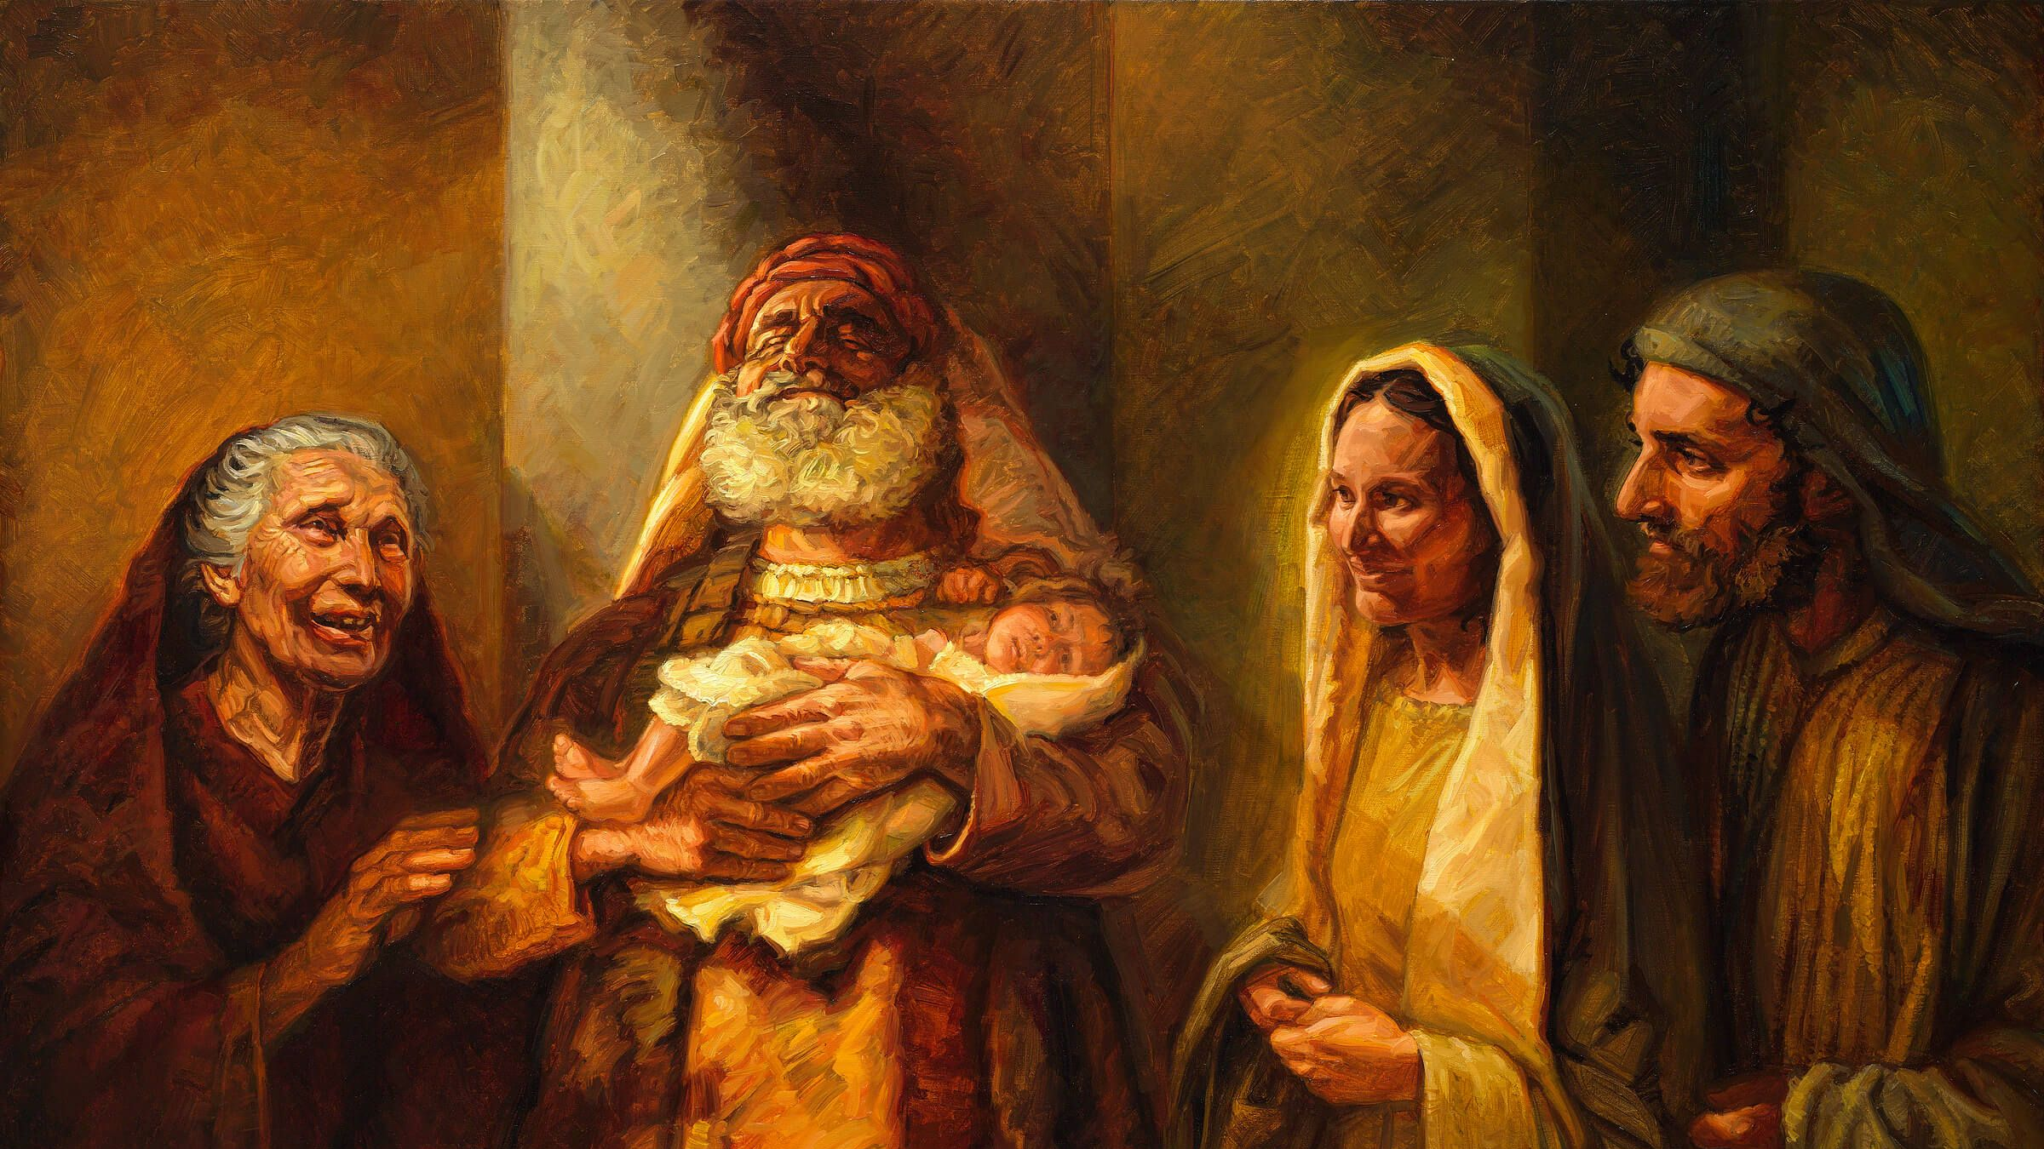

Slide 20
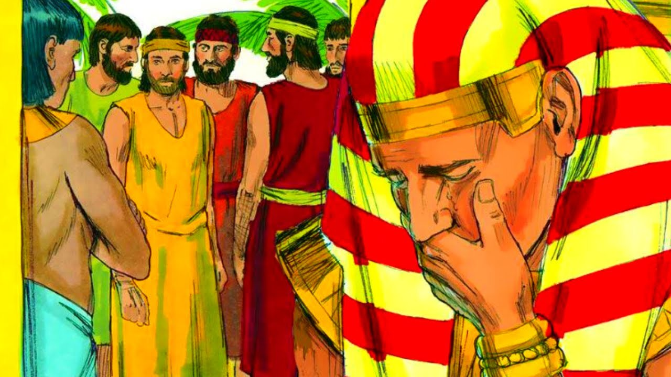

Slide 21
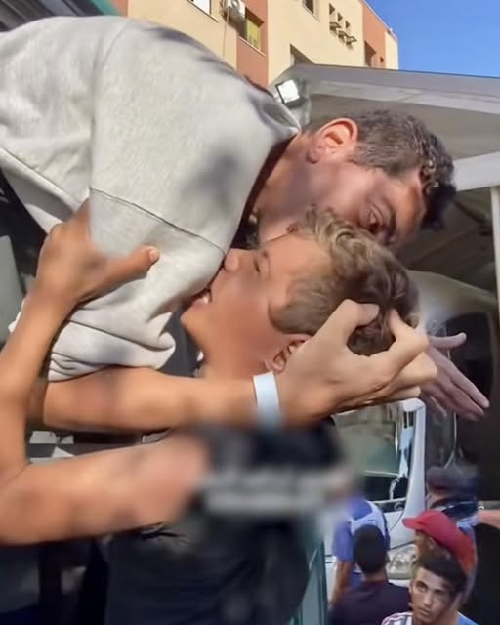
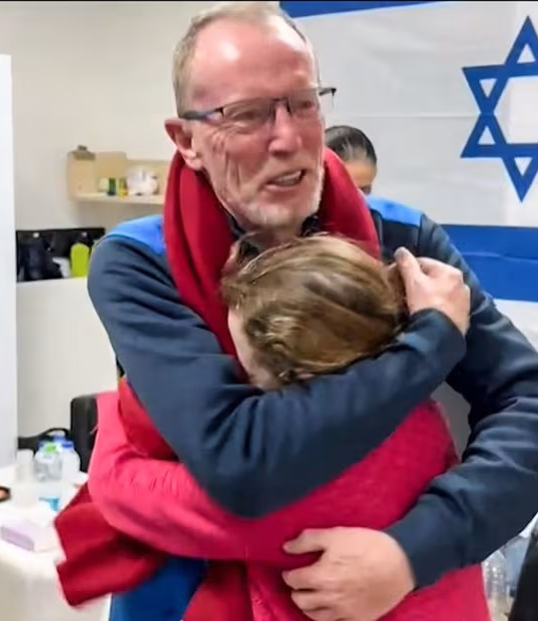
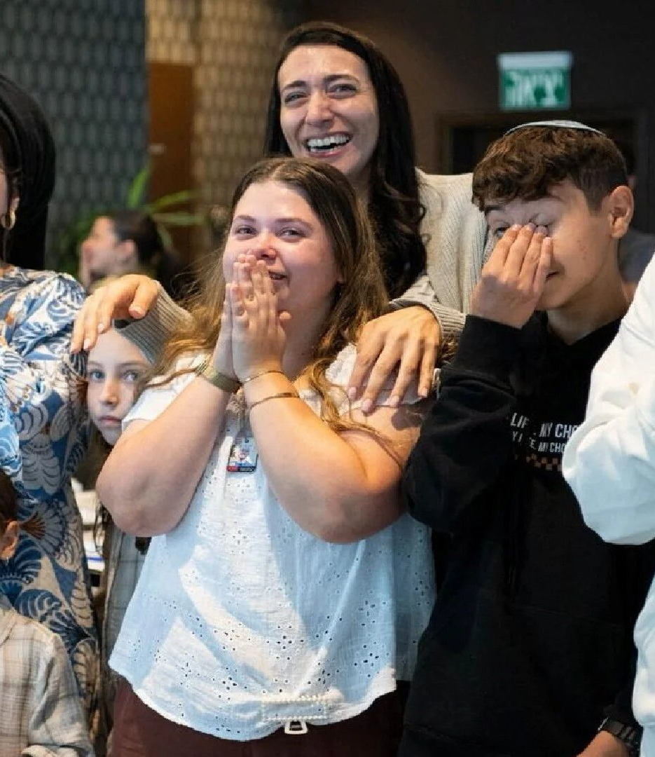

Slide 22
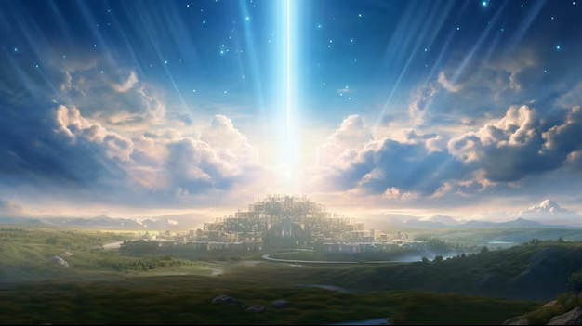
Don’t lose heart

Slide 23
Reflect

