Slide 1


Slide 2







Slide 3
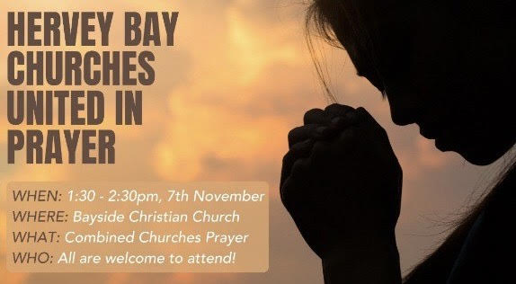

Slide 4
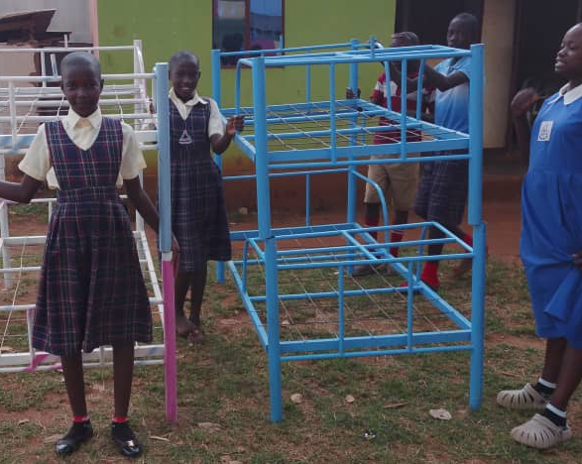
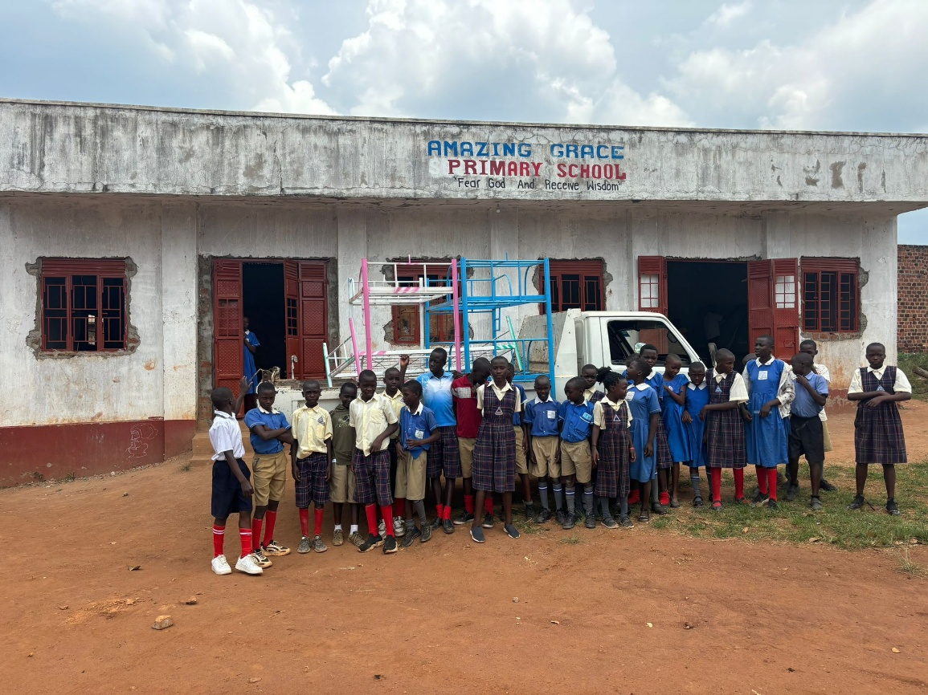
Beds for Orphans
Need $1800 more

Slide 5


Slide 6
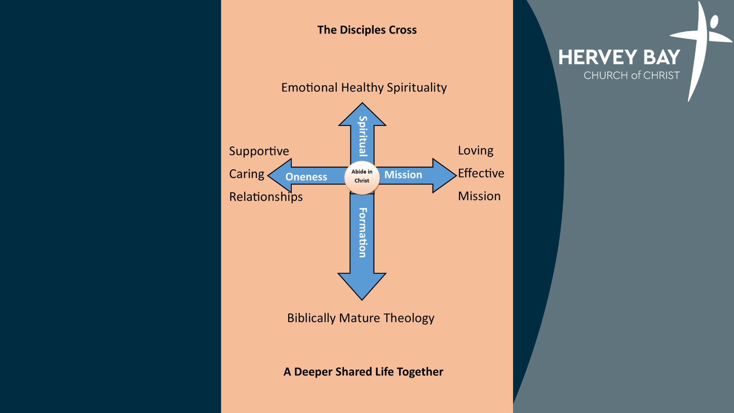

Slide 7

What is your day to day context?
Where have you seen God at work there?
How can we pray with you?

