Slide 1
Christ is King
Cosmic Christ
Luke 23:32-43

Slide 2
Isaiah 53:12
Luke 23:32
….because he poured out his life unto death,
and was numbered with the transgressors.
Two other men, both criminals, were also led out with him to be executed.

Slide 3
Zechariah 12:10
Luke 23:27,33
They will look on me, the one they have pierced, and they will mourn for him as one mourns for an only child, and grieve bitterly for him as one grieves for a firstborn son.
A large number of people followed him, including women who mourned and wailed for him…..
When they came to the place called the Skull, they crucified him there, along with the criminals – one on his right, the other on his left.

Slide 4
Psalm 22:18
Luke 23:34
They divide my clothes among them
and cast lots for my garment.
Jesus said, ‘Father, forgive them, for they do not know what they are doing.’ And they divided up his clothes by casting lots.

Slide 5
Psalm 22:7
PsAlm 109:25
Luke 23:35
All who see me mock me;
they hurl insults, shaking their heads.
I am an object of scorn to my accusers;
when they see me, they shake their heads
The people stood watching, and the rulers even sneered at him. They said, ‘He saved others; let him save himself if he is God’s Messiah, the Chosen One.’

Slide 6
Psalm 69:25
Luke 23:36
They gave me wine vinegar for my thirst.
The soldiers also came up and mocked him. They offered him wine vinegar

Slide 7
Zechariah 14:9
Psalm 72:11
Isaiah 9:6
The Lord will be king over the whole earth. On that day there will be one Lord, and his name the only name.
…all kings bow down to him
and all nations serve him.
…the government will be on his shoulders.

Slide 8
Luke 23:37-38
And (they) said, ‘If you are the king of the Jews, save yourself.’
There was a written notice above him, which read: this is the king of the jews.

Slide 9
Isaiah 53:3-6
He was despised and rejected by mankind, a man of suffering, and familiar with pain. Like one from whom people hide their faces he was despised, and we held him in low esteem.
Surely, he took up our pain and bore our suffering, yet we considered him punished by God, stricken by him, and afflicted.
But he was pierced for our transgressions, he was crushed for our iniquities; the punishment that brought us peace was on him, and by his wounds we are healed. We all, like sheep, have gone astray, each of us has turned to our own way; and the Lord has laid on him the iniquity of us all.

Slide 10
Luke 23:39-41
One of the criminals who hung there hurled insults at him: ‘Aren’t you the Messiah? Save yourself and us!’
But the other criminal rebuked him. ‘Don’t you fear God,’ he said, ‘since you are under the same sentence? We are punished justly, for we are getting what our deeds deserve. But this man has done nothing wrong.’

Slide 11
Psalm 16:11
Luke 23:42-43
you will fill me with joy in your presence,
with eternal pleasures at your right hand.
Then he said, ‘Jesus, remember me when you come into your kingdom.’
Jesus answered him, ‘Truly I tell you, today you will be with me in paradise.’

Slide 12
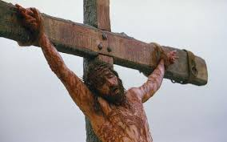
Christ the king?

Slide 13
1 Corinthians 2:6-8
We do, however, speak a message of wisdom among the mature, but not the wisdom of this age or of the rulers of this age, who are coming to nothing. No, we declare God’s wisdom, a mystery that has been hidden and that God destined for our glory before time began. None of the rulers of this age understood it, for if they had, they would not have crucified the Lord of glory.

Slide 14
Atonement Theories
Penal
Substitutionary
Atonement

Slide 15

Atonement Theories
???Penal???
Substitutionary
Atonement

Slide 16
Atonement Theories
Medical
Substitutionary
Atonement

Slide 17
Atonement Theories
Christus
Victor

Slide 18

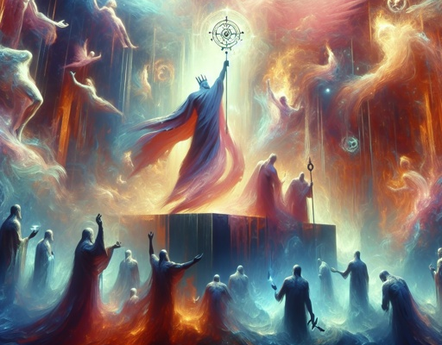
Colossians 2:15
And having disarmed the powers and authorities, he made a public spectacle of them, triumphing over them by the cross.

Slide 19
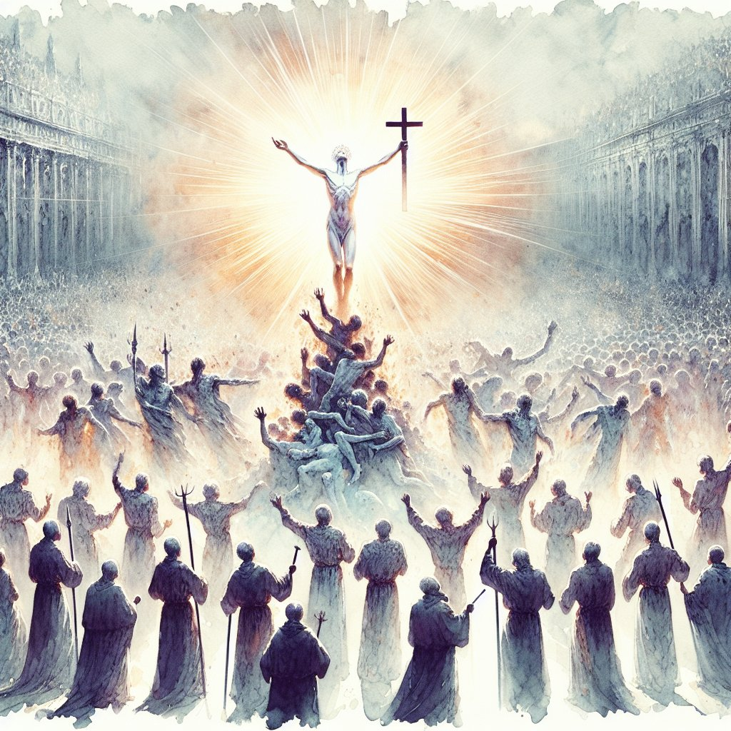
1 Peter
1 Peter 3:18-22
For Christ also suffered once for sins, the righteous for the unrighteous, to bring you to God. He was put to death in the body but made alive in the Spirit. After being made alive, he went and made proclamation to the imprisoned spirits— to those who were disobedient long ago when God waited patiently in the days of Noah while the ark was being built. In it only a few people, eight in all, were saved through water, and this water symbolizes baptism that now saves you also—not the removal of dirt from the body but the pledge of a clear conscience toward God. It saves you by the resurrection of Jesus Christ, who has gone into heaven and is at God’s right hand—with angels, authorities and powers in submission to him.

Slide 20
at the cross…
Insight | Scripture | Theory
God’s nature revealed | Rom 5:8; John 14:7-10 | Non-Violent Atonement
Reconciles to Himself | 2 Cor 5:18-19; Col 1:20-22 | Penal Substitutionary Atonement
Forgive sins and bought back | Acts 13:38; Eph 1:7 | Ransom Theory
Healed from our sin-disease nature | 1 Pet 2:24 | Medical Substitutionary Atonement
Empowers us to live with and like Him | Rom 8:2-16; Eph 5:1-2; 1 Pet 2:21 | Moral Exemplar
Defeats evil powers and sets up His Kingdom | John 12:31; 1 John 3:8; Heb 2:14-15; 1 Cor 15:25 | Christus Victor

Slide 21
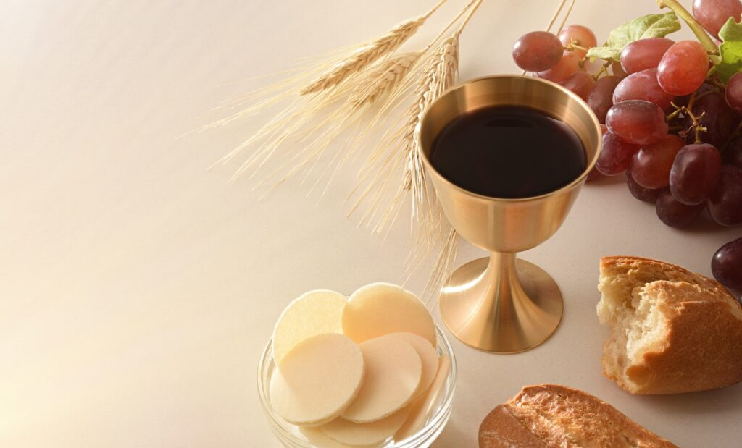
Not a theory but a meal

Slide 22
Jesus is Lord

Slide 23
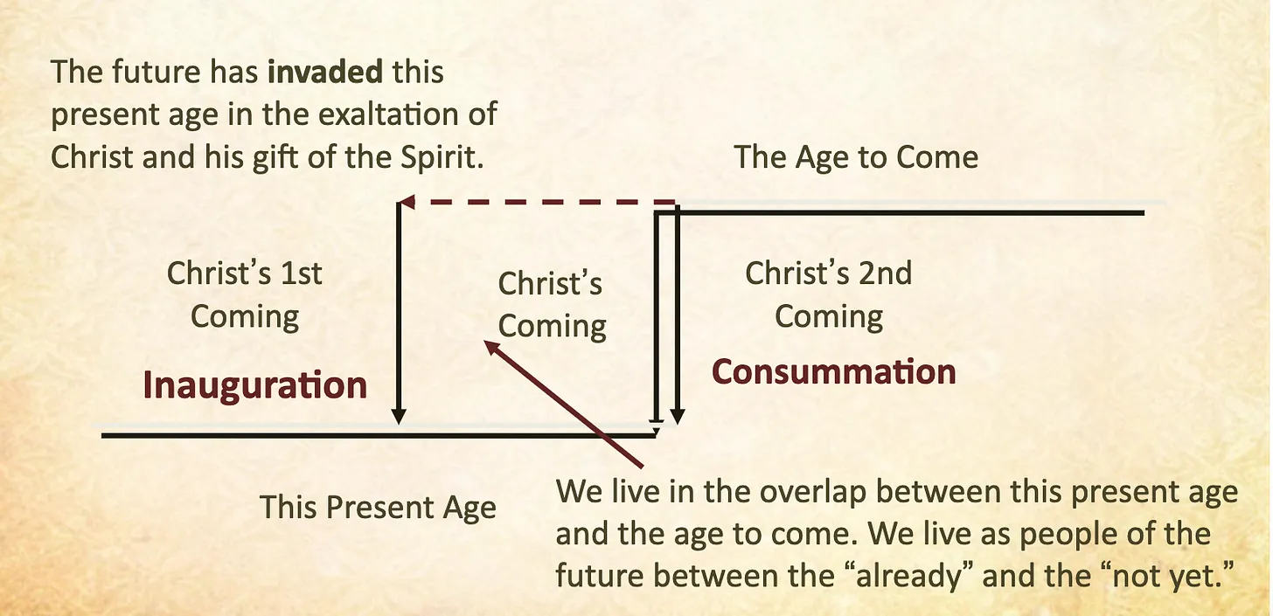
Inaugurated Eschatology

Slide 24
Reflect
How? –
Father forgive them…
Why? –
Sin; Kingdom; Defeat of Evil
Implications? - Self image; behaviour

