Slide 1
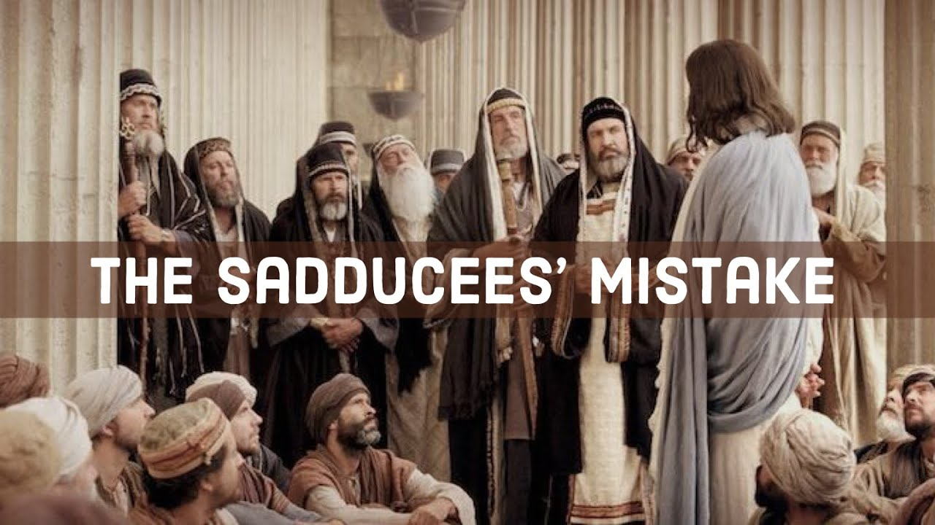

Slide 2
Luke 20:27-32 NIV
Some of the Sadducees, who say there is no resurrection, came to Jesus with a question. “Teacher,” they said, “Moses wrote for us that if a man’s brother dies and leaves a wife but no children, the man must marry the widow and raise up offspring for his brother. Now there were seven brothers. The first one married a woman and died childless. The second and then the third married her, and in the same way the seven died, leaving no children. Finally, the woman died too. Now then, at the resurrection whose wife will she be, since the seven were married to her?”

Slide 3
Luke 20:34-40 NIV
Jesus replied, “The people of this age marry and are given in marriage. But those who are considered worthy of taking part in the age to come and in the resurrection from the dead will neither marry nor be given in marriage, and they can no longer die; for they are like the angels. They are God’s children, since they are children of the resurrection. But in the account of the burning bush, even Moses showed that the dead rise, for he calls the Lord ‘the God of Abraham, and the God of Isaac, and the God of Jacob.’ He is not the God of the dead, but of the living, for to him all are alive.”
Some of the teachers of the law responded, “Well said, teacher!” And no one dared to ask him any more questions.

Slide 4
Luke 20:27-33 MSG
Some Sadducees came up. This is the Jewish party that denies any possibility of resurrection. They asked, “Teacher, Moses wrote us that if a man dies and leaves a wife but no child, his brother is obligated to marry her and give her children. Well, there once were seven brothers. The first took a wife. He died childless. The second married her and died, then the third, and eventually all seven had their turn, but no child. After all that, the wife died. That wife, now—in the resurrection whose wife is she? All seven married her.”

Slide 5
Luke 20:34-40 MSG
Jesus said, “Marriage is a major preoccupation here, but not there. Those who are included in the resurrection of the dead will no longer be concerned with marriage nor, of course, with death. They will have better things to think about, if you can believe it. All ecstasies and intimacies then will be with God. Even Moses exclaimed about resurrection at the burning bush, saying, ‘God: God of Abraham, God of Isaac, God of Jacob!’ God isn’t the God of dead men, but of the living. To him all are alive.”
Some of the religion scholars said, “Teacher, that’s a great answer!” For a while, anyway, no one dared put questions to him.

Slide 7
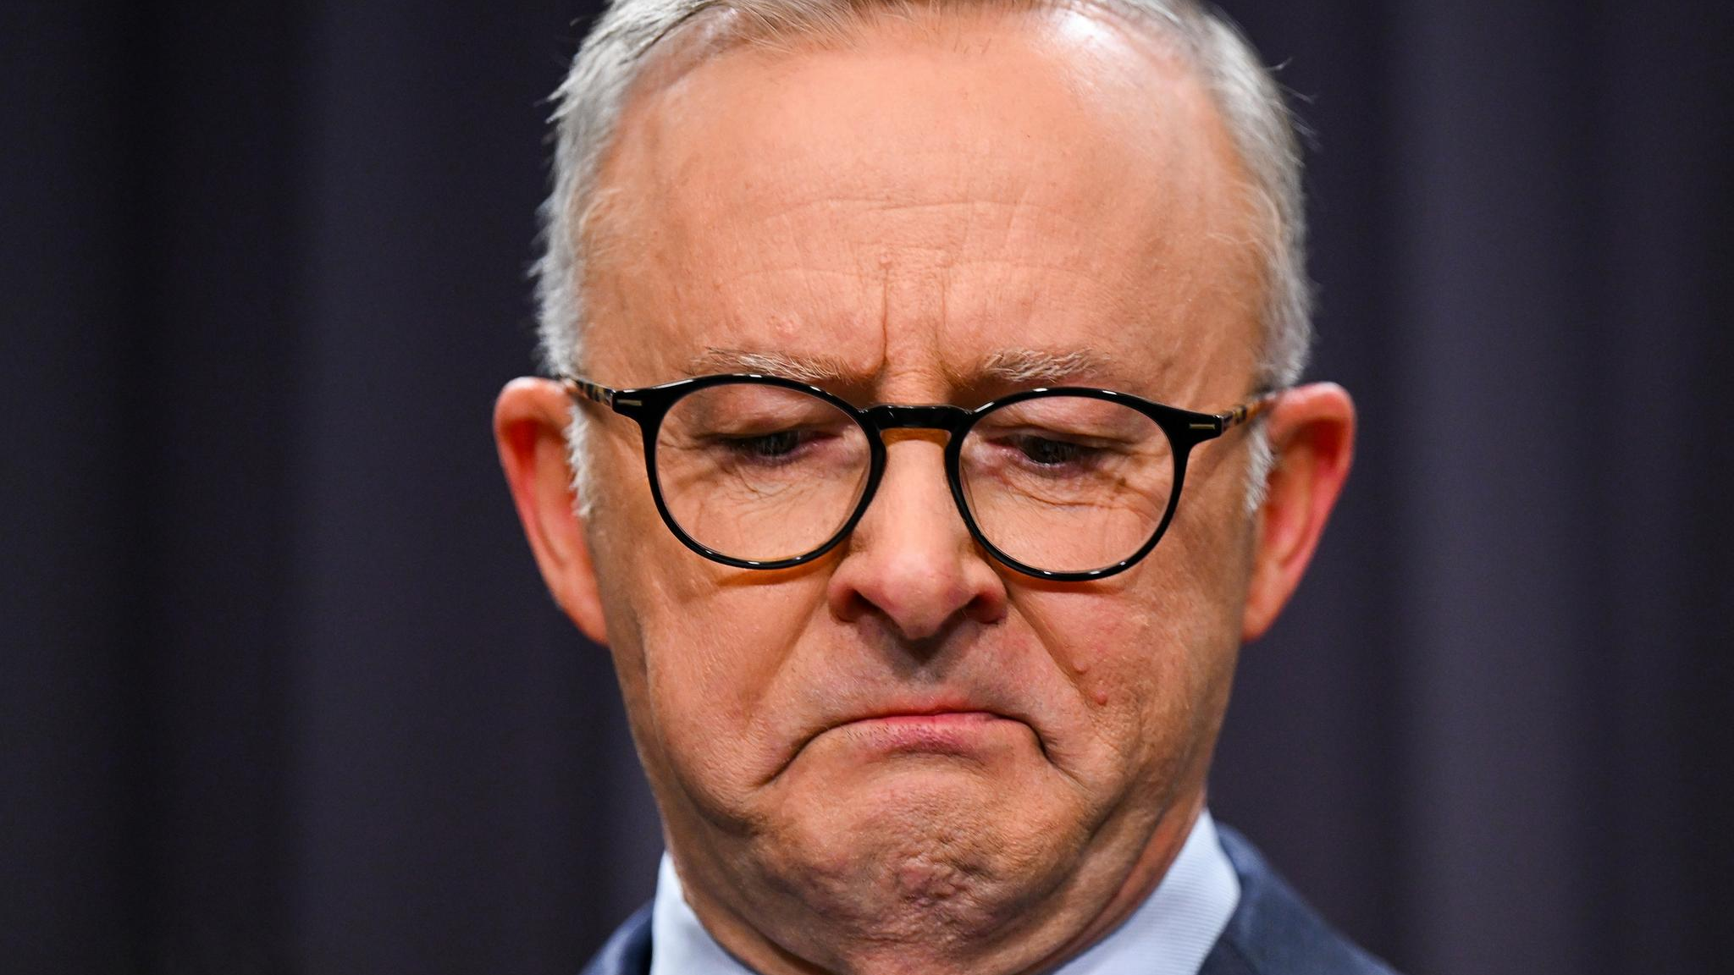

Slide 8
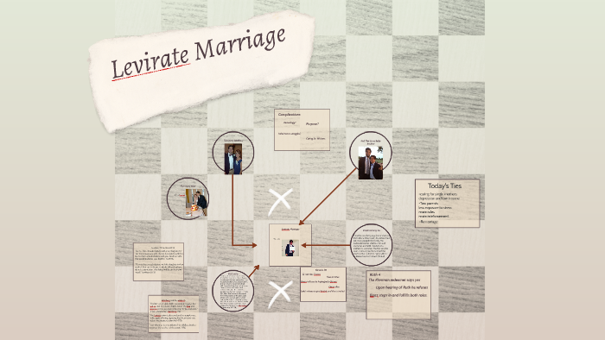

Slide 10


Slide 11
In essentials unity, in matters of opinion diversity and in all things love
We try to make more and more essential
We need everybody to have the same opinion as us

Slide 12


Slide 13


Slide 14
Discipleship, our apprenticeship to Jesus is learning to follow Jesus in this place and time with all of our lives.

Slide 15


Slide 16
Matthew 5:9 Blessed are the peacemakers, for they will be called children of God.
Matthew 10:16 ‘I am sending you out like sheep among wolves. Therefore be as shrewd as snakes and as innocent as doves.
James 1:19 My dear brothers and sisters, take note of this: everyone should be quick to listen, slow to speak and slow to become angry,

Slide 17
John Stott
“People are looking for an integrated world view which makes sense of their existence….Today’s world needs a bigger gospel, the full gospel of Scripture….Tripple listening….is the capacity to be listening to several voices at the same time, the voice of God through the scriptures, the voice of this cultural moment and its driving forces and the voices of men and women around us, voices from the frontlines. These voices will often contradict one another, but our purpose in listening to them all is to discover how they relate to each other. Tripple listening is indispensable to Christian discipleship and mission…”

Slide 18
John Stott
Every true disciple is a listener. One of the most important and neglected ingredients of Christian discipleship is the cultivation of a listening ear. Bad listeners do not make good disciples…James appeal to us to be “quick to listen” is not one we find easy to heed. People prefer to shout at one another than to listen to one another. Yet only when both sides are willing to sit down together, put aside their prejudiced positions and listen does any possibility of reconciliation emerge.”

Slide 19
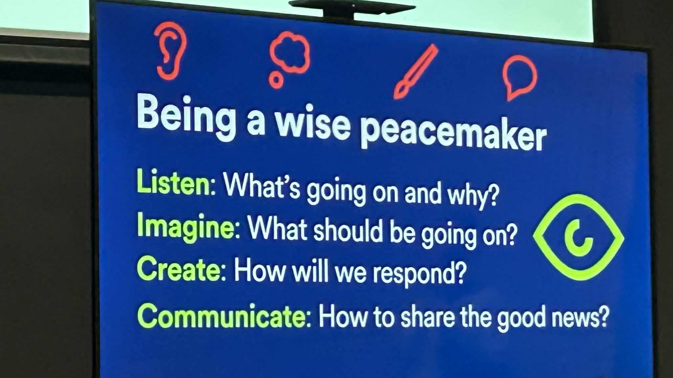

Slide 20
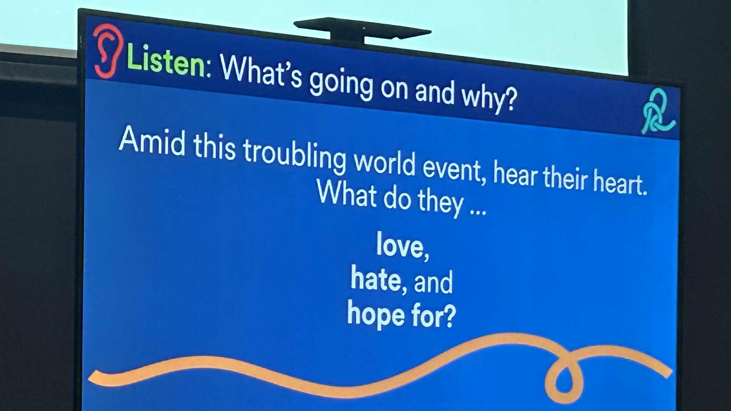

Slide 21
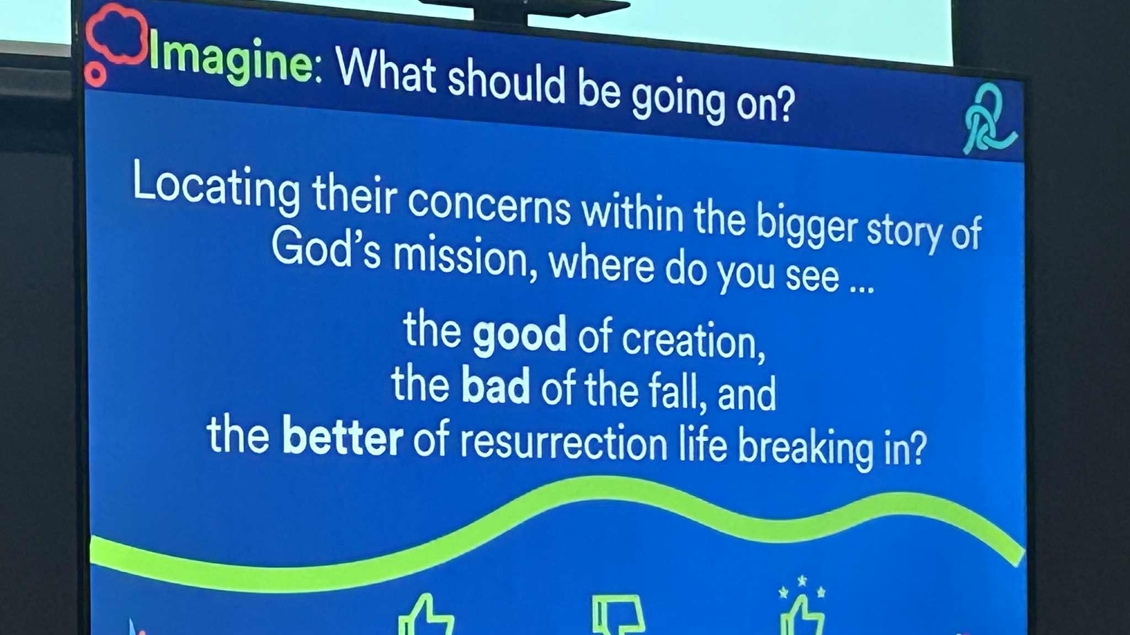

Slide 22
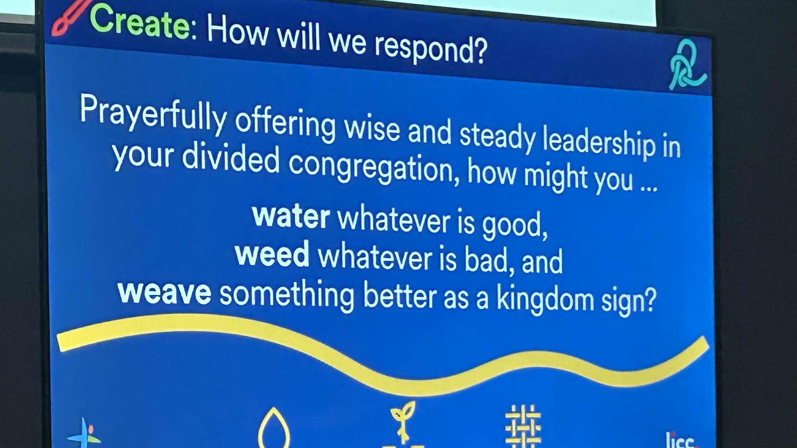

Slide 23
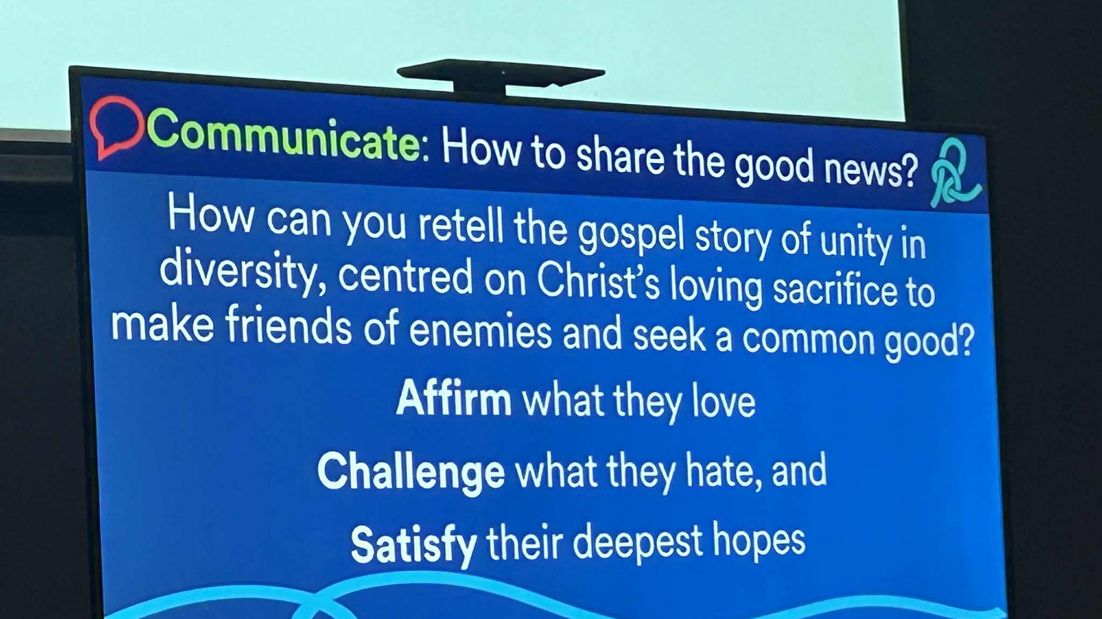

Slide 24
Reflect

