Slide 1

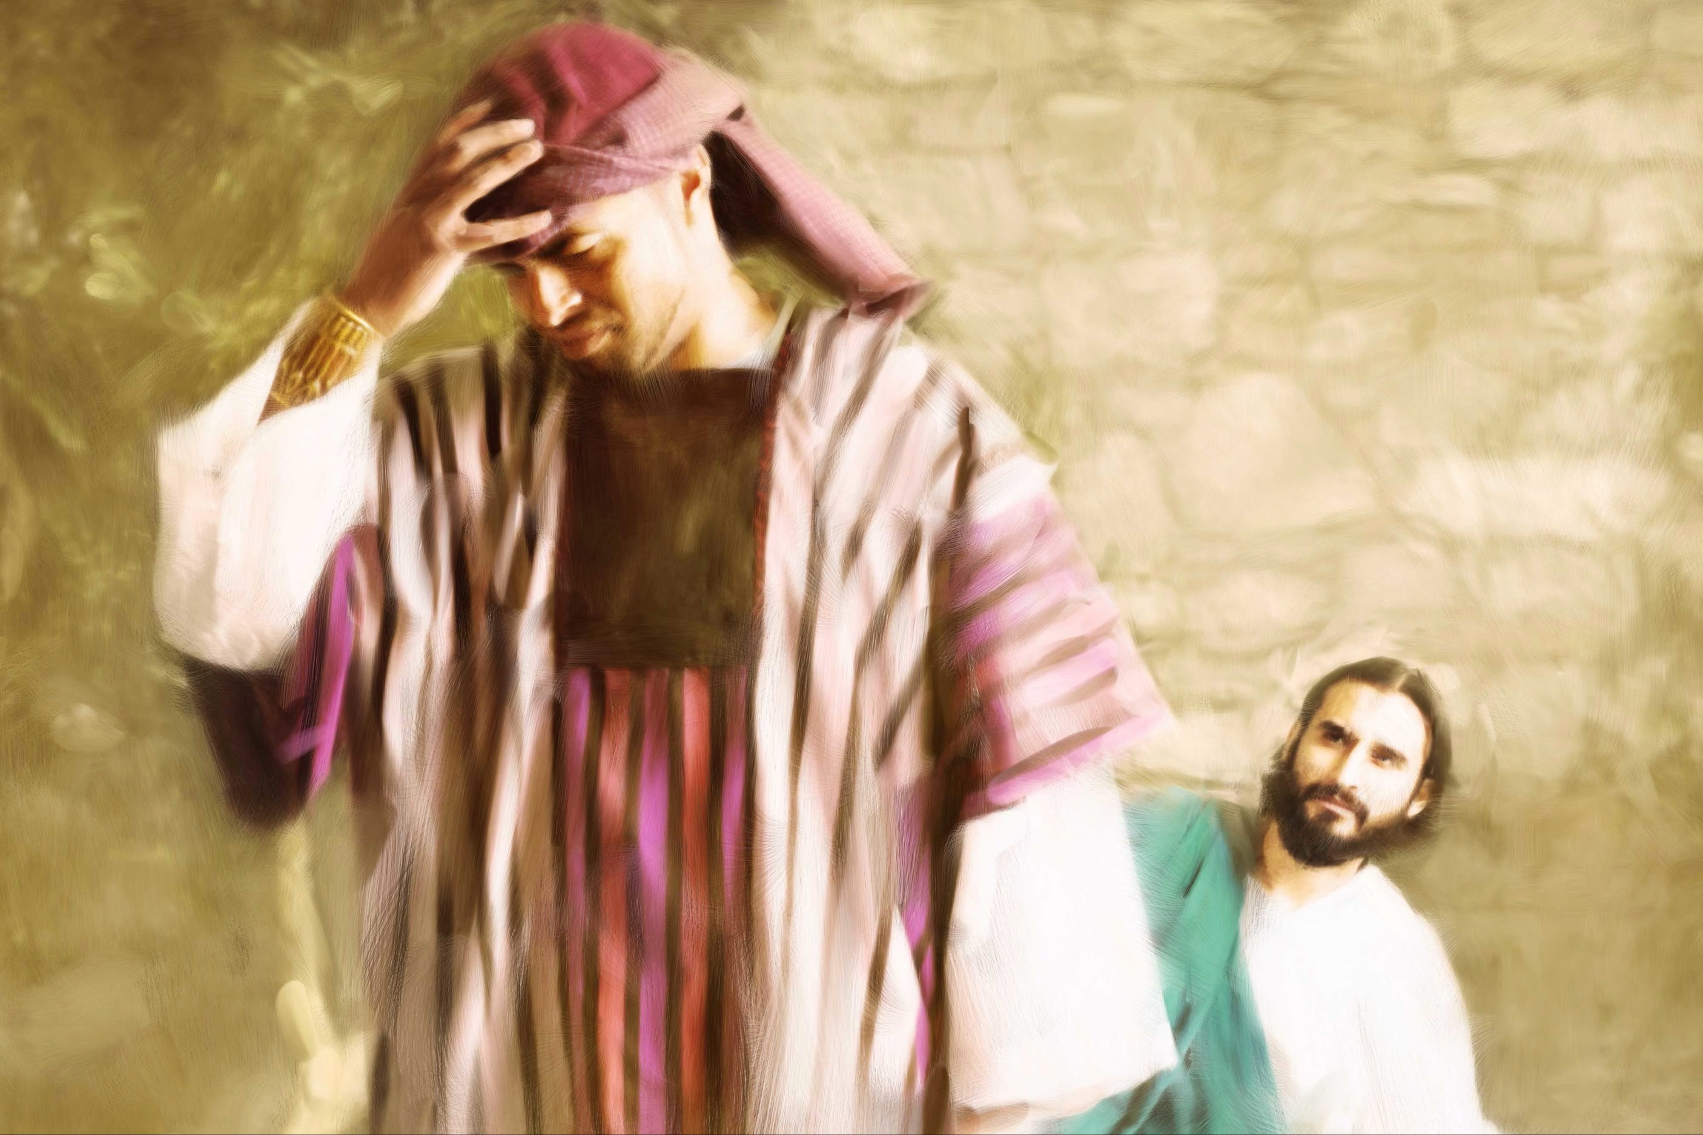
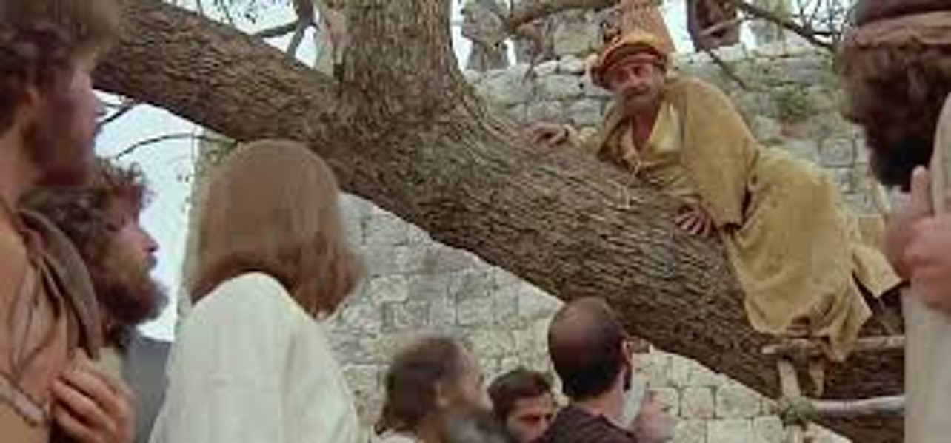
Riches and the Kingdom of God
Luke 18:18-30 and 19:1-10

Slide 2
Luke 18:15-17
People were also bringing babies to Jesus for him to place his hands on them. When the disciples saw this, they rebuked them. But Jesus called the children to him and said, “Let the little children come to me, and do not hinder them, for the kingdom of God belongs to such as these. Truly I tell you, anyone who will not receive the kingdom of God like a little child will never enter it.”

Slide 3
Luke 18:18-23
A certain ruler asked him, “Good teacher, what must I do to inherit eternal life?”
“Why do you call me good?” Jesus answered. “No one is good—except God alone. You know the commandments: ‘You shall not commit adultery, you shall not murder, you shall not steal, you shall not give false testimony, honor your father and mother.’”
“All these I have kept since I was a boy,” he said.
When Jesus heard this, he said to him, “You still lack one thing. Sell everything you have and give to the poor, and you will have treasure in heaven. Then come, follow me.”
When he heard this, he became very sad, because he was very wealthy.

Slide 4
Luke 18:24-30
Jesus looked at him and said, “How hard it is for the rich to enter the kingdom of God! Indeed, it is easier for a camel to go through the eye of a needle than for someone who is rich to enter the kingdom of God.”
Those who heard this asked, “Who then can be saved?”
Jesus replied, “What is impossible with man is possible with God.”
Peter said to him, “We have left all we had to follow you!”
“Truly I tell you,” Jesus said to them, “no one who has left home or wife or brothers or sisters or parents or children for the sake of the kingdom of God will fail to receive many times as much in this age, and in the age to come eternal life.”

Slide 5
Luke 18:31-34
Jesus took the Twelve aside and told them, “We are going up to Jerusalem, and everything that is written by the prophets about the Son of Man will be fulfilled. He will be delivered over to the Gentiles. They will mock him, insult him and spit on him; they will flog him and kill him. On the third day he will rise again.”
The disciples did not understand any of this. Its meaning was hidden from them, and they did not know what he was talking about.

Slide 6
Luke 18:35-42
As Jesus approached Jericho, a blind man was sitting by the roadside begging. When he heard the crowd going by, he asked what was happening. They told him, “Jesus of Nazareth is passing by.”
He called out, “Jesus, Son of David, have mercy on me!”
Those who led the way rebuked him and told him to be quiet, but he shouted all the more, “Son of David, have mercy on me!”
Jesus stopped and ordered the man to be brought to him. When he came near, Jesus asked him, “What do you want me to do for you?” “Lord, I want to see,” he replied.

Slide 7
Luke 18:41-42 and 19:1-5
Jesus said to him, “Receive your sight; your faith has healed you.” Imediately he received his sight and followed Jesus, praising God. When all the people saw it, they also praised God.
Jesus entered Jericho and was passing through. A man was there by the name of Zacchaeus; he was a chief tax collector and was wealthy. He wanted to see who Jesus was, but because he was short he could not see over the crowd. So he ran ahead and climbed a sycamore-fig tree to see him, since Jesus was coming that way.
When Jesus reached the spot, he looked up and said to him, “Zacchaeus, come down immediately. I must stay at your house today.”

Slide 8
Luke 19:6-10
So he came down at once and welcomed him gladly.
All the people saw this and began to mutter, “He has gone to be the guest of a sinner.”
But Zacchaeus stood up and said to the Lord, “Look, Lord! Here and now I give half of my possessions to the poor, and if I have cheated anybody out of anything, I will pay back four times the amount.”
Jesus said to him, “Today salvation has come to this house, because this man, too, is a son of Abraham. For the Son of Man came to seek and to save the lost.”

Slide 9


Read again
What are the “stand outs” from these passages?
What does it tell you about Jesus?
In what ways does it apply to you?

Slide 10
Overview
Luke tells several comparative stories close together
The pharisee and tax collector
The children before Jesus
The Rich Young Ruler
Jesus Predicts His death
Blind beggars trust
Zaccheaus

Slide 11
Themes
The pharisee and tax collector (relying on self righteousness vs faith in Jesus; the connection of Jesus with sinners)
The children before Jesus (the dehumanisation of idealising riches)
The Rich Young Ruler (the problem of self righteousness and the problem of riches and what to do about it)
Prediction of Death (seek and save the lost and fulfillment of prophesy)
Blind beggars trust (recognising Jesus and placing faith in Him; how riches and reputation dehumanise people; healing the broken)
Zaccheaus (recognising Jesus and placing faith in Him and the problem of riches and what to do about it; the connection of Jesus with sinners; seek and save the lost)

Slide 12
Themes
The Rich Young Ruler like the Pharisee
The young children like the beggar
The tax collector like the tax collector – Zaccheaus
Zaccheaus, though rich is more like the children and beggar than the Rich Young Ruler
What makes it so?

Slide 13
Invitation and Challenge
R.Y.R. asked to sacrifice both reputation and riches
Zacchaeus reputation already ruined
How much easier for children and poor?
What am I challenged to sacrifice?
What is invitational about that?

Slide 14

I’m coming to your house today….
Today salvation has come to your house

Slide 15
The ways of Jesus
Jesus hung out with the sinners and vulnerable
The son of man came to seek and save the lost…
The son of man came eating and drinking….
Jesus is going to Jerusalem where he will no longer dine with sinners by die with and for sinners

Slide 16
Reflect

