Slide 1


Slide 2


6PM

Slide 3

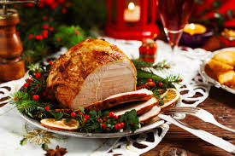



Hang out with the Crighto’s from 4pm Christmas Day

Slide 4



Slide 5


Slide 6
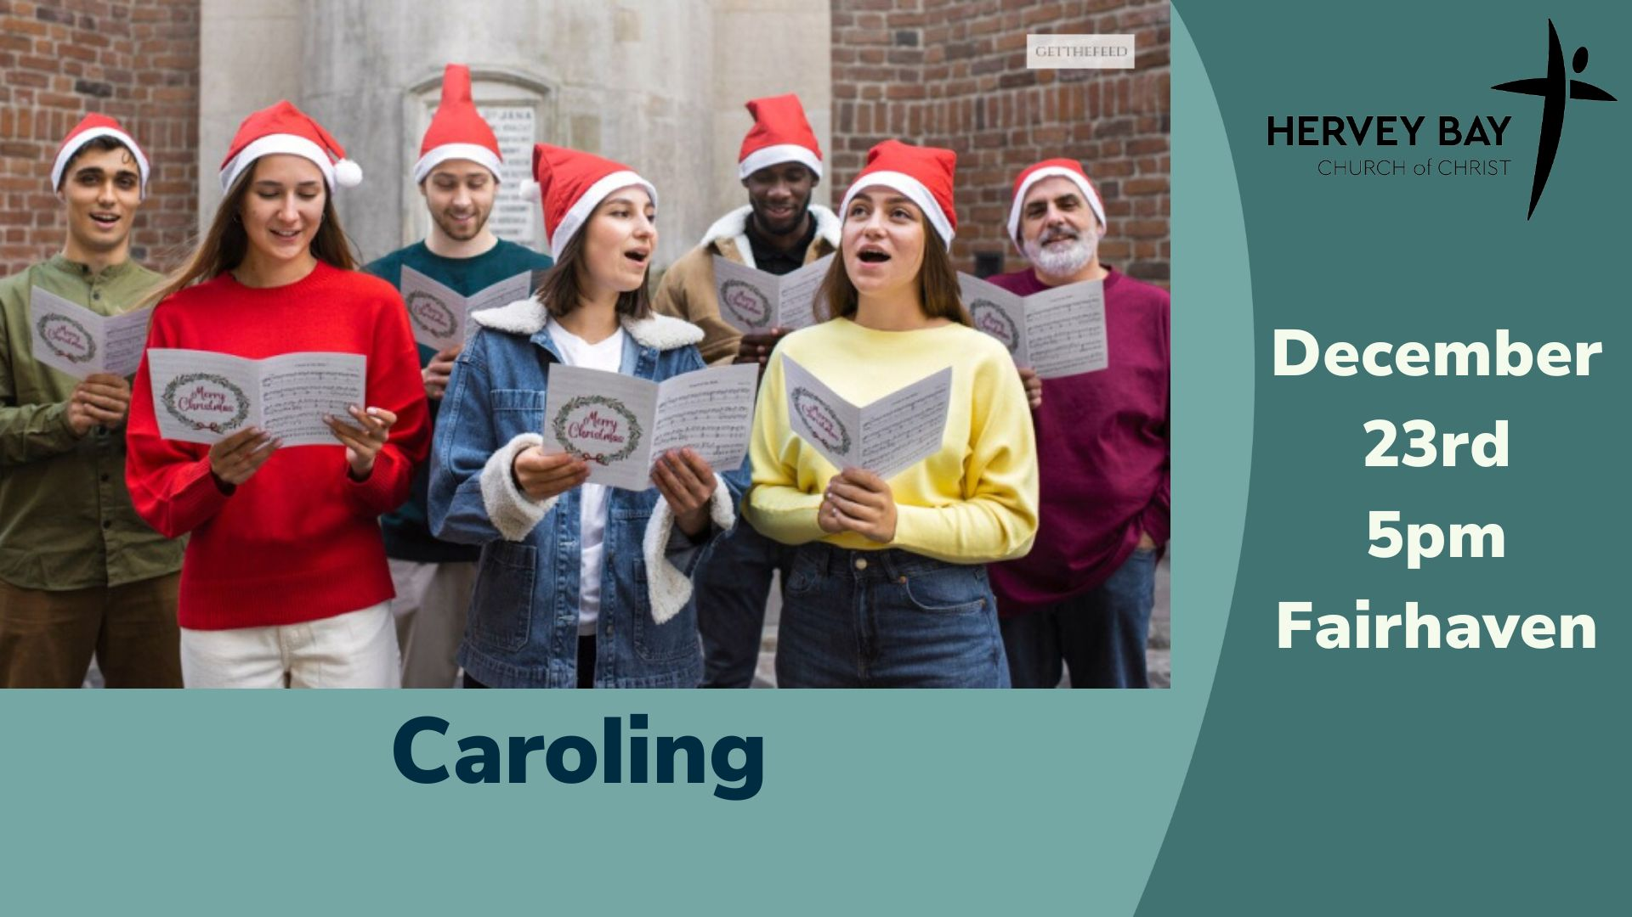

Slide 7
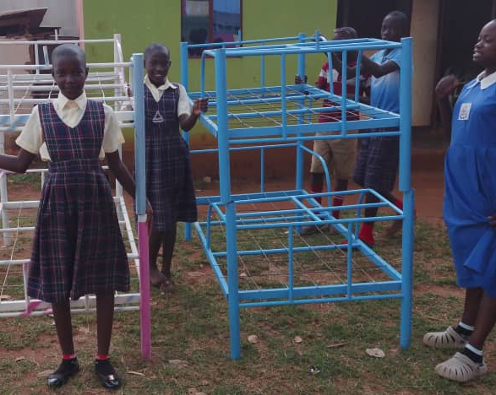
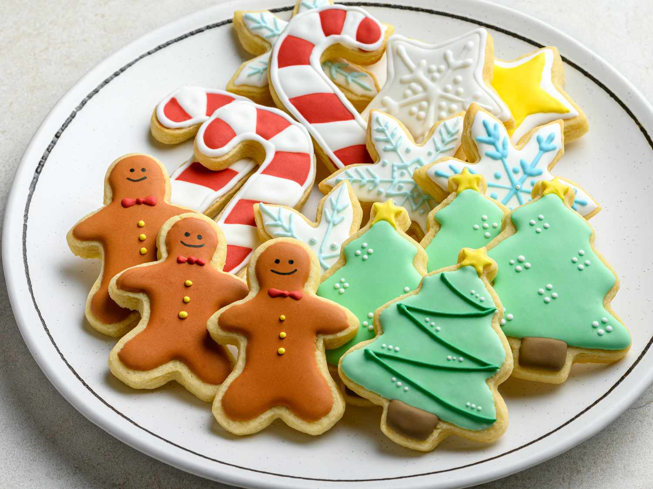
Beds for Orphans
Christmas bake sale December 20th
Bunnings

Slide 8


Slide 9

What is your day to day context?
Where have you seen God at work there?
How can we pray with you?

