Slide 1
Advent week 4 - LOVE

Slide 2
Matthew 1:18-25
This is how the birth of Jesus the Messiah came about: his mother Mary was pledged to be married to Joseph, but before they came together, she was found to be pregnant through the Holy Spirit. Because Joseph her husband was faithful to the law, and yet did not want to expose her to public disgrace, he had in mind to divorce her quietly.
But after he had considered this, an angel of the Lord appeared to him in a dream and said, ‘Joseph son of David, do not be afraid to take Mary home as your wife, because what is conceived in her is from the Holy Spirit.

Slide 3
Matthew 1:18-25
She will give birth to a son, and you are to give him the name Jesus, because he will save his people from their sins.’
All this took place to fulfil what the Lord had said through the prophet: The virgin will conceive and give birth to a son, and they will call him Immanuel’ (which means ‘God with us’).
When Joseph woke up, he did what the angel of the Lord had commanded him and took Mary home as his wife. But he did not consummate their marriage until she gave birth to a son. And he gave him the name Jesus.

Slide 4
Discuss
Recall a time of great struggle in your life. Disappointment; stress; rejection; loss. If you are willing share a short version of this with your group.
Have you ever had a dream from God? Share with each other? What happened as a result?

Slide 5
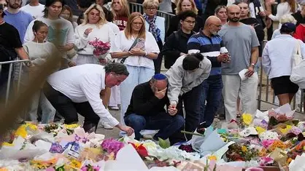

Slide 6

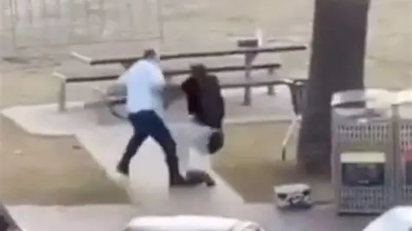
Best and Worst

Slide 7
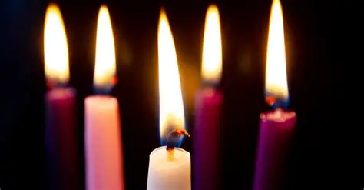
Notes:
An antidote to the fear, greed, anger and outrage of modern world and social media
Conservative politics – Keep the world good – Primary emotion is fear
Progressive politics – Make the world good – Primary motive Anger
Media and our social media feeds are often trying to make us fearful or angry – both often results in outrage keeps you scrolling or tuning in again – then they can sell you solutions – you need better security
Peace is when humanity flourish – war and violence only bring suffering
Peace is an inner quiet that can only come from faith
Peace comes from knowing the sure and certain hope of resurrection and a vision of the coming kingdom of God (repeat)

Slide 8
Isaiah 7:14
…the Lord himself will give you a sign: The virgin will conceive and give birth to a son, and will call him Immanuel.

Slide 9
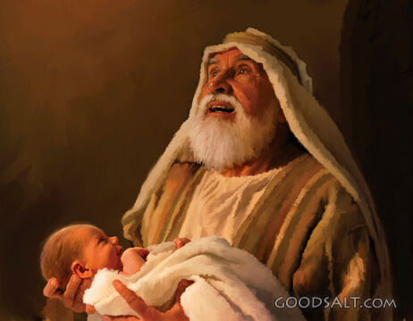

Slide 10


Slide 11


Slide 12


Slide 13
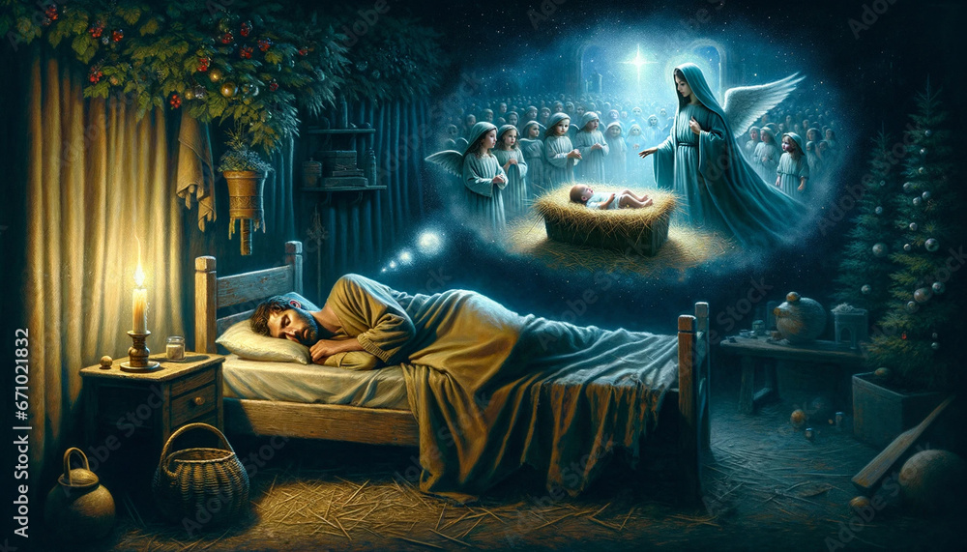

Slide 14
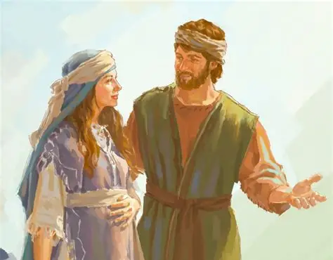
Love is everyday acts

Slide 15
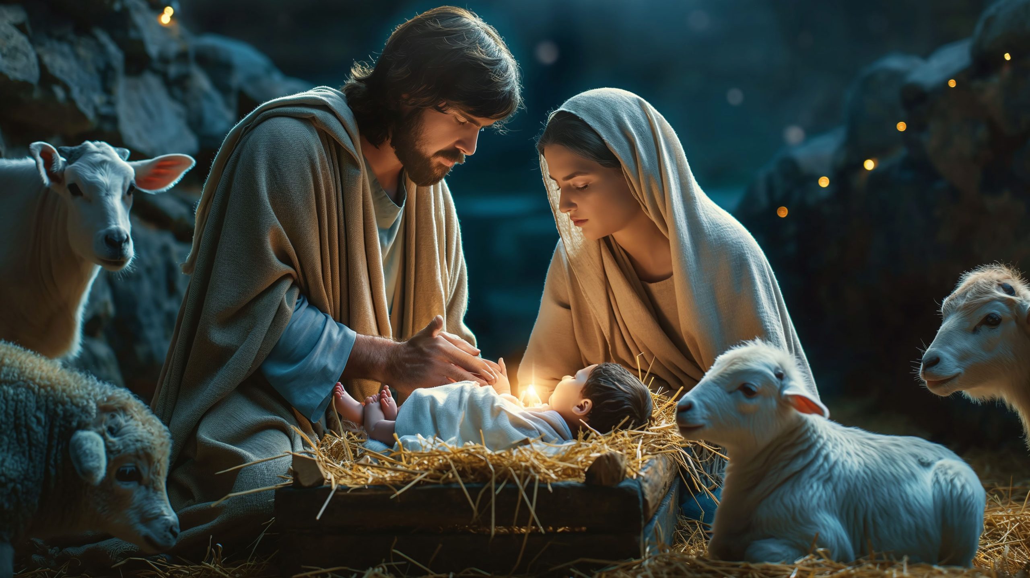

Slide 16
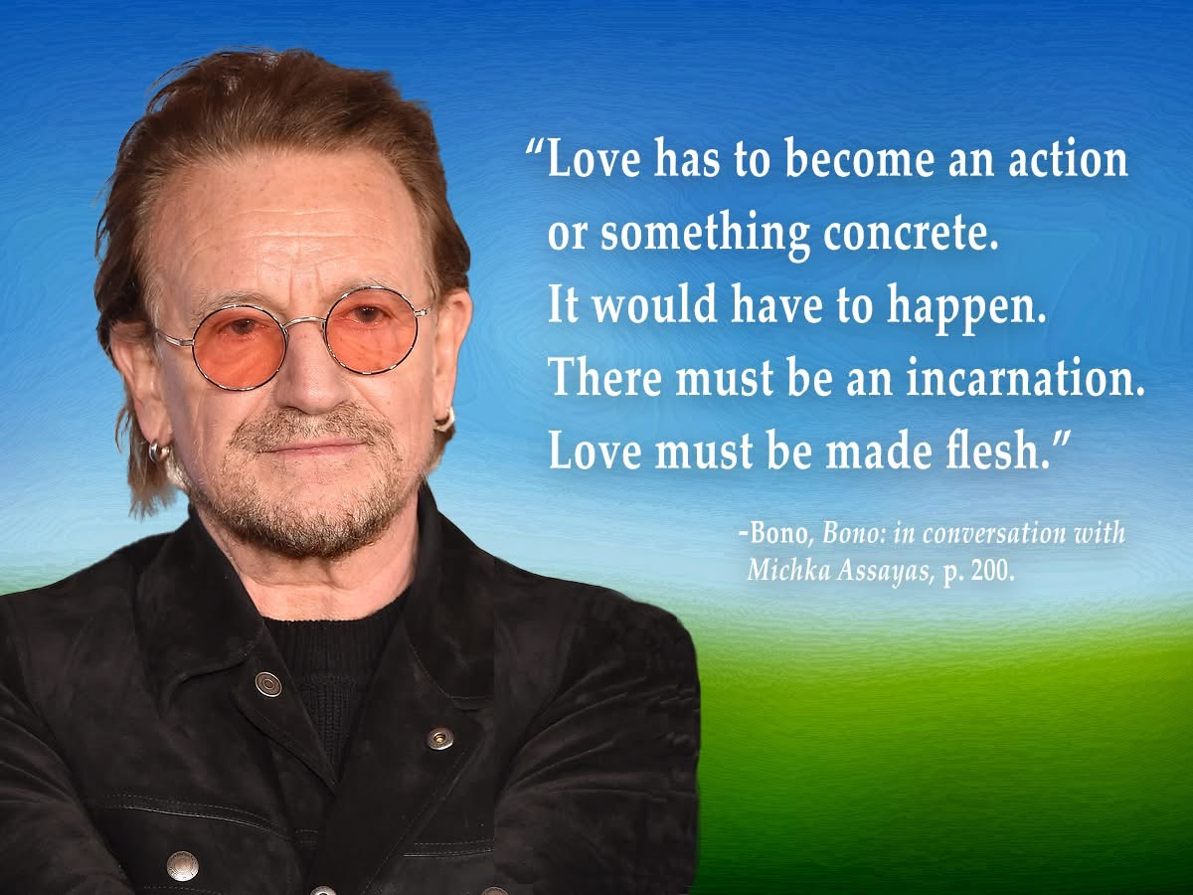

Slide 17
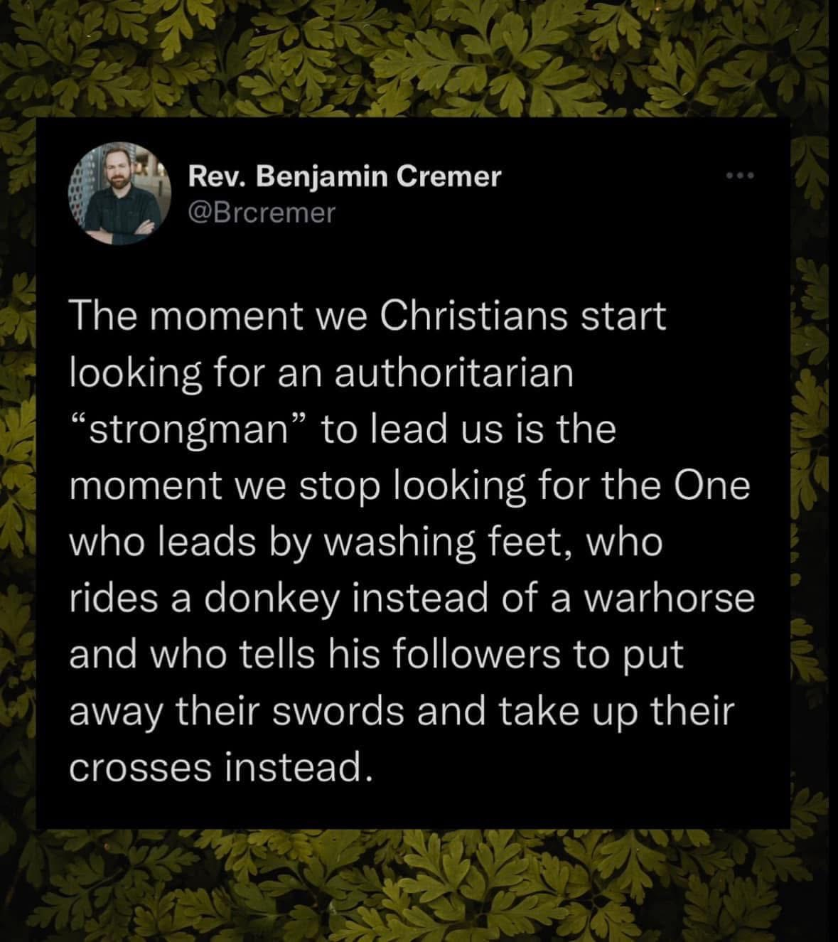

Slide 18
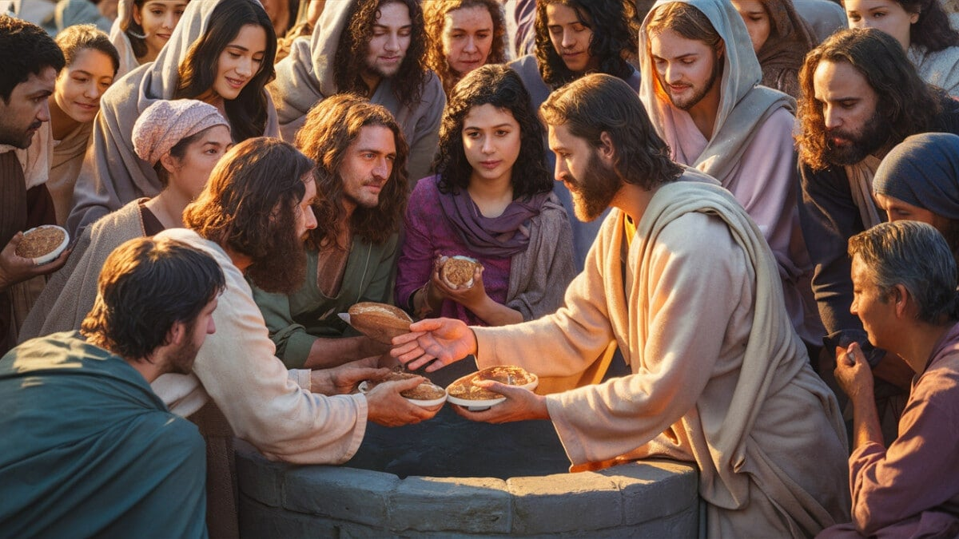
How to be human?

Slide 19
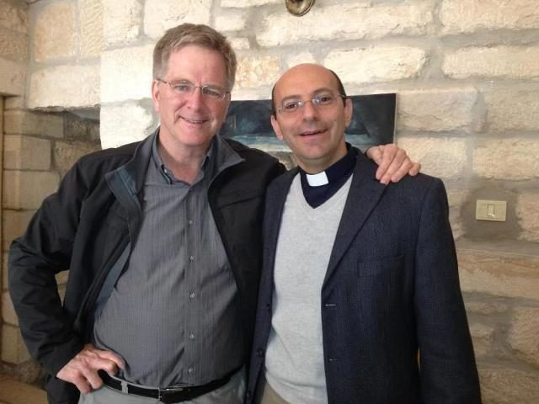
Dr. Rev. Mitri Raheb

Slide 20
Advent does not deny the darkness. It names it. But it also insists that darkness is never the final word.

Slide 21
Reflect
Faced with darkness in the world this year what simple acts of love could you express?
Tell your Neighbour

Slide 22
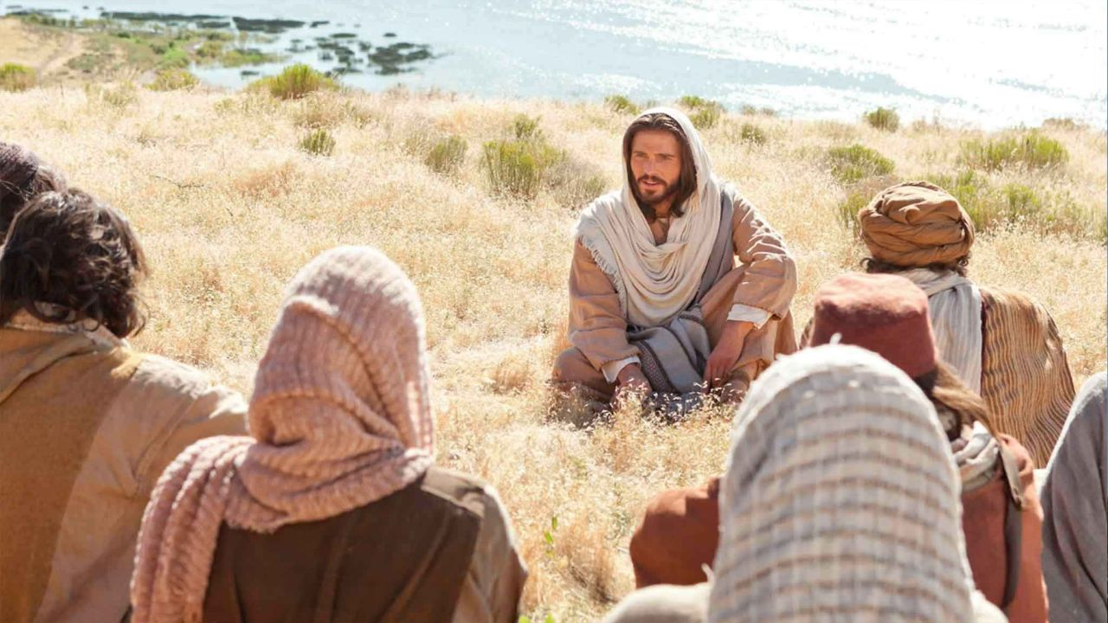
Love your enemies
Pray for those who persecute you

Slide 23
Pray for your abuser – Lords Prayer
Pray that…
They would hallow God’s name
Come under His Godly rule
Love to do God’s will
Have all their physical needs met
They repent; have sins forgiven; forgive others
They are protected from temptation and evil

Slide 24
Peace Joy Love meditation
May the peace of God rule in their heart
May the joy of the Holy Spirit fill their very being
May the love of God enfold them

Slide 25
Benediction
Oh Wisdom
Lord and Ruler
Root of Jesse
Key of David
Rising Sun
King of Nations
Emmanuel
Come, Lord Jesus

