Slide 1
Magi and our refugee King
Matthew Chapter 2

Slide 2
Matthew 2:1-5
After Jesus was born in Bethlehem in Judea, during the time of King Herod, Magi from the east came to Jerusalem and asked, “Where is the one who has been born king of the Jews? We saw his star when it rose and have come to worship him.”
When King Herod heard this he was disturbed, and all Jerusalem with him. When he had called together all the people’s chief priests and teachers of the law, he asked them where the Messiah was to be born. “In Bethlehem in Judea,” they replied, “for this is what the prophet has written:

Slide 3
Matthew 2:6-8
“‘But you, Bethlehem, in the land of Judah,
are by no means least among the rulers of Judah;
for out of you will come a ruler
who will shepherd my people Israel.’”
Then Herod called the Magi secretly and found out from them the exact time the star had appeared. He sent them to Bethlehem and said, “Go and search carefully for the child. As soon as you find him, report to me, so that I too may go and worship him.”

Slide 4
Matthew 2:9-12
After they had heard the king, they went on their way, and the star they had seen when it rose went ahead of them until it stopped over the place where the child was. When they saw the star, they were overjoyed. On coming to the house, they saw the child with his mother Mary, and they bowed down and worshiped him. Then they opened their treasures and presented him with gifts of gold, frankincense and myrrh. And having been warned in a dream not to go back to Herod, they returned to their country by another route.

Slide 5
Matthew 2:16-18
When Herod realized that he had been outwitted by the Magi, he was furious, and he gave orders to kill all the boys in Bethlehem and its vicinity who were two years old and under, in accordance with the time he had learned from the Magi. Then what was said through the prophet Jeremiah was fulfilled:
“A voice is heard in Ramah,
weeping and great mourning,
Rachel weeping for her children
and refusing to be comforted,
because they are no more.”

Slide 6
Matthew 2:19-23
After Herod died, an angel of the Lord appeared in a dream to Joseph in Egypt and said, “Get up, take the child and his mother and go to the land of Israel, for those who were trying to take the child’s life are dead.”
So he got up, took the child and his mother and went to the land of Israel. But when he heard that Archelaus was reigning in Judea in place of his father Herod, he was afraid to go there. Having been warned in a dream, he withdrew to the district of Galilee, and he went and lived in a town called Nazareth. So was fulfilled what was said through the prophets, that he would be called a Nazarene.

Slide 7

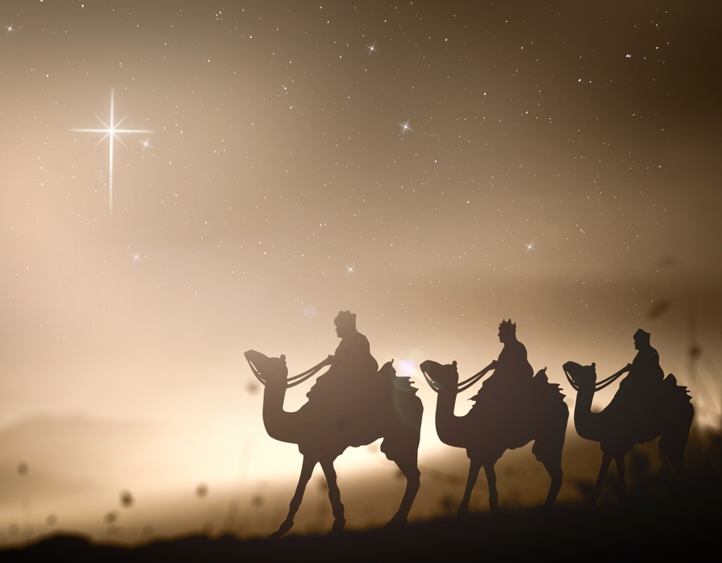
December?
Notes:
One of the most influential and completely fabricated books is called The two Babylons by Alexander Hisplop first published 1853. Hisplop was a free church of Scotland minister who hated the Catholic Church and saw paganism in every church doctrine and celebration.
Hislop was a terrible historian. He had primary sources misquoted secondary sources and made others up.
His theory about Christmas was particularly devastating. He claimed that the Christmas date came from an adoption of pagan practices. Hislop claimed that this was the birthday of ancient Mesopotamian Sun God. The Mesopotamian calendar does not even align with that date.
The reality is the earliest mention of pagan festivals on Dec 25th is from the late third Century.
The real reason that 25th Dec was chosen was because as the traditional date of celebrating the birth of Jesus, When we look at actual early Christian sources, we find that the date of December 25 arose from a Jewish Christian tradition that prophets died on the same date as their conception.
For us this is not really logical and modern scholarship thinks Jesus was more likely born in September or October. But Dec 25th origins certainly isn’t pagan.

Slide 8
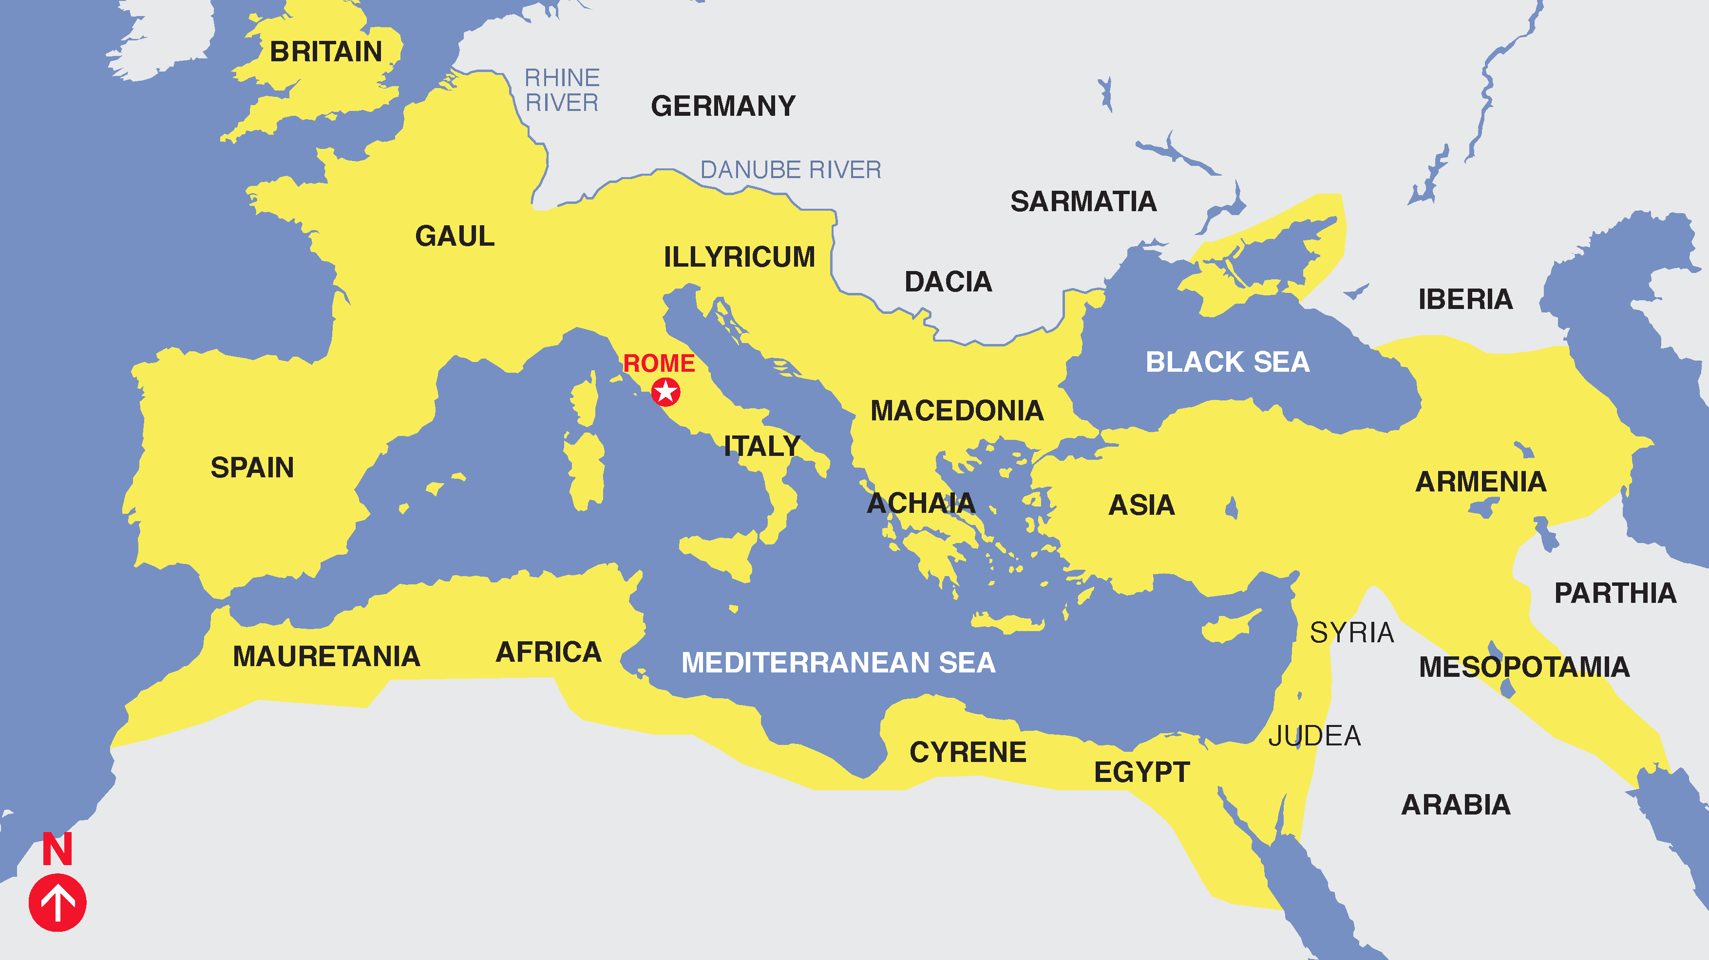
Notes:
In 63BC Pompey invaded Judea with his Roman garrison. The problem was that Rome couldn’t grow enough grain to support the empire and needed grain from the vast fields in northern Africa. But shipping it to Europe put it at risk from pirates.
The solution was to control every port along the Mediterranean so pirates had no port to seek refuge in. And you only needed to tax the local populations to pay for it.

Slide 9
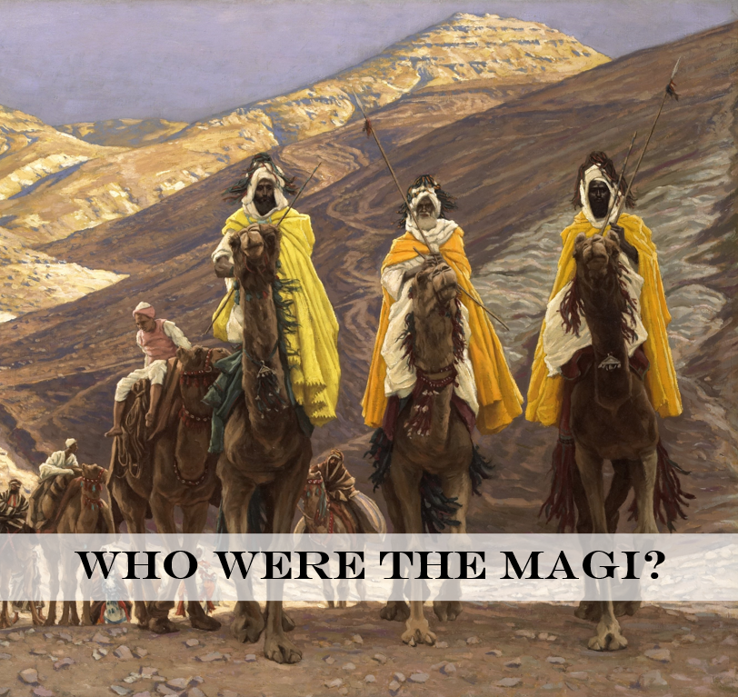
Searching for a King
Notes:
Can’t be too sure
In some traditions they are kings of the East of Persia, India and Arabia.
A probable piece of probable fiction written in Syriac script that may date as early as 2nd century but the earliest copy is 8th C copy in Vatican Library has them as Persian Zorastian Magicians.
In Modern times many scholars have leaned toward Nabatean Magi.
Empire of Arabia; Capital at Petra; wealthy with trade routes and spices; Arabs – descended from Nebaioth son of Ishmael grandson of Abraham.
Herod was descended from both Maccabean family who led the revolt to free Judeans from Selucid Empire from 167 to 160BC and also the royal family of Nabatea – by then called the Hasmoneans. His own father was an Edomite Jewish convert who worked in the court of the High Priest. He wasn’t very Jewish. But in 47 BC he managed to get himself appointed governor of Judea.
In 40 BC the Parthians invaded Judea. From 40BC-37BC the Parthians –Persian Empire ruled Judea. The Nabatean’s and Persians were culturally, economically and linguistically aligned. The King of Nabatea was upset with Herod, possibly over the way he had treated his sister. Plus the Roman Empire was in turmoil entwined in civil wars. Plus holding Judea was a significant economic advantage being part of trade routes to Africa; Asia Minor or Europe by land and sea. So the Parthians invaded; with encouragement from the Nabateans and Herod who was governor fled to Rome. In Rome the Senate appointed him King of Judea and gave him an army to take Judea back. He did but in the ensuing peace several agreements were made.
Herod took a new Hasmonean (Nabatean) princess to be his bride – Mariamne 1st
Parthians and Nabateans were given significant payment and slaves.
One of those slaves was a particularly attractive young girl who the king of Nabataea fell in love with and had a son to. Years later this “queen” killed the king and all of the other princes and installed her son as King. This upset the Magi. In their system it was the Magi’s role to train the young princes and select the brightest and best to be the next King. They weren’t happy with succession by assassination. So they had gone looking for a candidate as king. That’s what they were doing there, looking for a potential Nabatean King.
We know from Chinese astrological records that there was a supernova 5 and 4BC around the time of Jesus birth. Possibly this is what they were following.
When the Magi turned up in Jerusalem with military envoy in tow, I bet it caused a real stir.
Herod came to love Mariamne 1st and had two sons to her. But he was deeply paranoid and his sister Salome was happy to stir up trouble to sure up her own position. So when she pointed out that Mariamne was teacher hers sons state craft he had them all executed because it reminded him of his own mortality.
https://www.biblicalarchaeology.org/daily/people-cultures-in-the-bible/jesus-historical-jesus/bible-scholar-brent-landau-asks-who-were-the-magi/
https://www.walkingwithgiants.net/jesus-christ/birth-of-jesus/the-magi-nabatean-courtiers/

Slide 10
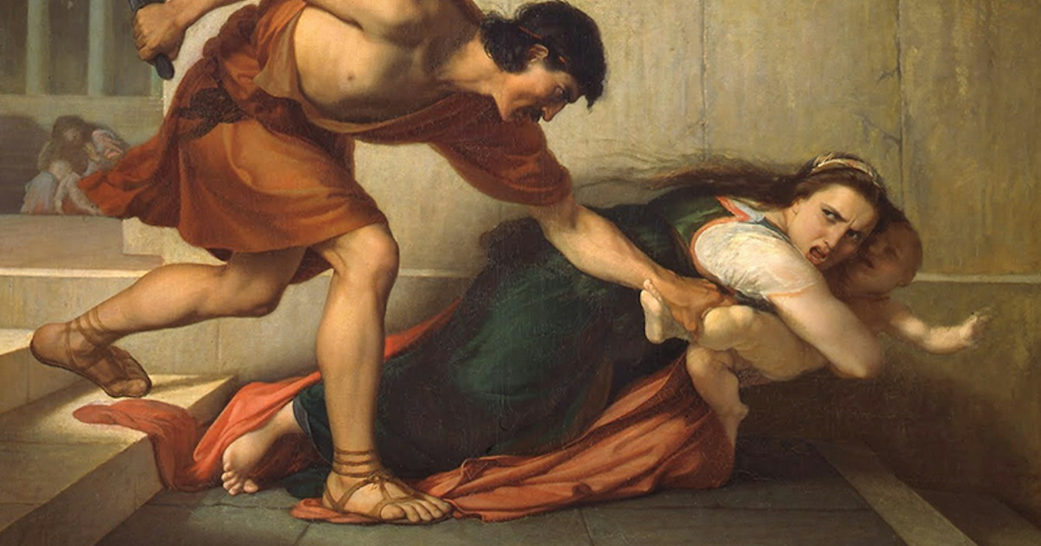
Notes:
Plenty of critics have doubted Matthew’s account because we actually, thanks to Jesephus have a great deal of information about Herod the Great and Jesephus nor anyone else mentions this event. But that’s not uncommon in ancient history. Often ancient history relies on scraps and single source accounts. Secondly this is a terrible account but relatively minor in the reign of Herod. At times he killed hundred of Jewish leaders. 5-15 babies in a time where infant mortality was so high anyway may not have impressed Jesephus enough to include it in his writing or it is possible Josephus didn’t know of it.
Contrast the two kings….

Slide 11

Is the world getting better or worse?
Notes:
Has 2000 years of Christianity had any influence at all?
Well historian Tom Holland in his book “Dominion: the making of the West” argues yes. The callus disregard for human life, slavery, the complete acceptance of the potency of the Roman penis taking almost any woman when he wanted, child sacrifices, violence and Roman power are all just taken for granted in that world but considered abhorrent to us.
Over the last 150 years literacy rates, % of people in abject poverty, rates of child mortality, availability of medical treatment has improved in most of the world.
But we continue to find better ways to kill each other. There are more than 50 million slaves world wide. There are still many many places where these advances simply don’t apply.
We might also argue about sexual ethics; how prosperity and technology have not necessarily brought us closer or more civil or helped us be connected to God. Indeed, it often distracts or leads people directly from God.

Slide 12
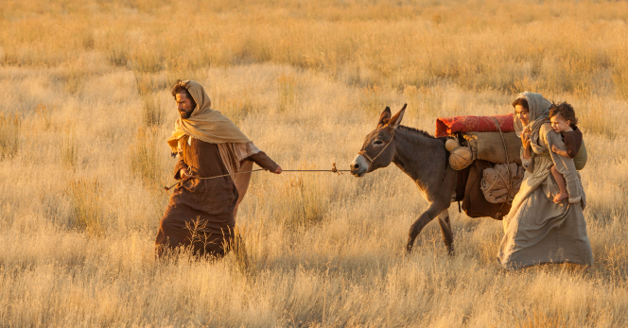
Notes:
First Century Roman Empire was a violent and scary place.
So Mary, Joseph and Jesus flee to Egypt. For a time they become refugees. Fleeing home; fleeing for safety.
Of course that term didn’t exist. That term was first used in the 17th century to describe French protestants Huguenots fleeing for the lives. Later in the 20th Century it was those displaced and fleeing WW1 and WW2 and international conventions in 1921 and 1951.
Even when the young family return they decide it is unsafe to live in Judea where they probably had ancestral land and relatives and went instead to Galilee. They remained displaced people.
This is why it is often said – We follow a refugee King.
In Matthew 25 Jesus reminds us that whatever we do to the least of these we do unto him.

Slide 13
Immigrants?
“The foreigner residing among you must be treated as your native-born. Love them as yourself, for you were foreigners in Egypt. I am the LORD your God.” – Leviticus 19:34
“Do not forget to show hospitality to strangers, for by so doing some people have shown hospitality to angels without knowing it.” – Hebrews 13:2
“And you are to love those who are foreigners, for you yourselves were foreigners in Egypt. I am the LORD your God.” – Deuteronomy 10:19
“The LORD watches over the foreigner and sustains the fatherless and the widow, but he frustrates the ways of the wicked.” – Psalms 146:9
Notes:
How we treat the poor, needy, foreigners, strangers, hungry, imprisoned, widow and orphan is a central measure of how real faith is lived out.
Matthew 25 Jesus says what you do to the least of these is what you do to me.

Slide 14
Politics and Christians
Mixing Church and politics is like mixing ice-cream and manure. It doesn’t do much to the manure but sure ruins the ice-cream. (Tony Campolo)
“Silence in the face of evil is itself evil: God will not hold us guiltless. Not to speak is to speak. Not to act is to act.” —Dietrich Bonhoeffer (1906–1945), German pastor and dissident
Notes:
But by what he meant was partisan politics.
The trouble with party politics is the packaging: All in. one side always right the other always wrong. When you do that as a Christian there will come a time when the party or candidate will do something that conflicts with your Christian values. Sometimes people become way too connected to their party to be able to weigh up issues on their merit.
We can care for individuals; do our bit to make a difference (Sunbird and Amazing Grace); We can speak out, sing songs and protest in various ways; finally should pray.
Syrian Refugee Story -

Slide 15
O Holy Night
Truly He taught us to love one another;
His law is Love and His gospel is Peace;
Chains shall he break, for the slave is our brother,
And in his name all oppression shall cease,
Sweet hymns of joy in grateful Chorus raise we;
Let all within us praise his Holy name!
Notes:
Written in French in 1847 and translated into English in 1855 Churches in the South of US refused to sing the song.
Abolition of slavery was the biggest issue of the time.
The American Civil War started 6 years later. It was a very heated time, very partisan time.

Slide 16
Speak truth to power
The King of Kings is born in a humble manger;
Proud rulers of today, boastful of your greatness,
It is there that God preaches against your pride:
Bow down your heads before the Redeemer!
Notes:
No was no wonder that authorities and the Catholic church both objected.

Slide 17
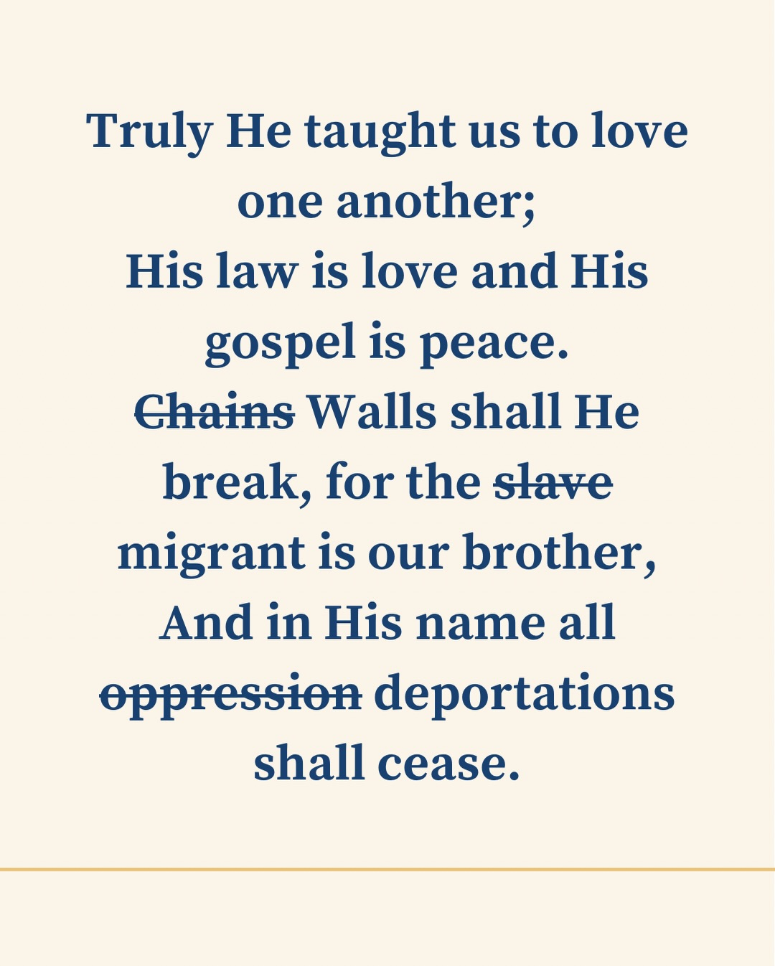
Notes:
American Joash Thomas wants to keep the radical edge to the song. Speaking about the American context and controversy about Border Force deportations he suggests sone lyric changes.
Now I have nothing to say into an American context. All our responses should local and within our sphere of influence.
And governments have responsibility to serve their constituents and keep them safe. Under God they are appointed to serve and protect including responsibility for boarders.
What does wholeness and shalom look like for all?
What would lyrics that reflect the values of the Kingdom of God be?
What would lyrics that declare the universal reign of Jesus as King?
If you could speak truth to power what would you say?

Slide 18
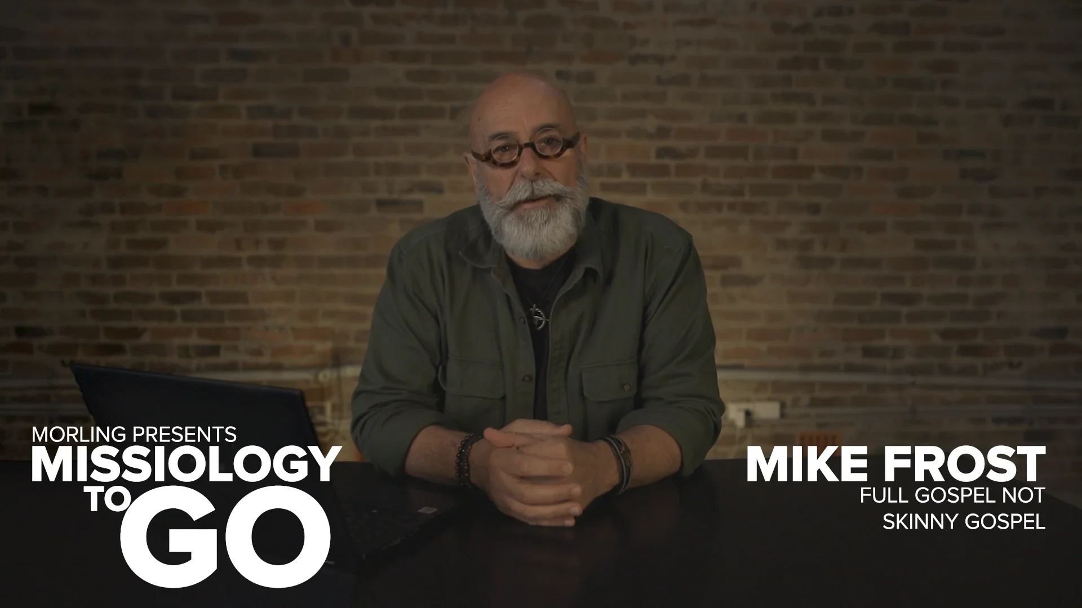
Notes:
Play video

Slide 19
Proclaiming and demonstrating the universal reign of Christ
Reconciliation
Justice
Beauty
Wholeness
Notes:
Discuss

