Slide 1
Advent week 2 - Peace
Isaiah 11:1-10
Psalm 72:1-7; 18-19
Romans 15:4-13
Matthew 3:1-12

Slide 2
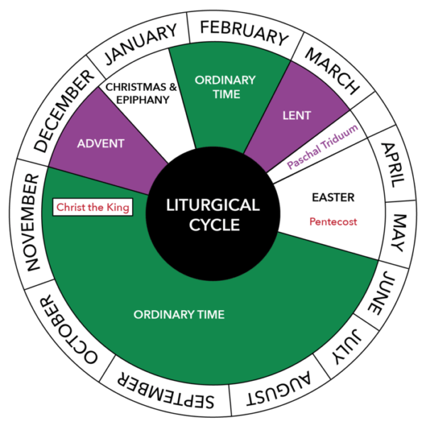
Advent
Notes:
The months of the year are either roman numbers or emperors
Christian Calendar outlined
Advent
Christmas
Ordinary time
Lent
Easter
Pentecost
More ordinary time culminating with Christ the king
Christian Calendar is an opportunity to offer an alternative empire, militarism, oppression and greed
We lament Christian holidays being commercialized Christ in Christmas
Slow down
Care for the poor and needy
Advent is our opportunity to look forward to Christ’s return and His kingdom being consummated –”Look Forward”
Hope, Peace, Joy, Love

Slide 3
Isaiah 11:1-10 - Prophets
A shoot shall come out from the stock of Jesse,
and a branch shall grow out of his roots.
2 The spirit of the Lord shall rest on him,
the spirit of wisdom and understanding,
the spirit of counsel and might,
the spirit of knowledge and the fear of the Lord.
3 His delight shall be in the fear of the Lord.
He shall not judge by what his eyes see,
or decide by what his ears hear;

Slide 4
Isaiah 11:1-10 - Prophets
4 but with righteousness he shall judge the poor,
and decide with equity for the meek of the earth;
he shall strike the earth with the rod of his mouth,
and with the breath of his lips he shall kill the wicked.
5 Righteousness shall be the belt around his waist,
and faithfulness the belt around his loins.
6 The wolf shall live with the lamb,
the leopard shall lie down with the kid,
the calf and the lion and the fatling together,
and a little child shall lead them.

Slide 5
Isaiah 11:1-10 - Prophets
7 The cow and the bear shall graze,
their young shall lie down together;
and the lion shall eat straw like the ox.
8 The nursing child shall play over the hole of the asp,
and the weaned child shall put its hand on the adder’s den.
9 They will not hurt or destroy
on all my holy mountain;
for the earth will be full of the knowledge of the Lord
as the waters cover the sea.

Slide 6
Isaiah 11:1-10 - Prophets
10 On that day the root of Jesse shall stand as a signal to the peoples; the nations shall inquire of him, and his dwelling shall be glorious.

Slide 7

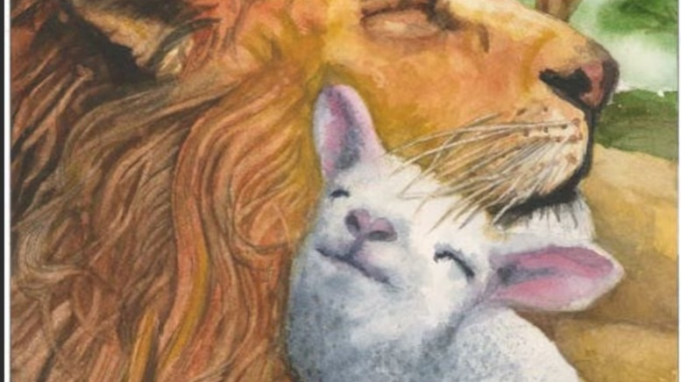
Prophets
Notes:
Dorithy Day…Bohemian; Socialist; Anarchist; Christian; Radical pacifist….Inspired by the radical vision of the Kingdom of God and the deep commitment the prophets in particular had with the poor she dedicated herself to identifying with the poor (Catholic).
Inspired both by her non-violent, sacramental direct action her granddaughter broke into a submarine base and symbolically beat hammers against machines in order to symbolically protest nuclear submarines and beat swords into plough shears.
Dorathy Day was a 20th Century prophet; praying rather than participating in the 1950’s nuclear war drills. She famously said, “hiding under desks won’t help, only nuclear disarmament can do that.”
Eventually the Catholic church caught up. The man who led that push was the military Chaplain who served the bomber crew communion before the dropped a nuclear bomb on Nagasaki. Nagasaki had no military significance but it did have a population of 10 000 Catholics. Most of them lived in the inner city and were killed. Christianity has never really got a hold in Japan in any significant way since. Father William Downey later spoke of how he served the most holy of Christian sacraments to a crew to go and kill other Christians.
Prophets don’t have 2020 vision.
They are putting words to hope and joy and peace and desires for justice and end to oppression
Sometimes Isaiah timeline can feel all over the place A babe will be born and the lion will lie down with the lamb and the Israelites will be freed from exile
But it is the hope and joy and peace that comes from waiting on God to achieve what in the natural cannot seem possible
Paradise in first two chapters and paradise in the last two.

Slide 8
Psalm 72:1-6; 18-19
Of Solomon.
1 Give the king your justice, O God,
and your righteousness to a king’s son.
2 May he judge your people with righteousness,
and your poor with justice.
3 May the mountains yield prosperity for the people,
and the hills, in righteousness.

Slide 9
Psalm 72:1-7; 18-19
4 May he defend the cause of the poor of the people,
give deliverance to the needy,
and crush the oppressor.
5 May he live while the sun endures,
and as long as the moon, throughout all generations.
6 May he be like rain that falls on the mown grass,
like showers that water the earth.
7 In his days may righteousness flourish
and peace abound, until the moon is no more.

Slide 10
Psalm 72:1-7; 18-19
18 Blessed be the Lord, the God of Israel,
who alone does wondrous things.
19 Blessed be his glorious name for ever;
may his glory fill the whole Earth.
Amen and Amen.

Slide 11
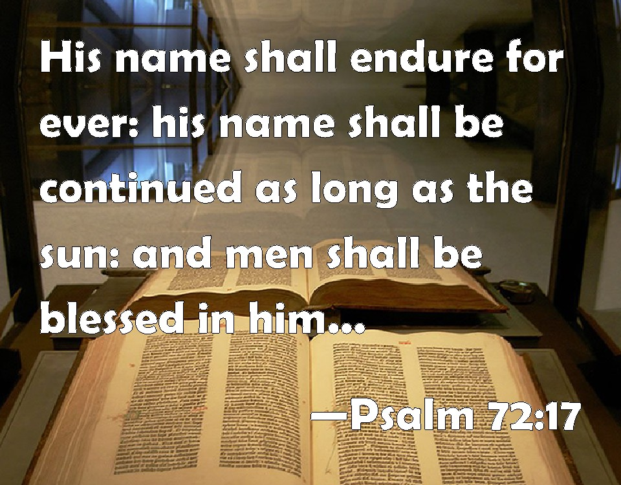
Messianic
Notes:
Moves from Solomon to the great king – the messiah
What are the things you notice him doing?

Slide 12
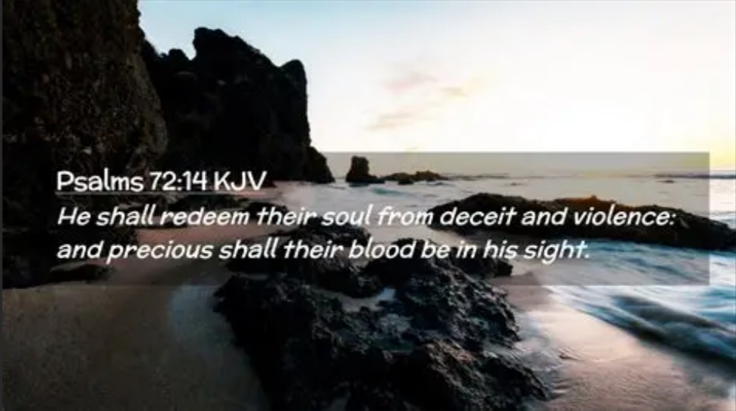
Notes:
Moves from Solomon to the great king – the messiah
What are the things you notice him doing?

Slide 13
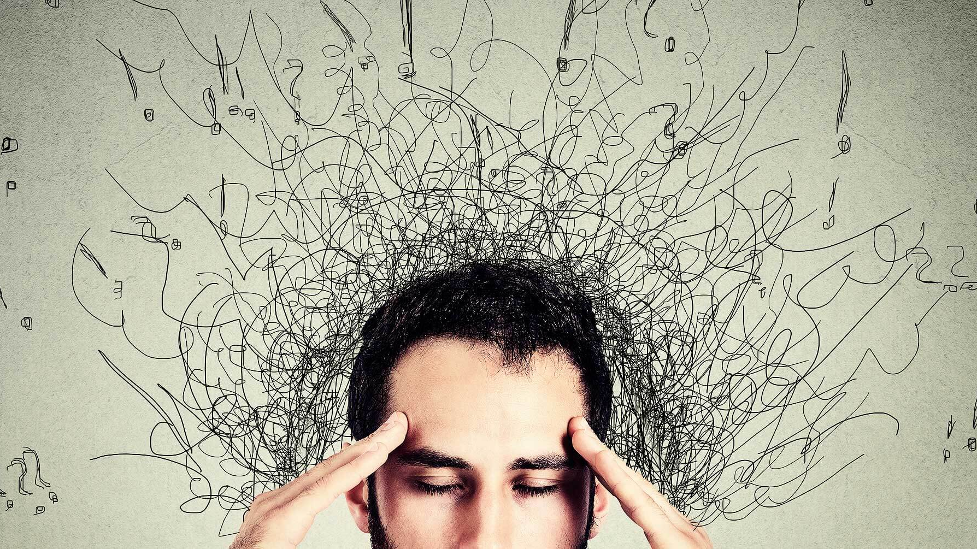
Peace?
Notes:
An antidote to the fear, greed, anger and outrage of modern world and social media
Conservative politics – Keep the world good – Primary emotion is fear
Progressive politics – Make the world good – Primary motive Anger
Media and our social media feeds are often trying to make us fearful or angry – both often results in outrage keeps you scrolling or tuning in again – then they can sell you solutions – you need better security
Peace is when humanity flourish – war and violence only bring suffering
Peace is an inner quiet that can only come from faith
Peace comes from knowing the sure and certain hope of resurrection and a vision of the coming kingdom of God (repeat)

Slide 14
Peace
7 In his days may righteousness flourish
and peace abound, until the moon is no more.

Slide 15
Romans 15:4-13
4For whatever was written in former days was written for our instruction, so that by steadfastness and by the encouragement of the scriptures we might have hope. 5May the God of steadfastness and encouragement grant you to live in harmony with one another, in accordance with Christ Jesus, 6so that together you may with one voice glorify the God and Father of our Lord Jesus Christ. 7 Welcome one another, therefore, just as Christ has welcomed you, for the glory of God.

Slide 16
Romans 15:4-13
8For I tell you that Christ has become a servant of the circumcised on behalf of the truth of God in order that he might confirm the promises given to the patriarchs, 9and in order that the Gentiles might glorify God for his mercy. As it is written,
‘Therefore I will confess you among the Gentiles,
and sing praises to your name’;
10and again he says,
‘Rejoice, O Gentiles, with his people’;

Slide 17
Romans 15:4-13
11and again,
‘Praise the Lord, all you Gentiles,
and let all the peoples praise him’;
12and again Isaiah says,
‘The root of Jesse shall come,
the one who rises to rule the Gentiles;
in him the Gentiles shall hope.’
13May the God of hope fill you with all joy and peace in believing, so that you may abound in hope by the power of the Holy Spirit.
Notes:
Peace along with joy and hope are gifts to us that come via the Holy Spirit

Slide 18
Thomas Merton (Seeds of Contemplation)
“Peace is not something that you can find; it must be created. During Advent, we have the opportunity to foster peace in our hearts and share it with those who are troubled.”
Notes:
But it is also something that we can create, cultivate, practice.
In a world that is broken; partisan; troubled; fearful and where justice and oppression reign as often as not; where relationships and families and friends are divided we have an opportunity to be the non-anxious – peace filled presence.

Slide 19
Matthew 3:1-12 Incarnation
In those days John the Baptist appeared in the wilderness of Judea, proclaiming, 2‘Repent, for the kingdom of heaven has come near.’ 3This is the one of whom the prophet Isaiah spoke when he said,
‘The voice of one crying out in the wilderness:
“Prepare the way of the Lord,
make his paths straight.” ’
4Now John wore clothing of camel’s hair with a leather belt around his waist, and his food was locusts and wild honey.

Slide 20
Matthew 3:1-12 Incarnation
5Then the people of Jerusalem and all Judea were going out to him, and all the region along the Jordan, 6and they were baptized by him in the river Jordan, confessing their sins.
7 But when he saw many Pharisees and Sadducees coming for baptism, he said to them, ‘You brood of vipers! Who warned you to flee from the wrath to come? 8Bear fruit worthy of repentance. 9Do not presume to say to yourselves, “We have Abraham as our ancestor”; for I tell you, God is able from these stones to raise up children to Abraham.

Slide 21
Matthew 3:1-12 Incarnation
10Even now the axe is lying at the root of the trees; every tree therefore that does not bear good fruit is cut down and thrown into the fire.
11 ‘I baptize you with water for repentance, but one who is more powerful than I is coming after me; I am not worthy to carry his sandals. He will baptize you with the Holy Spirit and fire. 12His winnowing-fork is in his hand, and he will clear his threshing-floor and will gather his wheat into the granary; but the chaff he will burn with unquenchable fire.’

Slide 22
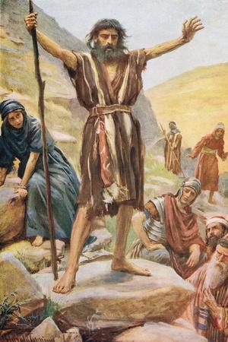
God’s Incarnational vision
Notes:
Matthew:
John the Baptist was a radical. Locusts and honey; Camel hair; some came to repent; some came to gawk. But he was proclaiming the kingdom of God is at hand. That’s the vision of peace; shalom; wholeness; it is shorthand for God’s up to something good in this world.
Direction of the incarnation
God is interested in the transformation of this world
In that we are transformed by Jesus with Holy Spirit baptised lives
Hypocrisy of the religious leaders who practiced purity laws but not the laws of justice and treating people right. The took God’s laws and made them a heavy and bitter yoke.
Hollowness of hoping in politics particularly Christian Nationalism – Christian Nationalists walk around with a mouth full of scripture and a heart full of hate (James Talaico). That’s because they are afraid. Fear and peace cannot abide together.
His axe was at the root of the tree of the pharisees and Sadducees and their religious system. Repentance, giving up power and greed the solution. The system works for the rich and powerful.
Spend time reflecting that God has come unexpectedly in the form of a baby. He will come again as a great, powerful but just King who will put the world right. Let it fill your heart with peace; let his gift of peace fill you; cultivate his peace.

Slide 23

Reflect
God has a great and wonderful vision for this world
God gives Peace
Peace needs to be cultivated
Best action comes out of contemplation
God’s transformative vision for this world starts with you being filled with Peace, Joy and the Holy Spirit

Slide 24
Benediction
Oh Wisdom
Lord and Ruler
Root of Jesse
Key of David
Rising Sun
King of Nations
Emmanuel
Come, Lord Jesus

