Slide 1
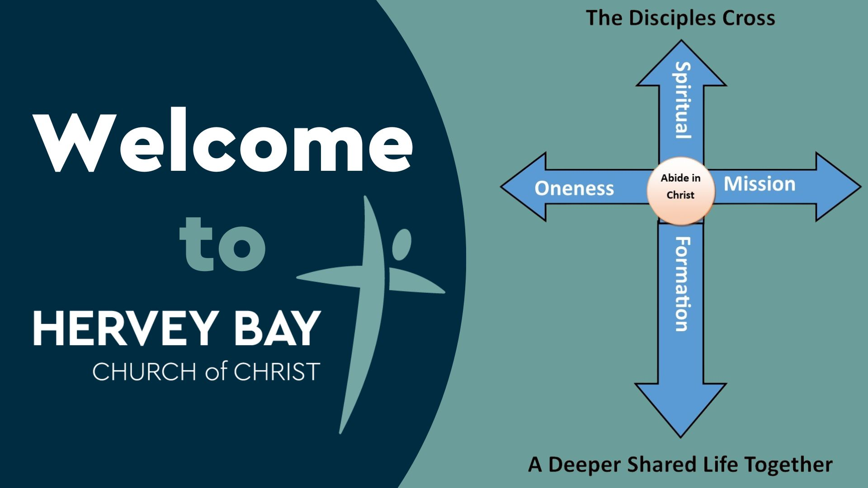

Slide 2
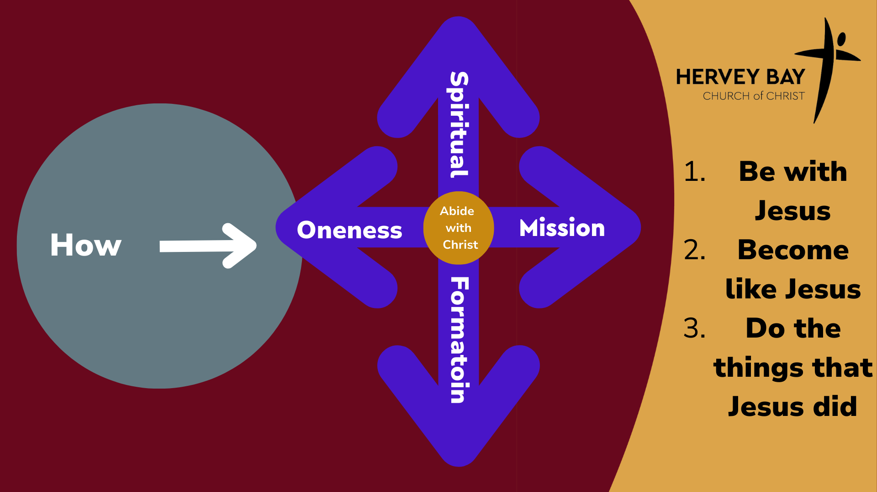

Slide 3
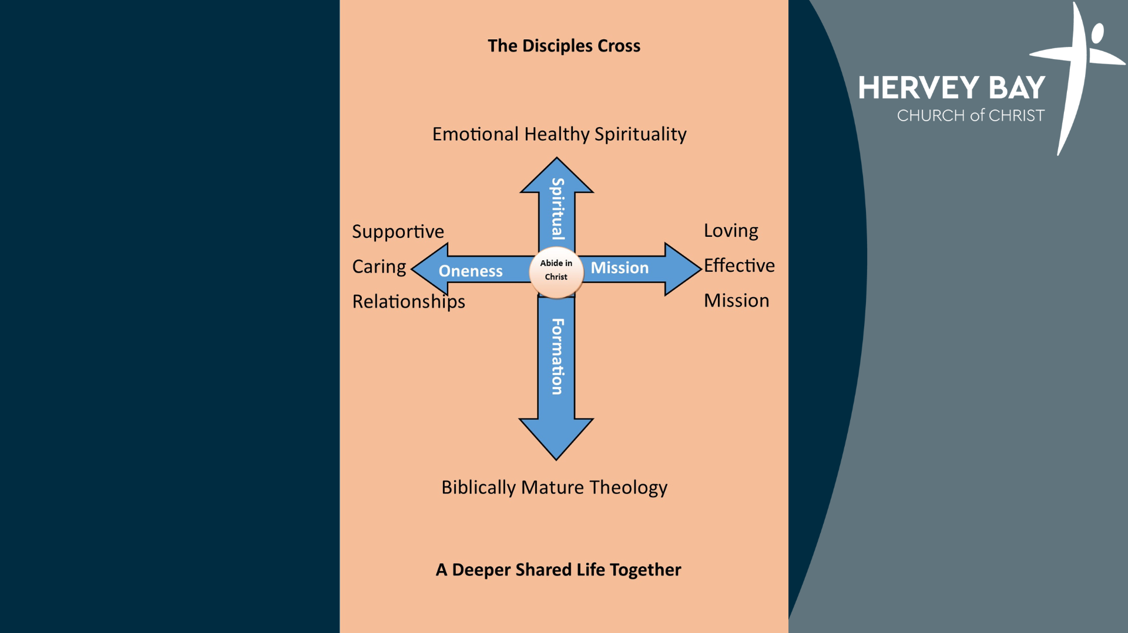
“I’ve been with Jesus”
“I find meaning doing the things Jesus did”
“ I feel valued”
“I am becoming like Jesus”

Slide 4


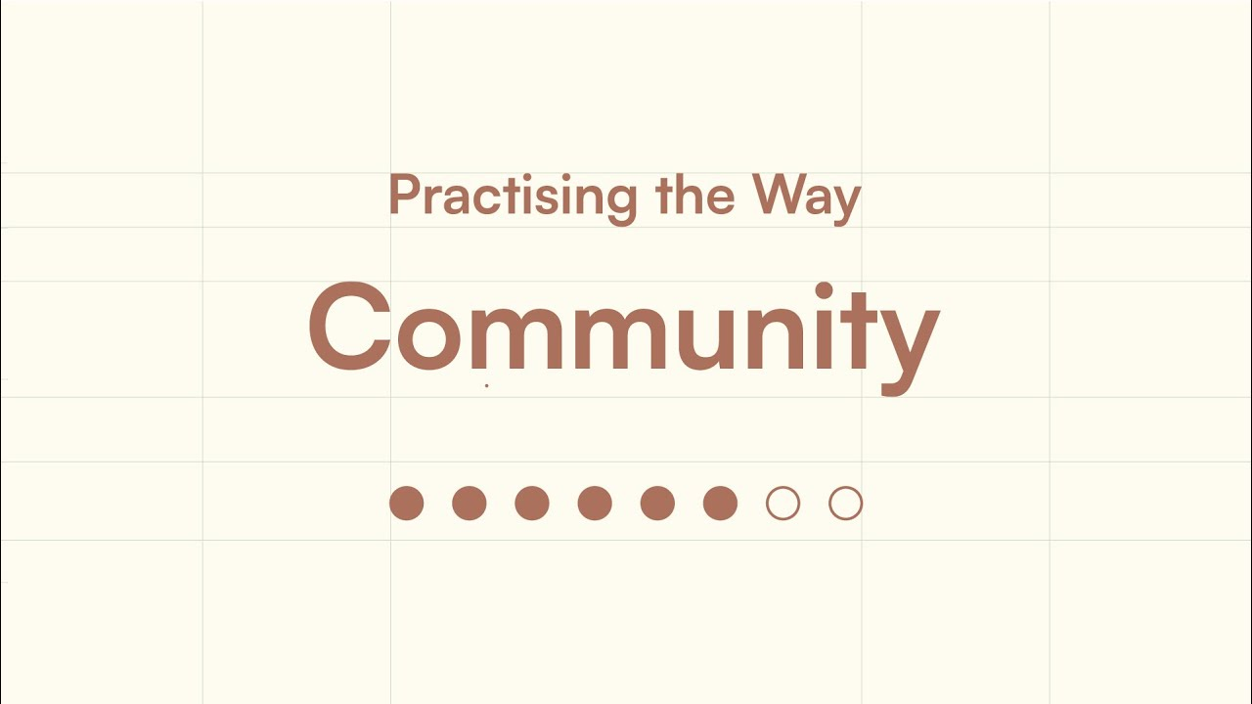



Starting Thursday 19th 6PM

Slide 5
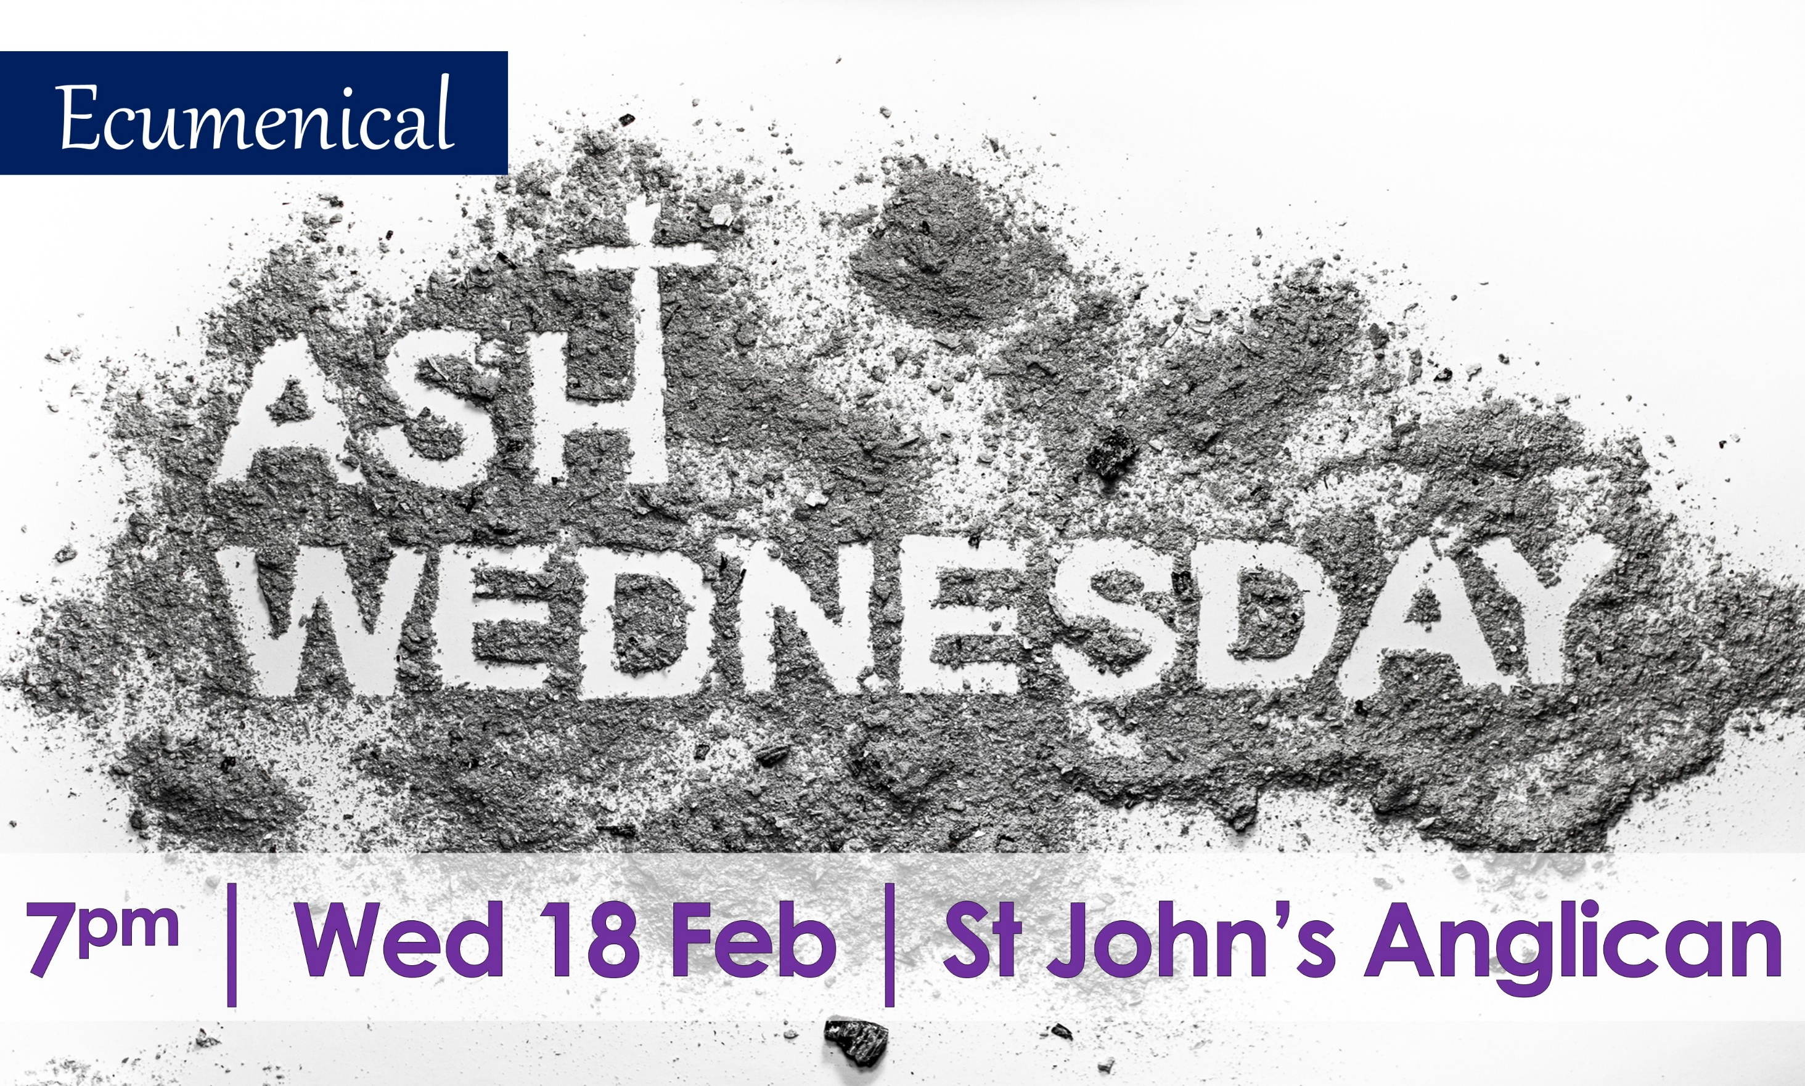

Slide 6


Slide 7


Slide 8

What is your day to day context?
Where have you seen God at work there?
How can we pray with you?

