Slide 1
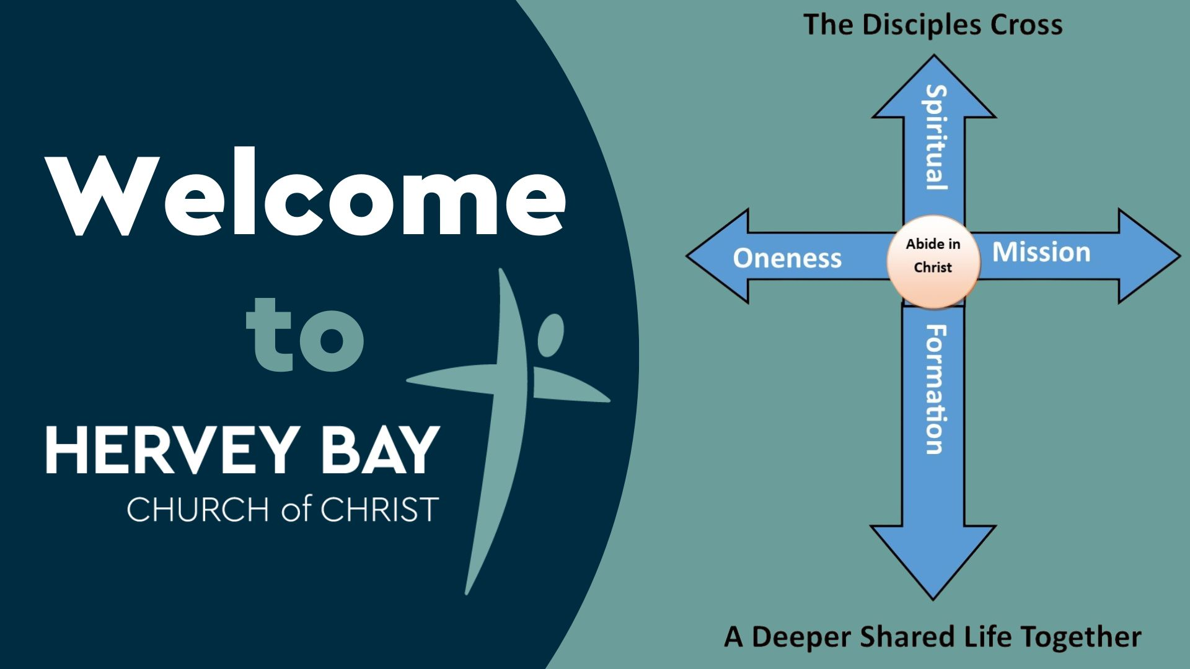

Slide 2
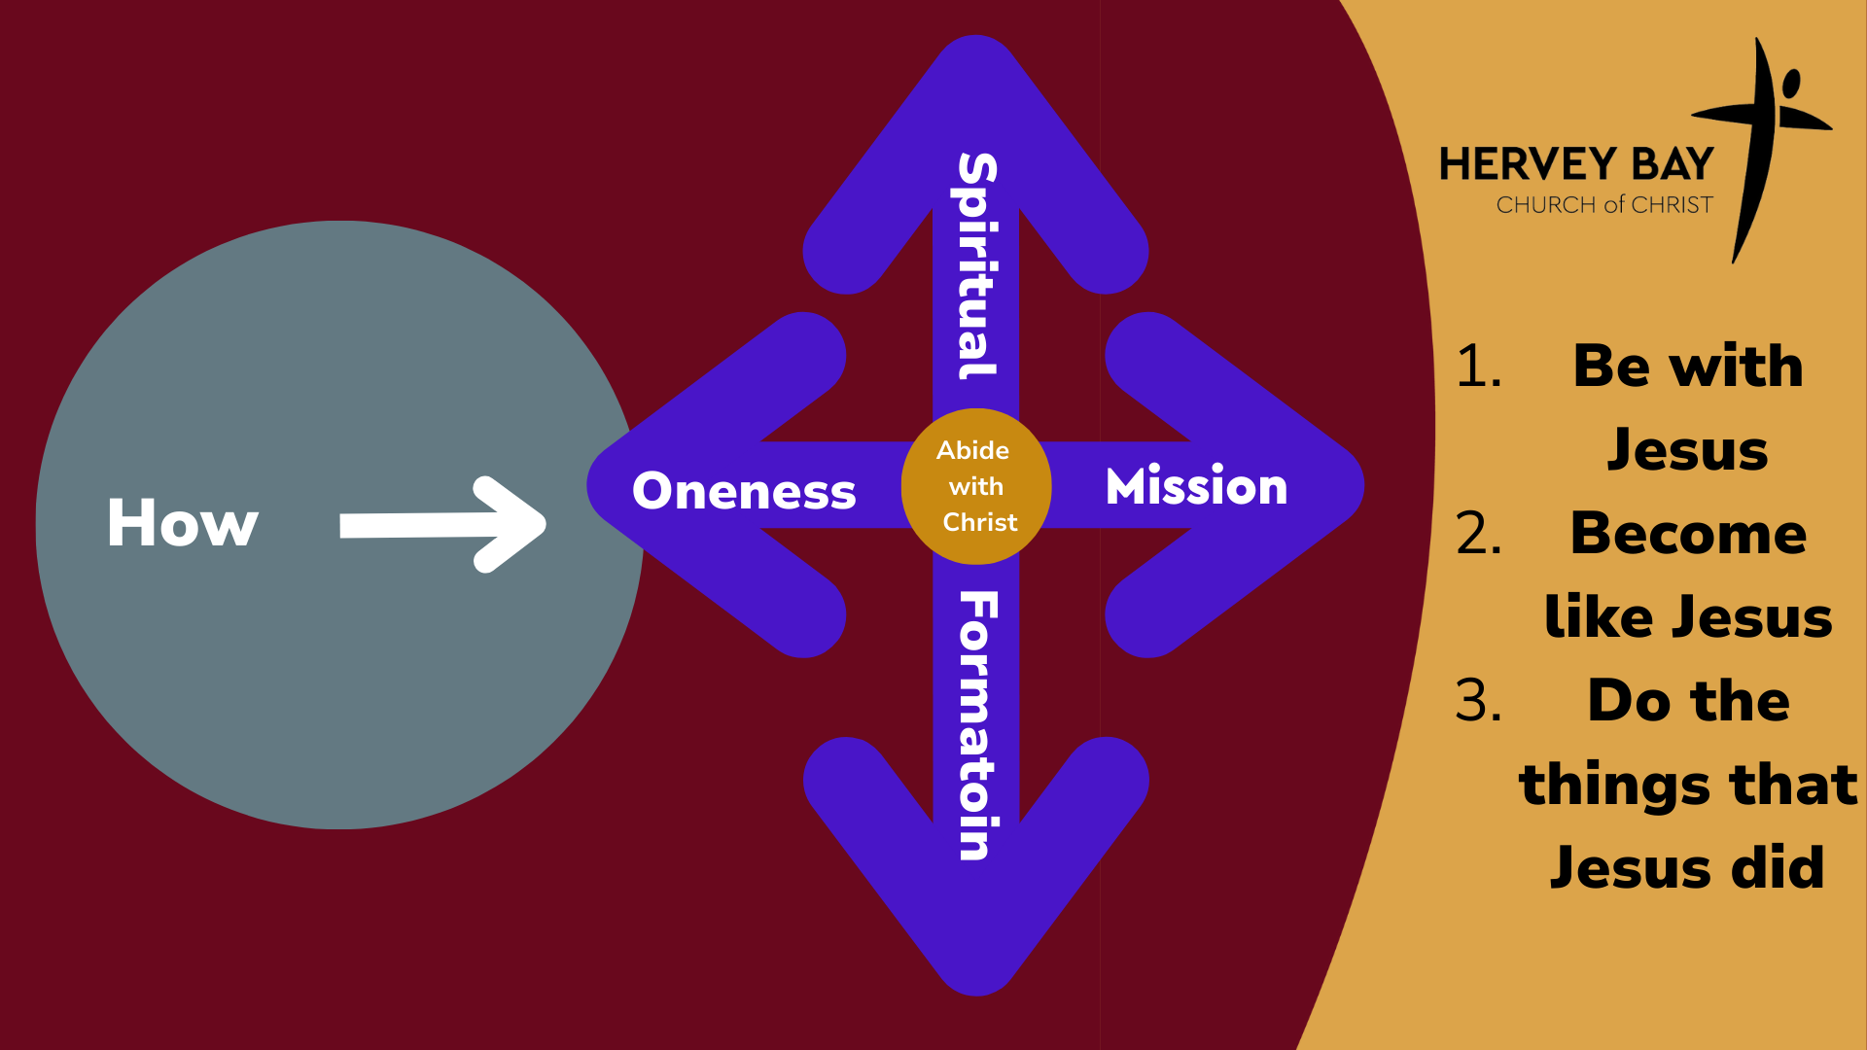

Slide 3


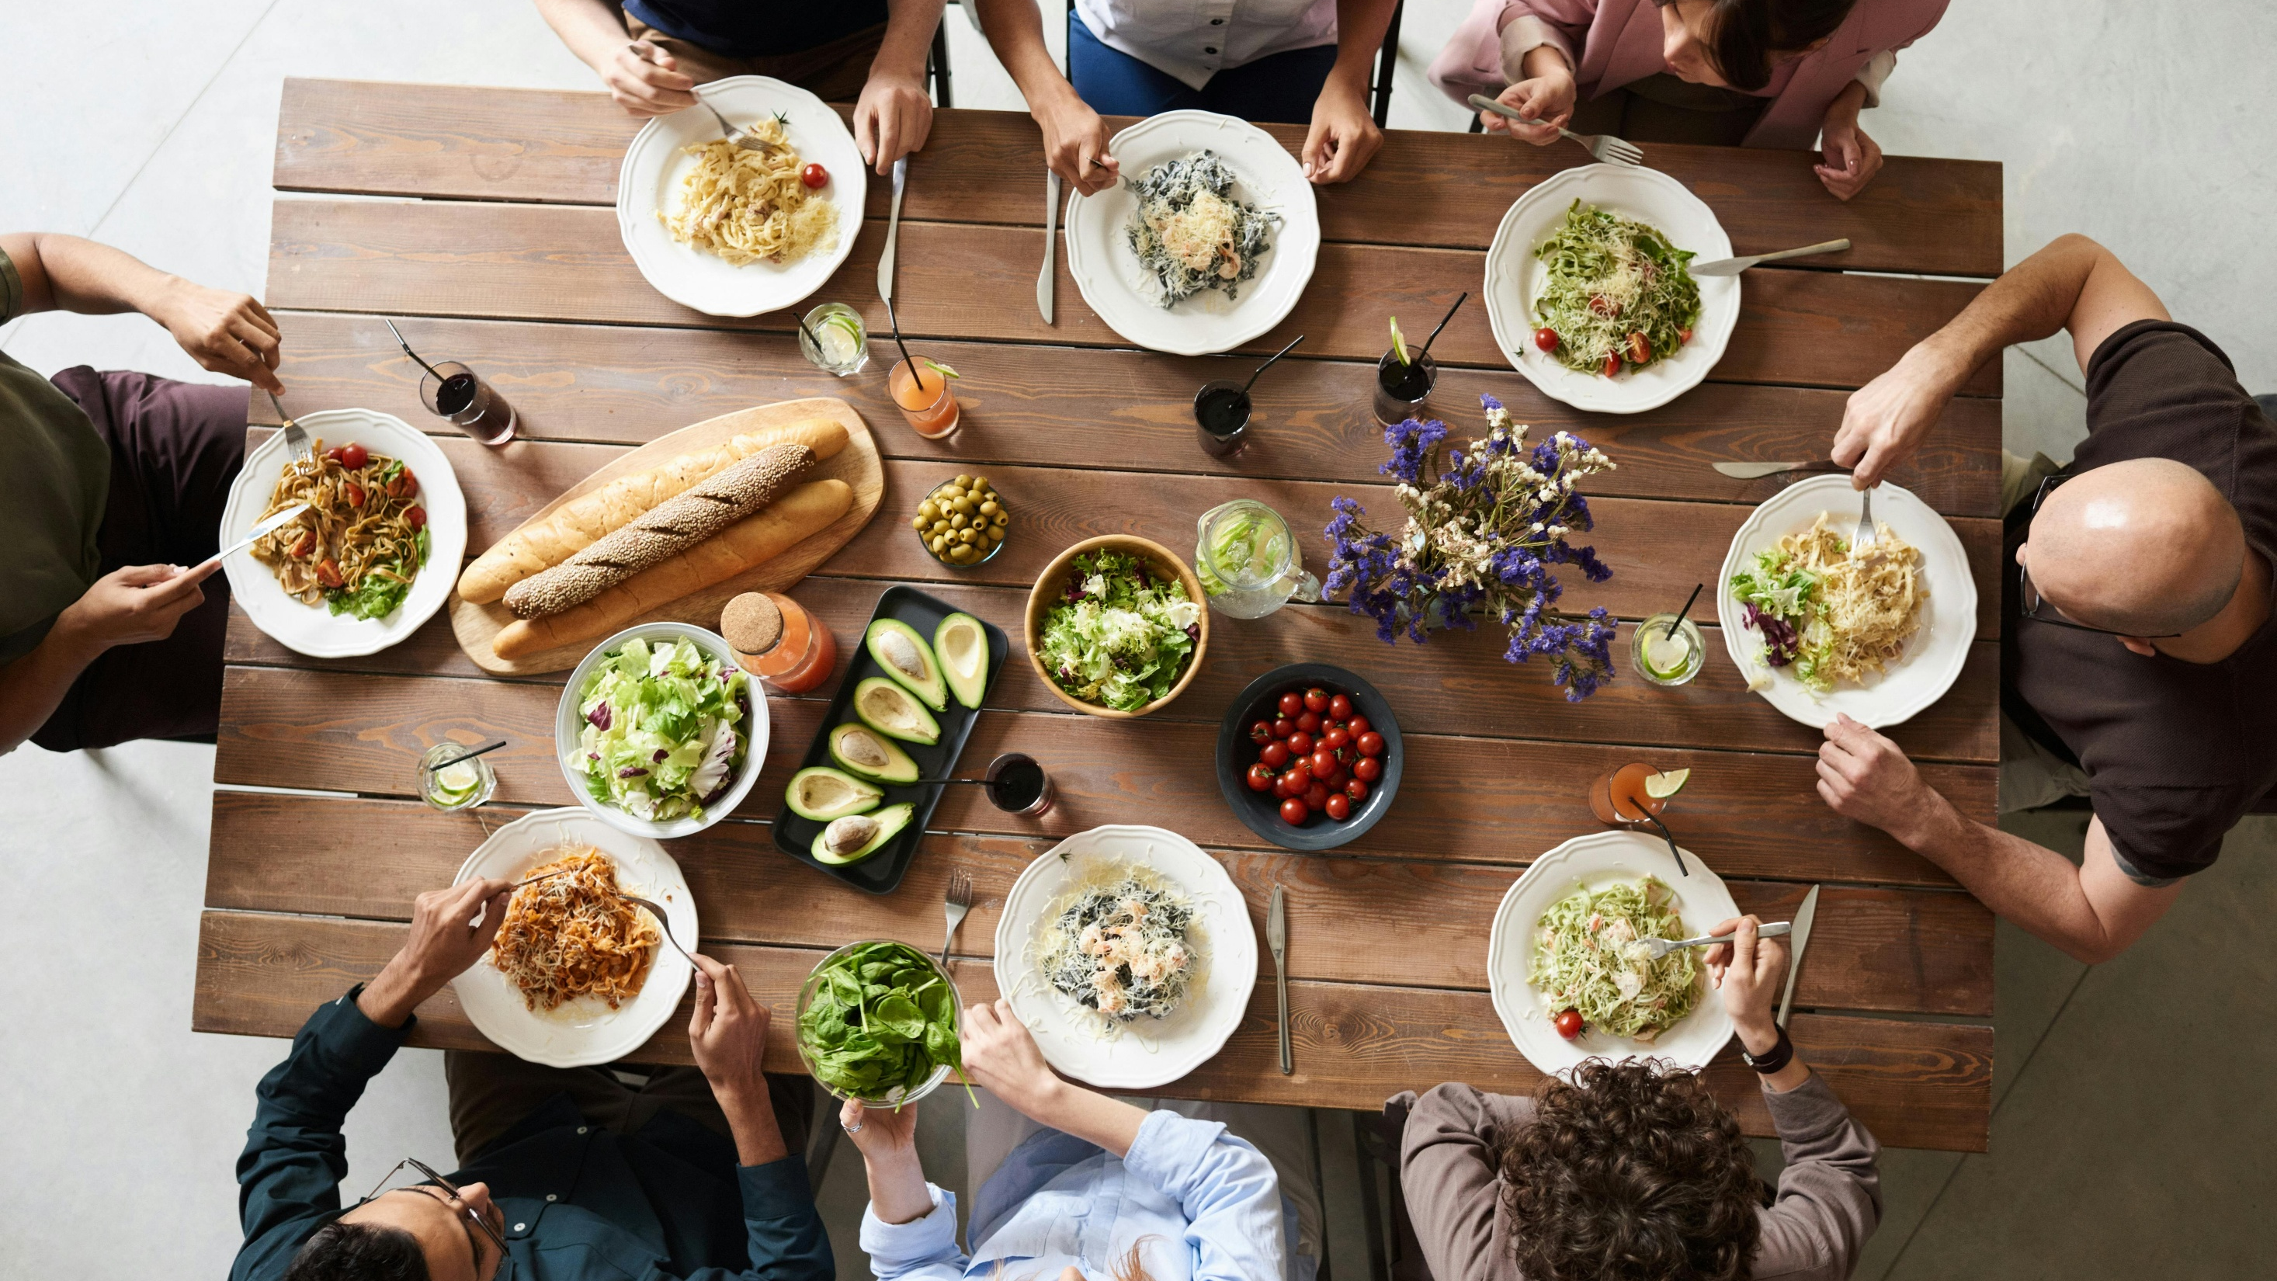




Slide 4


Slide 5

What is your day to day context?
Where have you seen God at work there?
How can we pray with you?

Slide 6


