Slide 1
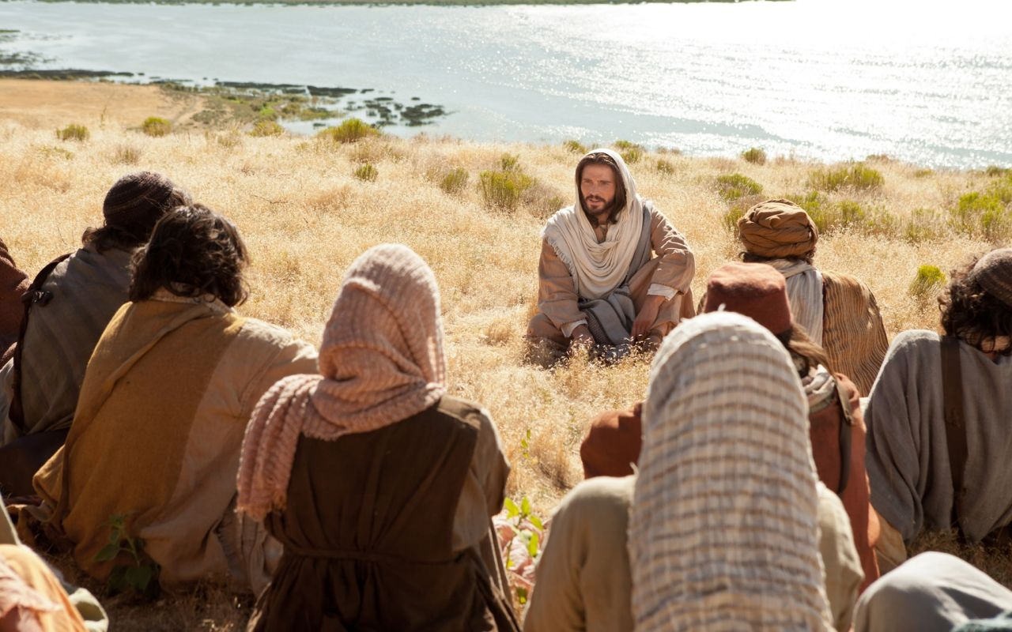
Transfiguration
Matthew 16:28-17:13

Slide 2
Matthew 16:28-17:3 NTE
I’m telling you the truth: some of those standing here will not taste death until they see “the son of man coming in his kingdom”.’
After six days Jesus took Peter, James, and James’s brother John, and led them off up a high mountain by themselves. There he was transformed in front of them. His face shone like the sun, and his clothes became as white as light. Then, astonishingly, Moses and Elijah appeared to them. They were talking with Jesus.

Slide 3
Matthew 17:4-7 NTE
Peter just had to say something. ‘Master,’ he said to Jesus, ‘it’s wonderful for us to be here! If you want, I’ll make three shelters here – one for you, one for Moses, and one for Elijah!’
While he was still speaking, a bright cloud overshadowed them. Then there came a voice out of the cloud. ‘This is my dear son,’ said the voice, ‘and I’m delighted with him. Pay attention to him.’
When the disciples heard this, they fell on their faces and were scared out of their wits. Jesus came up and touched them.

Slide 4
Matthew 17:7-11 NTE
‘Get up,’ he said, ‘and don’t be afraid.’
When they raised their eyes, they saw nobody except Jesus, all by himself.
As they were coming down the mountain, Jesus gave them strict instructions. ‘Don’t tell anyone about the vision,’ he said, ‘until the son of man has been raised from the dead.’
‘So why’, asked the disciples, ‘do the scribes say that “Elijah must come first”?’
‘Elijah does indeed come,’ replied Jesus, ‘and “he will restore everything”.

Slide 5
Matthew 17:12-13 NTE
But let me tell you this: Elijah has already come, and they didn’t recognize him! They did to him whatever they wanted. That’s how the son of man, too, will suffer at their hands.’
Then the disciples realized that he was talking to them about John the Baptist.

Slide 6
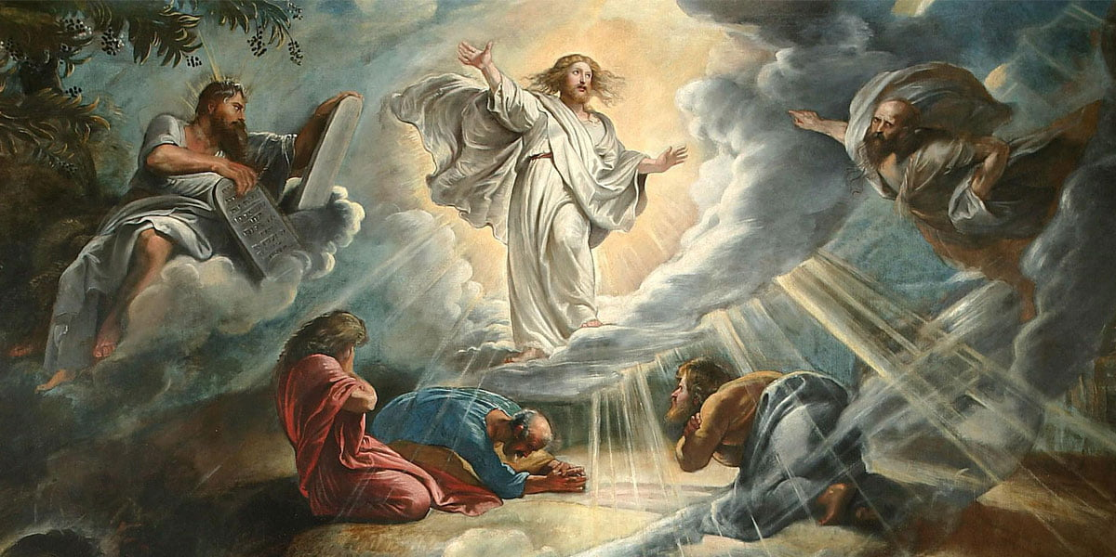
What stood out for you from the Scripture?
2. Do you have any questions?
3. Have you ever had a peak spiritual experience? What was it like? Is their lasting fruit from that experience?

Slide 8
Transfiguration | Crucifixion
Revealed in glory | Covered in shame
Clothes shining white | Clothes striped off
Flanked by Moses and Elijah | Flanked by brigands
Great bright cloud covers them | Darkness covers them
Peter burst out how wonderful they are | Peter denies Jesus
The voice of God declares this is his beloved son | A surprised Roman soldier declares this is the Son of God

Slide 9
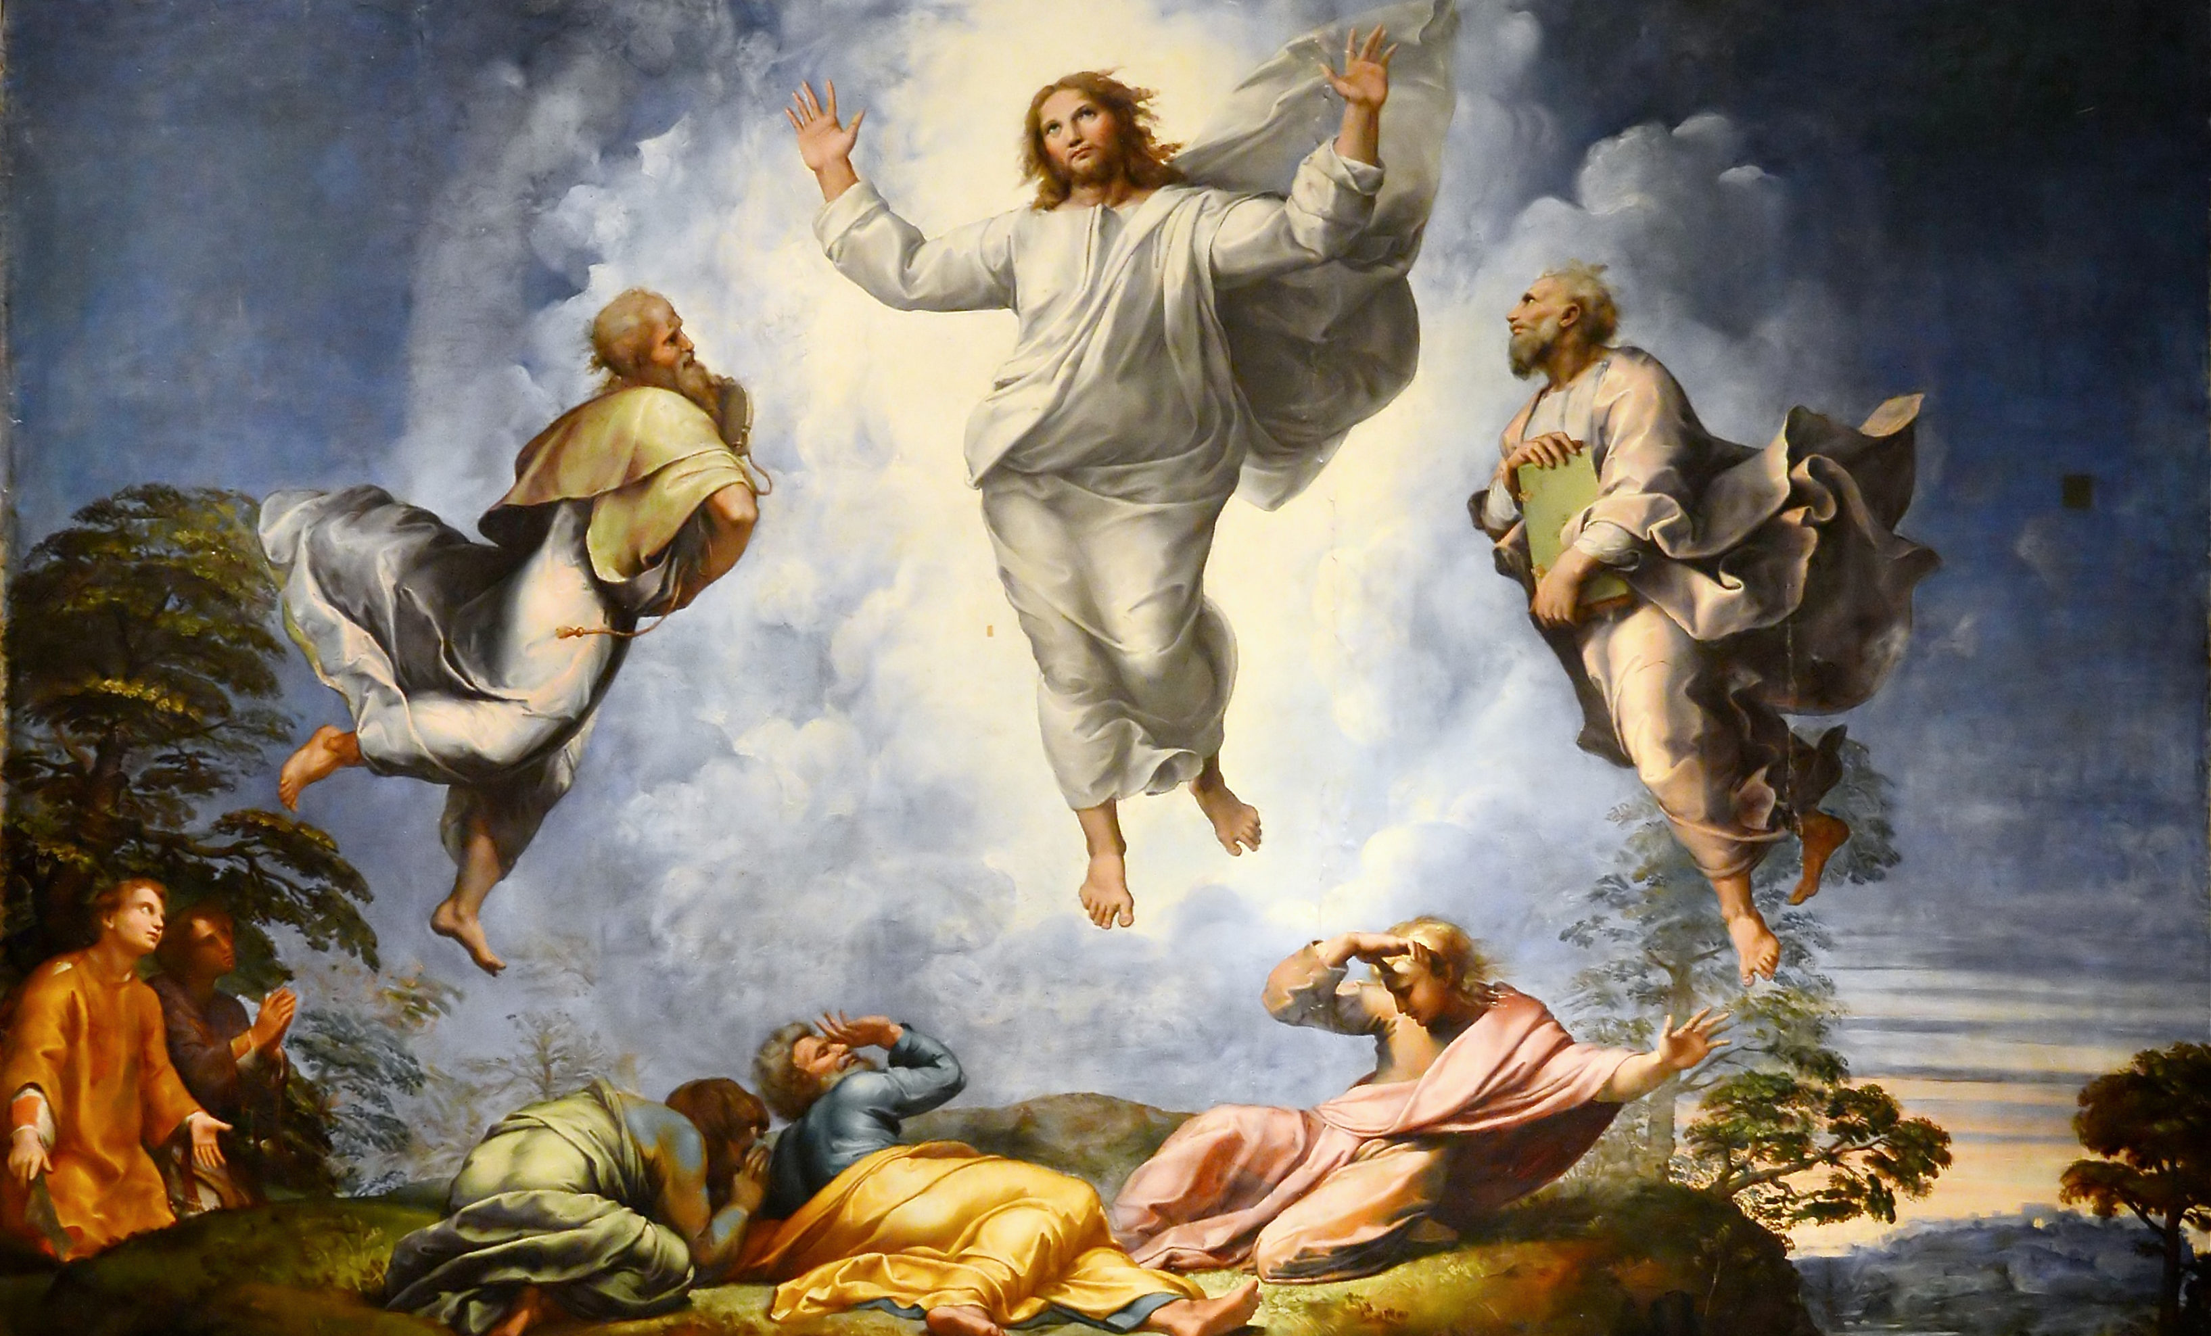

Slide 10
The Hebrew Scriptures:
The Law
The Prophets
The Wisdom Literature

Slide 11
How do we listen to Jesus?

Slide 12

Read the Scriptures Christo-centrically

