Slide 1


Slide 2






5th Sunday Retreat and Lunch
“To know is to love”

Slide 3

Lounge – Open House
1-3pm March 1st

Slide 4

World Day of Prayer
Date: Friday, 6th March 2026
Time: 9.30am
Venue: St Joseph Catholic Church, Cnr Torquay Road & Bryant Street, Pialba

Slide 5



Slide 6
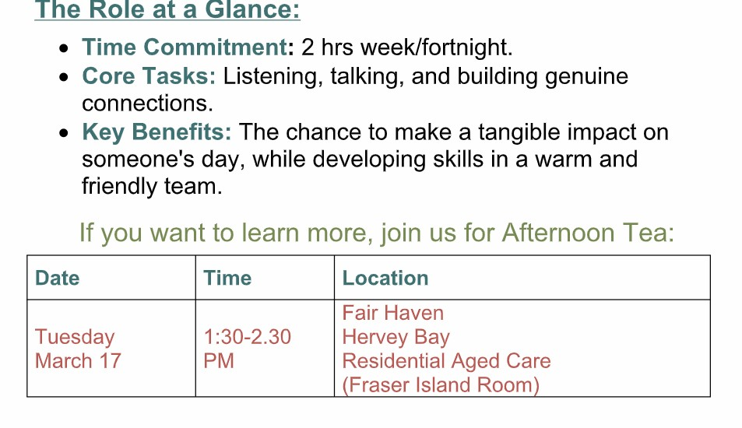

Slide 7


See Jackie

Slide 8


Slide 9

What is your day to day context?
Where have you seen God at work there?
How can we pray with you?

Slide 10


