Slide 1


Slide 2


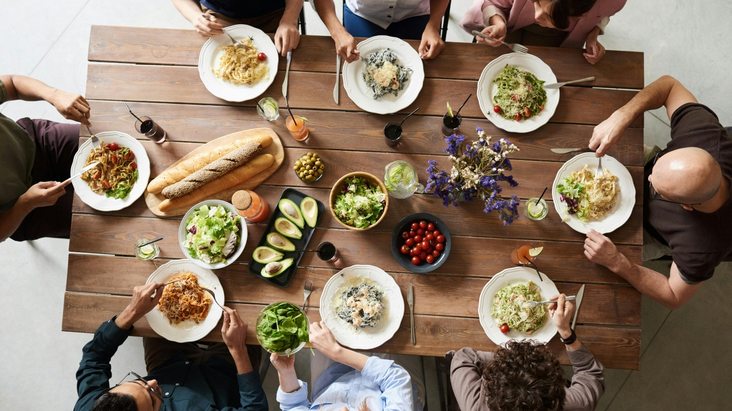



5th Sunday Retreat and Lunch
March 29th
Come at 9am – Stay for Lunch
“To know is to love”

Slide 3



Slide 4
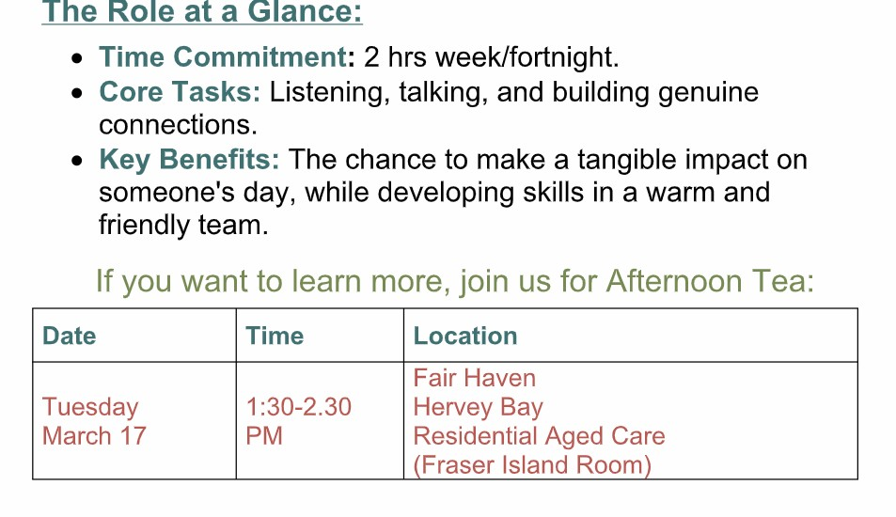

Slide 5

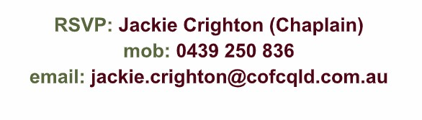
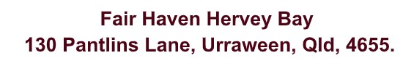
See Jackie
Good Friday 3rd April 2026 at 10.30am
Location: St Joseph’s Catholic Church, Pialba

Slide 6

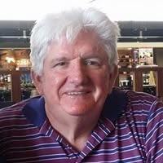
March 22nd

Slide 7


Slide 8

Good Friday 3rd April 2026 at 10.30am
✝️ Location: St Joseph’s Catholic Church, Pialba
Good Friday 3rd April 10:30am
St Joseph’s Catholic Church

Slide 9


Slide 10

What is your day to day context?
Where have you seen God at work there?
How can we pray with you?

Slide 11


