Slide 1
John 3:1-18
Death and Rebirth

Slide 2
John 3:1-4 NTE
There was a man of the Pharisees called Nicodemus, a ruler of the Judaeans. He came to Jesus by night.
“Rabbi,” he said to him. “We know that you’re a teacher who’s come from God. Nobody can do these signs that you’re doing, unless God is with him.”
“Let me tell you the solemn truth,” replied Jesus. “Unless someone has been born from above, they won’t be able to see God’s kingdom.”
“How can someone possibly be born,” asked Nicodemus, “when they’re old? You’re not telling me they can go back a second time into the mother’s womb and be born, are you?”

Slide 3
John 3:5-9 NTE
“I’m telling you the solemn truth,” replied Jesus. “Unless someone is born from water and spirit, they can’t enter God’s kingdom. Flesh is born from flesh, but spirit is born from spirit. Don’t be surprised that I said to you, You must be born from above. The wind blows where it wants to, and you hear the sound it makes; but you don’t know where it’s coming from or where it’s going to. That’s what it’s like with someone who is born from the spirit.”
“How can this be so?” asked Nicodemus.

Slide 4
John 3:10-13 NTE
“Well, well!” replied Jesus. “You’re a teacher of Israel, and yet you don’t know about all this? I’m telling you the solemn truth: we’re talking about things we know about. We’re giving evidence about things we’ve seen. But you won’t admit our evidence. If I told you earthly things and you don’t believe, how will it be if I tell you heavenly things? Are you going to believe then? And nobody has gone up into heaven except the one who came down from heaven, the son of man.”

Slide 5
John 3:14-18 NTE
“So, just as Moses lifted up the snake in the desert, in the same way the son of man must be lifted up, so that everyone who believes in him may share in the life of God’s new age. This, you see, is how much God loved the world: enough to give his only, special son, so that everyone who believes in him should not be lost but should share in the life of God’s new age. After all, God didn’t send the son into the world to condemn the world, but so that the world could be saved by him.
“Anyone who believes in him is not condemned. But anyone who doesn’t believe is condemned already, because they didn’t believe in the name of God’s only, special son.

Slide 6
Q & eh?
What sticks out for you?

Slide 7

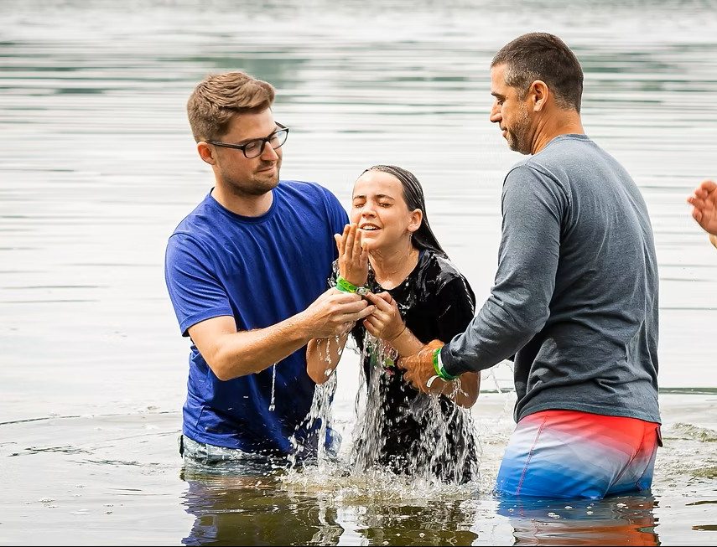
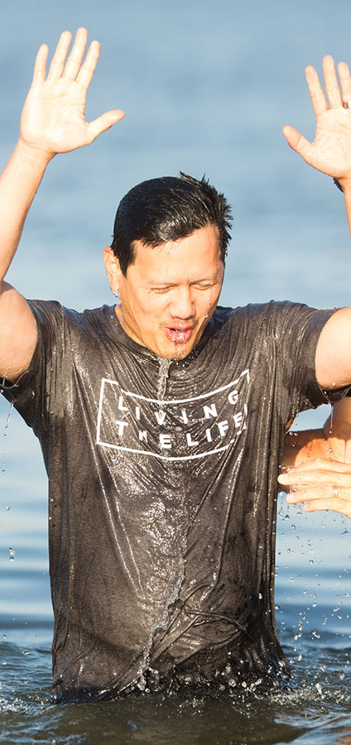
Born of water and Spirit

Slide 8
Q & eh?
What is verse 14 about?
Read verses 16-18 again. What does this tell us about god’s love?
How should we understand condemnation?

Slide 9
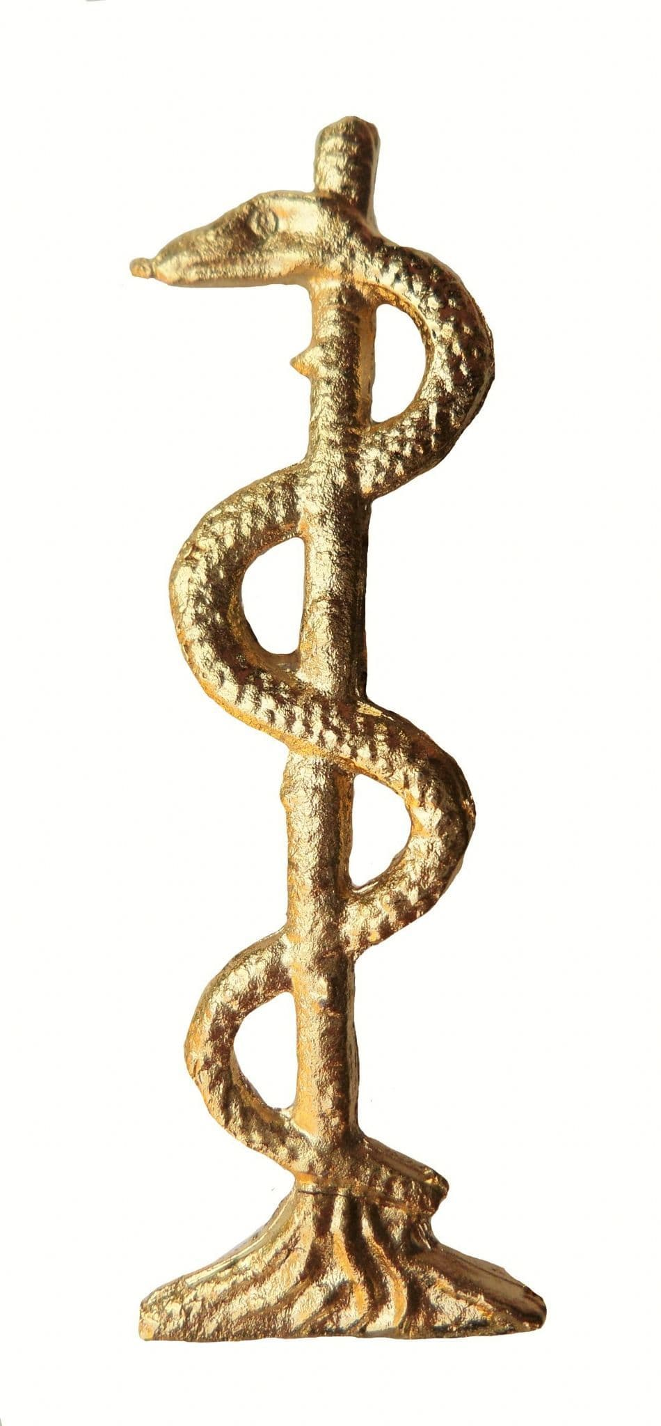
Snake on the staff

Slide 10
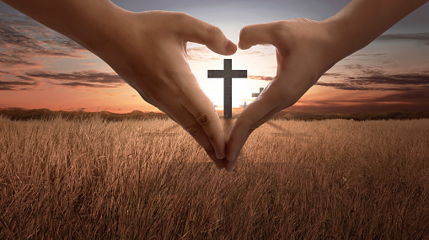
God’s love demonstrated

Slide 11
John 3:18-21
“Anyone who believes in him is not condemned. But anyone who doesn’t believe is condemned already, because they didn’t believe in the name of God’s only, special son. And this is the condemnation: that light has come into the world, and people loved darkness rather than light, because what they were doing was evil. For everyone who does evil hates the light; people like that don’t come to the light, in case their deeds get shown up and reproved. But people who do the truth come to the light, so that it can become clear that what they have done has been done in God.”

Slide 12
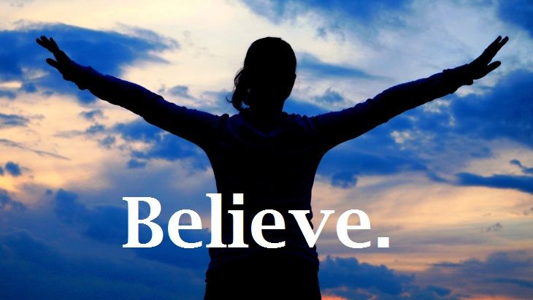

Slide 13
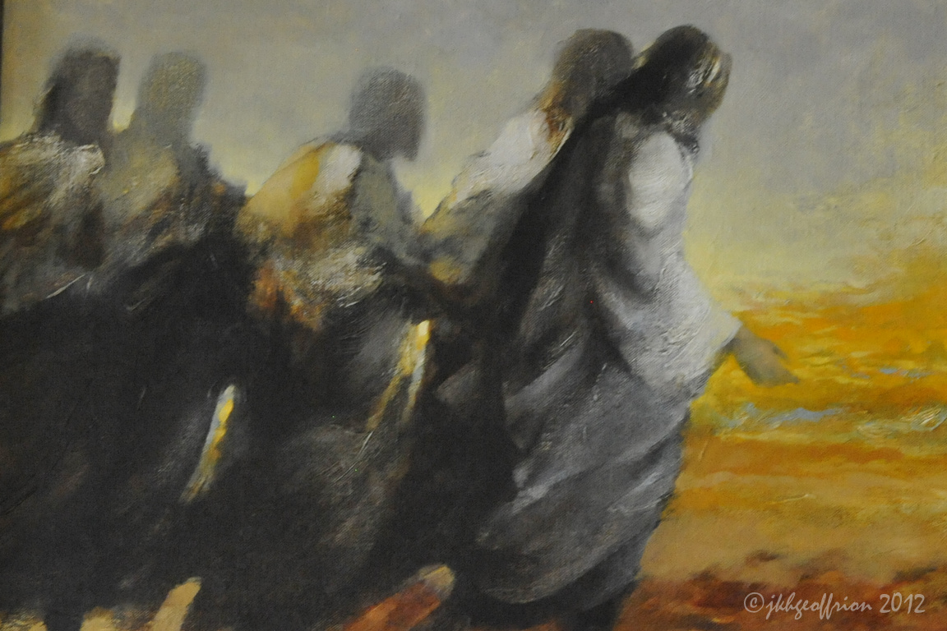
Life Goals
1. Be with Jesus
2. Become like Jesus
3. Do what Jesus does

Slide 14
Jesus came:
To show us how to be truly human
To defeat the evil forces that had held the world captive
To reconcile the lost and forgive sinners

Slide 15
Reflect

