Slide 1

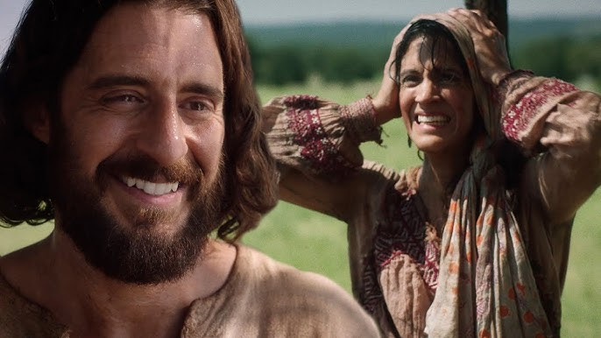
Woman at the Well
John 4:5-42

Slide 2
John 4:5-9
and he came to a town in Samaria named Sychar. It was near the place which Jacob gave to his son Joseph. Jacob’s well was there. So Jesus, tired from the journey, sat down there by the well. It was about midday.
A Samaritan woman came to draw water, and Jesus spoke to her.
“Give me a drink,” he said. (The disciples had gone off into the town to buy food.)
“What!” said the Samaritan woman. “You, a Jew, asking for a drink from me, a woman, and a Samaritan at that?” (Jews, you see, don’t have any dealings with Samaritans.)

Slide 3
John 4:10-13
“If only you’d known God’s gift,” replied Jesus, “and who it is that’s saying to you, ‘Give me a drink,’ you’d have asked him, and he would have given you living water.”
“But sir,” replied the woman, “you haven’t got a bucket! And the well’s deep! So how were you thinking of getting living water? Are you greater than our father Jacob, who gave us the well, and drank of it himself, with his sons and his animals?”
“Everyone who drinks this water,” Jesus replied, “will get thirsty again.

Slide 4
John 4:14-15
But anyone who drinks the water I’ll give them won’t ever be thirsty again. No: the water I’ll give them will become a spring of water welling up to the life of God’s new age.”
“Sir,” the woman said, “give me this water! Then I won’t be thirsty anymore, and I won’t have to come here to draw from the well.”

Slide 5
Questions
Who were the Samaritans?
Why was she surprised Jesus spoke to her?
What do you think Jesus is angling at speaking of “Living Water” and what is confusing the woman?

Slide 6
John 4:16-20
“Well then,” said Jesus to the woman, “go and call your husband and come here.”
“I haven’t got a husband,” replied the woman.
“You’re telling me you haven’t got a husband!” replied Jesus. “The fact is, you’ve had five husbands, and the one you’ve got now isn’t your husband. You were speaking the truth!”
“Well, sir,” replied the woman, “I can see you’re a prophet . . . Our ancestors worshiped on this mountain. And you say that in Jerusalem is the place where people ought to worship.”

Slide 7
John 4:21-24
“Believe me, woman,” replied Jesus, “the time is coming when you won’t worship the father on this mountain or in Jerusalem. You worship what you don’t know. We worship what we do know; salvation, you see, is indeed from the Jews. But the time is coming—indeed, it’s here already!—when true worshipers will worship the father in spirit and in truth. Yes; that’s the kind of worshipers the father is looking for. God is spirit, and those who worship him must worship in spirit and in truth.”

Slide 8
John 4:25-26
“I know that Messiah is coming,” said the woman, “the one they call ‘the anointed.’ When he comes, he’ll tell us everything.”
“I’m the one—the one speaking to you right now,” said Jesus.

Slide 9
Questions
What role do you think Spiritual Gifts have in evangelism?
What do you think is going on with this woman to have had 5+ husbands?
What is a fast way to avoid being vulnerable?
What Jesus mean by Spirit and truth?

Slide 10
John 4:27-30
Just then Jesus’ disciples came up. They were astonished that he was talking with a woman; but nobody said “What did you want?” or “Why were you talking with her?” So the woman left her water-jar, went into the town and spoke to the people.
“Come on!” she said. “Come and see a man who told me everything I ever did! You don’t think he can be the Messiah, do you?”
So they left the town and were coming out to him.

Slide 11
John 4:31-34
Meanwhile the disciples were nagging him.
“Come on, Rabbi!” they were saying. “You must have something to eat!”
“I’ve got food to eat that you know nothing about,” he said.
“Nobody’s brought him anything to eat, have they?” said the disciples to one another.
“My food,” replied Jesus, “is to do the will of the one who sent me, and to finish his work!

Slide 12
John 4:35-38
Don’t you have a saying, ‘Another four months, then comes harvest’? Well, let me tell you, raise your eyes and see! The fields are white! It’s harvest time already! The reaper earns his pay, and gathers crops for the life of God’s coming age, so that sower and reaper can celebrate together. This is where that saying comes true, ‘One sows, another reaps.’ I sent you to reap what you didn’t work for. Others did the hard work, and you’ve come into the results.”

Slide 13
John 4:39-42
Several Samaritans from that town believed in Jesus because of what the woman said in evidence about him, “He told me everything I did.” So when the Samaritans came to him, they asked him to stay with them. And he stayed there two days.
Many more believed because of what he said.
“We believe, too,” they said to the woman, “but it’s no longer because of what you told us. We’ve heard him ourselves! We know that he really is the one! He’s the savior of the world!”

Slide 14
Questions
In what way is this woman a person of Peace?
I’ve got food you know nothing about????
Saviour of the world?

Slide 15
Reflect
In what way am I like the woman at the well?

