Slide 1
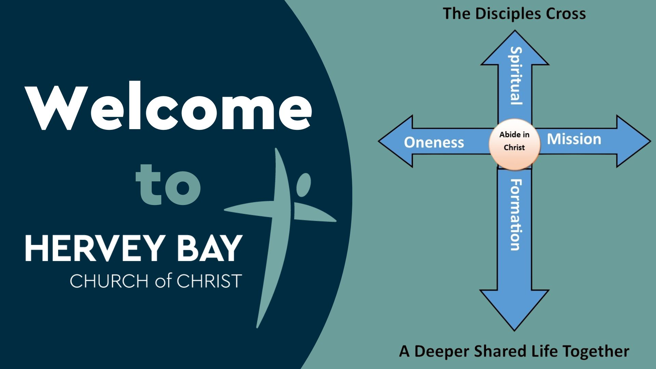

Slide 2
Rosters
Date | Serving
 | Name
Look for Version 2

Slide 3
Combined Churches Pentecost Service
6pm
Sunday 24th May
Hervey Bay Baptist Church

Slide 4

Crightons are on Holiday
April 16th –May 19th

Slide 5






What is your day to day context?
Where have you seen God at work there?
How can we pray with you?

Slide 6


Slide 7


