Slide 1
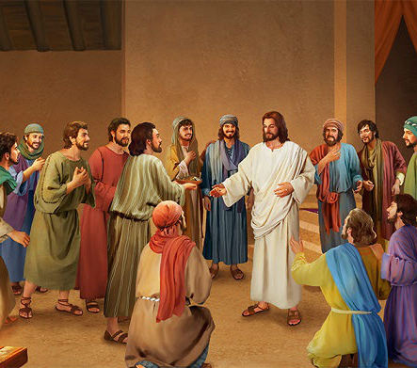
John 20
Resurrection????

Slide 2
John 20:19-23
On the evening of that first day of the week, when the disciples were together, with the doors locked for fear of the Jewish leaders, Jesus came and stood among them and said, “Peace be with you!” After he said this, he showed them his hands and side. The disciples were overjoyed when they saw the Lord.
Again Jesus said, “Peace be with you! As the Father has sent me, I am sending you.” And with that he breathed on them and said, “Receive the Holy Spirit. If you forgive anyone’s sins, their sins are forgiven; if you do not forgive them, they are not forgiven.”

Slide 3
Standouts!
Questions?
Tangents…

Slide 4
John 20:24
24 Now Thomas (also known as Didymus[a]), one of the Twelve, was not with the disciples when Jesus came. 25 So the other disciples told him, “We have seen the Lord!”
But he said to them, “Unless I see the nail marks in his hands and put my finger where the nails were, and put my hand into his side, I will not believe.”
26 A week later his disciples were in the house again, and Thomas was with them. Though the doors were locked, Jesus came and stood among them and said, “Peace be with you!”

Slide 5
John 20:24
27 Then he said to Thomas, “Put your finger here; see my hands. Reach out your hand and put it into my side. Stop doubting and believe.”
28 Thomas said to him, “My Lord and my God!”
29 Then Jesus told him, “Because you have seen me, you have believed; blessed are those who have not seen and yet have believed.”

Slide 6
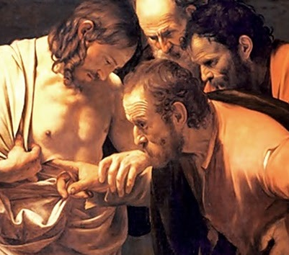
Standouts!
Questions?
Tangents…

Slide 7
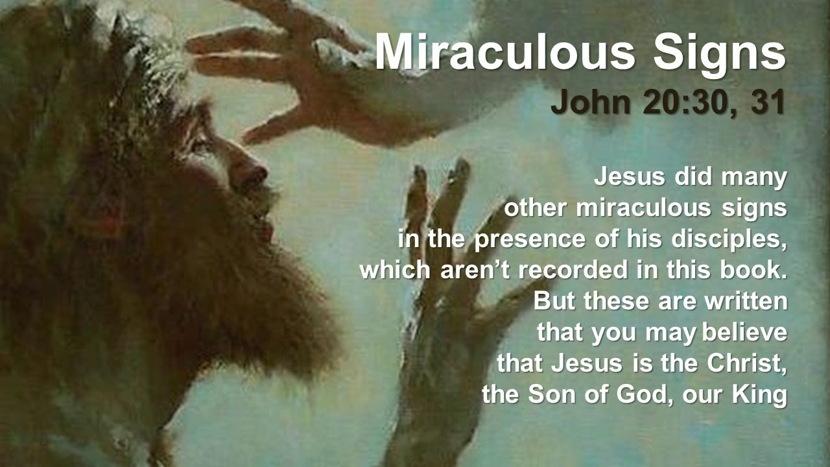

Slide 8
Can we trust the Gospels?
Reliable
Disciples died for this claim
Consistent explanation
O.T. prophesies fulfilled
Millions of people have experienced God’s Peace
You also can experience God’s Peace

Slide 9
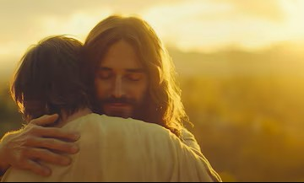
Reflect
Jesus offers his peace to you.

