Slide 1


Slide 2
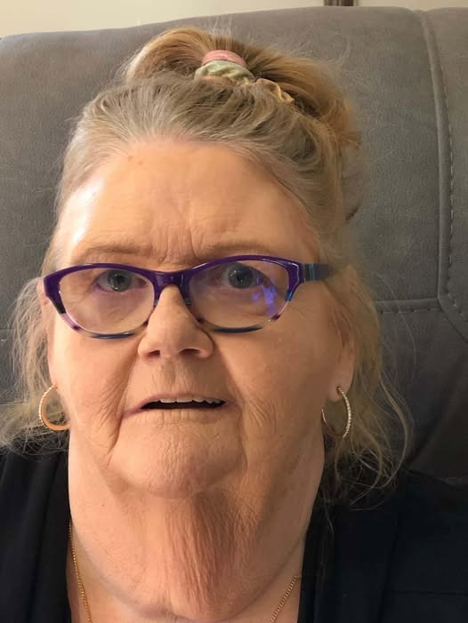
Susan Kirwin
Funeral 11am Friday 12 June
Kirk’s Chapel, Urraween Road

Slide 3
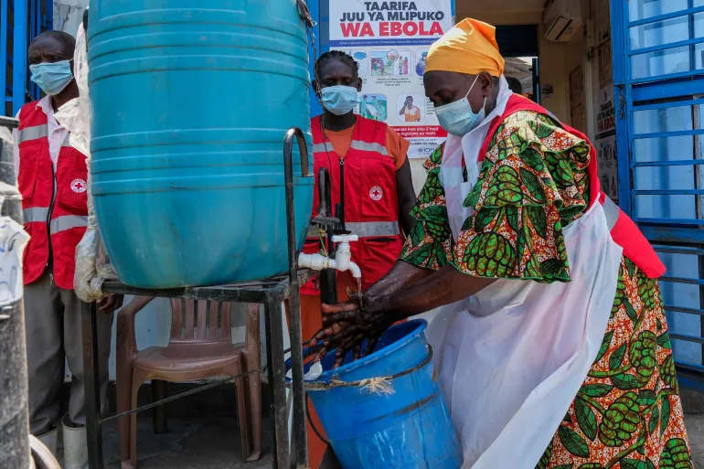
Ebola – Cost of Standard Operating Procedures

Slide 4







Slide 5

What is your day to day context?
Where have you seen God at work there?
How can we pray with you?

Slide 6


