Slide 1
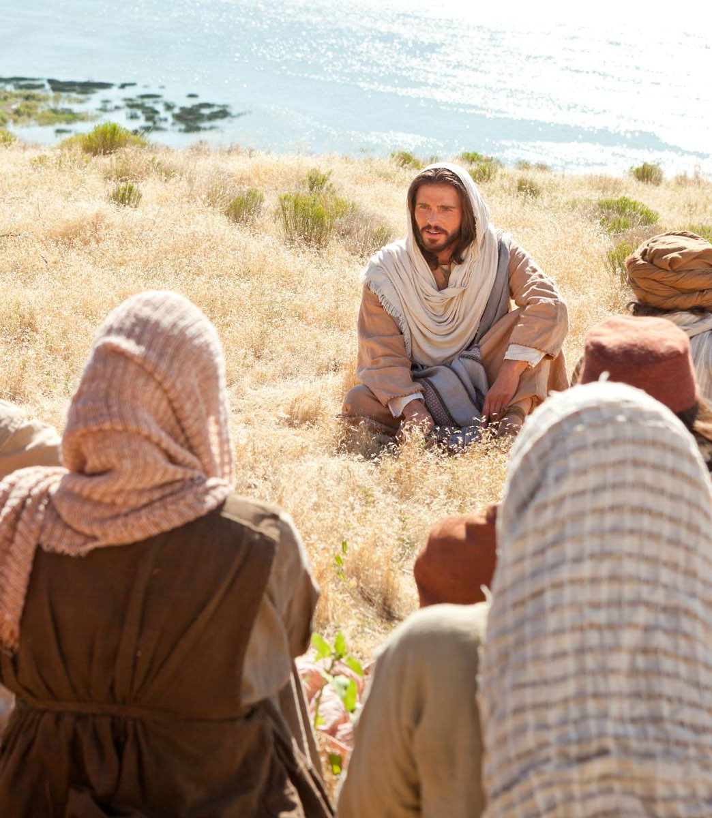
Matthew 10:24-39
Warnings, Encouragements and Challenges

Slide 2
What is the most common command in the Scriptures?

Slide 3
What is the most common command in the Scriptures?
Don’t be afraid

Slide 4
Matthew 10
24 “The disciple isn’t greater than the teacher; the slave isn’t greater than the master. 25 It’s quite enough for the disciple to be like the teacher, and the slave to be like the master. If they called the master of the house ‘Beelzebul,’ think what they’re going to call his family!
What is Jesus trying to say?

Slide 5
Matthew 10
28 “Don’t be afraid of people who can kill the body, but can’t kill the soul. The one you should be afraid of is the one who can destroy both body and soul in Gehenna.
What about these words do you find most encouraging and why?

Slide 6
Matthew 10
28 “Don’t be afraid of people who can kill the body, but can’t kill the soul. The one you should be afraid of is the one who can destroy both body and soul in Gehenna.
Who could Jesus be speaking about?

Slide 7
Matthew 10
29 How much would you get for a couple of sparrows? A single copper coin if you’re lucky? And not one of them falls to the ground without your father knowing about it. 30 When it comes to you—why, every hair on your head is counted. 31 So don’t be afraid! You’re worth much more than a great many sparrows.”
What about these words do you find most encouraging and why?

Slide 8
Matthew 10
32 “So: everyone who owns up in front of others to being on my side, I will own them before my father in heaven. 33 But anyone who disowns me in front of others, I will disown that person before my father in heaven.
Who’s are we? Does this stand out for you or the warning?

Slide 9
Matthew 10
34 “Don’t think it’s my job to bring peace on the earth. I didn’t come to bring peace—I came to bring a sword! 35 I came to divide a man from his father, a daughter from her mother, and a daughter-in-law from her mother-in-law. 36 Yes, you’ll find your enemies inside your own front door.
What is your experience or the most obvious application?

Slide 10
Matthew 10
37 “If you love your father or mother more than me, you don’t deserve me. If you love your son or daughter more than me, you don’t deserve me. 38 Anyone who doesn’t pick up their cross and follow after me doesn’t deserve me. 39 If you find your life you’ll lose it, and if you lose your life because of me you’ll find it.
These are familiar words, but what is Jesus getting at?

Slide 11
Reflect

