Slide 1
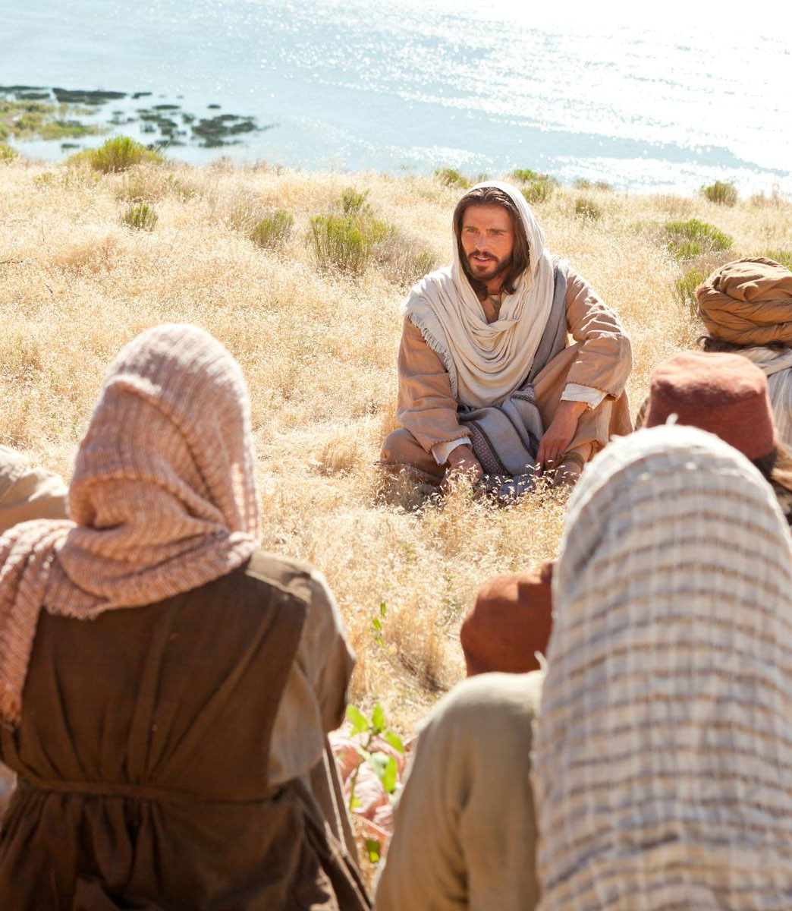
Matthew 9:35-10:23
Sends out the 12

Slide 3
Matthew 9
35 Jesus went around all the towns and villages, teaching in their synagogues, announcing the good news of the kingdom, and healing every disease and every sickness. 36 When he saw the crowds, he felt deeply sorry for them, because they were distressed and dejected, like sheep without a shepherd. 37 Then he said to his disciples, “There’s plenty of harvest to be had, but not many workers! 38 So pray the master of the harvest to send more workers to harvest his fields!”

Slide 4
Matthew 10
Jesus called his twelve disciples to him, and gave them authority over unclean spirits, to cast them out and to heal every disease and every sickness.
2 These are the names of the twelve apostles. First, Simon, who is called Peter (“the rock”), and Andrew his brother; James the son of Zebedee, and John his brother; 3 Philip and Bartholomew, Thomas and Matthew the tax-collector, James son of Alphaeus, and Thaddaeus; 4 Simon the Cananaean; and Judas Iscariot (who betrayed him).
5 Jesus sent these Twelve off with the following instructions.

Slide 5
Matthew 10
“Don’t go into Gentile territory,” he said, “and don’t go into a Samaritan town. 6 Go instead to the lost sheep of the house of Israel. 7 As you go, declare publicly that the kingdom of heaven has arrived. 8 Heal the sick, raise the dead, cleanse people with skin diseases, cast out demons.
“You received without cost; give without charge. 9 Don’t take any gold or silver or copper in your belts; 10 no bag for the road, no second cloak, no sandals, no stick. Workers deserve their keep.

Slide 6
Matthew 10
11 “When you go into a town or village, make careful inquiry for someone who is good and trustworthy, and stay there until you leave. 12 When you go into the house give a solemn greeting. 13 If the house is trustworthy, let your blessing of peace rest upon it, but if not, let it return to you. 14 If anyone won’t welcome you or listen to your message, go out of the house or the town and shake the dust off your feet. 15 I’m telling you the truth: it will be more bearable for Sodom and Gomorrah on the day of judgment than for that town.”

Slide 7
Matthew 10
16 “See here,” Jesus continued, “I’m sending you out like sheep surrounded by wolves. So be as shrewd as snakes, and as innocent as doves.
17 “Watch out for danger from people around you. They will hand you over to councils, and flog you in their synagogues. 18 You will be dragged before governors and kings because of me, as evidence to them and to the nations. 19 But when they hand you over, don’t worry how to speak or what to say. What you have to say will be given to you at that moment. 20 It won’t be you speaking, you see; it will be the spirit of your father speaking in you.

Slide 8
Matthew 10
21 “One brother will betray another to death; fathers will betray children, and children will rebel against their parents and have them put to death. 22 You will be hated by everyone because of my name. But the one who holds out to the end will be delivered.
23 “When they persecute you in one town, run off to the next one. I’m telling you the truth: you won’t have gone through all the towns of Israel before the son of man comes.”

Slide 9
Discuss
Read Through it again at your tables…
What is the challenge?
What is the invitation?
What part indicates covenant relationship?
What part Kingdom Responsibilities?

Slide 10
1. Jesus is leading by example – proclaiming the Kingdom and healing the sick

Slide 11
1. Jesus is leading by example – proclaiming the Kingdom and healing the sick
2. Driven by compassion

Slide 12
1. Jesus is leading by example – proclaiming the Kingdom and healing the sick
2. Driven by compassion
3. Prayer is the work

Slide 13
1. Jesus is leading by example – proclaiming the Kingdom and healing the sick
2. Driven by compassion
3. Prayer is the work
4. Given authority over unclean spirits and sickness

Slide 14
1. Jesus is leading by example – proclaiming the Kingdom and healing the sick
2. Driven by compassion
3. Prayer is the work
4. Given authority over unclean spirits and sickness
5. Named but flawed

Slide 15
1. Jesus is leading by example – proclaiming the Kingdom and healing the sick
2. Driven by compassion
3. Prayer is the work
4. Given authority over unclean spirits and sickness
5. Named but flawed
6. Sends them to the receptive

Slide 16
1. Jesus is leading by example – proclaiming the Kingdom and healing the sick
2. Driven by compassion
3. Prayer is the work
4. Given authority over unclean spirits and sickness
5. Named but flawed
6. Sends them to the receptive
7. Commissions them to proclaim the reign of God

Slide 17
1. Jesus is leading by example – proclaiming the Kingdom and healing the sick
2. Driven by compassion
3. Prayer is the work
4. Given authority over unclean spirits and sickness
5. Named but flawed
6. Sends them to the receptive
7. Commissions them to proclaim the reign of God
8. Heal the sick

Slide 18
1. Jesus is leading by example – proclaiming the Kingdom and healing the sick
2. Driven by compassion
3. Prayer is the work
4. Given authority over unclean spirits and sickness
5. Named but flawed
6. Sends them to the receptive
7. Commissions them to proclaim the reign of God
8. Heal the sick
9. Cast out demons

Slide 19
1. Jesus leads by example – proclaiming the Kingdom and healing the sick
2. Driven by compassion
3. Prayer is the work
4. Given authority over unclean spirits and sickness
5. Named but flawed
6. Sends them to the receptive
7. Commissions them to proclaim the reign of God
8. Heal the sick
9. Cast out demons
10. Trust wholly in God

Slide 20
1. Jesus leads by example – proclaiming the Kingdom and healing the sick
2. Driven by compassion
3. Prayer is the work
4. Given authority over unclean spirits and sickness
5. Named but flawed
6. Sends them to the receptive
7. Commissions them to proclaim the reign of God
8. Heal the sick
9. Cast out demons
10. Trust wholly in God
11. Find a person of Peace

Slide 21
Person of Peace
Likes you
Listens to you
Wants to help and serve you

Slide 22
1. Jesus leads by example – proclaiming the Kingdom and healing the sick
2. Driven by compassion
3. Prayer is the work
4. Given authority over unclean spirits and sickness
5. Named but flawed
6. Sends them to the receptive
7. Commissions them to proclaim the reign of God
8. Heal the sick
9. Cast out demons
10. Trust wholly in God
11. Find a person of Peace
12. Stay

Slide 23
1. Jesus leads by example – proclaiming the Kingdom and healing the sick
2. Driven by compassion
3. Prayer is the work
4. Given authority over unclean spirits and sickness
5. Named but flawed
6. Sends them to the receptive
7. Commissions them to proclaim the reign of God
8. Heal the sick
9. Cast out demons
10. Trust wholly in God
11. Find a person of Peace
12. Stay
13. Build trust

Slide 24
Trust = Relational Capital
Notice
Listen
Serve
Your way into conversations

Slide 25
1. Jesus leads by example – proclaiming the Kingdom and healing the sick
2. Driven by compassion
3. Prayer is the work
4. Given authority over unclean spirits and sickness
5. Named but flawed
6. Sends them to the receptive
7. Commissions them to proclaim the reign of God
8. Heal the sick
9. Cast out demons
10. Trust wholly in God
11. Find a person of Peace
12. Stay
13. Build trust
14. Count the cost
15. God is with you

Slide 26
1. Jesus leads by example – proclaiming the Kingdom and healing the sick
2. Driven by compassion
3. Prayer is the work
4. Given authority over unclean spirits and sickness
5. Named but flawed
6. Sends them to the receptive
7. Commissions them to proclaim the reign of God
8. Heal the sick
9. Cast out demons
10. Trust wholly in God
11. Find a person of Peace
12. Stay
13. Build trust
14. Count the cost
15. God is with you
16. Task is urgent

Slide 27


