Slide 1
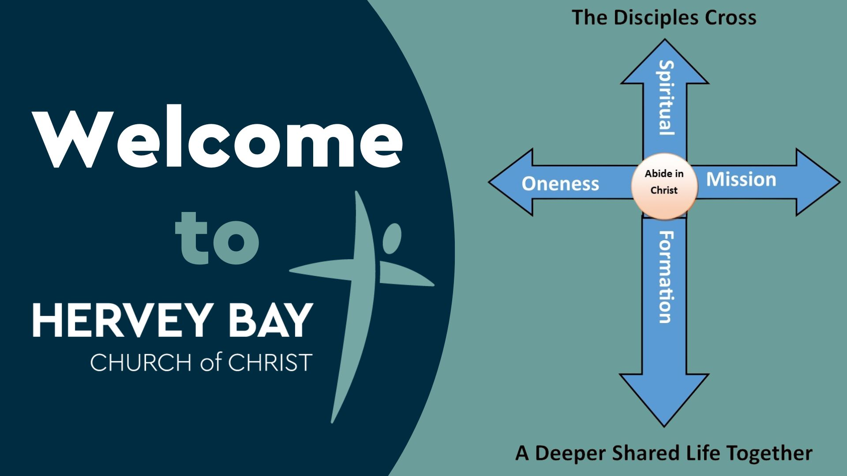

Slide 2

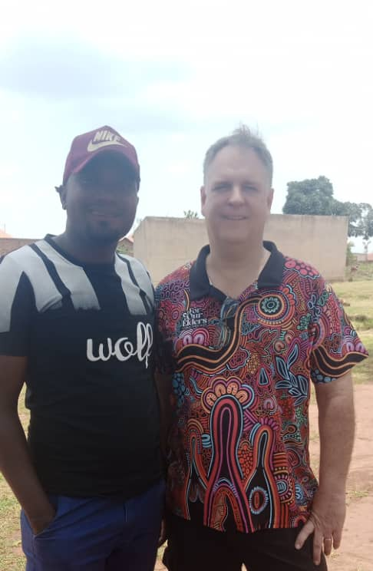




Pastor David Bravo

Slide 3


Slide 4
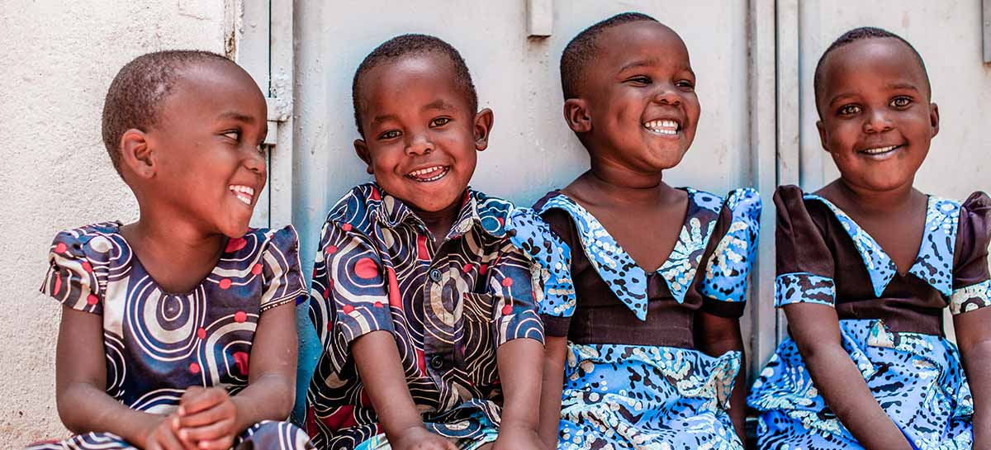

Dave Wooward
July 5th

Slide 5

What is your day to day context?
Where have you seen God at work there?
How can we pray with you?

Slide 6


