Slide 1

Introduction

Slide 2
What’s the gospel?
Get more money
Have more fun/pleasure/sex
Live peacefully
Family
Glorify God
Be good
Achieve something great
Power and influence

Slide 3
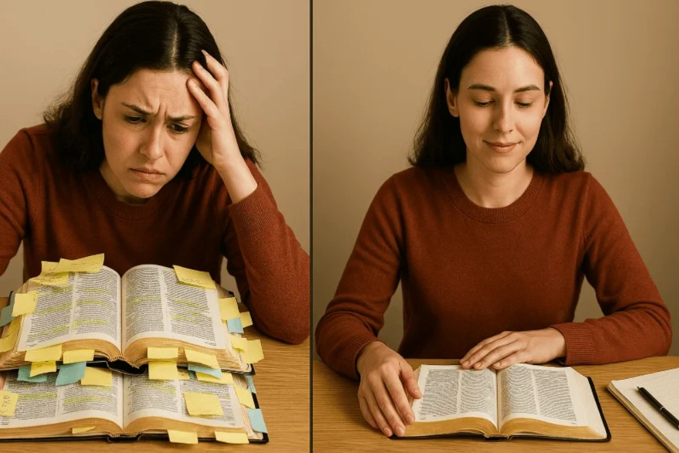
Problems for us understanding Romans
Complex

Slide 4
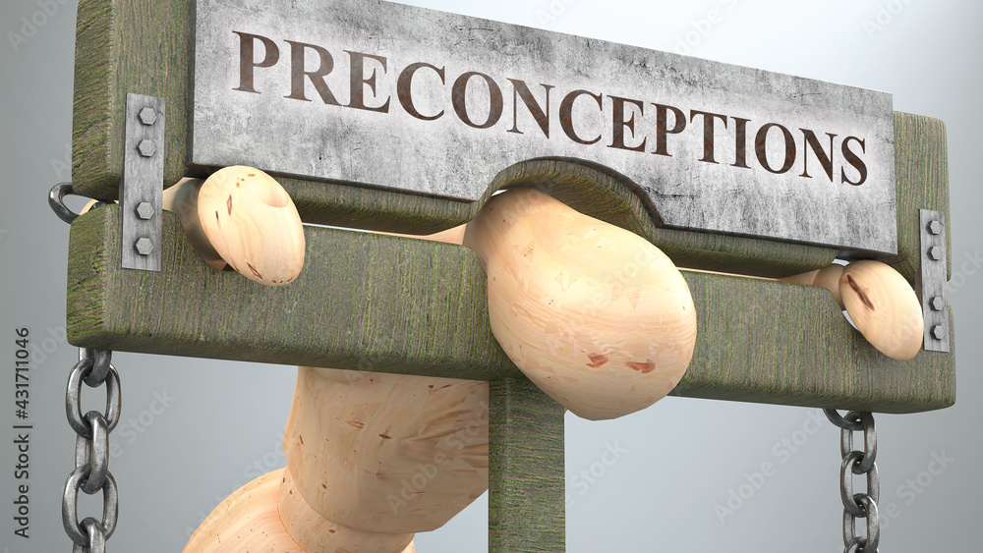
Problems for us understanding Romans
Complex
Preconception

Slide 5

Problems for us understanding Romans
Complex
Preconception
We know the highlights reel

Slide 6
Highlights Reel
1:16-17 "For I am not ashamed of the gospel, for it is God’s power for salvation to everyone who believes… The righteous will live by faith.“
3:23 "For all have sinned and fall short of the glory of God."
5:8 "But God demonstrates his own love for us, in that while we were still sinners, Christ died for us."
6:23 "For the wages of sin is death, but the gift of God is eternal life in Christ Jesus our Lord.“

Slide 7
Highlights Reel continued
5:1: "Therefore, since we have been justified through faith, we have peace with God through our Lord Jesus Christ."
10:9-10: "If you confess with your mouth that Jesus is Lord and believe in your heart that God raised him from the dead, you will be saved."
10:13: "For everyone who calls on the name of the Lord will be saved."
8:2: "For the law of the life-giving Spirit in Christ Jesus has set you free from the law of sin and death."

Slide 8
Highlights Reel even more continued
8:28 “We know, that God works all things together for good with those who love him, who are called according to his purpose.”
8:38-39 For I am convinced that neither death nor life, neither angels nor demons,^{[k]} neither the present nor the future, nor any powers, neither height nor depth, nor anything else in all creation, will be able to separate us from the love of God that is in Christ Jesus our Lord.
12: 1-2a Therefore, I urge you, brothers and sisters, in view of God’s mercy, to offer your bodies as a living sacrifice, holy and pleasing to God – this is your true and proper worship. Do not conform to the pattern of this world but be transformed by the renewing of your mind.

Slide 9
Romans 1:1-4
Paul, a slave of the Messiah, King Jesus, called to be an apostle, set apart for God’s good news, which he promised beforehand through his prophets in the sacred writings— the good news about his son, who was descended from David’s seed in terms of flesh, and who was marked out powerfully as God’s Son in terms of the Spirit of holiness by the resurrection of the dead: Jesus, the royal Messiah, our Lord!

Slide 10
Romans 1:5-7
Through him we have received grace and apostleship to bring about believing obedience among all the nations for the sake of his name. That includes you, too, who are called by Jesus the Messiah.
This letter comes to all in Rome who love God, all who are called to be his holy people. Grace and peace to you from God our father, and Messiah Jesus, the Lord.

Slide 11
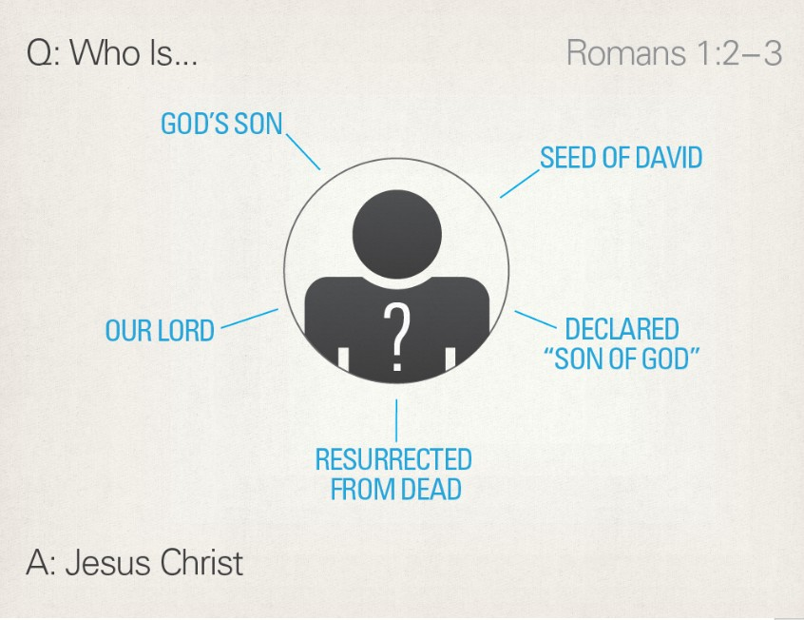

Slide 12
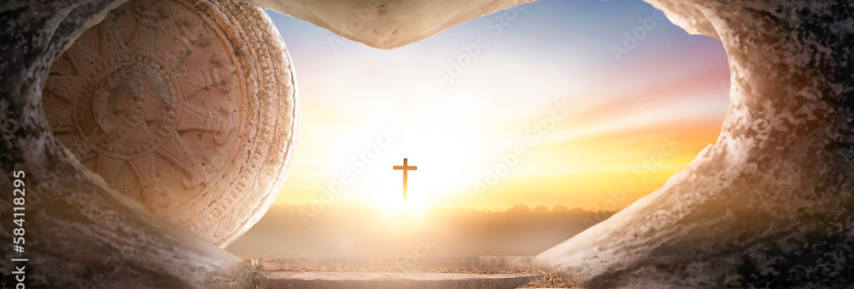
Romans 1:3-4

Slide 13
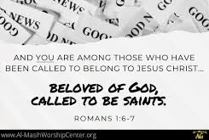
You Belong!

Slide 14

Reflect and Discuss
What is the invitation of the Good News of Jesus; the gospel of his Lordship, for you?
How will this play out in practice?
Homework Read Chapter 1 & 2 of Romans this week.
Can you keep each other accountable?

