Slide 1
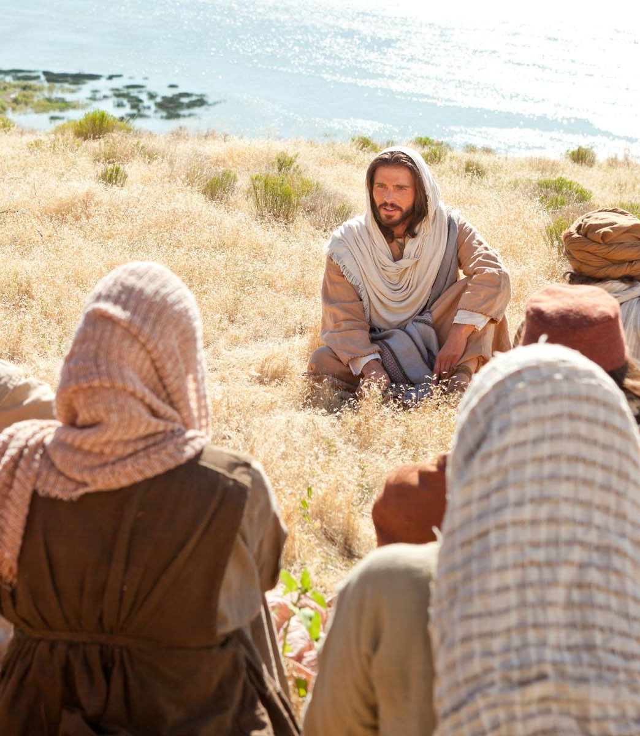
Matthew 10:40-42
Practicing the presence of people
Seeing Christ in the ones He sends

Slide 2
Matthew 10
40 “Anyone who welcomes you, welcomes me; and anyone who welcomes me, welcomes the one who sent me. 41 Anyone who welcomes a prophet in the name of a prophet will receive a prophet’s reward; and anyone who receives an upright person in the name of an upright person will receive an upright person’s reward. 42 Anyone who gives even a cup of cold water to one of these little ones, in the name of a disciple—I’m telling you the truth, they won’t go short of their reward!”

Slide 3
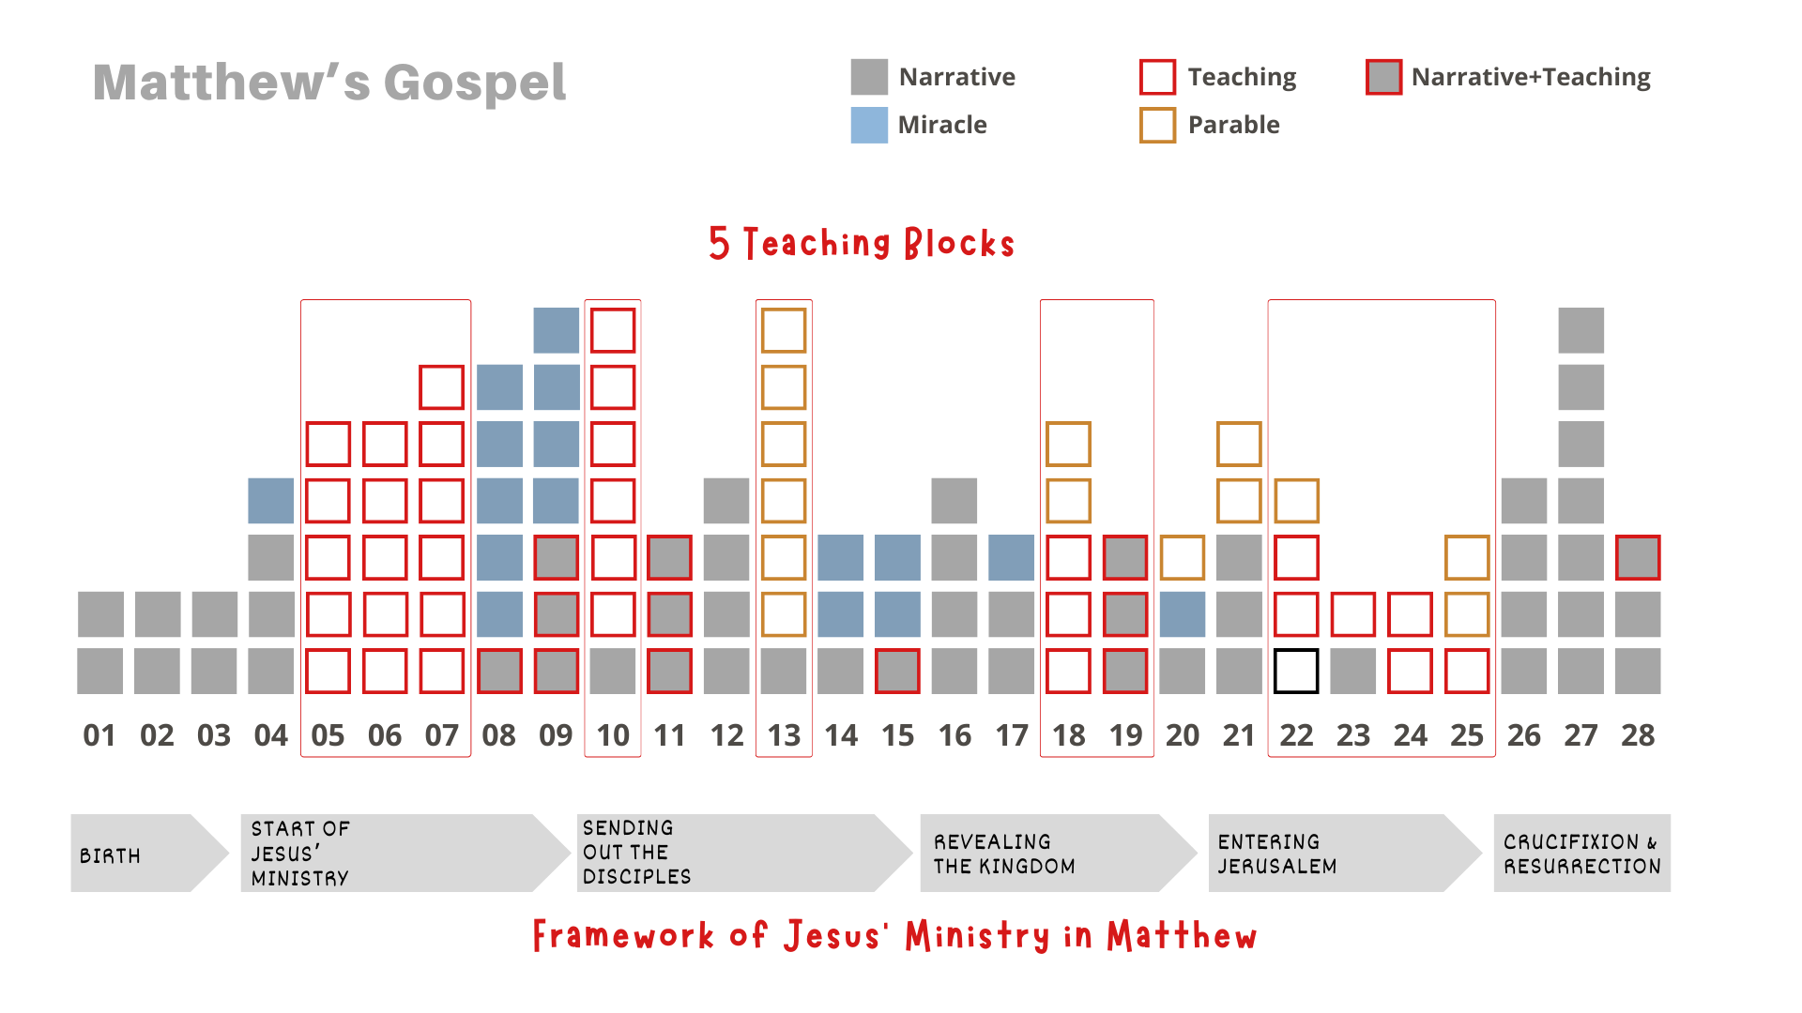

Slide 4

The sheep and the goats

Slide 5
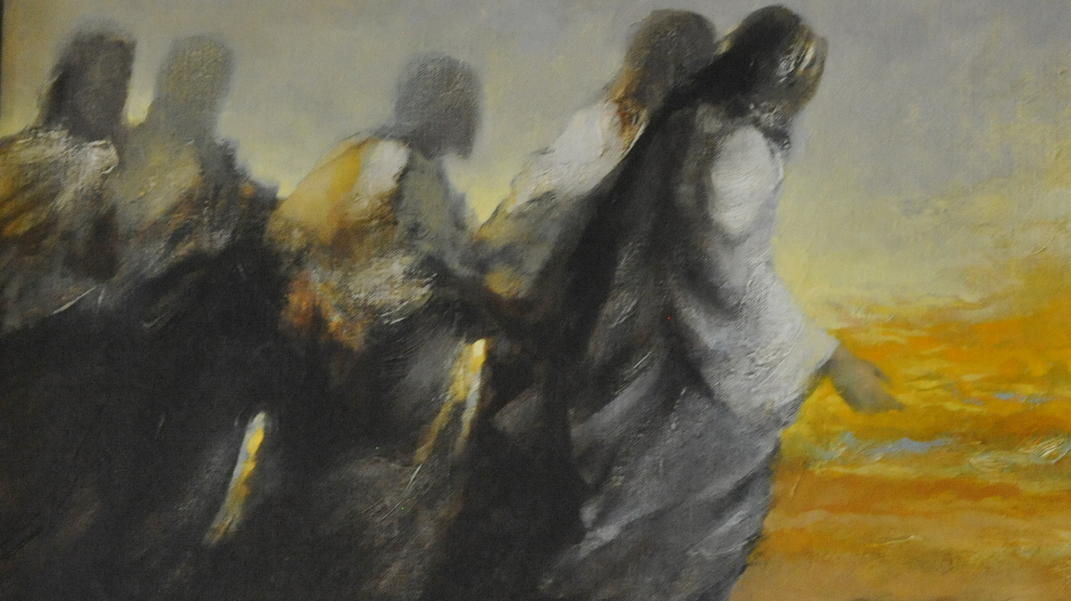
Life Goals
1. Be with Jesus
2. Become like Jesus
3. Do what Jesus does

Slide 6
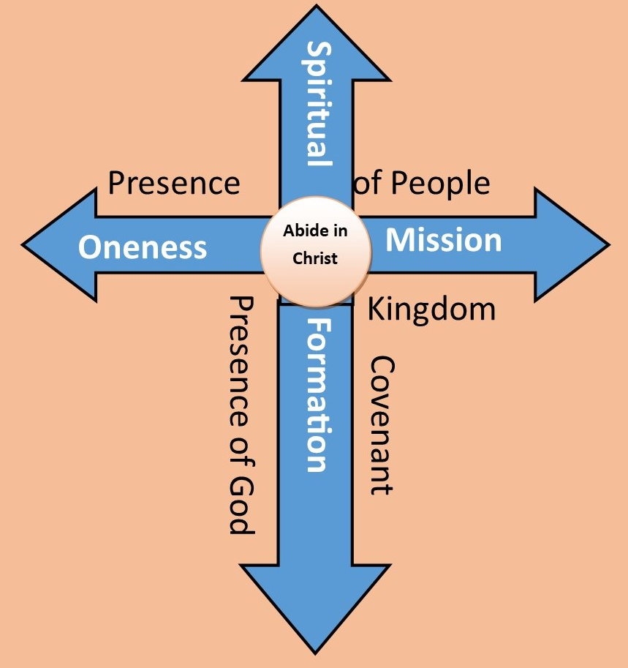


Slide 7

AI, Social Media, Gaming and the challenge of loneliness

Slide 8


Slide 9

To Practice the Presence of People
Be fully present
See beyond the surface
Cultivate Empathy
Embrace Vulnerability
See the Image of God

Slide 10
Practical Steps
Active Listening
Cultivate Curiosity
Slow down
Practice Empathy
Body Language
Embrace Silence
Practice Gratitude

Slide 11
Challenges
Distractions
Fear of Vulnerability
Biases
Time Constraints
EGR’s

Slide 12
Overcoming Challenges
Distractions –Set technology boundaries
Fear of Vulnerability – Start Small; allow trust to build
Biases- Challenge assumptions, suspend judgements
Time Constraints – live with margin, quality over quantity
EGR’s – everyone has inherent value and worth

Slide 13
Transformative Power of Practicing the Presence of People
Deeper Connections
Increased Empathy
Personal Growth
Enhance Communication
Greater Joy and Fulfillment
Spiritual Growth
Reward

Slide 14
Integration
Set Daily Intentions
Create reminders, rituals and habits
Reflect
Seek Accountability
Regularly Revisit

Slide 15
Transformative Relationships
Notice
Connect
Serve
Love

Slide 16

Reflect and Discuss
How can I put this into practice this week?

