Slide 1

Chapter 4

Slide 2
Romans 4:1-4
What shall we say, then? Have we found Abraham to be our ancestor in a human, fleshly sense? After all, if Abraham was reckoned “in the right” on the basis of works, he has grounds to boast—but not in God’s presence!
So what does the Bible say? “Abraham believed God, and it was calculated in his favor, putting him in the right.” Now when someone “works,” the “reward” they get is not calculated on the basis of generosity, but on the basis of what they are owed.

Slide 3
Romans 4:5-8
But if someone doesn’t “work,” but simply believes in the one who declares the ungodly to be in the right, that person’s faith is calculated in their favor putting them in the right.
We see the same thing when David speaks of the blessing that comes to someone whom God calculates to be in the right apart from works:
Blessed are those whose lawbreaking is forgiven
and whose sins have been covered over;
Blessed is the man to whom the Lord will not calculate sin.

Slide 4
Romans 4:9-10
So, then, does this blessing come on circumcised people or on uncircumcised? This is the passage we quoted: “His faith was calculated to Abraham as indicating that he was in the right.” How was it calculated? When he was circumcised or when he was uncircumcised? It wasn’t when he was circumcised; it was when he was uncircumcised!

Slide 5
Romans 4:11-12
He received circumcision as a sign and seal of the status of covenant membership, on the basis of faith, which he had when he was still uncircumcised. This was so that he could be the father of all who believe even when uncircumcised, so that the status of covenant membership can be calculated to their account as well. He is also, of course, the father of the circumcised who are not merely circumcised but who follow the steps of the faith which Abraham possessed while still uncircumcised.

Slide 6
Romans 4:13-15
The promise, you see, didn’t come to Abraham or to his family through the law—the promise, that is, that he would inherit the world. It came through the covenant justice of faith. For if those who belong to the law are going to inherit, then faith is empty, and the promise has been abolished. For the law stirs up God’s anger; but where there is no law, there is no lawbreaking.

Slide 7
Romans 3:16-17
That’s why it’s “by faith”: so that it can be in accordance with grace, and so that the promise can thereby be validated for the entire family—not simply those who are from the law, but those who share the faith of Abraham. He is the father of us all, just as the Bible says, “I have made you the father of many nations.” This happened in the presence of the God in whom he believed, the God who gives life to the dead and calls into existence things that do not exist.

Slide 8
Romans 4:18-20
Against all hope, but still in hope, Abraham believed that he would become the father of many nations, in line with what had been said to him: “That’s what your family will be like.” He didn’t become weak in faith as he considered his own body (which was already as good as dead, since he was about a hundred years old), and the lifelessness of Sarah’s womb. He didn’t waver in unbelief when faced with God’s promise. Instead, he grew strong in faith and gave glory to God,

Slide 9
Romans 4:21-25
being fully convinced that God had the power to accomplish what he had promised. That is why “it was calculated in his favor, putting him in the right.”
But it wasn’t written for him alone that “it was calculated to him.” It was written for us as well! It will be calculated to us, too, since we believe in the one who raised from the dead Jesus our Lord, who was handed over because of our trespasses and raised because of our justification.

Slide 10
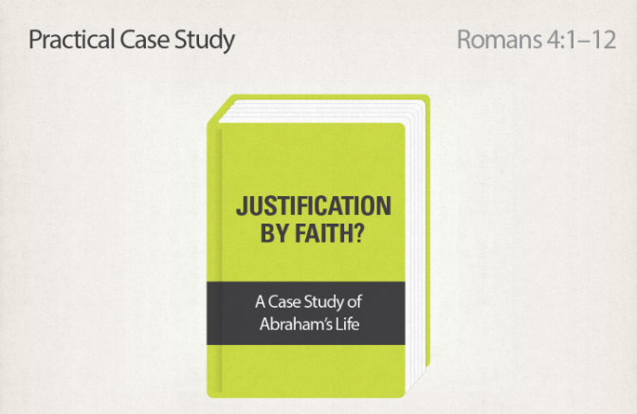
More than

Slide 11
Romans 4
Being right with God = Adoption

Slide 12
Romans 4
We all come to God just as Abraham did – unglodly made godly by faith in God

Slide 13
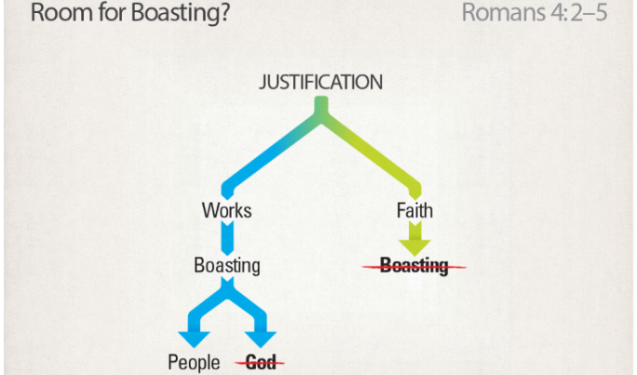

Slide 14
Romans 4
We all come to God just as Abraham did – unglodly made godly by faith in God

Slide 15
Psalm 32 :1-2
1 Blessed is the one
whose transgressions are forgiven,
whose sins are covered.
2 Blessed is the one
whose sin the Lord does not count against them
and in whose spirit is no deceit.

Slide 16
Circumcision – THE BIG ISSUE

Slide 17
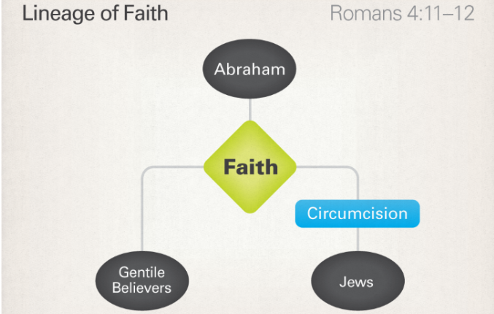

Slide 18
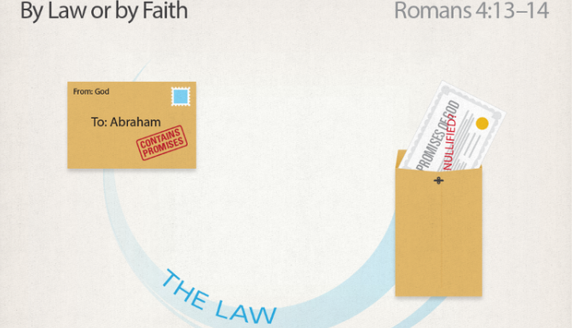

Slide 19
God’s Covenant Justice was always meant to put the world right.

Slide 20
Depravity of sin | Abraham’s Faith
Ignored God (1:20,25) | Believed God creator and life giver (4:17)
Dismissed God’s power and didn’t worship Him (1:20) | Recognised God’s power and trusted in it (4:21)
Didn’t give God glory (1:21) | Gave God glory (4:20)
Dishonoured their own bodies worshipping the undivine (1:24) | Worshipped God who gave his body new life to father a child (4:19)
Given to pleasure and same-sex practices (1:26-27) | Trusted God and were given the power to conceive (4:19)

Slide 21
Romans 1
3 the good news about his son, who was descended from David’s seed in terms of flesh, 4 and who was marked out powerfully as God’s son in terms of the spirit of holiness by the resurrection of the dead: Jesus, the royal Messiah, our Lord!

Slide 22
reflect
In what way do I share the faith of Abraham?
In what way do I live in gratitude to the God of the impossible?
In what way do I celebrate God and live as one family with all those who share this faith?

