Slide 1


Slide 2

^{Romans 6}
^{Next Week Romans 7}
⁻

Slide 3
October 11
Q & eh?

Slide 4
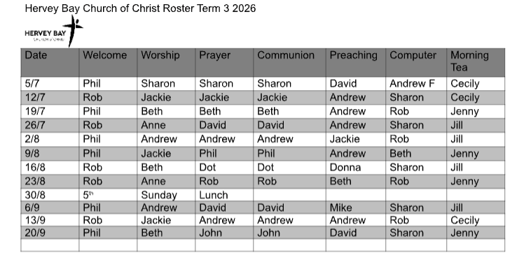

Slide 5






What is your day to day context?
Where have you seen God at work there?
How can we pray with you?

Slide 6


