Slide 1
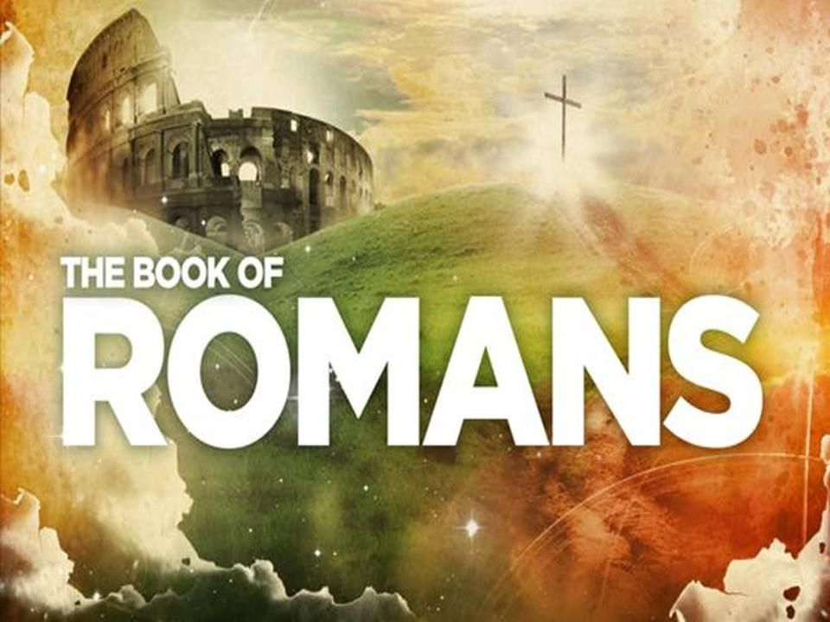
Chapter 5

Slide 2
Romans 5:1-5
The result is this: since we have been declared “in the right” on the basis of faith, we have peace with God through our Lord Jesus the Messiah. Through him we have been allowed to approach, by faith, into this grace in which we stand; and we celebrate the hope of the glory of God.
That’s not all. We also celebrate in our sufferings, because we know that suffering produces patience, patience produces a well-formed character, and a character like that produces hope. Hope, in its turn, does not make us ashamed, because the love of God has been poured out in our hearts through the holy spirit who has been given to us.

Slide 3
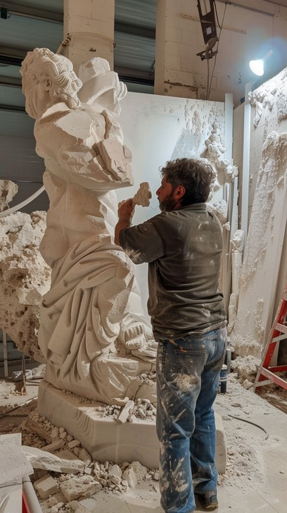

Slide 4
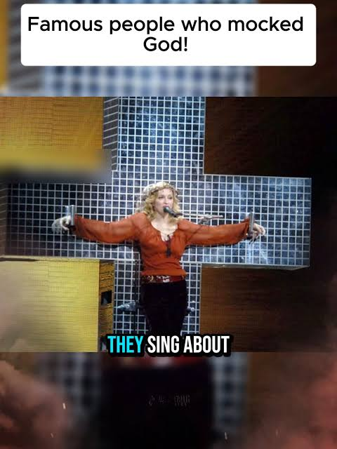

Slide 5
Chapter | Theme
1 | Human rebellion and consequences
2 | Everyone will be judged but by a good God and the result already decided – we are safe
3 | Justified by Faith – we are declared in the right, by Jesus, before God
4 | Included in God’s family with Abraham as our father - We belong

Slide 6
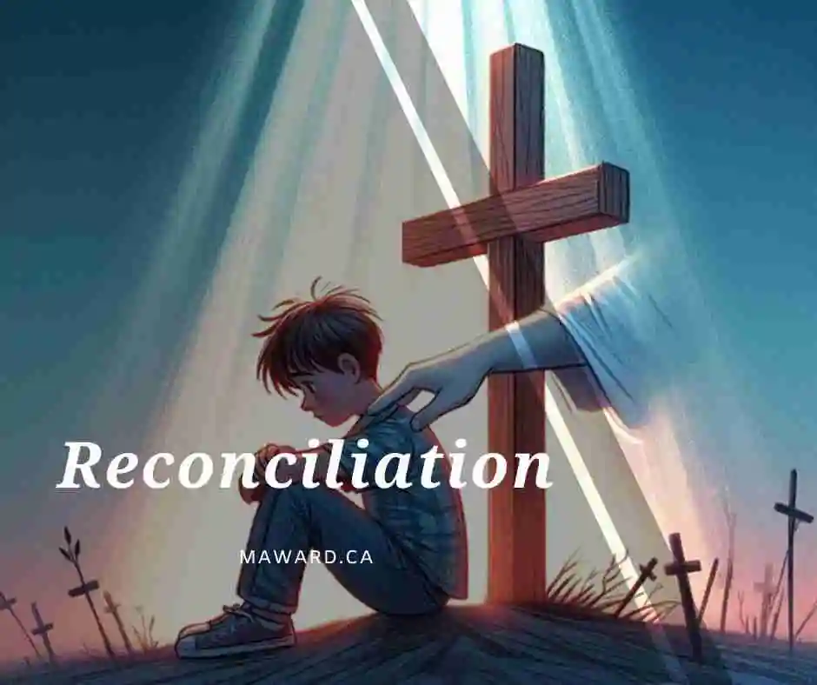

Slide 7
Romans 5:6-9
This is all based on what the Messiah did: while we were still weak, at that very moment he died on behalf of the ungodly. It’s a rare thing to find someone who will die on behalf of an upright person—though I suppose someone might be brave enough to die for a good person. But this is how God demonstrates his own love for us: the Messiah died for us while we were still sinners.
How much more, in that case—since we have been declared to be in the right by his blood—are we going to be saved by him from God’s coming anger!

Slide 8
Romans 5:10-11
When we were enemies, you see, we were reconciled to God through the death of his son; if that’s so, how much more, having already been reconciled, shall we be saved by his life. And that’s not all. We even celebrate in God, through our Lord Jesus the Messiah, through whom we have now received this reconciliation.

Slide 9
Romans 5:12
Therefore, just as sin came into the world through one human being, and death through sin, and in that way death spread to all humans, in that all sinned . . .

Slide 10
Romans 5:13-15
Sin was in the world, you see, even in the absence of the law, though sin is not calculated where there is no law. But death reigned from Adam to Moses, even over the people who did not sin by breaking a command, as Adam had done—Adam, who was the imprint of the one who was to come.
But it isn’t “as the trespass, so also the gift.” For if many died by one person’s trespass, how much more has God’s grace, and the gift in grace through the one person Jesus the Messiah, abounded to the many?

Slide 11
Romans 5:16-17
And nor is it “as through the sin of the one, so also the gift.” For the judgment which followed the one trespass resulted in a negative verdict, but the free gift which followed many trespasses resulted in a positive verdict. For if, by the trespass of the one, death reigned through that one, how much more will those who receive the abundance of grace, and of the gift of covenant membership, of “being in the right,” reign in life through the one man Jesus the Messiah?

Slide 12
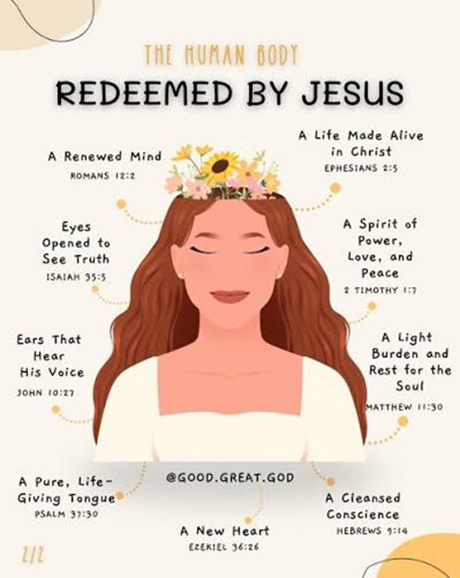

Slide 13
Romans 5:18-21
So, then, just as, through the trespass of one person, the result was condemnation for all people, even so, through the upright act of one person, the proper verdict is life for all people. For just as through the disobedience of one person many received the status of “sinner,” so through the obedience of one person many will receive the status of being “in the right.”
The law came in alongside, so that the trespass might be filled out to its full extent. But where sin increased, grace increased all the more; so that, just as sin reigned in death, even so, through God’s faithful covenant justice, grace might reign to the life of the age to come, through Jesus the Messiah, our Lord.

Slide 14
Who we are Created to be
Adam and Eve in the garden all was good.
Intimacy
Acceptance
Belonging
Value
Acceptance
Belonging
Value
Reflection
The Image Relationship The Source

Slide 15
Consequences of the fall
Insecurity, fear,
Inadequacy, denial,
Vulnerable, blaming,
Guilt, self-deception,
Shame, expelled
J
U
D
G
E
Father
Intimacy
Relationship
Love
Truth
justice

Slide 16
Consequences of the Fall
CRITICISM REJECTION FAILURE
PERFORMANCE
APPROVAL OF OTHERS
Acceptance
Value
Belonging
Acceptance Value
Belonging

Slide 17
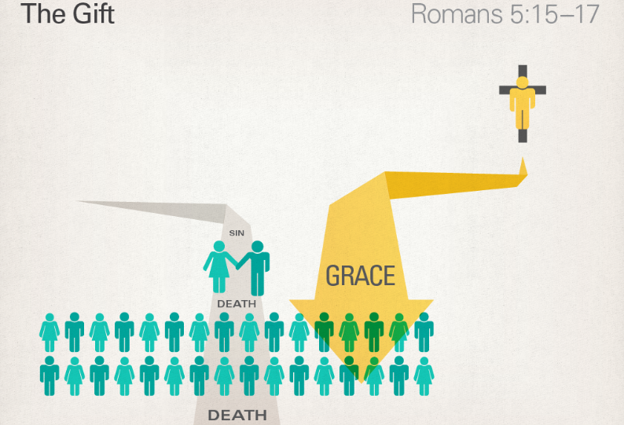

Slide 19
Reflect AND Discuss
What does reconciliation with God mean for you?
What does it actually mean when we talk about a “relationship” with Jesus?

