Slide 1
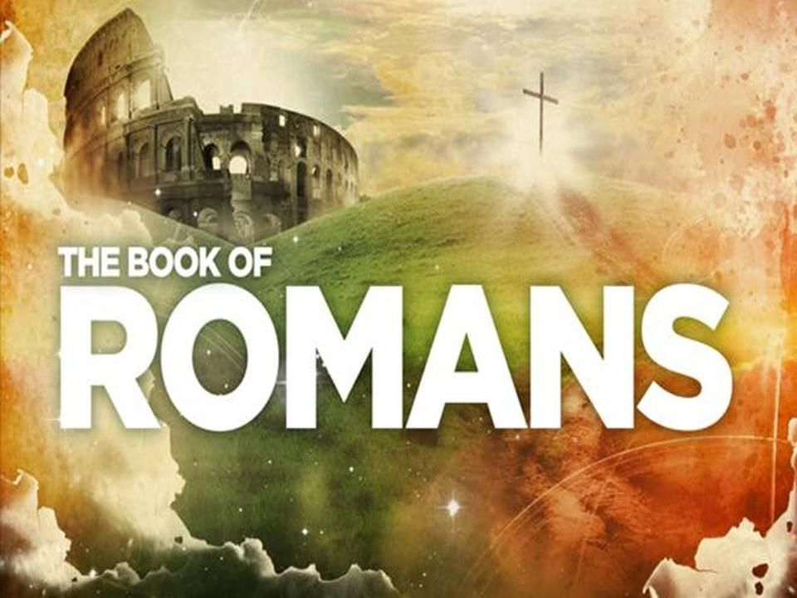
Chapter 6

Slide 2
Romans 6:1-5
What are we to say, then? Shall we continue in the state of sin, so that grace may increase? ² Certainly not! We died to sin; how can we still live in it? ³ Don’t you know that all of us who were baptized into the Messiah, Jesus, were baptized into his death? ⁴ That means that we were buried with him, through baptism, into death, so that, just as the Messiah was raised from the dead through the father’s glory, we too might behave with a new quality of life. ⁵ For if we have been planted together in the likeness of his death, we shall also be in the likeness of his resurrection.

Slide 3
Chapter | Theme
1 | Human rebellion and consequences
2 | Everyone will be judged but by a good God and the result already decided – we are safe
3 | Justified by Faith – we are declared in the right, by Jesus, before God
4 | Included in God’s family with Abraham as our father - We belong
5 | We have been Reconciled to God

Slide 4


Slide 5
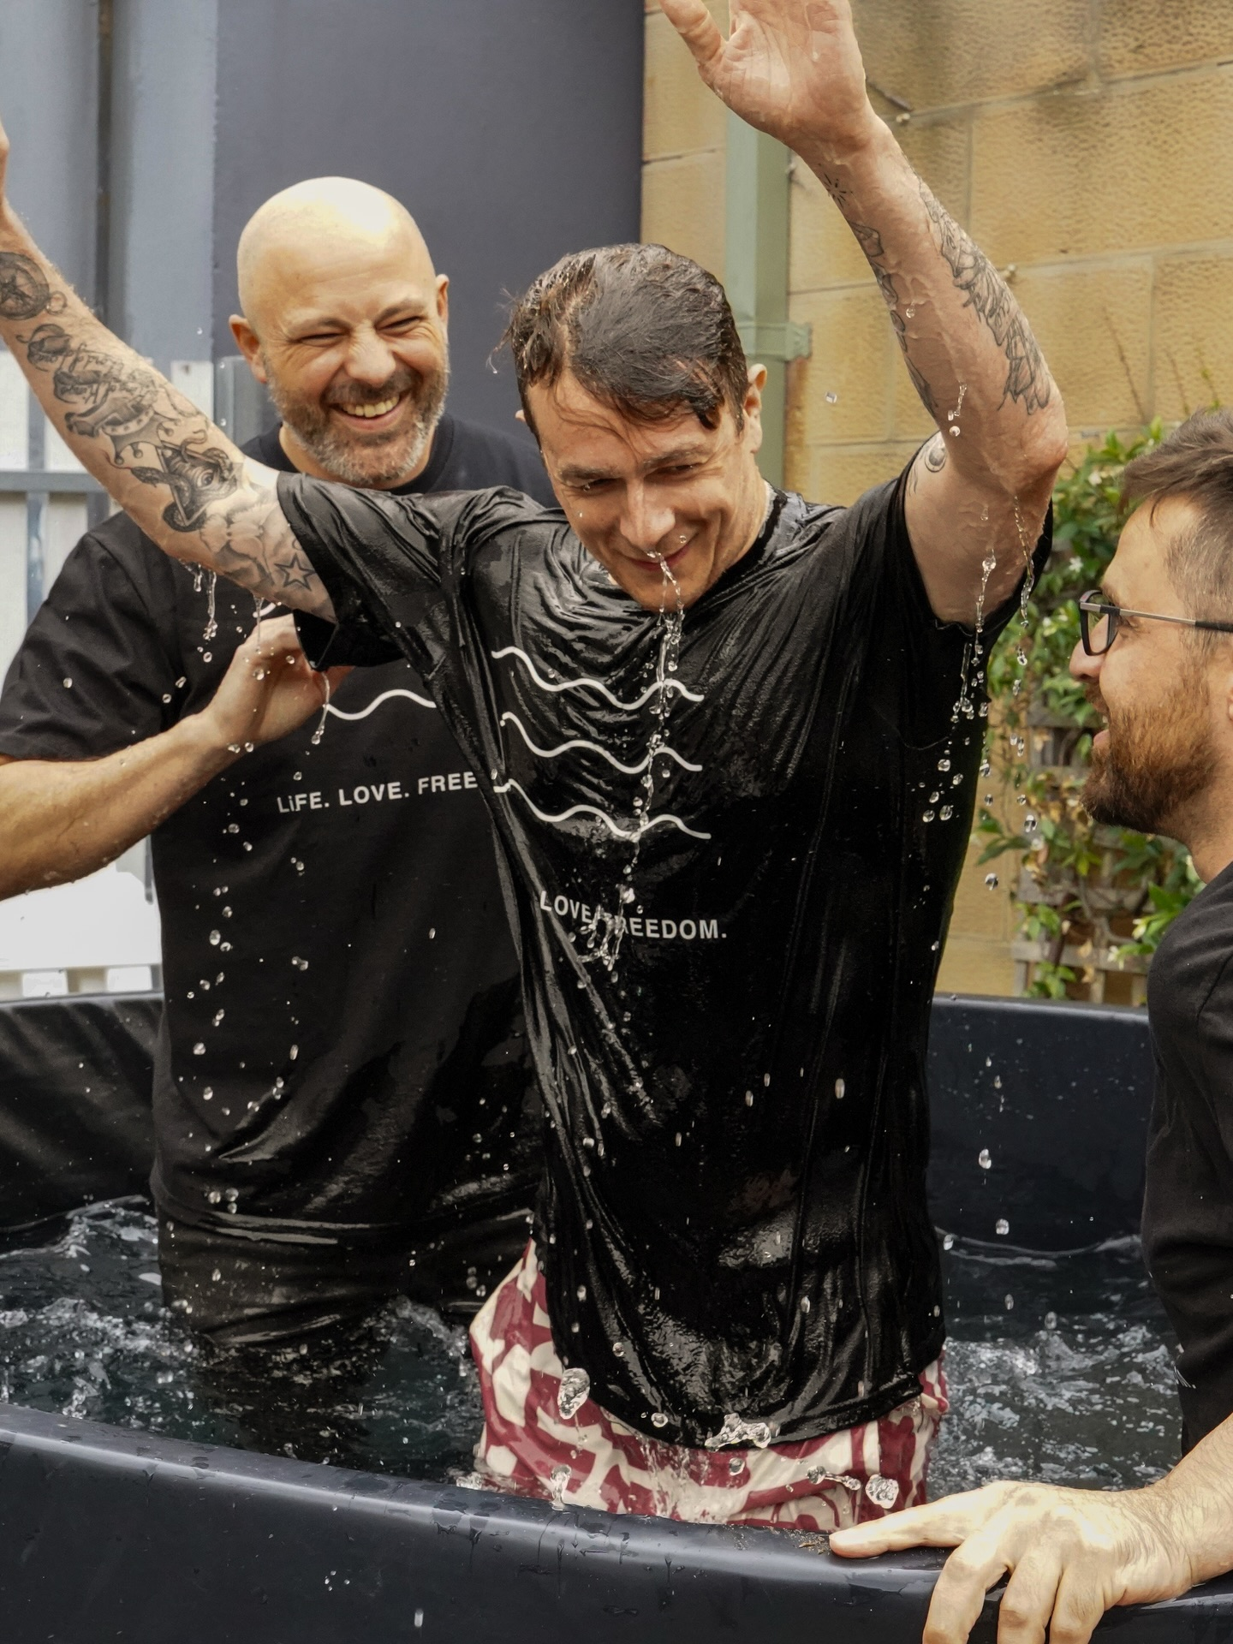

Slide 6
Romans 6:6-11
6 This is what we know: our old humanity was crucified with the Messiah, so that the bodily solidarity of sin might be abolished, and that we should no longer be enslaved to sin. 7 A person who has died, you see, has been declared free from all charges of sin.
8 But if we died with the Messiah, we believe that we shall live with him. 9 We know that the Messiah, having been raised from the dead, will never die again. Death no longer has any authority over him. 10 The death he died, you see, he died to sin, once and only once. But the life he lives, he lives to God. 11 In the same way you, too, must calculate yourselves as being dead to sin, and alive to God in the Messiah, Jesus.

Slide 7
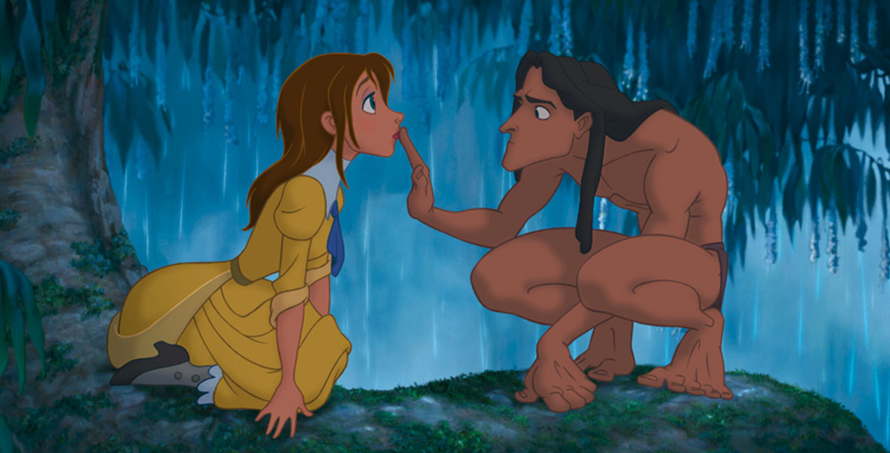

Slide 8
Romans 6:6-11
6 This is what we know: our old humanity was crucified with the Messiah, so that the bodily solidarity of sin might be abolished, and that we should no longer be enslaved to sin. 7 A person who has died, you see, has been declared free from all charges of sin.
8 But if we died with the Messiah, we believe that we shall live with him. 9 We know that the Messiah, having been raised from the dead, will never die again. Death no longer has any authority over him. 10 The death he died, you see, he died to sin, once and only once. But the life he lives, he lives to God. 11 In the same way you, too, must calculate yourselves as being dead to sin, and alive to God in the Messiah, Jesus.

Slide 9
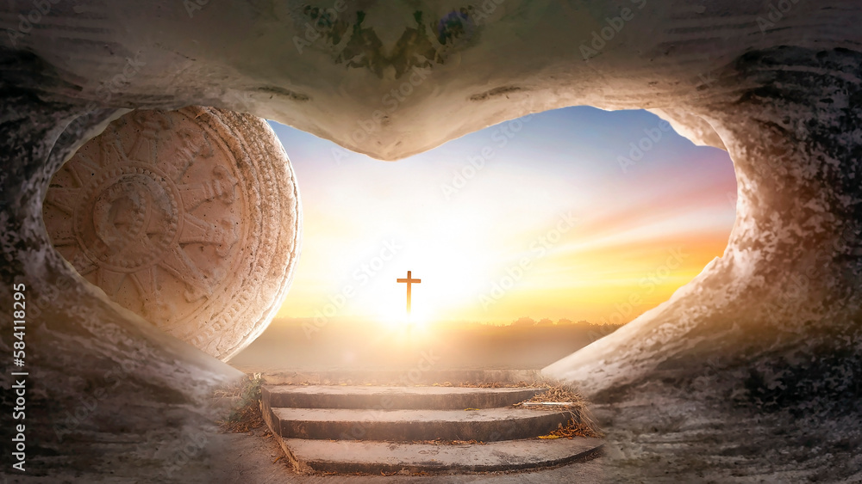

Slide 10


Slide 11
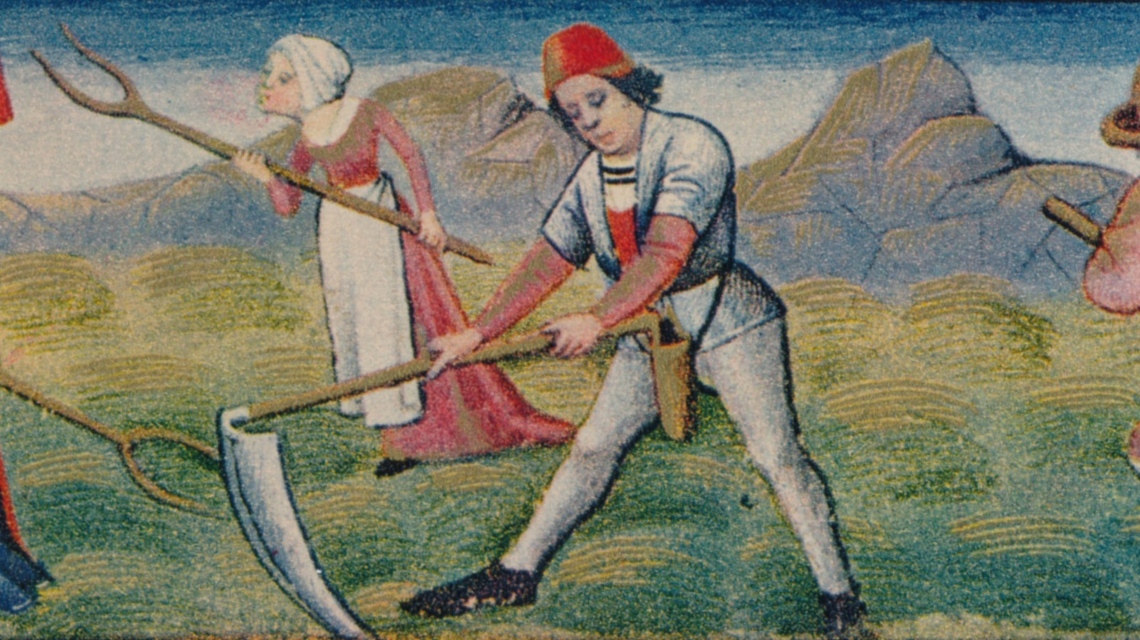

Slide 12
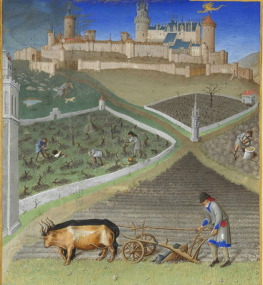

Slide 13
Romans 6:12-14
12 So don’t allow sin to rule in your mortal body, to make you obey its desires. 13 Nor should you present your limbs and organs to sin to be used for its wicked purposes. Rather, present yourselves to God, as people alive from the dead, and your limbs and organs to God, to be used for the righteous purposes of his covenant. 14 Sin won’t actually rule over you, you see, since you are not under law but under grace.

Slide 15
Romans 6:15-18
15 What then? Shall we sin, because we are not under law but under grace? Certainly not! 16 Don’t you know that if you present yourselves to someone as obedient slaves, you really are slaves of the one you obey, whether that happens to be sin, which leads to death, or obedience, which leads to final vindication? 17 Thank God that, though you once were slaves to sin, you have become obedient from the heart to the pattern of teaching to which you were committed. 18 You were freed from sin, and now you have been enslaved to God’s covenant justice.

Slide 16
Romans 6:19
19 (I’m using a human picture because of your natural human weakness!) For just as you presented your limbs and organs as slaves to uncleanness, and to one degree of lawlessness after another, so now present your limbs and organs as slaves to covenant justice, which leads to holiness.

Slide 17
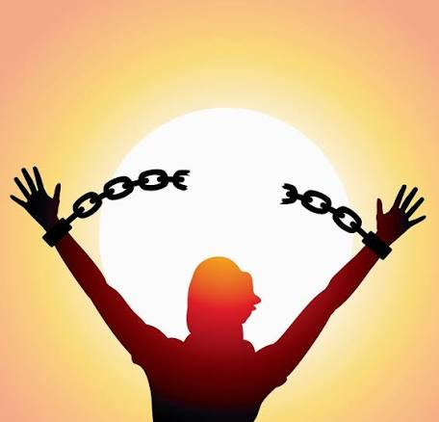
Redeemed from slavery to sin

Slide 18
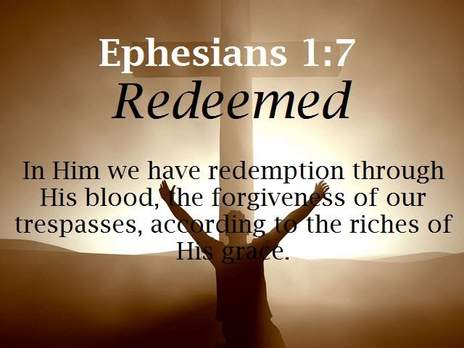

Slide 19
Romans 6:15-18
15 What then? Shall we sin, because we are not under law but under grace? Certainly not! 16 Don’t you know that if you present yourselves to someone as obedient slaves, you really are slaves of the one you obey, whether that happens to be sin, which leads to death, or obedience, which leads to final vindication? 17 Thank God that, though you once were slaves to sin, you have become obedient from the heart to the pattern of teaching to which you were committed. 18 You were freed from sin, and now you have been enslaved to God’s covenant justice.

Slide 20
Romans 6:20-23
20 When you were slaves of sin, you see, you were free in respect of covenant justice. 21 What fruit did you ever have from the things of which you are now ashamed? Their destination is death. 22 But now that you have been set free from sin and enslaved to God, you have fruit for holiness. Its destination is the life of the age to come. 23 The wages paid by sin, you see, are death; but God’s free gift is the life of the age to come, in the Messiah, Jesus our Lord.

Slide 21
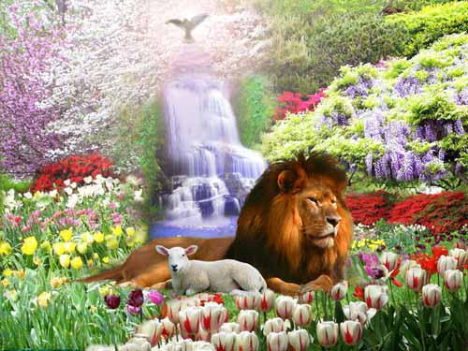

Slide 22
Reflect and Discuss
What stood out for you?
What is one thing you need to do as a result?

