Slide 1
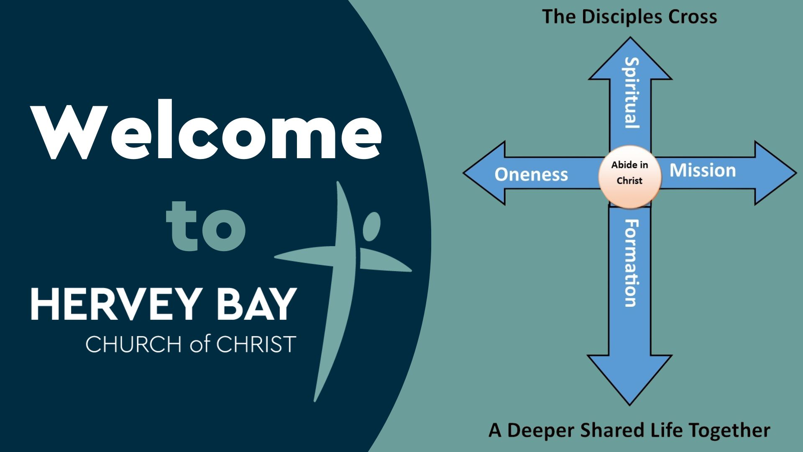

Slide 2

^{Today Romans 9 and 10}
⁻

Slide 3
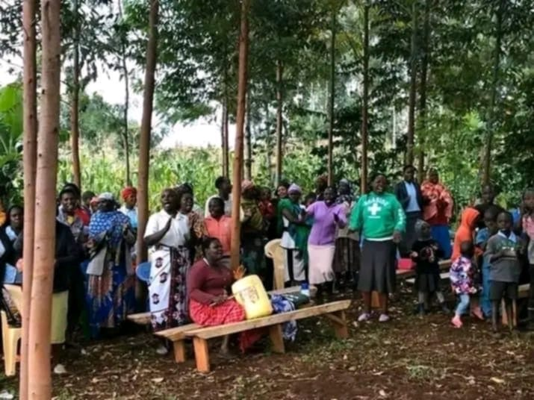
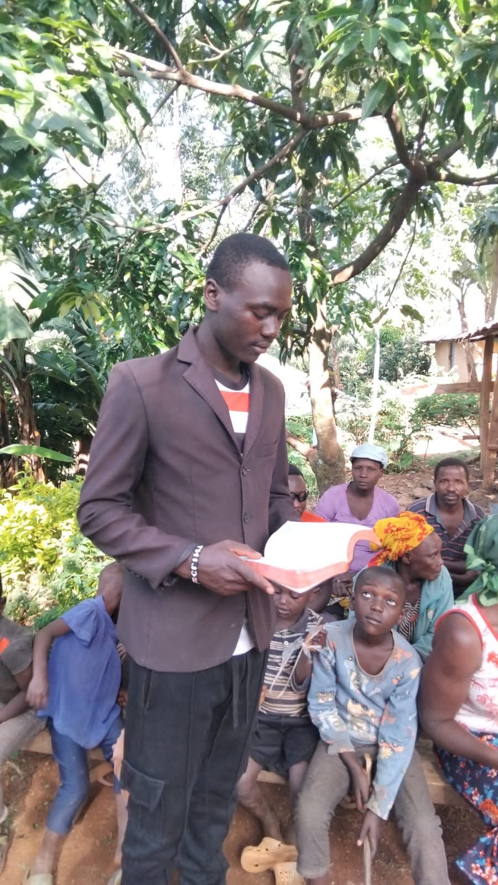
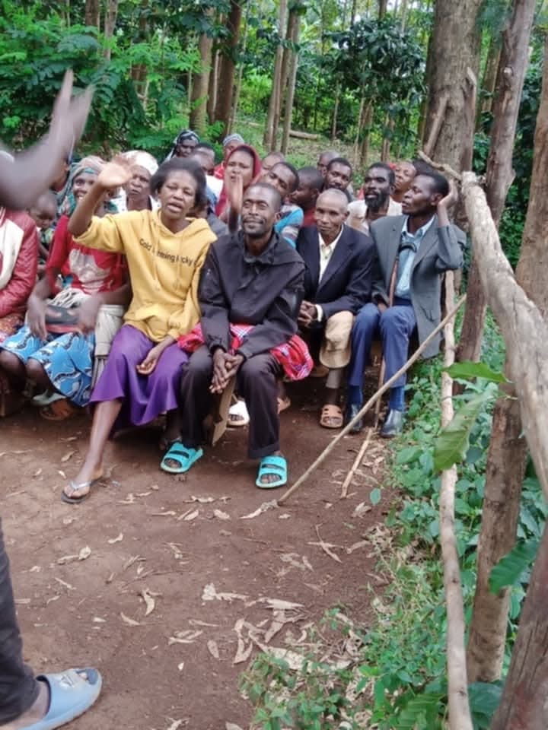
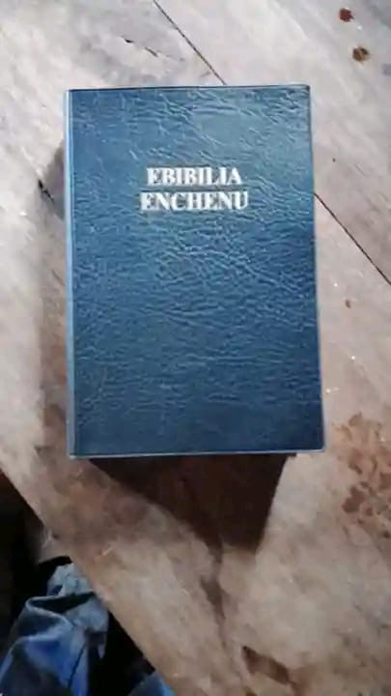
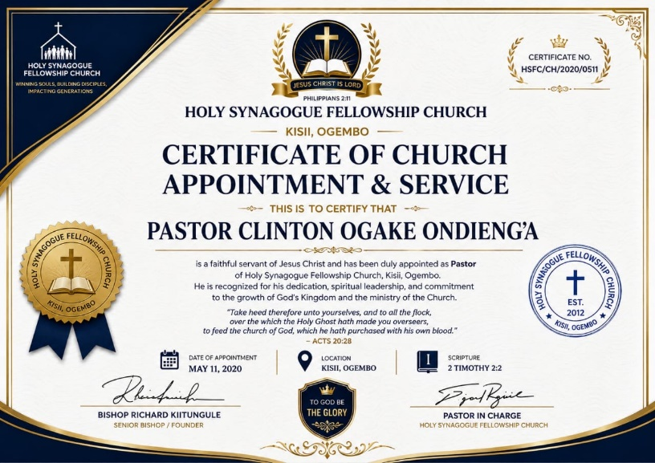
Ogoonchorwa Bible Drive

Slide 4







Slide 5
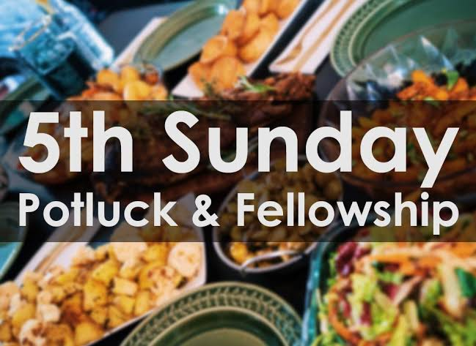

12pm
November
29th

Slide 6

What is your day to day context?
Where have you seen God at work there?
How can we pray with you?

