Slide 1
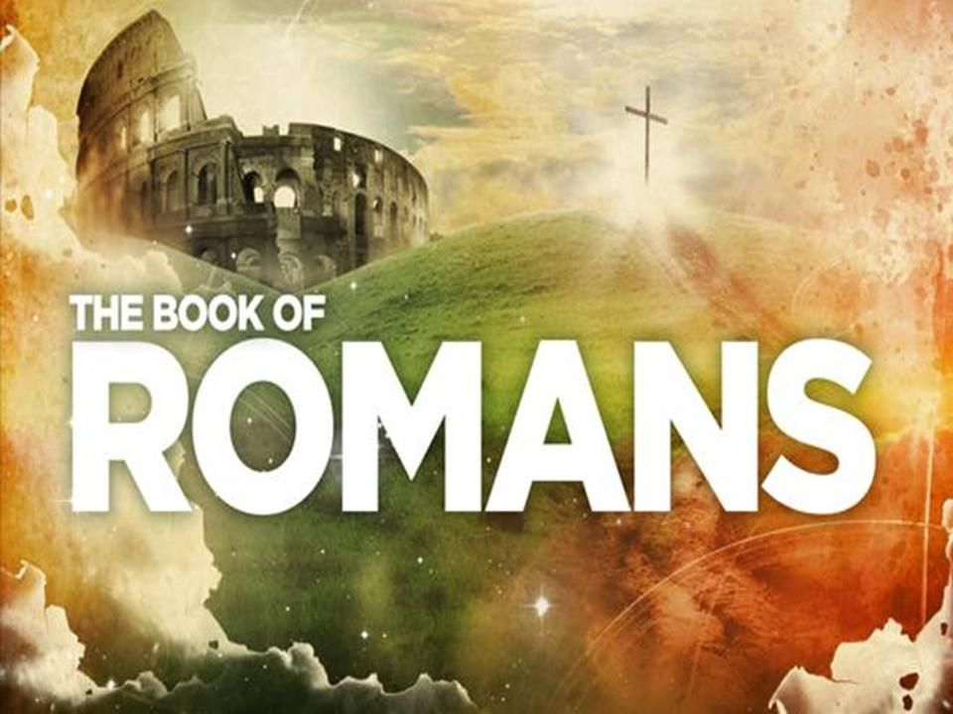
Chapter 8

Slide 2
Romans 8
So, therefore, there is now no condemnation for those in the Messiah, Jesus! 2 Why not? Because the law of the spirit of life in the Messiah, Jesus, released you from the law of sin and death.
3 For God has done what the law (being weak because of human flesh) was incapable of doing. God sent his own son in the likeness of sinful flesh, and as a sin-offering; and, right there in the flesh, he condemned sin. 4 This was in order that the right and proper verdict of the law could be fulfilled in us, as we live not according to the flesh but according to the spirit.

Slide 3
Romans 8
5 Look at it like this. People whose lives are determined by human flesh focus their minds on matters to do with the flesh, but people whose lives are determined by the spirit focus their minds on matters to do with the spirit. 6 Focus the mind on the flesh, and you’ll die; but focus it on the spirit, and you’ll have life, and peace. 7 The mind focused on the flesh, you see, is hostile to God. It doesn’t submit to God’s law; in fact, it can’t. 8 Those who are determined by the flesh can’t please God.

Slide 4
Romans 8
9 But you’re not people of flesh; you’re people of the spirit (if indeed God’s spirit lives within you; note that anyone who doesn’t have the spirit of the Messiah doesn’t belong to him). 10 But if the Messiah is in you, the body is indeed dead because of sin, but the spirit is life because of covenant justice. 11 So, then, if the spirit of the one who raised Jesus from the dead lives within you, the one who raised the Messiah from the dead will give life to your mortal bodies, too, through his spirit who lives within you.

Slide 5
Romans 8
12 So then, my dear family, we are in debt—but not to human flesh, to live our life in that way. 13 If you live in accordance with the flesh, you will die; but if, by the spirit, you put to death the deeds of the body, you will live.
14 All who are led by the spirit of God, you see, are God’s children. 15 You didn’t receive a spirit of slavery, did you, to go back again into a state of fear? But you received the spirit of sonship, in whom we call out “Abba, Father!” 16 When that happens, it is the spirit itself giving supporting witness to what our own spirit is saying, that we are God’s children.

Slide 6
Romans 8
17 And if we’re children, we are also heirs: heirs of God, and fellow heirs with the Messiah, as long as we suffer with him so that we may also be glorified with him.

Slide 7
Romans 8
18 This is how I work it out. The sufferings we go through in the present time are not worth putting in the scale alongside the glory that is going to be unveiled for us. 19 Yes: creation itself is on tiptoe with expectation, eagerly awaiting the moment when God’s children will be revealed. 20 Creation, you see, was subjected to pointless futility, not of its own volition, but because of the one who placed it in this subjection, in the hope 21 that creation itself would be freed from its slavery to decay, to enjoy the freedom that comes when God’s children are glorified.

Slide 8
Romans 8
22 Let me explain. We know that the entire creation is groaning together, and going through labor pains together, up until the present time. 23 Not only so: we too, we who have the first fruits of the spirit’s life within us, are groaning within ourselves, as we eagerly await our adoption, the redemption of our body. 24 We were saved, you see, in hope. But hope isn’t hope if you can see it! Who hopes for what they can see? 25 But if we hope for what we don’t see, we wait for it eagerly—but also patiently.

Slide 9
Romans 8
26 In the same way, too, the spirit comes alongside and helps us in our weakness. We don’t know what to pray for as we ought to; but that same spirit pleads on our behalf, with groanings too deep for words. 27 And the Searcher of Hearts knows what the spirit is thinking, because the spirit pleads for God’s people according to God’s will. 28 We know, in fact, that God works all things together for good with those who love him, who are called according to his purpose. 29 Those he foreknew, you see, he also marked out in advance to be shaped according to the model of the image of his son, so that he might be the firstborn of a large family. 30 And those he marked out in advance, he also called; those he called, he also justified; those he justified, he also glorified.

Slide 10
Romans 8
31 What then shall we say to all this?
If God is for us, who is against us?
32 God, after all, did not spare his own son; he gave him up for us all!
How then will he not, with him, freely give all things to us?
33 Who will bring a charge against God’s chosen ones?
It is God who declares them in the right.

Slide 11
Romans 8
34 Who is going to condemn?
It is the Messiah, Jesus, who has died, or rather has been raised;
who is at God’s right hand, and who also prays on our behalf!
35 Who shall separate us from the Messiah’s love?
Suffering, or hardship, or persecution, or famine, or nakedness, or danger, or sword? 36 As the Bible says,
Because of you we are being killed all day long; we are regarded as sheep destined for slaughter.

Slide 12
Romans 8
37 No: in all these things we are completely victorious through the one who loved us. 38 I am persuaded, you see, that neither death nor life, nor angels nor rulers, nor the present, nor the future, nor powers, 39 nor height, nor depth, nor any other creature will be able to separate us from the love of God in Messiah Jesus our Lord.

Slide 13
Reread and discuss
Is there a verse or passage that stands out for you?
Why?

Slide 14
Chapter | Theme
1 | Human rebellion and consequences
2 | Everyone will be judged but by a good God and the result already decided – we are safe
3 | Justified by Faith – we are declared in the right, by Jesus, before God
4 | Included in God’s family with Abraham as our father - We belong
5 | We have been Reconciled to God as a new kind of humanity
6 | We have been baptised into new life and redeemed from slavery to sin

Slide 15
Chapter | Theme
7 | Law was good but due to Sin Israel sinned. We are freed from Law and Sin by Jesus death. Law pointed to Jesus.
Chapter 8 the mid point!
Climax of argument so far

Slide 16
Romans 8:1-11
Conclusion of argument from chapter 7 and
Introduction of argument for chapter 8
Vs 1-4 Father, Son, Holy Spirit (God made a way; Spirit brought life; by the Messiah, Jesus)
Accomplished on the Cross
Jewish Law – fulfilled in and through gospel
Result = No Condemnation for those in Messiah

Slide 17
Widening argument
Vs 1 Initial Statement
Vs 2 Dense Explanation
Vs 3-4 Unpacking
Vs-5-8 Further unpacking
Vs 9-11 Conclusion

Slide 18
The widening argument Verses 1-6
There is no condemnation,
because the spirit-law has set you free from the sin-law,
because God has acted in his Son and his Spirit to condemn Sin and provide life,
because there are two types of human beings and you are the spirit-type,
because these two types are heading, respectively, for death and life.
There is no condemnation,
because of all this.

Slide 19
Atonement Theology – Verses 5-11
Sent His Son = comes himself
Sin is condemned in the flesh of Jesus – not Jesus himself
“Flesh” does not equal physical (which is good) but corrupt, rebellious, mortality, wrong use and decay (Self Interested Nature)
“Spirit” – Holy Spirit (sometimes human spirit made alive) that gives life
Result of Spirit enlivened mind and life is, the promise of resurrection

Slide 20
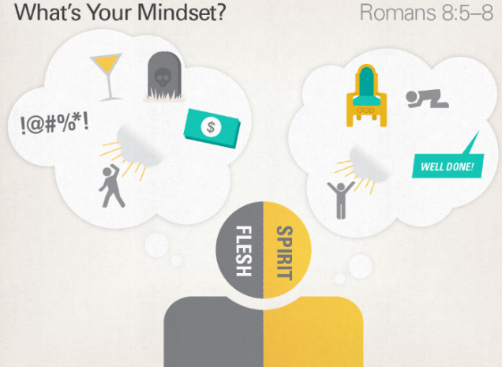

Slide 21
How does God declare believer in the right now, anticipating the verdict on the day of judgment?
The Spirit works to generate faith, by gospel proclamation, to bring the life of the Spirit, and will produce an incorruptible body at the day of the resurrection. (vs 4-6)

Slide 22
Debt? Vs 12-17
You don’t owe anything to the “flesh” or Sin
We are Children of the King
Must put to death the “flesh”
God’s presence and freedom from slavery (Exodus)
So don’t be surprised that the journey is hard
Adoption should make us cry “Abba Father”
Glorification – share in God’s rule of this world
Our debt is to the goodness and generosity of God

Slide 23
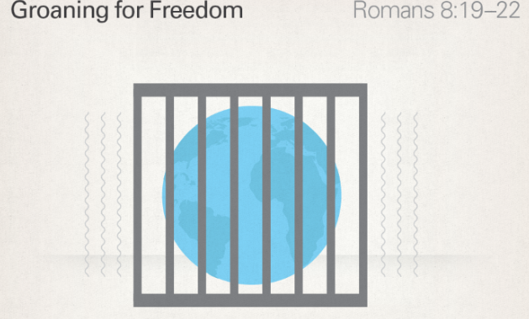
Take in the View vs 18-25
The grand plan of salvation
Our present suffering is outweighed by the glory to come
The current world is groaning under its suffering
Out of kilter awaiting proper care and renewal
Of this we wait in hope
(Come Lord Jesus)

Slide 24
Crux of the argument vs 18-25
When humans rebelled and worshiped the creation not the creator, creation fell into disrepair. They became enslaved to these lesser things. But God has always had a plan to put the world right.

Slide 25
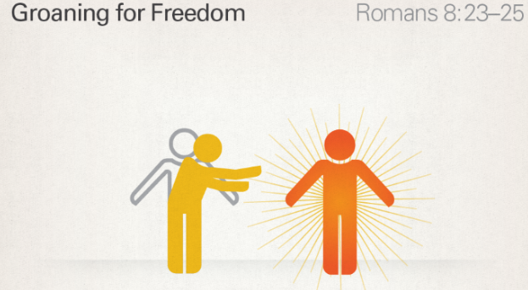
Spirit’s groanings vs 26-27
Searcher of hearts – looking for Spirit’s groaning
Earth groaning in pain; we are groaning for new bodies

Slide 26
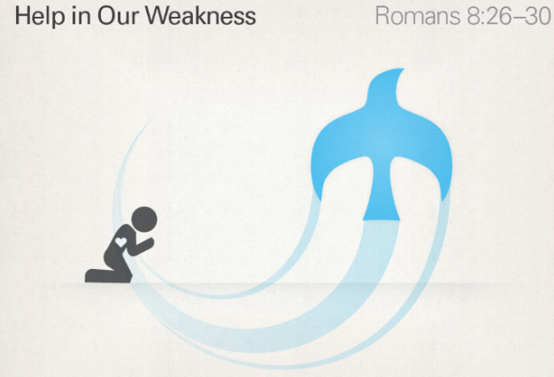
Spirit’s groanings vs 26-27
Searcher of hearts – looking for Spirit’s groaning
Earth groaning in pain; we are groaning for new bodies
We are to engage in the worlds pain –
First with spirit inspired groaning prayer
Compassion; tongues; imagination
We are called then to suffer
according to the pattern of the
Messiah in order to be glorified with
Him

Slide 27
The promise vs 28-30
The good is that we become more like Jesus
Reshaped into the image of God
Become genuinely human
They are called (hear the gospel); respond by faith (work of the spirit); and justified (declared to be in the right as a full member of the family); so, they can be glorified (share in redeeming rule over creation)

Slide 28
Is there no one left to accuse you? Vs 31-35
Question | Answer | Reason
Who is against us? | No one! | God gave His Son and all things with Him
Who will bring a charge against us? | No one! | God justified us and declared us in the right
Who will condemn us? | No one! | Jesus died, rose, exalted intercedes for us
Who shall separate us from His love? | No one! | Nothing in creation or beyond can separate us from God’s love in King Jesus

Slide 29
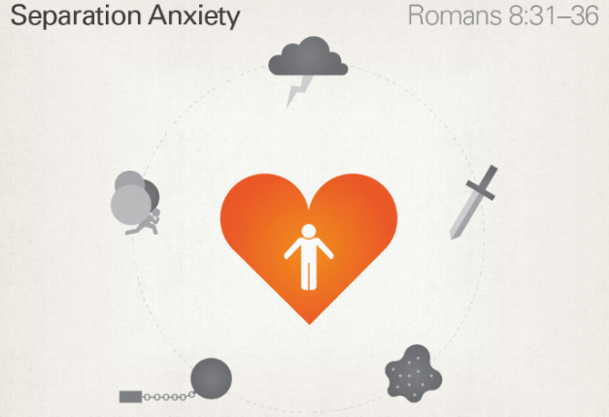
AsSurance????
The question of chapters 5-8
Assurance?
= Justification
= Assurance!

Slide 30
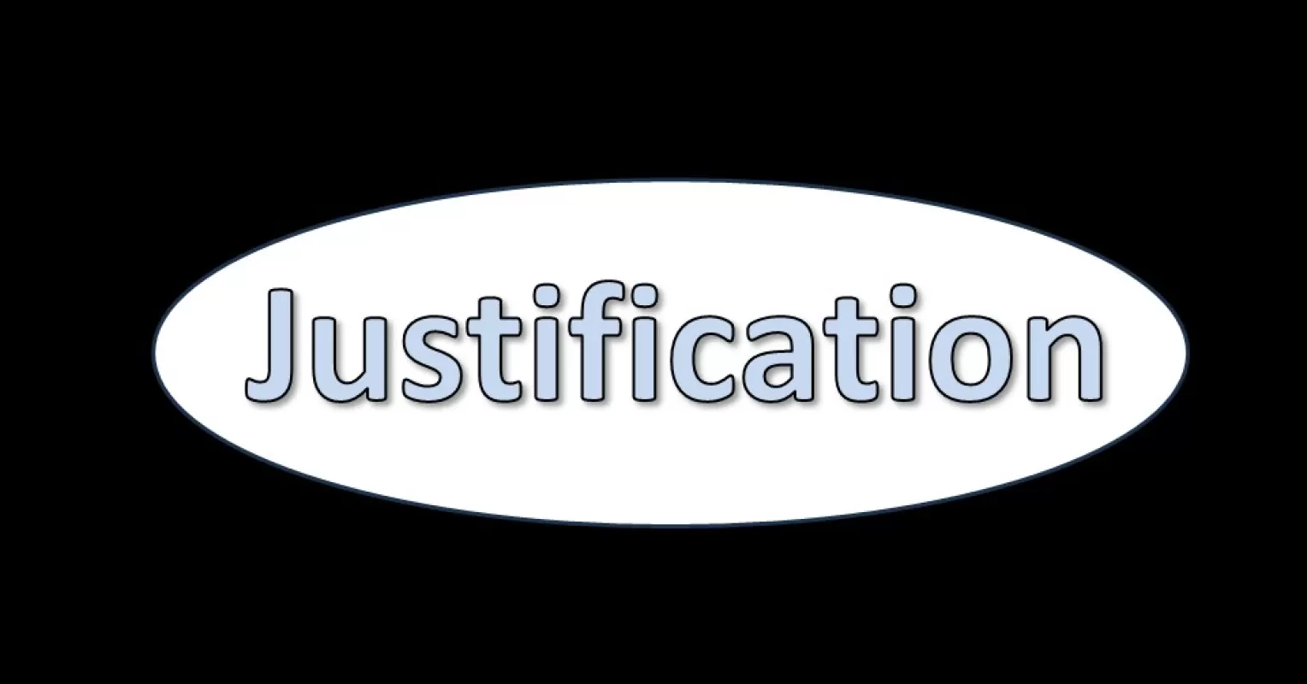
That by faith – we are declared to be in the right before God because God has made us a new people; with a new status; in a new covenant; as a foretaste of a new age.
(Michael F Bird)

Slide 31
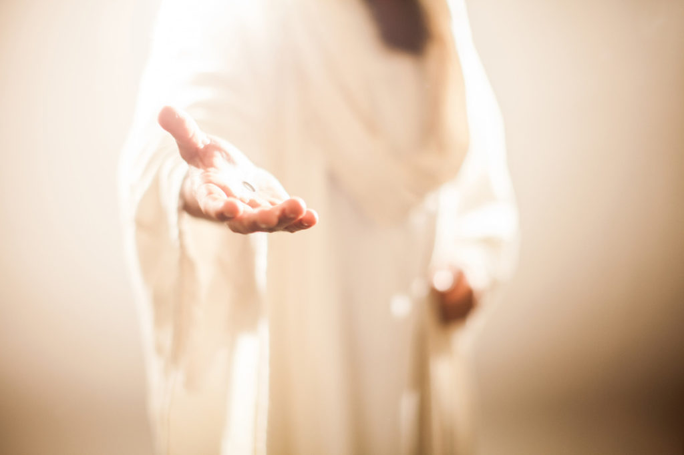
Reflect on God’s love

Slide 32
Reflect
Speak with others about what
God’s love means for you.
What difference does this actually
make in your life; thoughts and
actions?

