Slide 1
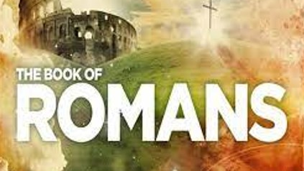
Chapter 9&10

Slide 2
Romans 9
I’m speaking the truth in the Messiah, I’m not lying. I call my conscience as witness, in the holy spirit, 2 that I have great sorrow and endless pain in my heart. 3 Left to my own self, I am half inclined to pray that I would be accursed, cut off from the Messiah, on behalf of my own family, my own flesh-and-blood relatives. 4 They are Israelites: the sonship, the glory, the covenants, the giving of the law, the worship and the promises all belong to them. 5 The patriarchs are their ancestors; and it is from them, according to the flesh, that the Messiah has come—who is God over all, blessed forever, Amen!

Slide 3
Romans 9
6 But it can’t be the case that God’s word has failed! Not all who are from Israel, you see, are in fact Israel. 7 Nor is it the case that all the children count as “seed of Abraham.” No: “in Isaac shall your seed be named.” 8 That means that it isn’t the flesh-and-blood children who are God’s children; rather, it is the children of the promise who will be calculated as “seed.” 9 This was what the promise said, you see: “Around this time I shall return, and Sarah shall have a son.”

Slide 4
Romans 9
10 And that’s not all. The same thing happened when Rebecca conceived children by one man, our ancestor Isaac. 11 When they had not yet been born, and had done nothing either good or bad—so that what God had in mind in making his choice might come to pass, 12 not because of works but because of the one who calls—it was said to her, “the elder shall serve the younger.” 13 As the Bible says, “I loved Jacob, but I hated Esau.”

Slide 5
Romans 9
14 So what are we going to say? Is God unjust? Certainly not! 15 He says to Moses, you see, “I will have mercy on those on whom I will have mercy, and I will pity those I will pity.” 16 So, then, it doesn’t depend on human willing, or on human effort; it depends on God who shows mercy. 17 For the Bible says to Pharaoh: “This is why I have raised you up, to show my power in you, and so that my name may be proclaimed in all the earth.” 18 So, then, he has mercy on the one he wants, and he hardens the one he wants.

Slide 6
Romans 9
19 You will say to me, then, “So why does he still blame people? Who can stand against his purpose?” 20 Are you, a mere human being, going to answer God back? “Surely the clay won’t say to the potter, ‘Why did you make me like this?’ ” 21 Doesn’t the potter have authority over the clay, so that he can make from the same lump one vessel for honor, and another for dishonor? 22 Supposing God wanted to demonstrate his anger and make known his power, and for that reason put up very patiently with the vessels of anger created for destruction, 23 in order to make known the riches of his glory on the vessels of mercy, the ones he prepared in advance for glory— 24 including us, whom he called not only from among the Jews but also from among the Gentiles?

Slide 7
Romans 9
25 This is what he says in Hosea,
I will call “not my people” “my people”;
and “not beloved” I will call “beloved.”
26 And in the place where it was said to them,
“You are not my people,”
there they will be called “sons of the living God.”
27 Isaiah cries out, concerning Israel,
Even if the number of Israel’s sons are like the sand by the sea,
only a remnant shall be saved

Slide 8
Romans 9
28 for the Lord will bring judgment on the earth, complete and decisive.
29 As Isaiah said in an earlier passage,
If the Lord of hosts had not left us seed,
we would have become like Sodom, and been made like Gomorrah.

Slide 9
Romans 9
30 What then shall we say? That the nations, who were not aspiring towards covenant membership, have obtained covenant membership, but it is a covenant membership based on faith. 31 Israel meanwhile, though eager for the law which defined the covenant, did not attain to the law. 32 Why not? Because they did not pursue it on the basis of faith, but as though it was on the basis of works. They have stumbled over the stumbling stone, 33 as the Bible says,

Slide 10
Romans 9
Look: I am placing in Zion
a stone that will make people stumble,
a rock that will trip people up;
and the one who believes in him
will never be put to shame.

Slide 11
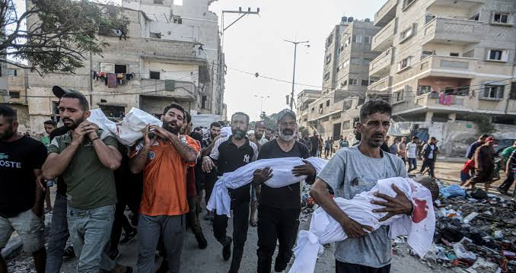
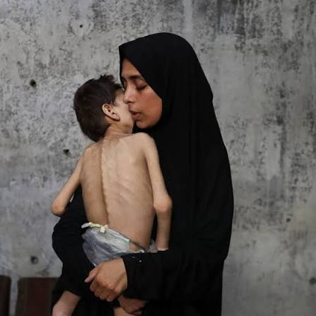
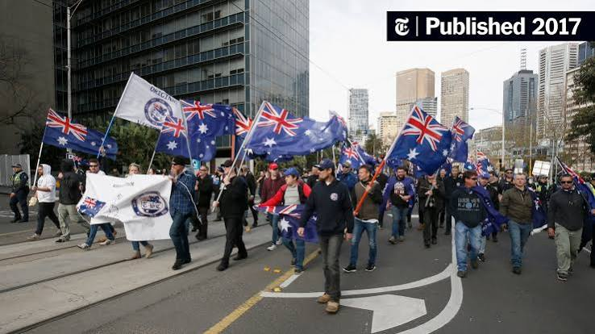
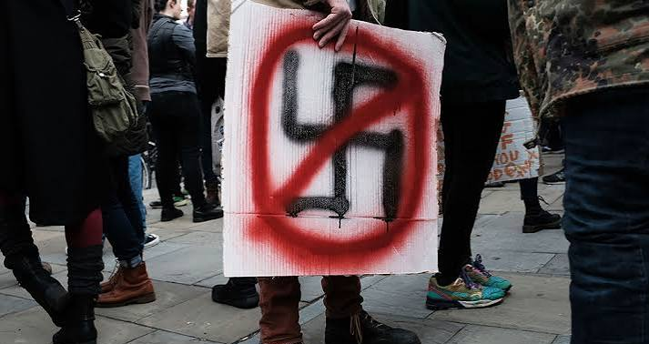
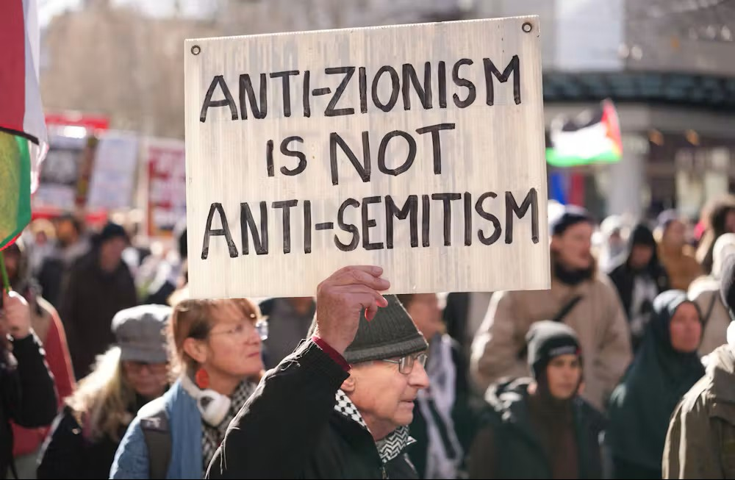
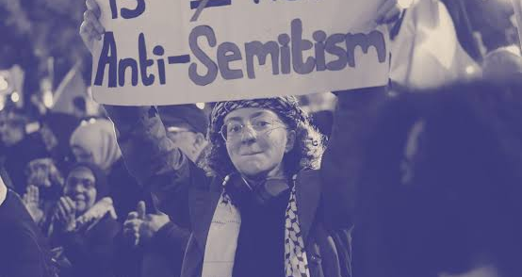
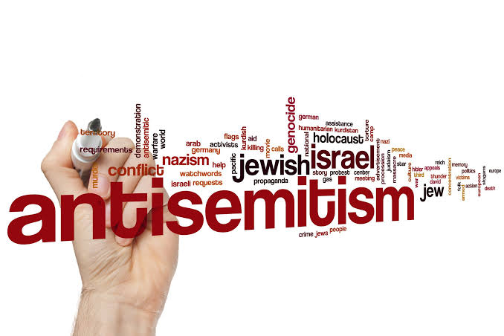

Slide 12
Theological Positions
Replacement | Fulfillment | Dispensational
Supersessionism Church has taken over Israel as people of God New Covenant – Old Obsolete Matt 21:43- Taken and given to another Faith the deciding factor Antisemitism | Jesus completely fulfills God's covenantal promises to Israel, expanding those blessings to a global, multi-ethnic body of believers, Plan always to bless all nations | Dual-Covenant God has two peoples Different destinies (Earthly and Heavenly) Different prophetic paths Christian Zionist 1948 – ‘bless you –I will bless’ Prophesy??

Slide 13
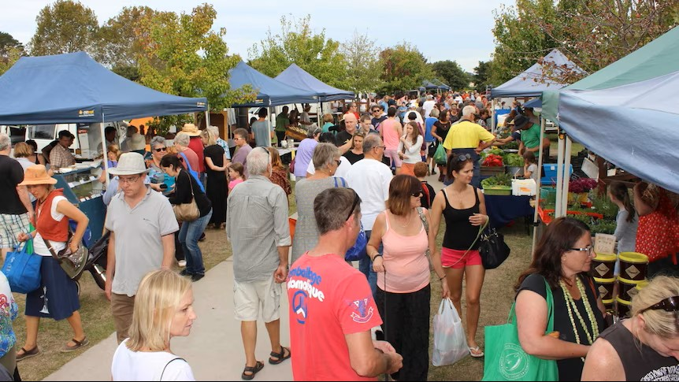
Does God create some people just to send them to hell?

Slide 14
Romans 9?
1 Big Story - God at work and Paul’s thinking through Romans

Slide 15
6 Acts of the Scriptures
Creation
Fall
Israel
Jesus
Church
New Creation

Slide 16
Chapter | Theme
1 | Human rebellion and consequences
2 | Everyone will be judged but by a good God and the result already decided – we are safe
3 | Justified by Faith – we are declared in the right, by Jesus, before God
4 | Included in God’s family with Abraham as our father - We belong
5 | We have been Reconciled to God as a new kind of humanity
6 | We have been baptised into new life and redeemed from slavery to sin

Slide 17
Chapter | Theme
7 | Law was good but due to Sin Israel sinned. We are freed from Law and Sin by Jesus death. Law pointed to Jesus.
8 | No condemnation, no debt to sin, groaning for New Creation, can’t be separated from God’s love

Slide 18
Romans 9?
1 Big Story
From exaltation to grief - What God wanted to do through Israel

Slide 19
Romans 9:4-5
Theirs is the adoption to sonship; theirs is divine glory. The covenants, the receiving of the law, the temple worship and the promises. Theirs are the patriarchs, and from them is traced the human ancestry of the Messiah, who is God over all, forever praised!

Slide 20
Romans 9?
1 Big Story –
From exaltation to grief –
Election???? 19th Century answer to 16th Century questions
Everyone’s an individual? – Paul uses individual to represent peoples
The Potter and the Clay – Jeremiah 18
Remnant of Israel

Slide 21
Romans 9:17
Though the number of Israelites be like the sand by the sea, only the remnant will be saved.
(quoting Isaiah 10:22)

Slide 22
Romans 9:25
This is what he says in Hosea,
I will call “not my people” “my people”;
and “not beloved” I will call “beloved.”

Slide 23
Romans 9?
1 Big Story –
From exaltation to grief –
Election???? 19th Century answer to 16th Century questions
Everyone’s an individual? – Paul uses individual to represent peoples
The Potter and the Clay – Jeremiah 18
Remnant of Israel
God’s People Redefined and refined
New Creation

Slide 24
Romans 10
My dear family, the longing of my heart, and my prayer to God on their behalf, is for their salvation. 2 I can testify on their behalf that they have a zeal for God; but it is not based on knowledge. 3 They were ignorant, you see, of God’s covenant faithfulness, and they were trying to establish a covenant status of their own; so they didn’t submit to God’s faithfulness. 4 The Messiah, you see, is the goal of the law, so that covenant membership may be available for all who believe.

Slide 25
Romans 10
5 Moses writes, you see, about the covenant membership defined by the law, that “the person who performs the law’s commands shall live in them.” 6 But the faith-based covenant membership puts it like this: “Don’t say in your heart, ‘Who shall go up to heaven?’ ” (in other words, to bring the Messiah down), 7 “or, ‘Who shall go down into the depths?’ ” (in other words, to bring the Messiah up from the dead). 8 But what does it say? “The word is near you, in your mouth and in your heart” (that is, the word of faith which we proclaim); 9 because if you profess with your mouth that Jesus is Lord, and believe in your heart that God raised him from the dead, you will be saved. 10 Why? Because covenant membership comes by believing with the heart, and salvation comes by professing with the mouth.

Slide 26
Romans 10
11 The Bible says, you see, “Everyone who believes in him will not be put to shame.” 12 For there is no distinction between Jew and Greek, since the same Lord is Lord of all, and is rich towards all who call upon him. 13 “All who call upon the name of the Lord,” you see, “will be saved.”
14 So how are they to call on someone when they haven’t believed in him? And how are they to believe if they don’t hear? And how will they hear without someone announcing it to them? 15 And how will people make that announcement unless they are sent? As the Bible says, “How beautiful are the feet of the ones who bring good news of good things.”

Slide 27
Romans 10
16 But not all obeyed the good news. Isaiah asks, you see, “Lord, who has believed our report?” 17 So faith comes from hearing, and hearing comes from the word of the Messiah.
18 This might make us ask, did they not hear? But they certainly did:
Their sound went out into all the world,
and their words to the ends of the earth.

Slide 28
Romans 10
19 But I ask, did Israel not know? To begin with, Moses says,
I will make you jealous with a non-nation;
and stir you to anger with a foolish people.
20 Then Isaiah, greatly daring, puts it like this:
I was found by those who were not looking for me;
I became visible to those who were not asking for me.
21 But in respect of Israel he says,
All day long I have stretched out my hands
to a disbelieving and disagreeable people.

Slide 29
Key Verse so far
10:4 The Messiah, you see, is the goal of the law, so that covenant membership may be available for all who believe.

Slide 30
Romans 10
True Israel? All who believe
The Cornerstone of Faith

Slide 31
Romans 10:9
….if you profess with your mouth that Jesus is Lord, and believe in your heart that God raised him from the dead, you will be saved.

Slide 32
Deuteronomy 6:4-5
4 Hear, O Israel: the Lord our God, the Lord is one. 5 Love the Lord your God with all your heart and with all your soul and with all your strength.

Slide 33
Romans 10
True Israel?
The Cornerstone of Faith
Yahweh –LORD
Deuteronomy and the Future – Warnings; Sodom; Remnant
Christ the Culmination
The upgraded Shema

Slide 34
Deuteronomy 30:6
⁶ The Lord your God will circumcise your hearts and the hearts of your descendants, so that you may love him with all your heart and with all your soul, and live.

Slide 35
Romans 10
True Israel?
The Cornerstone of Faith
Yahweh –LORD
Deuteronomy and the Future – Warnings; Sodom; Remnant
Christ the Culmination
The upgraded Shema

Slide 36
Romans 10:13
…‘Everyone who calls on the name of the Lord will be saved.’

Slide 37
Romans 10
True Israel?
The Cornerstone of Faith
Yahweh –LORD
Deuteronomy and the Future
Christ the Culmination
The upgraded Shema
Salvation and the Law
Faith and the Covenant – Now through Jesus

Slide 38
Romans 10:6-8
6 But the righteousness that is by faith says: ‘Do not say in your heart, “Who will ascend into heaven?”’ (that is, to bring Christ down) 7 ‘or “Who will descend into the deep?”’ (that is, to bring Christ up from the dead). 8 But what does it say? ‘The word is near you; it is in your mouth and in your heart,’ that is, the message concerning faith that we proclaim:
(Quoting Deuteronomy 30:12-14)
9 Because if you profess with your mouth that Jesus is Lord, and believe in your heart that God raised him from the dead, you will be saved.

Slide 39
Romans 10
True Israel?
The Cornerstone of Faith
Yahweh –LORD
Deuteronomy and the Future
Christ the Culmination
The upgraded Shema
Salvation and the Law
Faith and the Covenant
The Good News for All

Slide 40
Reflect
Romans 10:12 For there is no distinction between Jew and Gentile, since the same Lord is Lord of all, and is rich towards all who call upon him. 13 “All who call upon the name of the Lord,” you see, “will be saved.”
You are, by faith, part of God’s renewed covenant people.

